Slide 1
TRENDS IN
DIGITAL
INNOVATIONS
SPORTS AND TV INDUSTRY

Slide 2
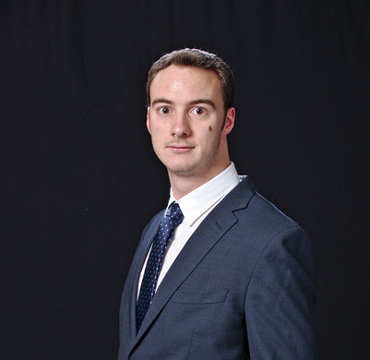
EEG EYE TRACKING
AUGMENTED REALITY VIRTUAL REALITY
GOAL REF
PLAY & CONNECT
NFL REPLAY MICROSOFT AND NFL
ANDREAS
DAVID
OLIVER
JUAN

Slide 3
GOAL REF

Slide 4
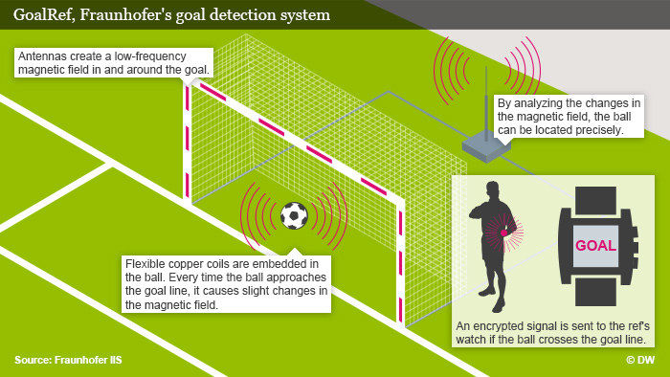
GOAL REF™
Problem
Complexity & speed
Reviews
Solutions
Radio sensing system
100% accurate
Examples
Superleague (Denmark)
Club WM 2012
European Championship 16
TRIZ Trend: Increasing Transparency & Decrease Human Involvement

Slide 5
PLAY & CONNECT

Slide 6
https://www.youtube.com/watch?v=U_nkw6aTLmo

Slide 7
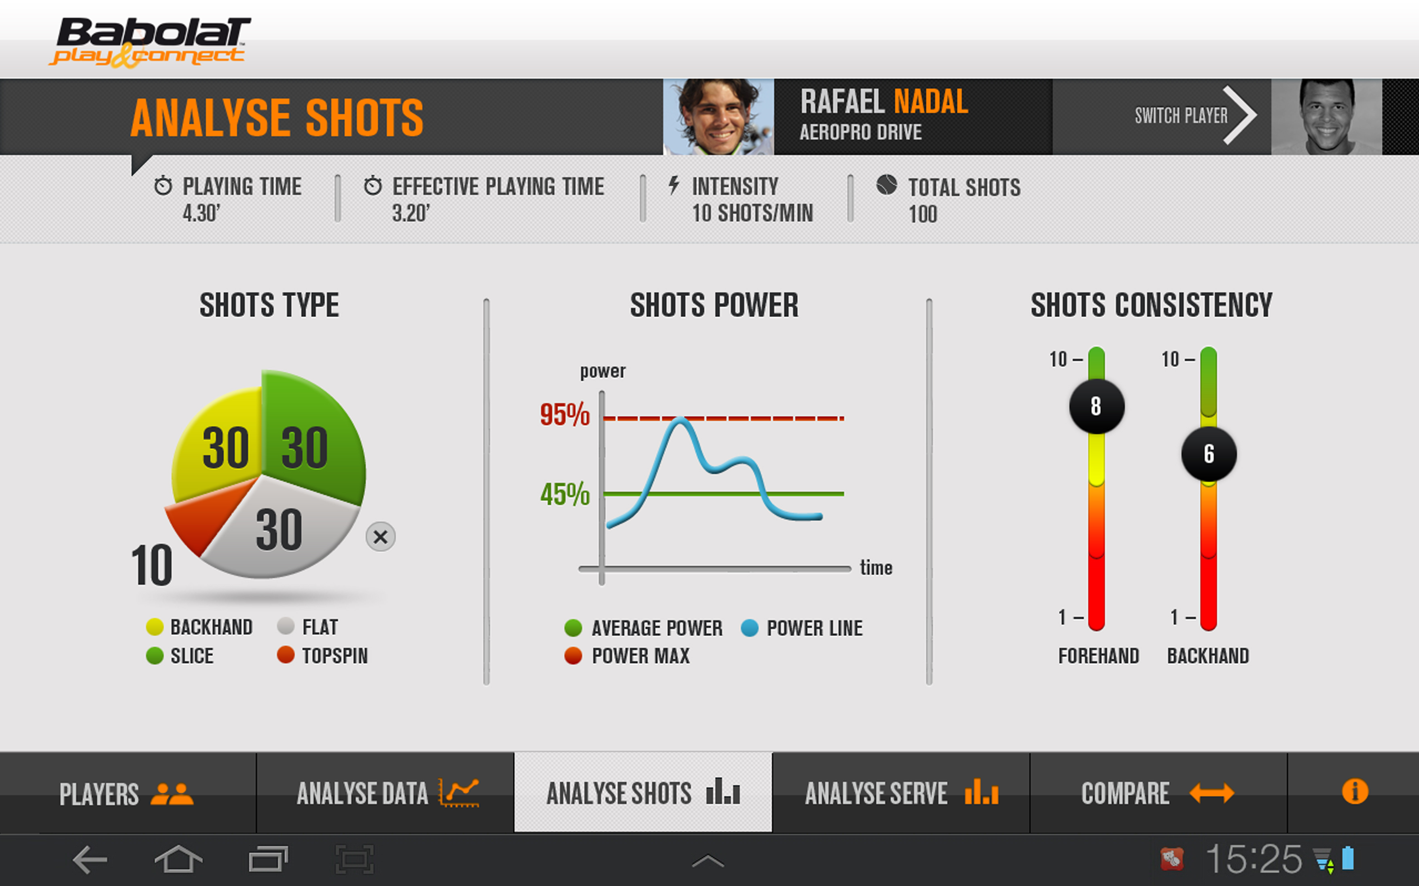
PLAY & CONNECT
Problem
No reviews for amateurs
Solutions
Smart tennis racket
Using sensoring technology and Bluetooth
Examples
Babolat Play & Connect
Other industries: Shoes, Shirts, Wristband etc.
TRIZ Trend: Dynamisation & Customer expectation & Nesting Up

Slide 8
ELECTROENCEPHALOGRAPHY

Slide 9
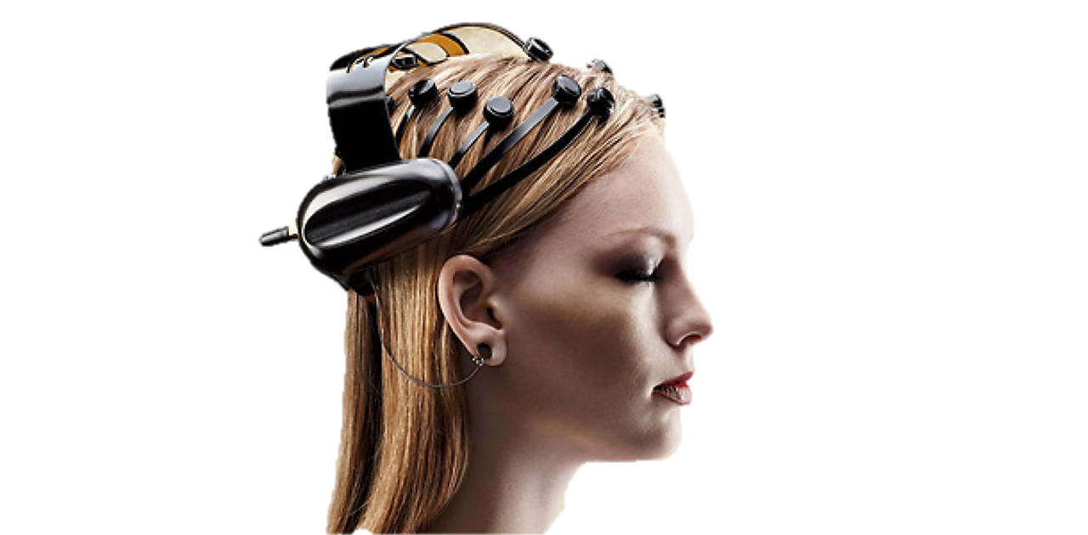
EEG
Use of EEG for Neuromarketing inputs: Superbowl Ads
Measures the activity of groups of neurons are activated in the brain throughout small electrical charge.
Areas activated in the brain
TRIZ Trend: Customer Buying Hierarchy & Transparency & Decrease Human Involvement

Slide 10
EYE TRACKING

Slide 11
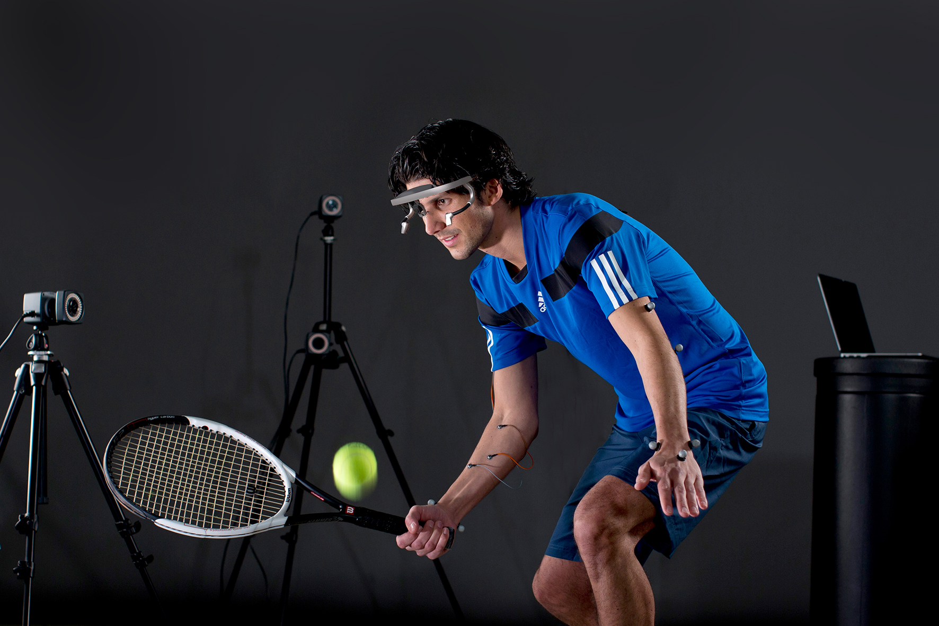
EYE TRACKING
Measurement of eye activity
Detects flaws linked to attentional focus, trajectory estimations, visual search strategies, and hand-eye coordination.
Improve training and identify talents
TRIZ Trend: Customer Buying Hierarchy & Transparency & Decrease Human Involvement &

Slide 12
https://www.youtube.com/watch?v=E5npuxOsM6c

Slide 13
NFL PARTNERSHIP WITH MICROSOFT

Slide 14
https://www.youtube.com/watch?v=TZBafiXkjio
Instant Replay on NFL.

Slide 15
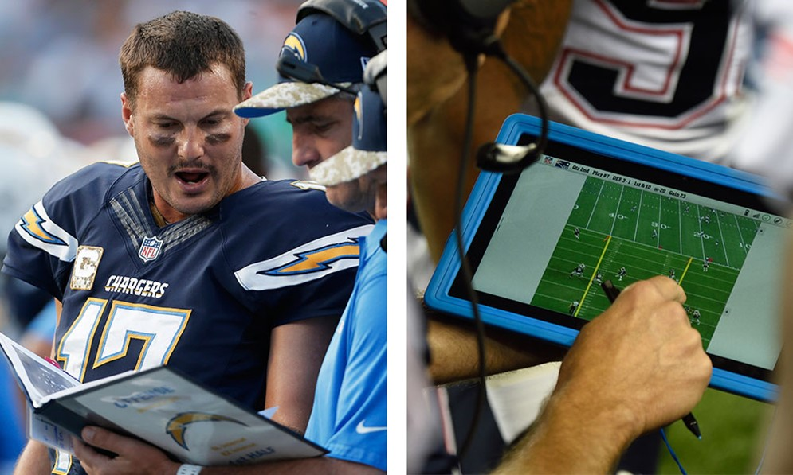
The league is moving away from the days when a printer behind a team’s bench spit out black-and-white snapshots.
A tablet just for displaying photos?
Reliable hardware and software
Better exchange of information within the team
TRIZ Trends: Boundary Breakdown & Decrease Human Involvement & Degree of freedom

Slide 16
NFL REPLAY

Slide 17
https://www.youtube.com/watch?v=WDEFfpdzfvE
Instant Replay on NFL.

Slide 18
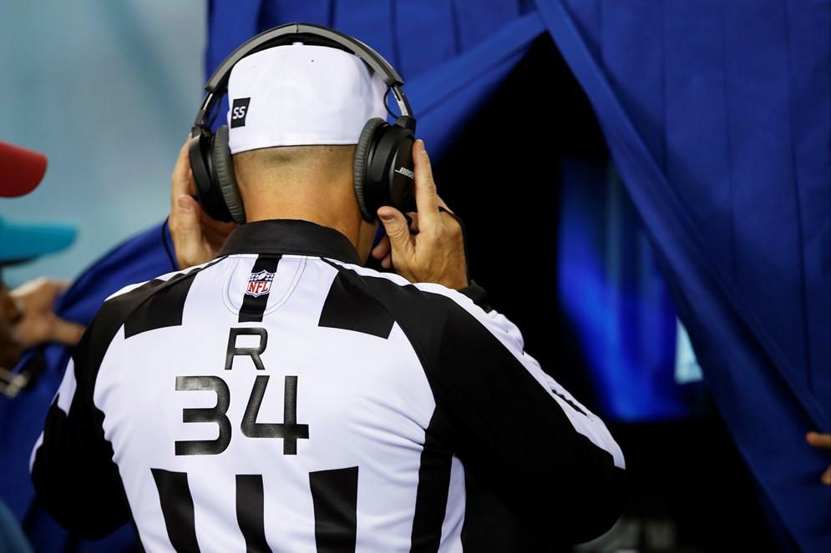
INSTANT REPLAY
The NFL's instant replay review process helps speed up reviews and make sure calls are made consistently.
Who is in favor? Who’s against? Correct calls sometimes are not good for the involved teams.
TRIZ Trends: Increasing Transparency & Decrease Human Involvement & Increased Dimensionality

Slide 19
VIRTUAL REALITY & AUGMENTED REALITY

Slide 20
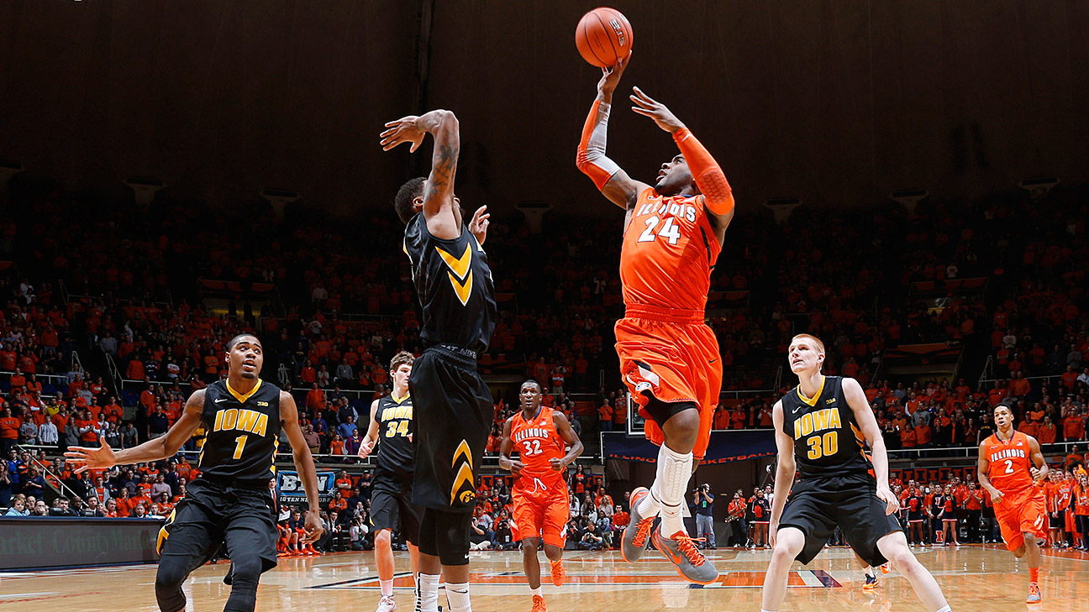
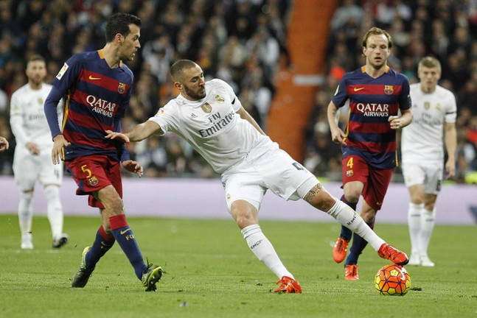
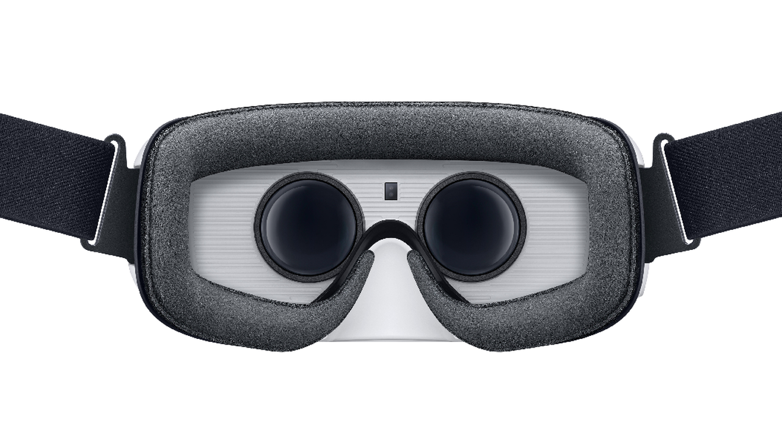
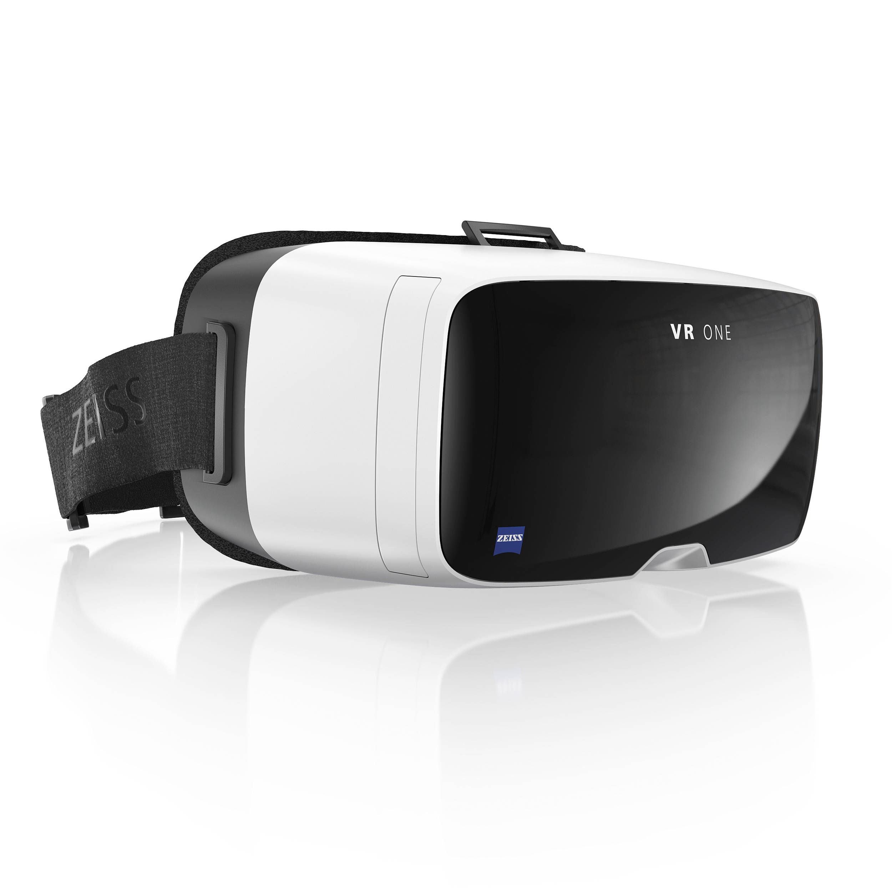
VR
Conclusion
Enables sports trainers to get a better overview in specific situations
Get better impression with the help of 360° view in a virtual situation
VR Headset as analyzation tool in sports
Could for example be implemented by fixing a mini 360° on the referee shirt
→ TRIZ Trends: Increasing Dimensionality & Increasing Use of Senses & Nesting UP

Slide 21
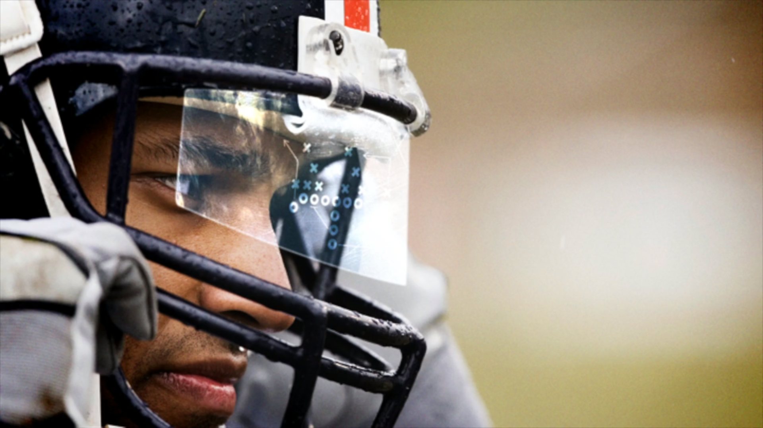
AR
Conclusion
Augmented Reality will play a significant role is sports
Examples of implementation could include Google Glass in the helmets of Football players
Cameras could be installed on the rof of a Stadium and data transferred to augmented reality device
It is already used for Wimbledon to navigate to the court with the help of your smartphone
TRIZ Trends: Increasing Dimensionality & Customer Expectation & Transparency & Increasing Use of Senses & Nesting Up
The differences between augmented and virtual reality are significant.
Augmented reality is when information is overlaid onto a clear visor for example Google Glass.
Virtual reality is the complete immersion of the user. Right now that means wearing goggles or a helmet that puts you into a 360 degree virtual world.

Slide 22
https://www.youtube.com/watch?v=QSJVU7PK660
VR VIDEO

Slide 23
https://www.youtube.com/watch?v=Pd2je6skbxY
VR VIDEO

Slide 24
DANKE
GRACIAS
MERCI
THANK YOU

