Slide 1
Digital Innovations in television and movies industry
Valentina Scarola
Lama Khouri
Miguel Afanador
Rutvik Pathak

Slide 2
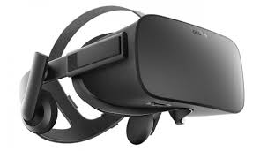
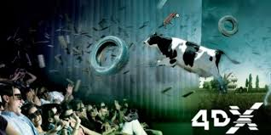
Companies Analyzed
1) OCULUS VR
2) CJ 4DPLEX
3) Netflix

Slide 3
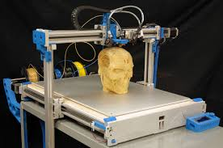
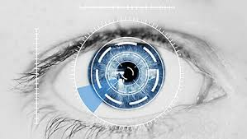
4) ZEBRA IMAGING
5) LEGACY EFFECT
6) HAIER

Slide 4
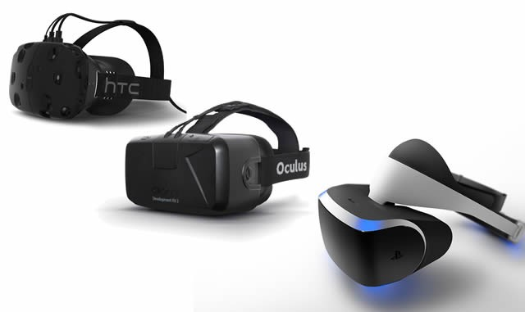
Virtual reality (VR) typically refers to computer technologies that use virtual reality headsets to generate the realistic images, sounds and other sensations that replicate a real environment or create an imaginary setting. VR has been defined as "a realistic simulation of a three dimensions, 360-degree environment
1. Increase use of senses
2.
1.
2.

Slide 5
Who developed the VR ?
Oculus is an American technology company founded on 2012 in California.
They have developed the VR world to allow people to play their favorite games, watch movies and connect their friends as if they were really inside the situation.

Slide 6
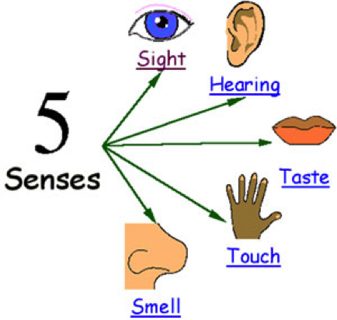
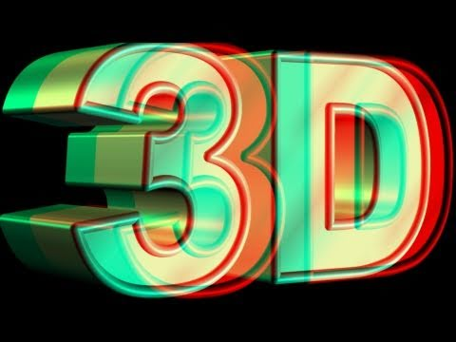
Trends
Increases uses of senses :
See the screen, listen to the different sounds, and touch the bottoms in
the joysticks.
Increasing Dimensionality :
Instead of using 1 or 2D, it increased the dimensions to 3D to make the person see the image in different angle the left eye can see extra area to the left and the right eye can see extra area to the right, and also headphones which provide a 3D audio effects

Slide 7
ZEBRA IMAGING
A hologram is a physical structure that diffracts light into an image.
A holographic image can be seen by looking by shining a laser through a hologram and projecting the image onto a screen.

Slide 8
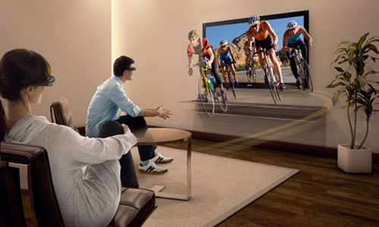
Hologram Functionality
Zebra Imaging develops 3D digital holographic images, hologram, and interactive 3D displays for government and commercial uses. No glasses required, full-parallax (viewing of the image from viewpoints above and below as well as from side to side)

Slide 9
Trends
Boundary Breakdown:
You can see people as if they are standing in front of you no more barriers or screens
Increasing Dimensionality:
Increasing the picture to be as a real object standing in the room with it full dimensions
Decrease human involvement:
When we interact with objects we don’t distinguish between physical or digital you can have a physical environment, with virtual objects and humans, mixing and matching as needed.
Customer expectation:
New technology meet the expectation of the the users not only watching the screen but also interacting with the virtual environment.

Slide 10
CJ 4DPLEX is a South Korean company, which has developed the first 4DX MOVIES.
4DX allows a motion picture presentation to be shaped with environmental effects such as seat motion, wind, rain, fog, lights, and scents along with the standard video and audio.
https://youtu.be/sAG2Nif1nYQ

Slide 11
Trends:
Increasing dimensionality:
2D movies, 3D movies
Customer expectation:
More emphasis on quality
more company involvement and thus profit;
better ability to build long term relationship with customer;
‘wow’ creation opportunities + customer relationship building based on emotion
Increasing use of senses:
Emphasis on eye sight, hearing, sense of smell, touch, taste

Slide 12
Haier Group Corporation is a Chinese collective multinational consumer electronics and home appliances company headquartered in China.

Slide 13
Eye- controlled TV
Users control the set by staring at the top or bottom of the screen to activate a user-interface
Users can then change the volume, switch channel or carry out other functions by looking at icons shown on the display
Eye-controlled TV has the potential to offer an alternative to the traditional remote control

Slide 14
https://www.youtube.com/watch?v=mnkf_3uheH0

Slide 15
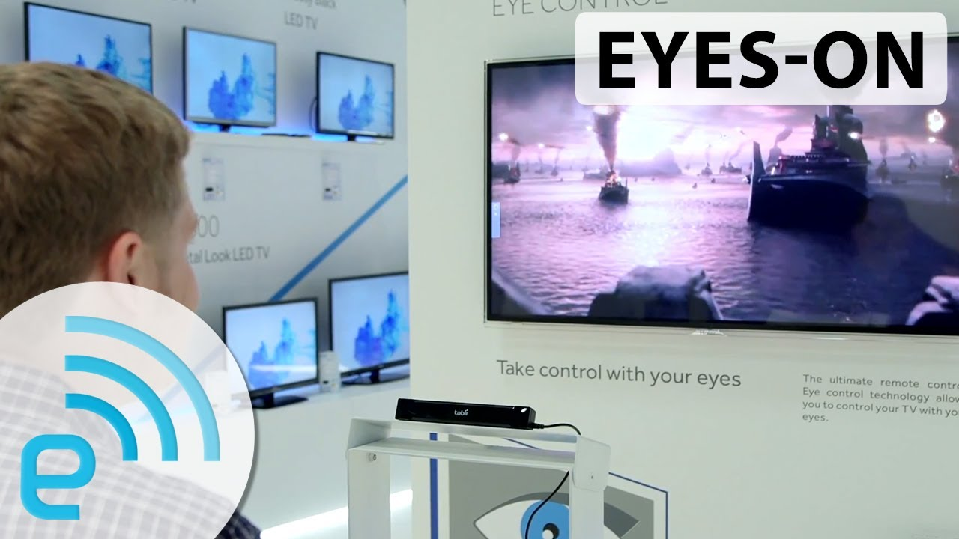
Trends:
Trimming/reducing complexity:
Reduced complexity
Improved reliability
Customer expectation:
Greater branding options
More customization
Less work for customer
Less work for customer
‘wow’ creation opportunities + customer relationship building based on emotion

Slide 16
Netflix Use of Big Data and Analytics To Select Movies, Create Content, and Make Multimillion Dollar Decisions
Trend
Increasing Asymmetry

Slide 17
American special effects studio.
Worked in more than 50 movies.
Recent examples: The Jungle Book, X Men Apocalypse, The Revenant.

Slide 18
"Our mission is to bring your visions and imaginings to life"
TRIZ Trends Involved:
Increasing Dimensionality
Functionality:
1. Imagination transforms into reality.
2. Use 3D to develop sophisticated film scenes
3. Core purpose is make better the visual effects
4. Fuses with other methods to achieve results

Slide 19
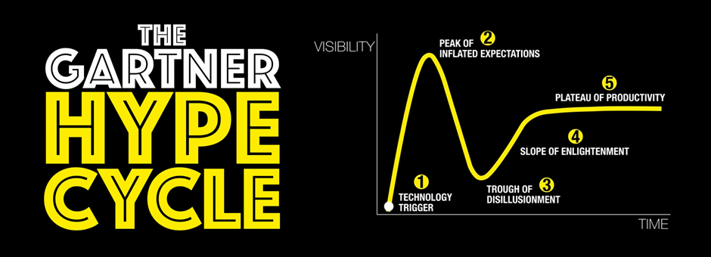
3D Printing

Slide 20
Oculus VR Digital Innovation
Creation of a new virtual reality where costumers can interact.
Pioneers on tangible technology that provides such experience.

Slide 21
https://youtu.be/CGmhOLFBRDU

