Slide 1
INNOVATIONS in Telecommunication Industry
Ning Fang
Nehal Bothra
Vanessa Schlosser
Matviy Kruglov

Slide 2
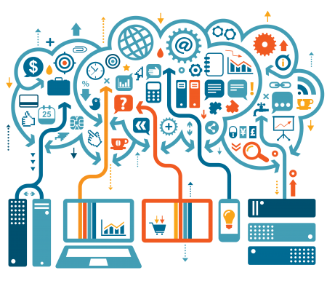
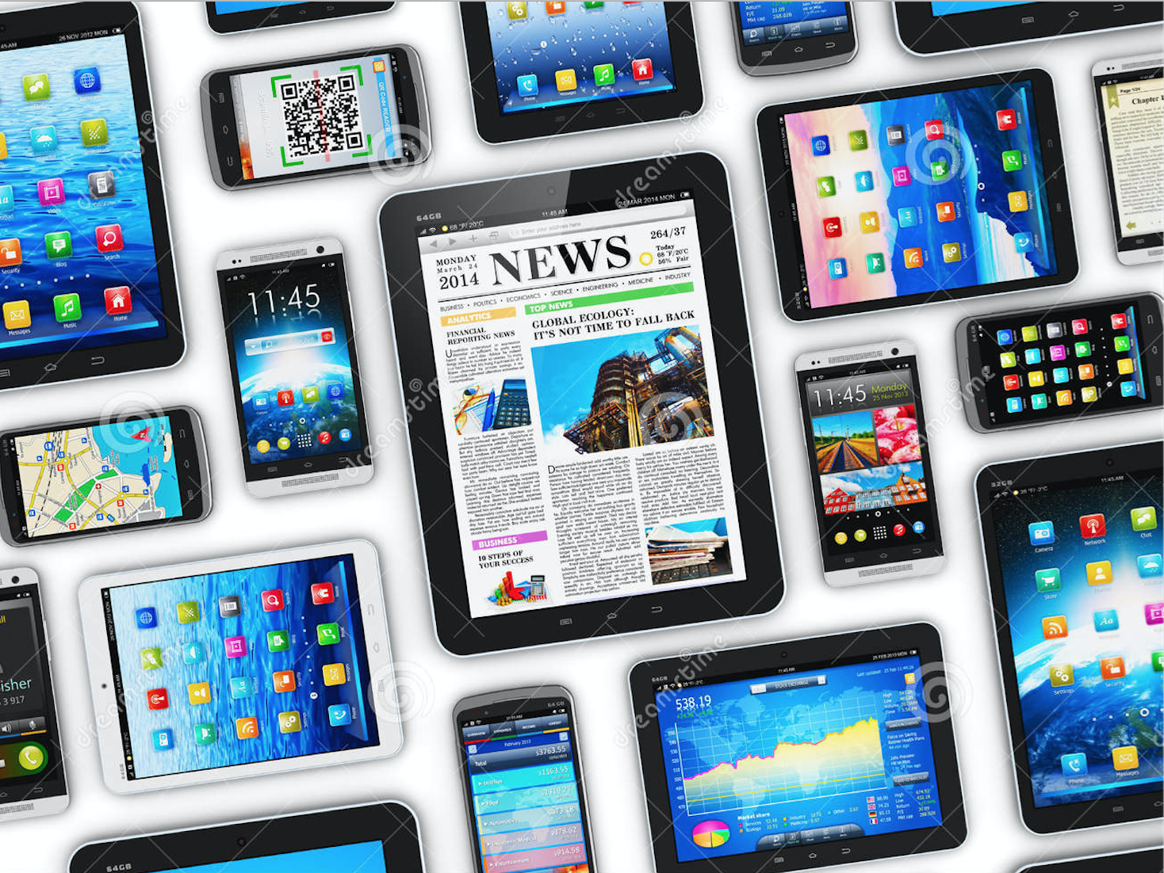
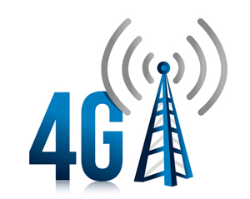
Digitalization, big data, mobile devices & broadband

Slide 3
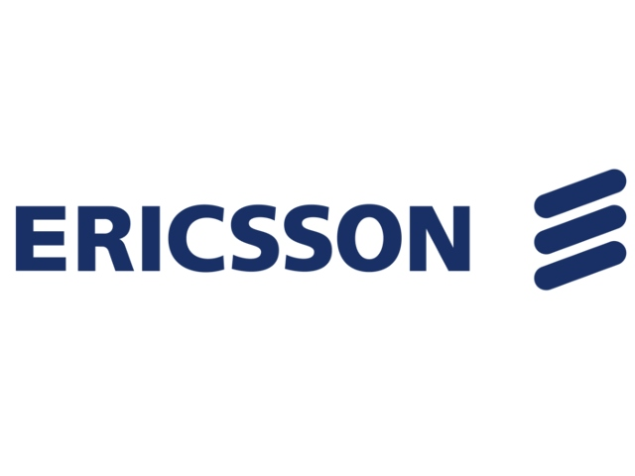
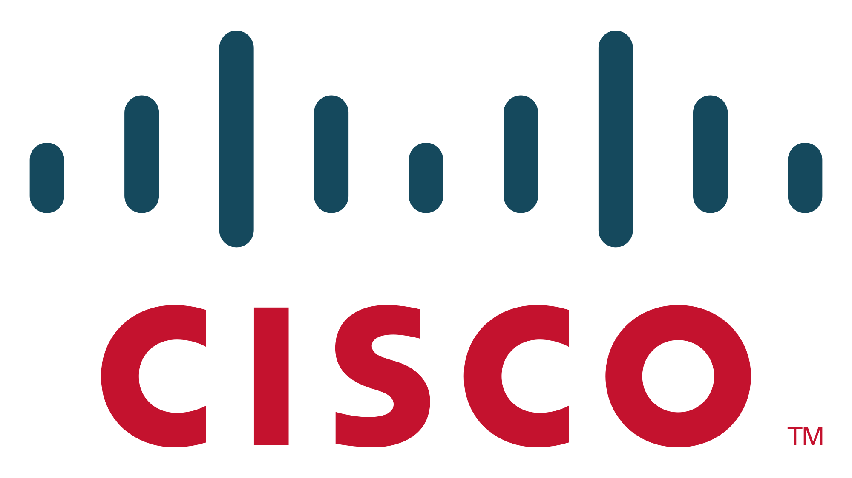
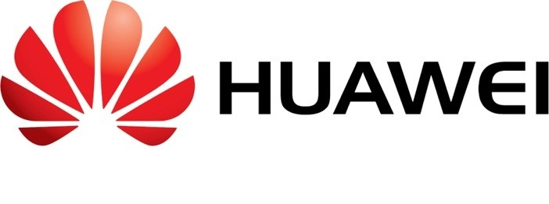
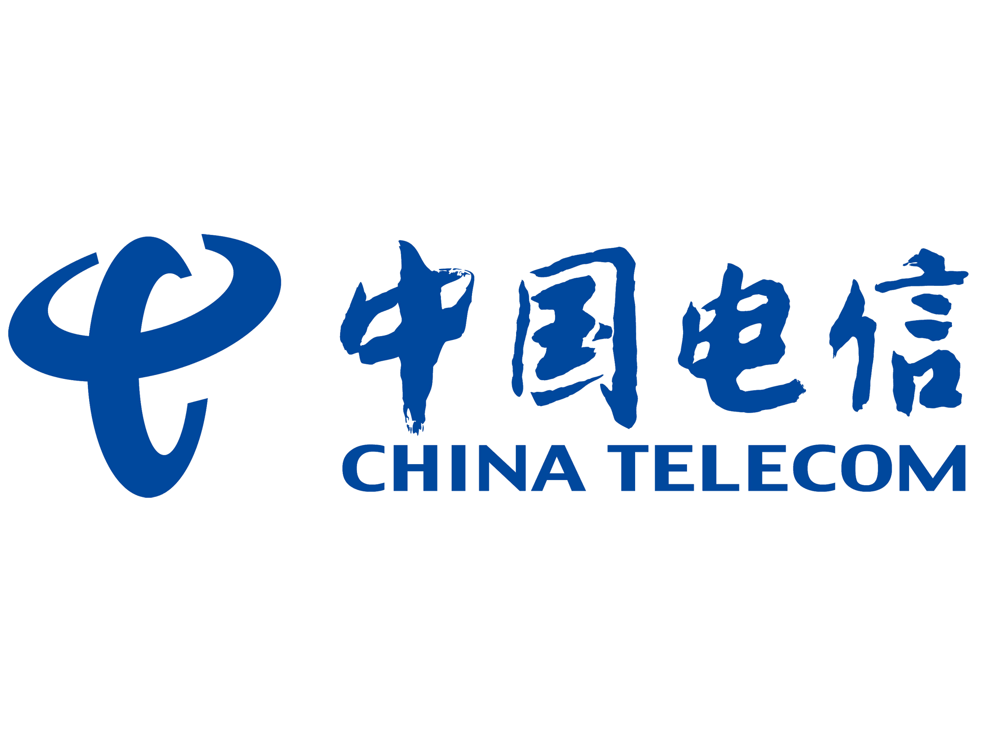
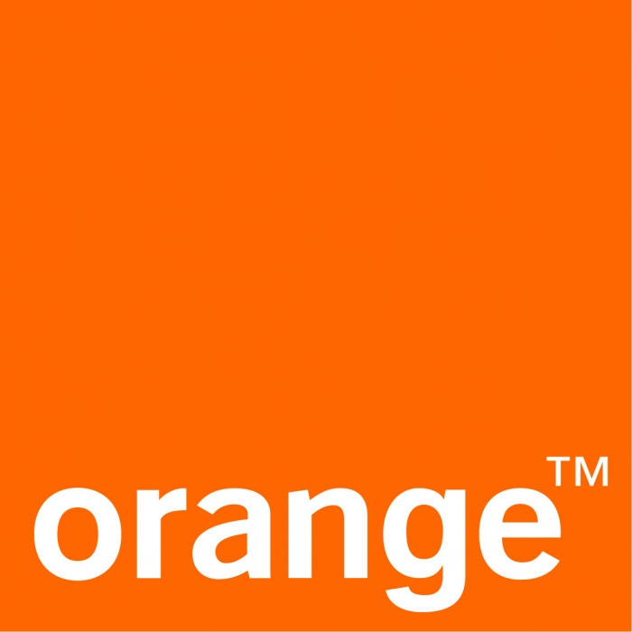
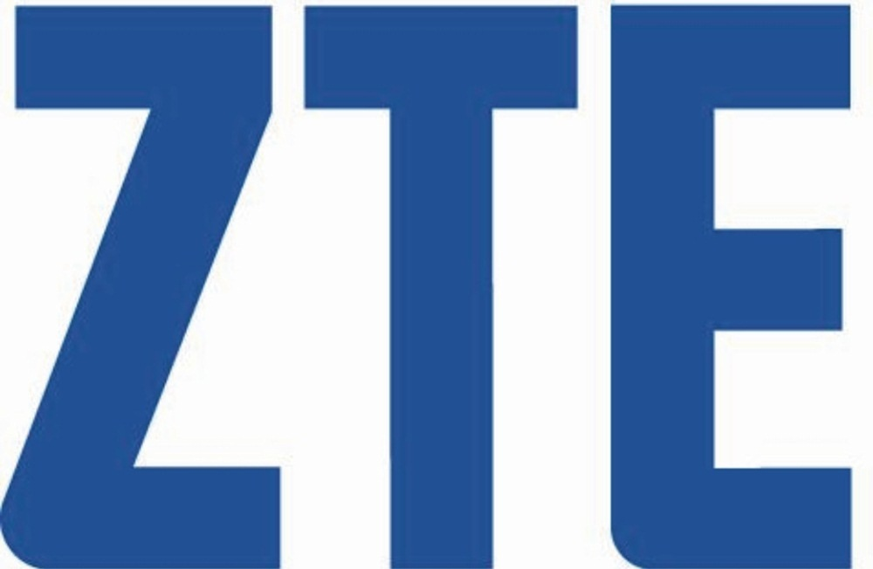
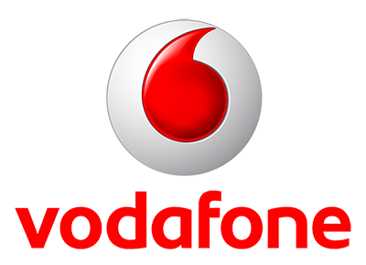
World’s leading telecommunication and ICT companies

Slide 4
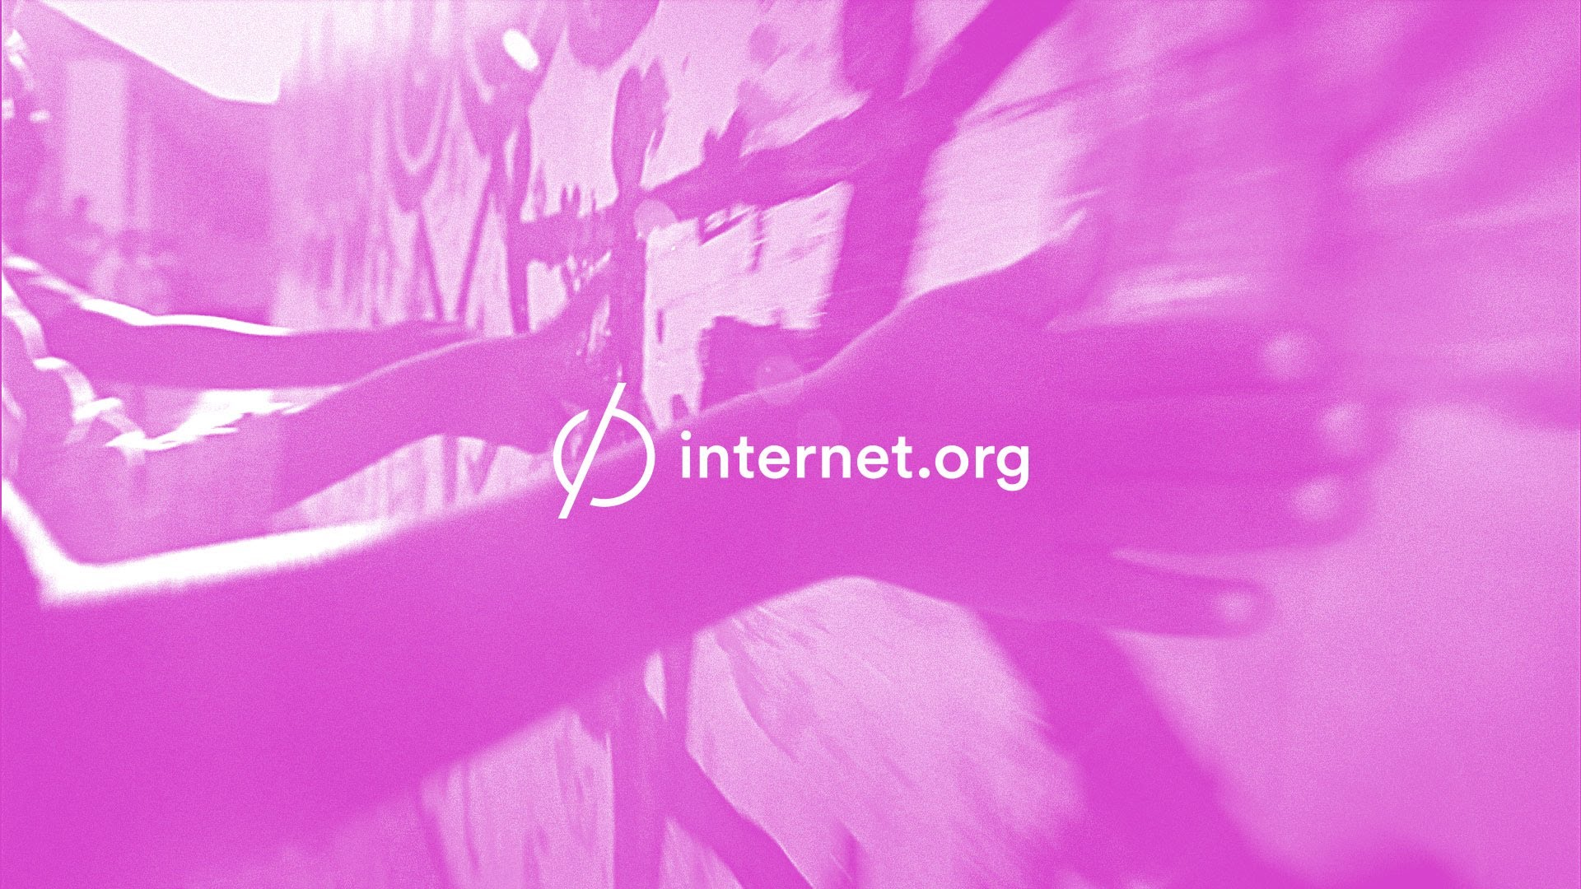
Internet.org
“Aquila”

Slide 5
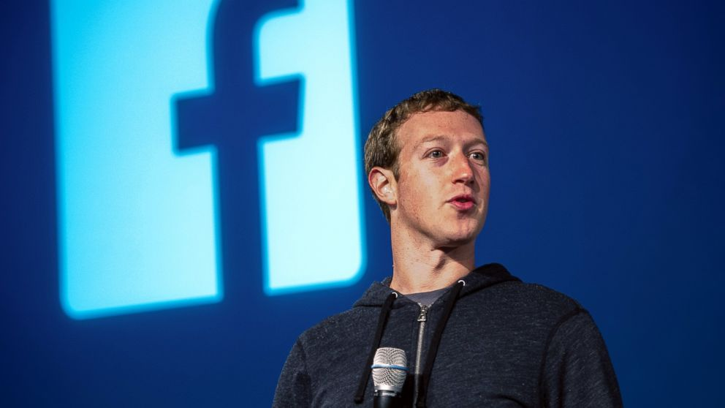
Internet.org
Initiative by Mark Zuckerberg
“Bringing together technology leader, Nonprofits and local communities to connect the two thirds of the world that doesn’t have internet access.”
Benefits:
Improved healthcare
Improved education
Improved economic situation

Slide 6
Internet.org
Innovations used to provide connectivity:
Building on already existing telecommunication networks:
Drones
Satellites
Lasers
Result: 25 million connected people

Slide 7
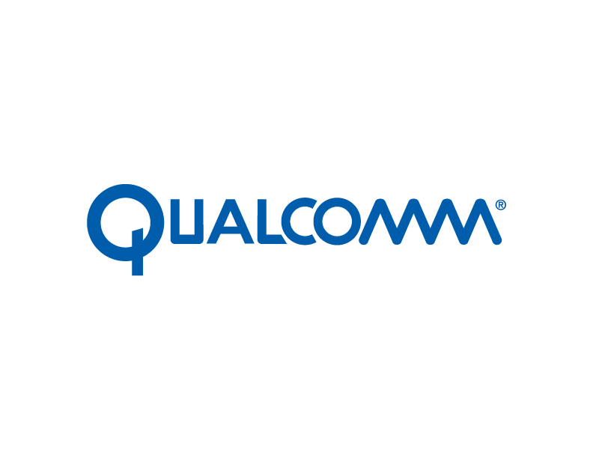
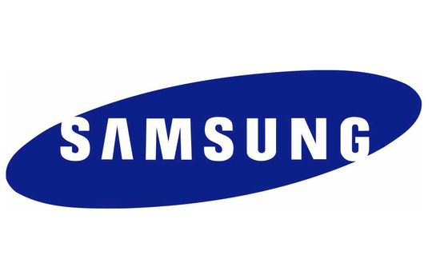
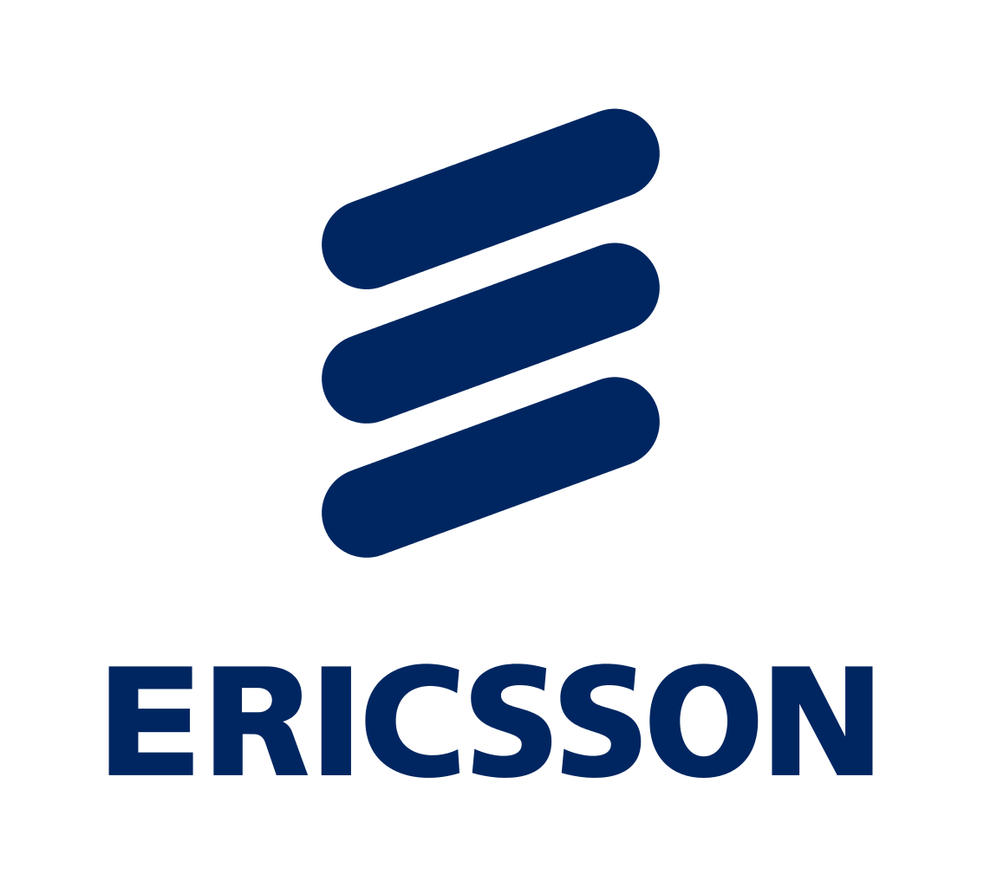
Internet.org
Partnerships with telecommunication companies, e.g.:
Application internet.org:
Enabling users access to free basic apps (i.e. Facebook, AccuWeather, Google Search)
Currently available in India, Ghana, Colombia, Kenya, Tanzania, Indonesia and Zambia

Slide 8
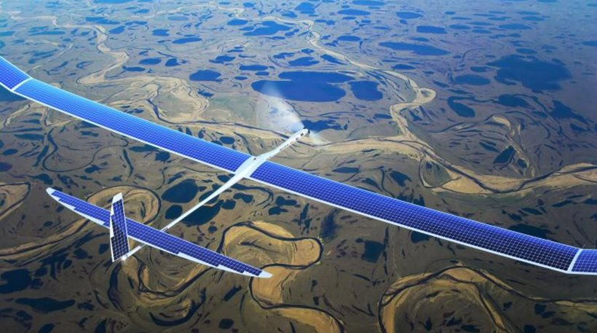
Internet.org
2. Developing new innovations to reach remote places:
“Aquila”
→ unmanned aircraft powered by solar cells.
Lasers
TRIZ
Dynamization

Slide 9
Internet.org

Slide 10
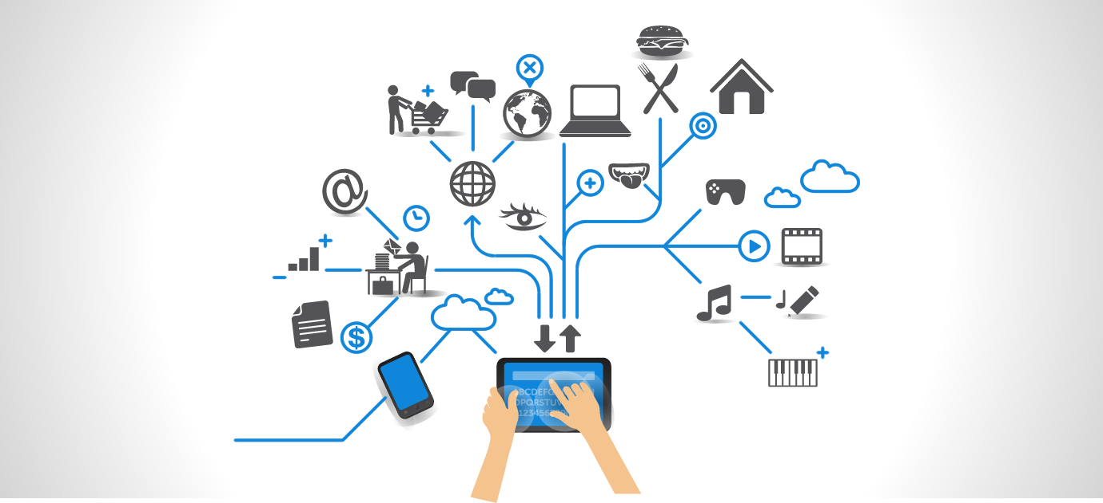
Internet of Things
Internet of Things
Smart Cities
Smart Cities

Slide 11
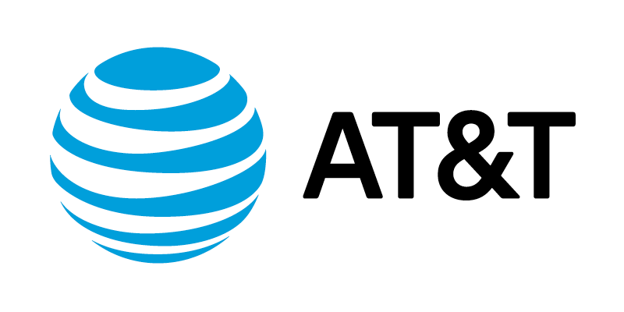
AT&T : Smart Cities

Slide 12
AT&T : Smart Cities
Combining IoT to make cities smarter.
Collaborating partners:

Slide 13
AT&T : Smart Cities
How does it work?
→ Dashboard: “Smart Grid Solutions”

Slide 14
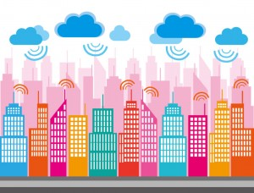
AT&T : Smart Cities
Benefits:
Cost-effective
Safe energy – be sustainable
Improve quality of life
Further engage with their citizen.
TRIZ
Dynamization
Decrease of human involvement
Customer expectation
Design point
Nesting

Slide 15
Cloud ecosystem : « Netbond »

Slide 16
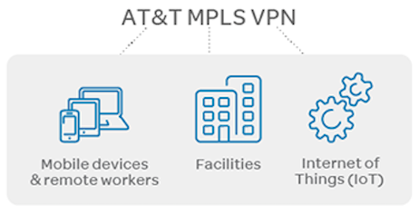
Cloud ecosystem : « Netbond »
Gain highly secure access to your data and applications
Virtual access from anywhere
Ease of applications integration
TRIZ
Dynamization
Boundary breakdown
Increasing transparency
Nesting
Degree of freedom

Slide 17
Cloud ecosystem : « Netbond »

Slide 18
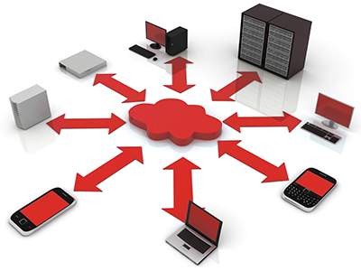
M2M Solutions

Slide 19
M2M Solutions
Fast response time
Scheduled planning
Asset inventory and visibility
Risk mitigation
TRIZ
Decrease of human involvement
Boundary breakdown
Action coordination
Nesting

Slide 20
M2M Solutions

Slide 21
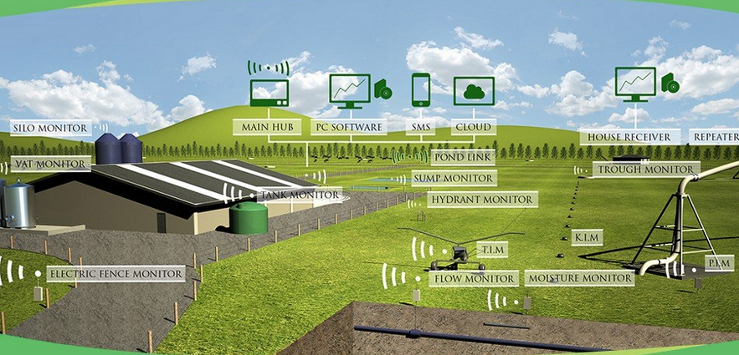
Connecting the farm to Internet of Things

Slide 22
Traditional agriculture

Slide 23
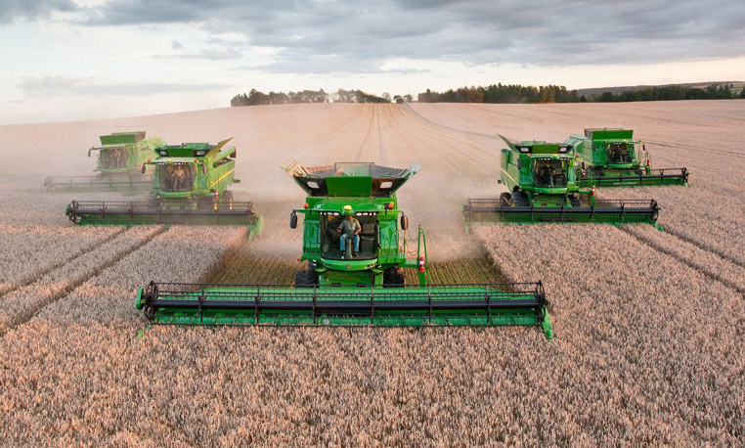
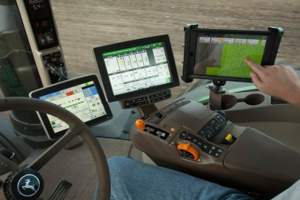
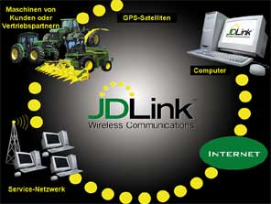
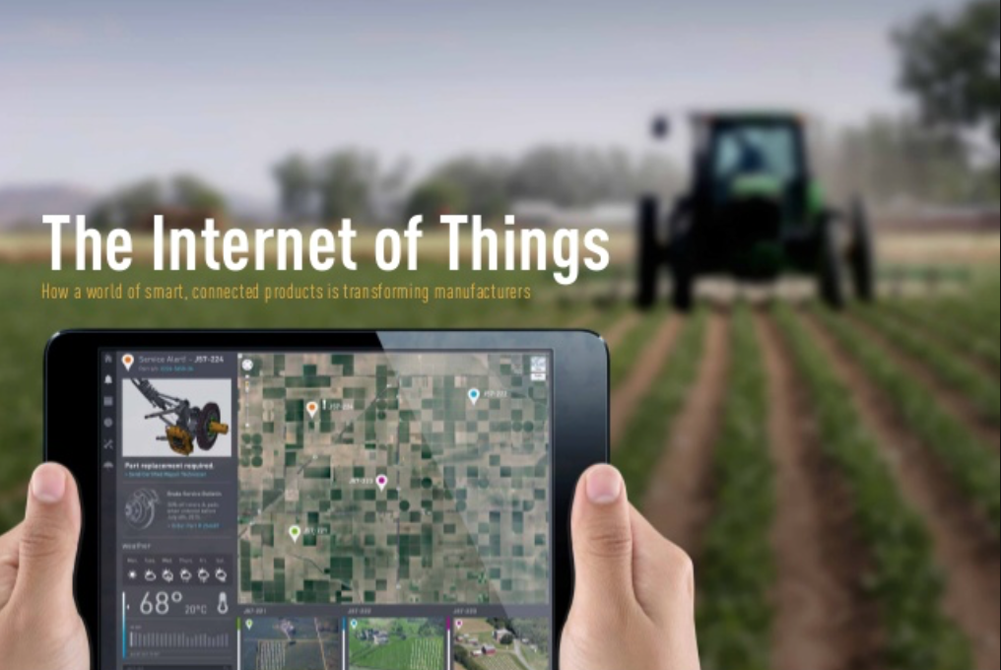
John Deere

Slide 24
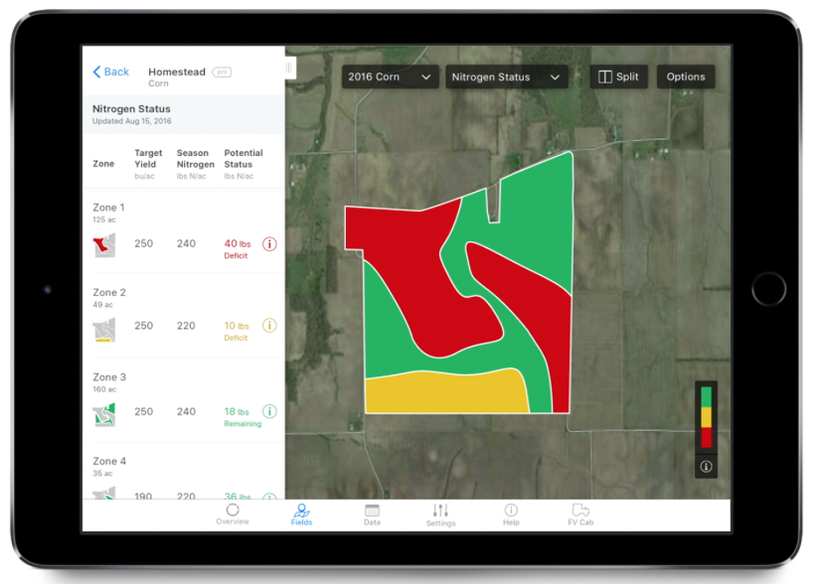
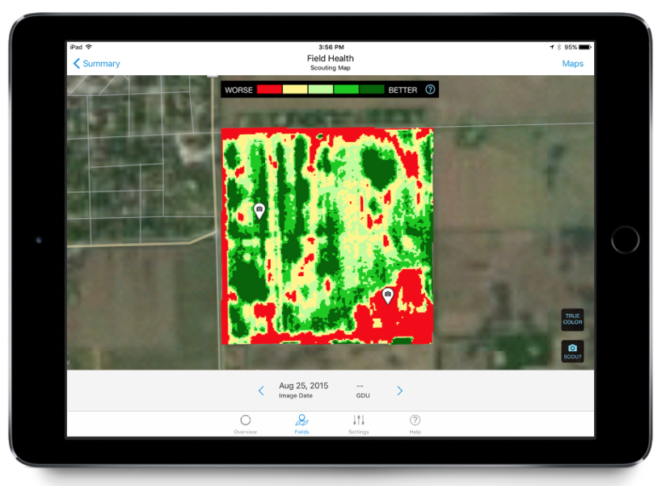
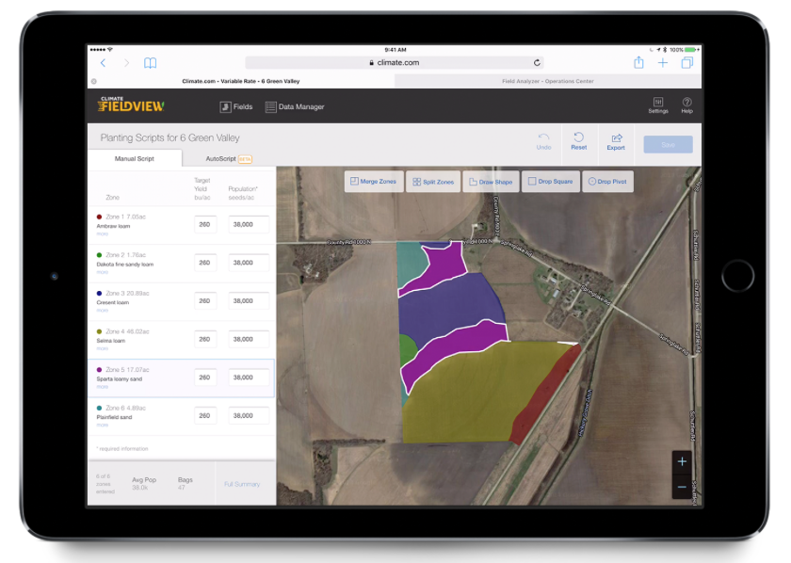
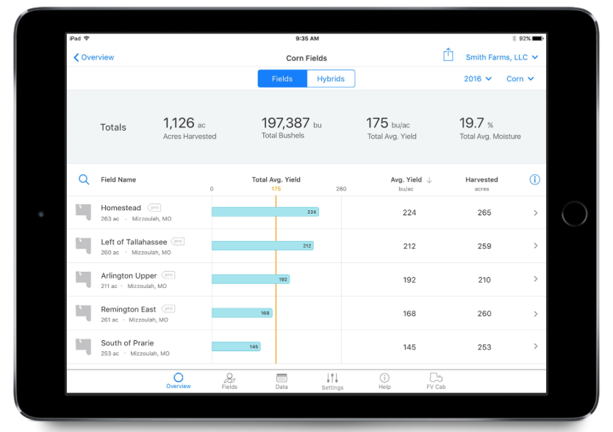
Monsanto

Slide 25
TRIZ
Decrease of human involvement
Action coordination
Nesting

Slide 26
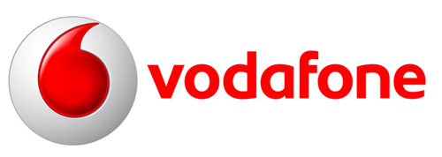
Innovation using Big Data (1)
To detect fraud
-Vodafone with Argyle developed a mobile application which detects the fraud in real time and stops it in few seconds after it occurs using Hadoop
-By using more algorithms , sophisticated technology and previous
TRIZ
Increasing transparency
Listening / communication
Decrease human involvement-automated
Notes:
-Vodafone with Argyle developed a mobile application which detects the fraud in real time and stops it in few seconds after it occurs using Adversarial Machine Learning on Hadoop
-The amount of data generated is beyond the control of humans so they employ more algorithms , sophisticated technology and previous data to stop fraudulent activity

Slide 27
Innovation using Big Data (2)
Real time customer insight
-Deloitte helped Orange company to achieve real-time marketing effectiveness
-SAP HANA was used which is an in-memory solution designed to deliver versatility and near real-time analytic
TRIZ
Customer buying heriachy
Rhythm coordination
Segmentation
Action coordination
Customer expectation
Notes:
-Deloitte helped Orange company to achieve real-time marketing effectiveness by giving out sales promotions , highlighting offers to the users according to the place , time by storing and analyzing huge data in real time
-SAP HANA was used which is an in-memory solution designed to deliver versatility and near real-time analytic
A global mobile communications service provider wanted to understand customer location and travel patterns to support realtime promotions, advertising and up-sell of services. In addition, they desired additional, textured information to improve the quality of their network operations and provide enhanced customer service for their most important customers.

Slide 28
The future of big data analytics in the telecoms industry

Slide 29
Innovation using Big Data (3)
Analyze consumer behaviour
-The Pakistan-based mobile-services provider Ufone, is using a combination of big data, software services and enterprise systems to market it’s product to its customers on individual level
-significantly helped reduce its churn rate
TRIZ
Customer buying heriachy
Rhythm Coordination
Segmentation
Action coordination
Customer expectation
Notes:
In the past, marketing often meant fliers jamming mailboxes, unwanted phone calls during dinner and show-stopping television commercials. Unfortunately, these campaigns were targeted in a scattershot approach, at best. If a company could get just a few people to respond from 10,000 contacts, the initiative was considered a success.
That’s changed recently, especially for large organizations in highly competitive industries. By adopting a data-driven and precisely targeted approach to customer outreach, they can increase customer interaction, whether it involves signing up new customers, retaining existing ones or improving overall customer satisfaction.
In less than a decade, it has amassed some 24 million subscribers, making it one of the largest wireless phone carriers in Pakistan.

Slide 30
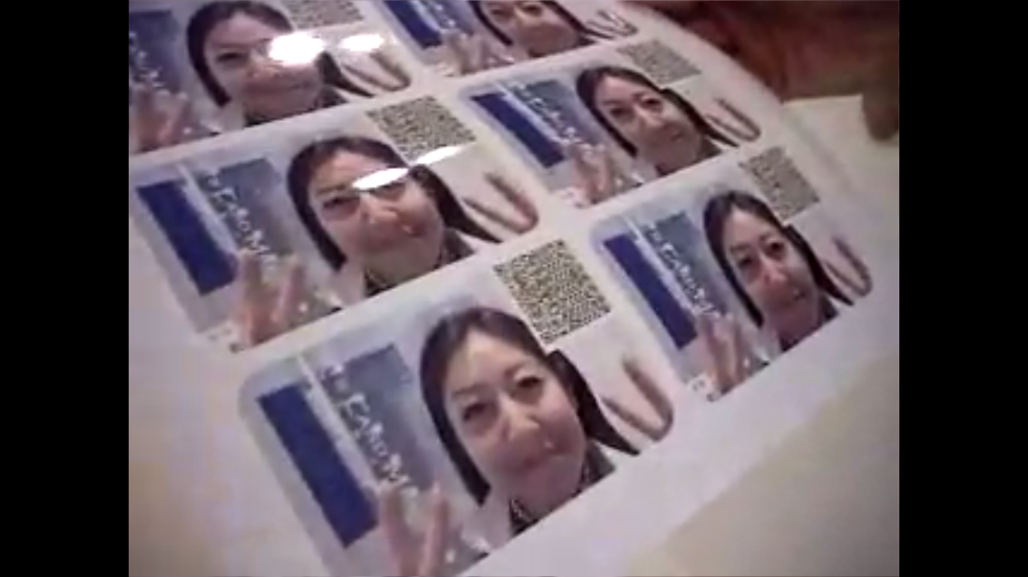
World’s best mobile phone store
Mail an animated tune
Photo content card
TRIZ
Customer expectation- experience
Decrease human involvement – Human semi-automated tool
Increasing dimensionality -2D

Slide 31
World's coolest Mobile Phone Shop is in Japan

Slide 32
THANKS !

Slide 33
QUESTIONS ?

Slide 34
References
http://www.ibmsystemsmag.com/power/casestudies/services/ufone_analytics/
http://www.marketwired.com/press-release/argyle-data-combating-billion-dollar-fraud-industry-with-machine-learning-real-time-1960507.htm
http://www2.deloitte.com/us/en/pages/technology-media-and-telecommunications/articles/real-time-customer-insight-foresight-with-analytics-making-the-right-call-case-study.html#
https://www.youtube.com/watch?v=PfsgOhQj9kE
http://bigdata-madesimple.com/11-interesting-big-data-case-studies-in-telecom/
https://www.aig.com/content/dam/aig/america-canada/us/documents/brochure/iot-case-studies-companies-leading-the-connected-economy-digital-report.pdf
http://www3.weforum.org/docs/WEFUSA_IndustrialInternet_Report2015.pdf
https://www.business.att.com/enterprise/Family/cloud/storage/
http://www.investopedia.com/articles/investing/021315/internetorg-what-it-and-how-it-works.asp#ixzz4KA4pcDtl
https://info.internet.org/en/
https://www.youtube.com/watch?v=YYDqpgA6kTA
https://www.business.att.com/enterprise/Portfolio/internet-of-things/
http://about.att.com/story/launches_smart_cities_framework.html
http://about.att.com/story/business_tap_into_iot.html
https://www.business.att.com/enterprise/Family/internet-of-things/smart-cities/

