Slide 1
Trends in digital Innovation : Sports Industry
ANCIRA Ana Sofia, FLORES Ariadna,
MOISSON Maxime, PATERON Pierre,

Slide 2
NASCAR Digital Dash
Cars go from Analog Dash to Digital one
24 different features with different designs
Customize it how you want
Soon → Give some info directly to the dash (flags, lap time, penalties)
Car info
TRIZ Trend : Nesting, Degrees of freedom, Segmentation

Slide 3
INTEL CURIE

Slide 4
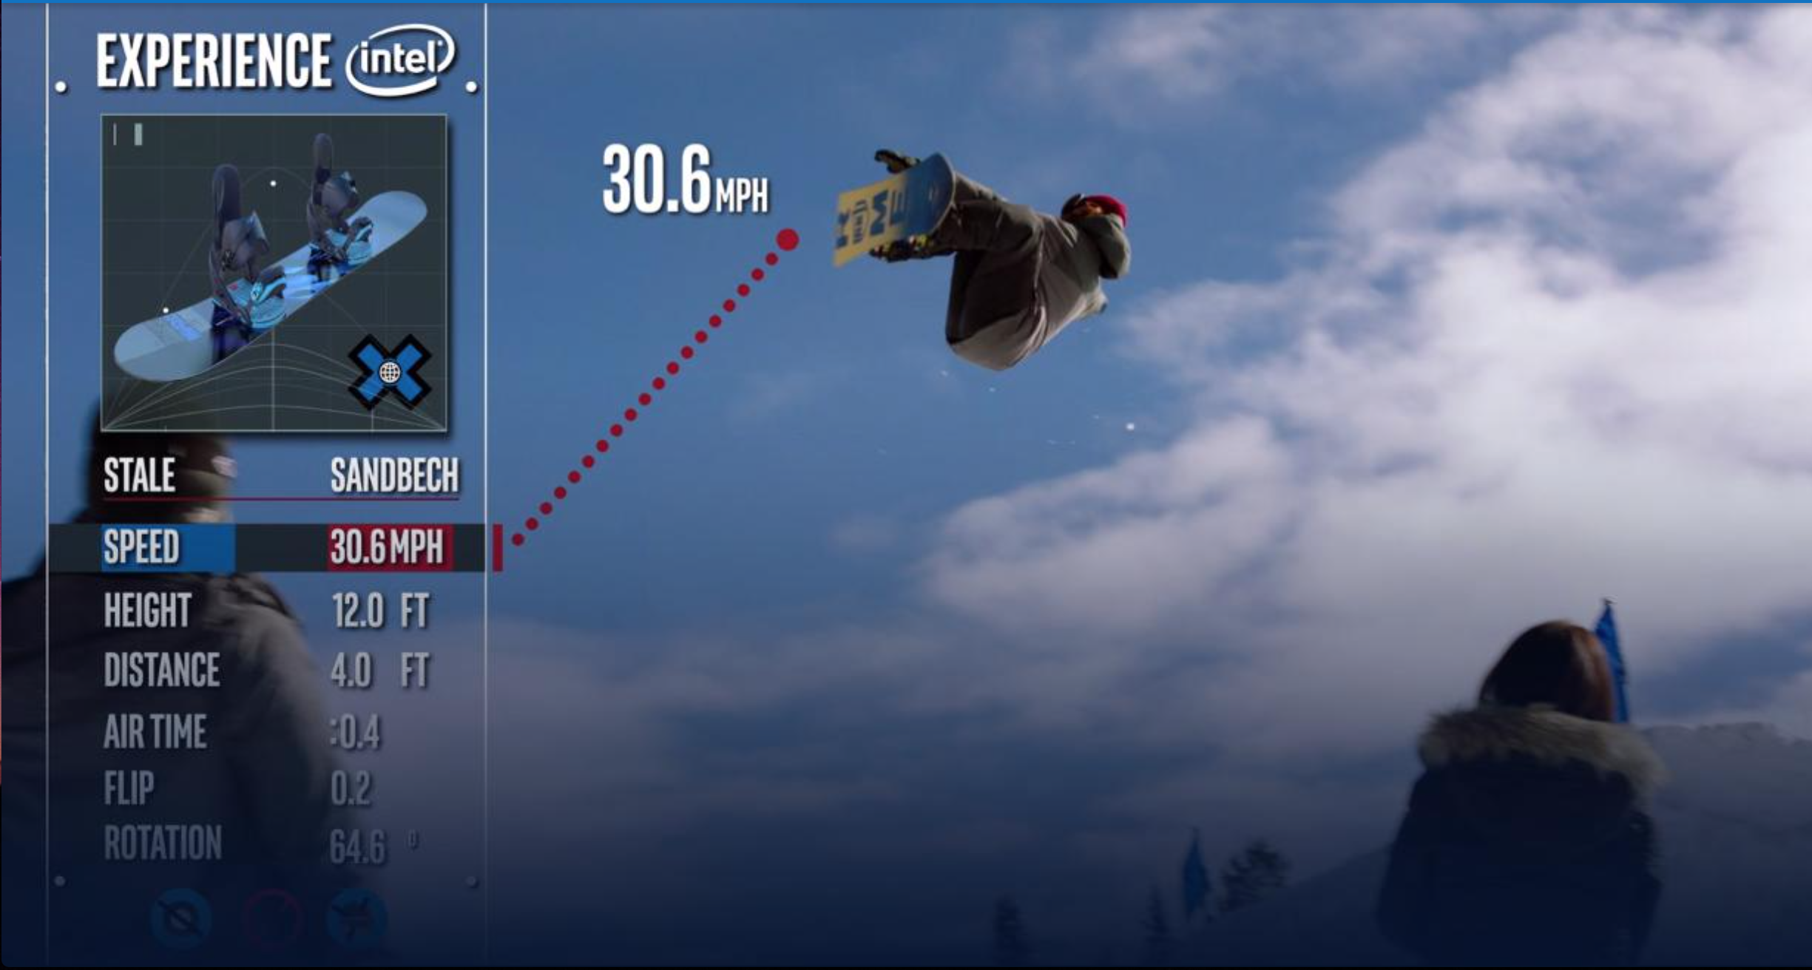
The smart device use sensor data to:
Provide metrics,
Real-time graphics,
Information to the athletes, announcers, fans and the audience at home
It can capture everything from speed and jump height, to air time and the number of rotations and flips.
New smart device
attached to their boards.
TRIZ trends: Nesting (UP)

Slide 5
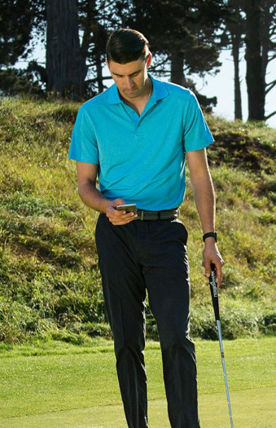
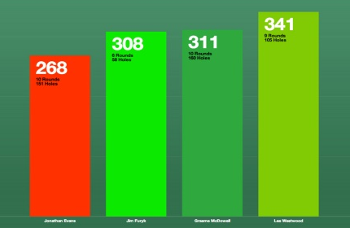
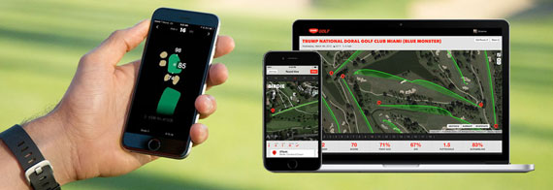
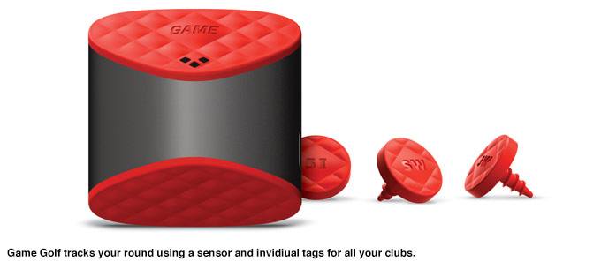
GAME GOLF
PLAY
SHARE
TECHNOLOGY
Lightweight device sensor interacts with red tags attached for every club
Player touches tag to the sensor and swings
Data: Device → Computer
Game Golf Website - dashboard
COMPARE
SEE
STATS – Real time shot tracking
Distance
Direction
Usage of each club
SHARE, COMPARE and COMPETE
Yourself
Family, friends, coach
Game Golf Community
Other players - Pros
TREND 19: Nesting (UP) – Completely integrated into higher level system
Notes:
I will play video until 1:37 sec
https://www.youtube.com/watch?v=DdXPzldzTZE

Slide 6
FOXTEL’S Alert Shirt
Feel the game while watching it
Use of an app with Bluetooth to transmit the feeling
Real time sensations
Side thought: can you imagine what the adult film industry could do with this technology?
Triz Trends : Increasing transparency, Increasing use of senses

Slide 7
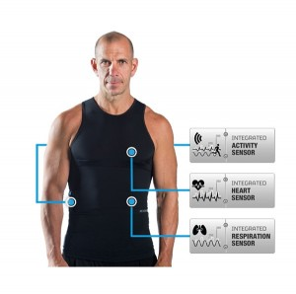
Hexoskin
Covered by Mister Clean

Slide 8
Problem : Lack of information and feedacks on body health (normal, action and rest) Solution : You can consult at the end of the day the result of your day with a washable shirt collecting your data, through a simple usb cable.
Performance | Reliability | Convenience | Price
-42 000 scientists pieces of information per minute | -Very long battery life-time | -Confortable -No Gadget to carry | -Expensive for amateur, but normal for professionnal (Sport or spatial business)
TRIZ Trend :
‘Customer buying hierarchy’

Slide 9
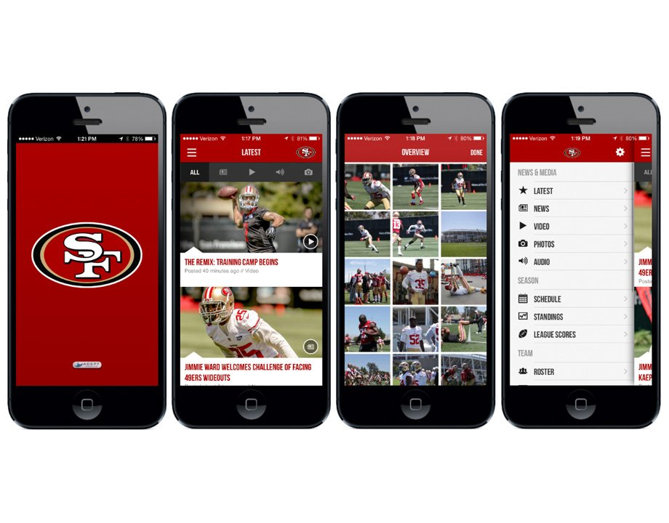
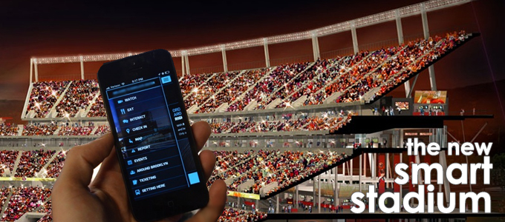
SMART STADIUMS
Virtual guide to seats
Watch replays during live game
Order food and drinks
Guide to closest bathroom
TREND 19: Nesting (UP) – Completely integrated into higher level system
Notes:
I will play video from 0.50 sec
https://www.youtube.com/watch?v=2zC1QGv2na4

Slide 10
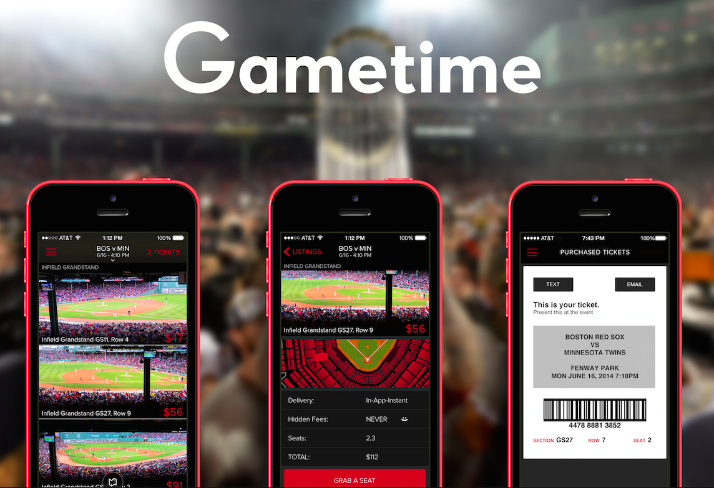
MOBILE TICKETING

Slide 11
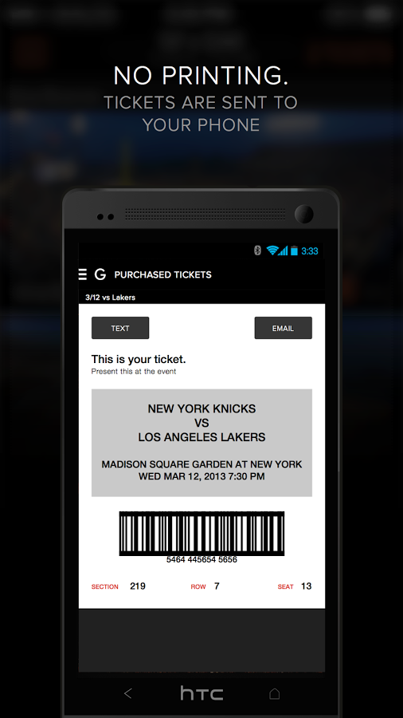
Problem : Most of the time, you renounce to buy tickets for match or concert because :
decide too late, weather uncertainty, price, faulse advertising, etc…
Solution : Textable tickets at last minute prices, mobilize friends in seconds, examines thousands of potential tickets, presenting only the best values, eliminating the laborious search process.
TRIZ Trend :
‘Boundary Breakdown’

Slide 12
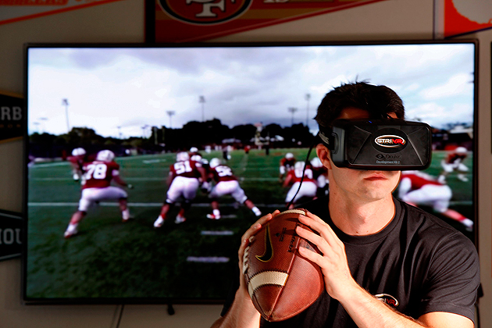
VIRTUAL REALITY
A 360-degree camera and audio system that captures all on-field action
Training and recruiting
STRIVR: Immersive training solutions
Football
Basketball
Hockey
“This is as close to the real thing as possible.”
TREND 7: Trimming/Reducing complexity – Elimination of non-key subsystems →Trimmed system
Notes:
https://www.youtube.com/watch?v=QSJVU7PK660
http://www.si.com/college-football/2015/08/06/college-football-virtual-reality-michigan-stanford-recruiting

Slide 13
?
BIG DATA IS CHANGING BASKETBALL
“The data are changing the way the game is played”
Big data and machine learning algorithms that analyze a game by reviewing images of each player's activity that are taken 25 times per second.
High-definition cameras and high-powered data analytics comes to predict the score of the game and the performance of athletes.
TRIZ : Increasing Asymmetry & Nesting UP

Slide 14
Data algorithms and miniature cameras will allow fans to watch each game from an individual player’s perspective

Slide 15
Conclusion
One main Triz Trend : Nesting Up
Other trends also, not main ones
Mainly to enhance performance in sports, some of them to enhance experience of customers.
Thank you for you attention !
Any questions ?

