Slide 1
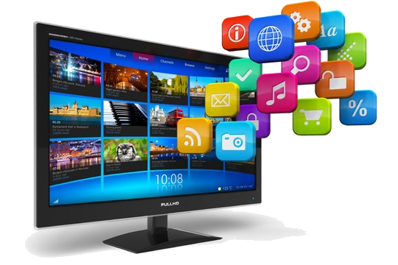
Television & Sports
Cécile ESKENAZI
MATEJ DOVADOVNIK
LUCIE RABATTU

Slide 2
1. The TV industry
How to create new experiences ?

Slide 3
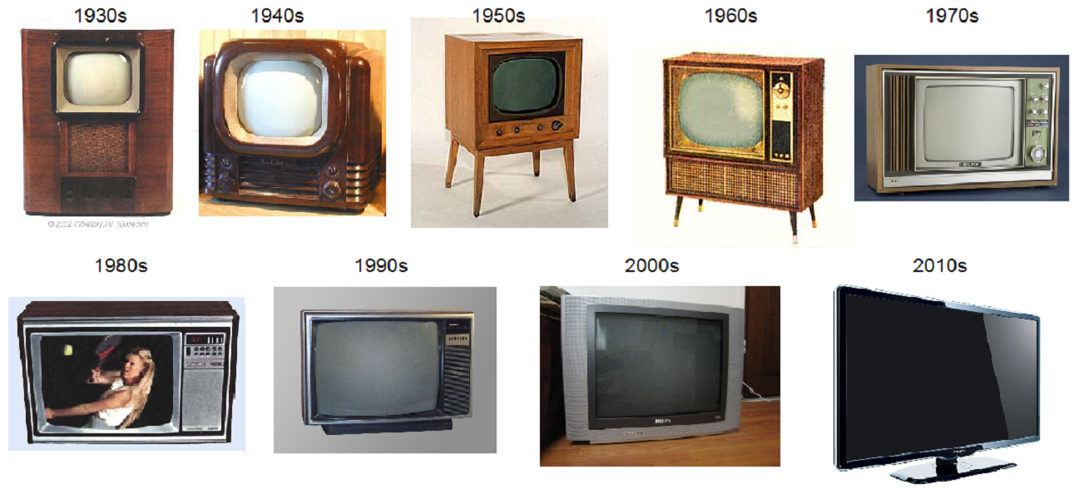
Problems Nowadays for the industry
The television and broadcasting sector à significant technological and structural changes
Technology acceptance
Convergence, new platforms and various wireless portable devices
Consumers access to a great variety of communications and media services
What's next?

Slide 4
Mobile is the new screen
On 12,000 connected devices owners asked:
Use their devices while watching television
70% of tablet owners
68% of smartphone owners
--> Only 35% of eReader owners
source: Nielsen 2011

Slide 5
Opportunities
First major move -> connected TV
More new technologies that are about to be commercialized
Your television is going to make toast
Steve Jobs to respond to a question about the convergence between IT industry and media industry said
In 1998!
Let's see what we will actually have

Slide 6
Technology N°1: connected tv
Television with integrated Internet and Web 2.0 features
Convergence between computers and television sets
Provide Internet TV, online interactive media, over-the-top content, on-demand streaming media, home networking access, social media etc
Samsung (SmartTV), Changhong, LG, Phillips
TRIZ Trend
Dynamisation

Slide 7
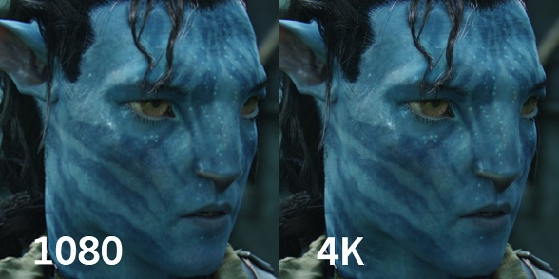
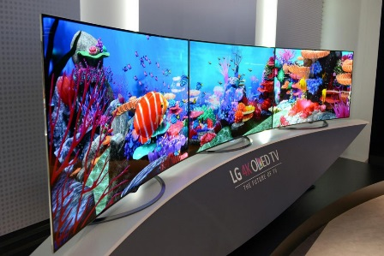
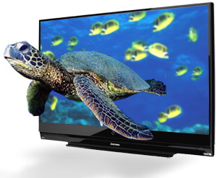
technology n°2: 8K, curved and 3d screens
8k
7680 pixels x 4320 pixels(33.18 megapixels)
3D
3D LED HDTV released by Samsung
increase immersion, wider field of view
Curved
Japan's NHK Hitoyoshi Station 8K TV
Samsung UN65JS9000, LG 55EA9809
offer a new dimension, with or without glasses
Alioscopy TV or TRIDELITY
TRIZ Trend
Increasing dimensionality

Slide 8
technology n°3: dual view
Works with a different display separated from 120 of a thousandth of a second
For the sound, one uses the speakers of the tv, the other uses a Bluetooth cask
Technology based on 3D technology, you have two pair of glasses
Watching two different programs on the same TV
Haier (Chinese low cost)​
Samsung (OLED, 10000€)
TRIZ Trend
Nesting
Customer Expectation

Slide 9
technology n°4 : no more screen
French start-up Sensorit and France TV, helped the Korean LG for simulation
Displays the contents of windows, windshields, mirrors
Intelligent glass
Holographic TV
Massachusetts Institute of Technology’s Media Lab
16 regular cameras to focus on a single object
The images are then sent to a computer, which reconstructs them into a 3D holographic image
Samsung and Amazon are interrested
TRIZ Trend
Increasing dimensionality
Mono-Bi-Poly (Various)

Slide 10
Technology n°4: No more screen

Slide 11
TECHNOLOGY N°5 : CHROMECAST 2

Slide 12
TECHNOLOGY N°5 : CHROMECAST 2
Released last month
Attachable to any TV
Very portable
HDMI plugin
Audio jack
Access from laptop, smartphone or tablet
Cheap
Gamming experience
TV shows
TV channels
YouTube
Photos and videos
No space required accessible from the cloud

Slide 13
2. The sport industry
How to make sport even more accessible to everyone?

Slide 14
Sport industry
Constant development in order to improve:
performance
measurements
popularity

Slide 15
TECHNOLOGY N°6: SMARTWHEEL

Slide 16
TECHNOLOGY N°6: SMARTWHEEL
Released last year
Developed in Slovenia
It can do between 40 - 100 km
25km/h
Charging time is 3 hours
Locked with a pin code.
It can be attached to any bike
Has a smartphone application
A bit pricy
TRIZ Trend
Mono-Bi-Poly (Various)

Slide 17
TECHNOLOGY N°7: BABOLAT and piQ Sensor
Makes the on-court experience during the game more fun
Makes wearable technology now available for all tennis players
Stroke speed is revealed in real-time
Results can be shared and compared with friends
Useful and easy to use. Good price for the value provided: $179
TRIZ Trend
Nesting
Video

Slide 18
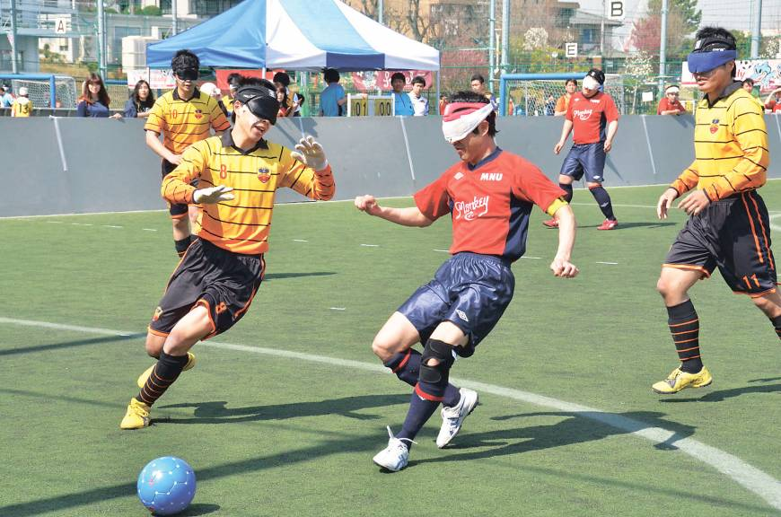
TECHNOLOGY N°8: Superhuman sport society
Augmented human reality
Using augmented reality to turn sports into a real-life video game
Use of powered suits or other wearable robotic devices to compete using “superhuman” powers
“Blind soccer” allowing students who attend schools for the blind to participate in the sport
Virtual reality technology is used to allow players to unleash Goku’s “Kame Hame Ha” in Dragon Ball.
Video

Slide 19
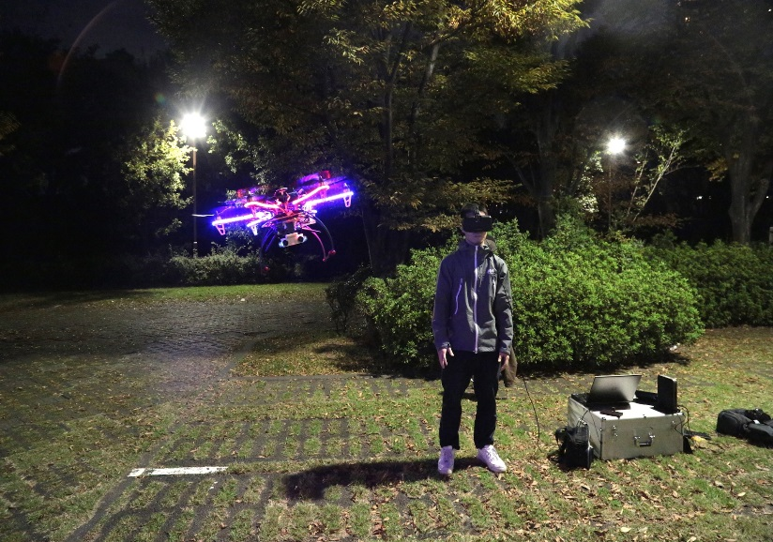
TECHNOLOGY N°8: Superhuman sport society
Plan to develop Quidditch from Harry Potter using tele-existence
Make sport accessible to aged people or people with disabilities
View of hosting an international tournament in 2020 during the Olympic Games
TRIZ Trend
Increasing dimensionality + increasing use of senses

Slide 20
Thank your for your attention ☺
Any question?

