Slide 1
“Print is not the future, but it’s not the past either.” Peter Preston
Newspapers & books
Louise Jacquot, Maud Lebrun, Marie Couraudon
Notes:
http://www.theguardian.com/media/2014/apr/27/print-future-past-digital-media-newspapers

Slide 2
What are the problems/opportunities companies in the industry are confronted with?
In February 2011, E-book sales totaled $90.3 million
202% up compared to February 2010
(source: the Association of American Publishers)
E-BOOKS No. 1 "among all categories of trade publishing" that month
The first time e-books have beaten out traditional publishing formats including paperbacks and hardcovers
TRIZ trend: increasing asymmetry
Notes:
http://money.cnn.com/2011/04/15/technology/ebooks_beat_paperbacks/index.htm

Slide 3
Will the books AND NEWSPAPERS IN PAPER disappear?
Advantages of online articles: (TRIZ: boundary breakdown)
shorter
more dynamic: videos
easy to access
read what you want
free
instantaneously: quick updates possible
top bestsellers : 92% of the top-100 best-selling books are e-books
Oxford English Dictionary has announced that it will no longer have a printed edition

Slide 4

What technologies are used?
AND WHERE?

Slide 5
BiblioTech, SAN ANTONIO, TEXAS, USA
bookless public library
Stocked with 20,000 e-books, 600 e-readers for adults and 200 for children, 48 computers, and 10 laptops and 40 tablets, the library had a cost of $2.3 million
More than 100,000 visitors in its first year
Notes:
http://www.csmonitor.com/Books/chapter-and-verse/2014/0128/America-s-first-bookless-public-library-appears-to-be-a-success-video

Slide 6
Why e-books are better than books for children?

Slide 7
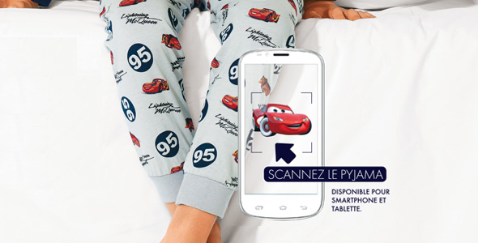
Pyjebook
Wearables + digital books = The Pyjebook, created by Kiabi
Technologies used: Apps and visual recognition (images on the pajamas)
TRIZ trend: Customer buying hierarchy (Performance, Reliability, Convenience, Price)

Slide 8




Augmented reality & books
TRIZ Trend: Boundary Breakdown (limitation of knowledge)

Slide 9
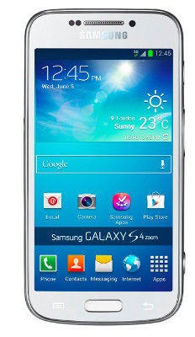


« GéoCulture, la France des écrivains »
Geo culture, France of writers
The old lady was
living in a beautiful
town called Tours.
TRIZ Trend: Increasing Dimensionality

Slide 10
Newspapers and technologies
2012: Last number of the Dutch version of Financial Times
Le Monde rides the wave with a free online content and a premium content
New kind of newspapers 100% digital : Rue 89, Huffington Post,…
Hybrid : social network/news website

Slide 11

Medium

Slide 12
Robot journalists
Robots that are able to write simple articles thanks to algorithms.
1st case in France: Le Monde, during the departmental elections in March 2015, a robot journalist wrote 36,000 articles about the results of the votes.
LA Times: Quakebot (Ken Schwencke, March, 17th2014) and the "Homicide Report”
➜ still human interaction but journalists have more time to write papers that matters and need more investigation
Slate Reader, 50% algorithm, 50% human ➜ data curation
TRIZ trend: Decrease human involvement (autonomous tool with Autopoiesis but there is still a human check)

Slide 13
Immersive Journalism
Uses virtual reality like the Google Glasses
Created by Nonny de la Peña to transmit emotions and feelings, not only images, texts and information.
Mix of real noise recorded on the scene and graphics realized thanks to video games techniques.
TRIZ trend: Increasing dimensionality

Slide 14

WIBBITZ
TRIZ Trend: Reducing complexity
Press Release
Identify the topic
Video
1 or 2 minutes
Images
Infographics
Voice-off
Highlight key-points
Analyse the text
Notes:
http://www.wibbitz.com/watch/?id=b83eacf8a41f74c30b9c2df6bba543e28

Slide 15



"La presse au futur" - November 2015 in Paris ~ Best Digital Innovation Award
TRIZ Trend: Reducing Complexity
TRIZ Trend: Customer Buying Hierarchy (convenience)
« The Netflix of television coverages »
  9,90€/month
  No adds
→ Content curation: collect information, select the most interesting according to your choice and send it to you in a daily mail.
https://vimeo.com/107247075
Notes:
https://vimeo.com/107247075

Slide 16

Thank you

Slide 17
References
http://www.bfmtv.com/culture/pour-couvrir-les-departementales-le-site-du-monde-a-fait-appel-a-des-robots-journalistes-871121.html
http://www.lesinrocks.com/2015/03/23/actualite/le-monde-fait-rediger-un-papier-par-un-robot-les-algorithmes-vont-ils-remplacer-les-journalistes-11626280/
http://www.forbes.com/sites/ellenhuet/2015/05/29/using-virtual-reality-to-create-immersive-journalism/
http://www.goglasses.fr/oculus-rift/journalisme-immersif-avec-oculus-rift
http://www.theguardian.com/media/2014/apr/27/print-future-past-digital-media-newspapers
http://money.cnn.com/2011/04/15/technology/ebooks_beat_paperbacks/index.htm
http://mashable.com/2013/01/16/e-books-vs-print/#7eYMpLj7bPqE
http://sharonbellis.hubpages.com/hub/books-obsolete-books-disappear
http://bestsellerlabs.com/no-more-books-stephen-king/
http://www.csmonitor.com/Books/chapter-and-verse/2014/0128/America-s-first-bookless-public-library-appears-to-be-a-success-video
http://www.wibbitz.com/
http://www.lejdd.fr/Culture/Livres/Actualite/Salon-du-livre-par-ici-les-nouveautes-numeriques-598330
https://www.brief.me/
www.spicee.com/
http://www.abc-luxe.com/actus/l-actu-des-marques/article/stylist-se-digitalise-et-lance-la-list
http://www.lapresseaufutur.com/trophees-innovation-presse-2015
http://www.ladn.eu/actualites/lancement-spicee-media-video-grands-reportages,article,26916.html

