Slide 1
Trends in Digital Innovation for Newspapers/Books Industry
Tu Xan
Neha Rajan

Slide 2
Trend 1 | Trend 2 | Trend 3 | Trend 4 | Trend 5 | Product
Dynamization | Increasing Transparency | Trimming/reducing Complexity | Decrease Human Involvement | Boundary Breakdown | E-books, E-newspapers
Increasing Asymmetry |  |  |  |  | Putmeinthestory.com
Segmentation |  |  |  |  | Blendle
Customer Expectation | Action Coordination | Degree of Freedom |  |  | Chooseyourstory.com
Rhythm Coordination |  |  |  |  | Bookswim, Paperspine
Increasing Use Of Senses |  |  |  |  | Audible
Mono-Bi-Poly (various) |  |  |  |  | Harry Potter : Hogwarts Mystery
Mono-Bi-Poly(Similar) |  |  |  |  | Classic, paper newspaper + Digital version + augmented reality version for kids
Mono-Bi-Poly(Increasing Differences) |  |  |  |  | Movies/Documentaries about books/newspapers
Design Points |  |  |  |  | InShorts
Nesting(UP) |  |  |  |  | Eyetracking in Kindle
Listening/Communication |  |  |  |  | Text2.0
Customer Buying Hierarchy |  |  |  |  | justbooks
Increasing Dimensionality |  |  |  |  | sareddy

Slide 3
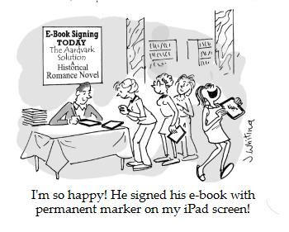
E-books, E-Newspapers
Dynamization
Increasing Transparency
Trimming/reducing Complexity
Decrease Human Involvement
Boundary Breakdown

Slide 4

putmeinthestory.com
Increasing Asymmetry

Slide 5

Blendle
Segmentation

Slide 6
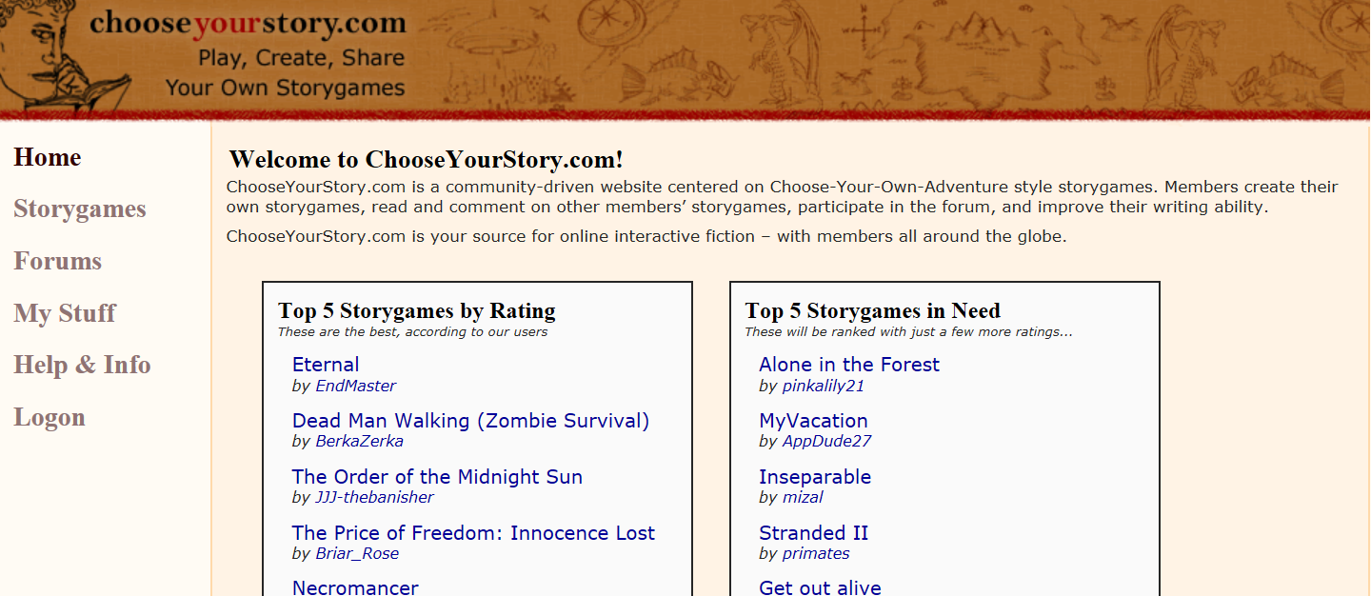
chooseyourstory.com
Customer Expectation
Action Coordination
Degree of Freedom

Slide 7

Bookswim, Paperspine
Rhythm Coordination

Slide 8

Audible
Increasing Use Of Senses

Slide 9

Harry Potter : Hogwarts Mystery
Mono-Bi-Poly(various)

Slide 10
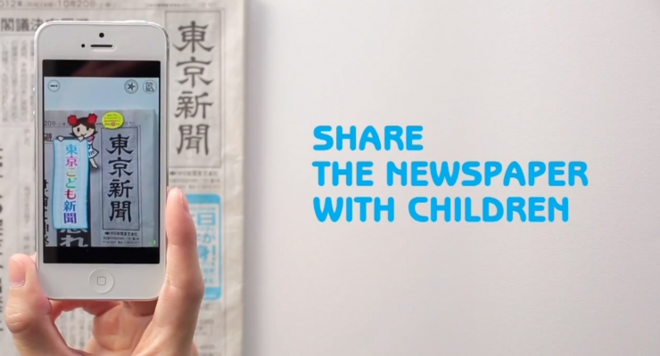
Classic, paper newspaper + Digital version + augmented reality version for kids
Mono-Bi-Poly(Similar)

Slide 11
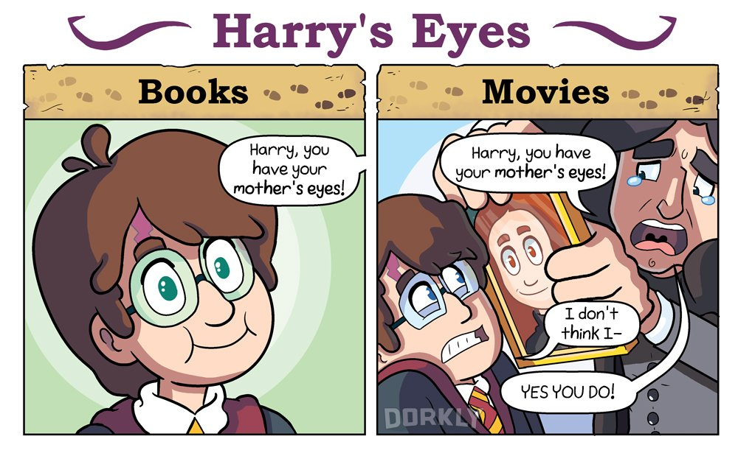
Movies/Documentaries
Mono-Bi-Poly (increasing differences)

Slide 12

InShorts
Design Point

Slide 13

Eyetracking in Kindle
Nesting (UP)

Slide 14
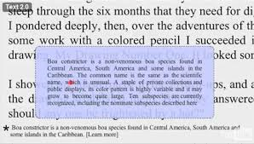
text2.0
Listening/Communication

Slide 15

justbooks
Customer Buying Hierachy

Slide 16
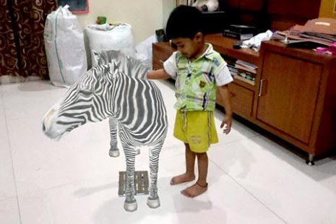
Sareddy 4D Books
Increasing Dimensionality

Slide 17
THANK YOU!

