Slide 1
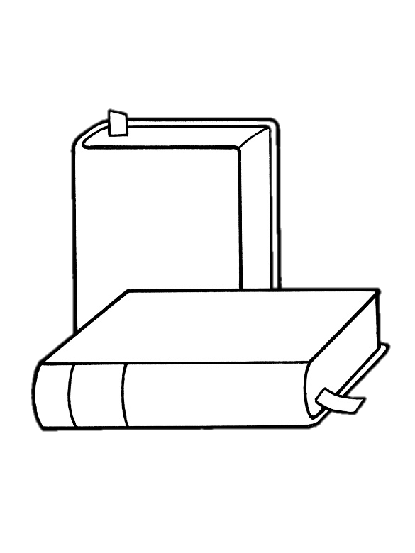
Latest trends in the Newspaper,
Books,
and gaming industries
Done by:
AINSINJI Charbel
GHILDIYAL Kritika
META Alma
QIN Ying
For the class of Trends in Digital Innovations

Slide 2
Publishing INDUSTRY Problems
newspaper & Books Industry
Publishing is costly
Publishing is time consuming
High cost of shelving
Keeping readers engaged is a problem

Slide 3
Publishing INDUSTRY Opportunities
newspaper & Books Industry
Combination with digital technologies
Easier access to readers
Instantaneous update
Perspectives in depth
Interactive Communication
User-friendly experience for readers
Breaking down publishing cost

Slide 4
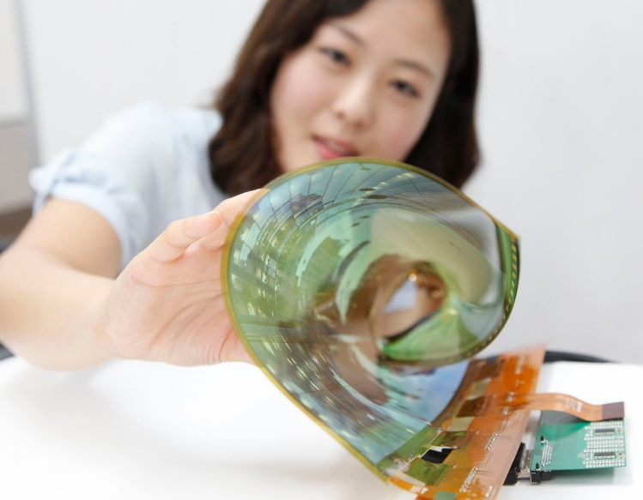
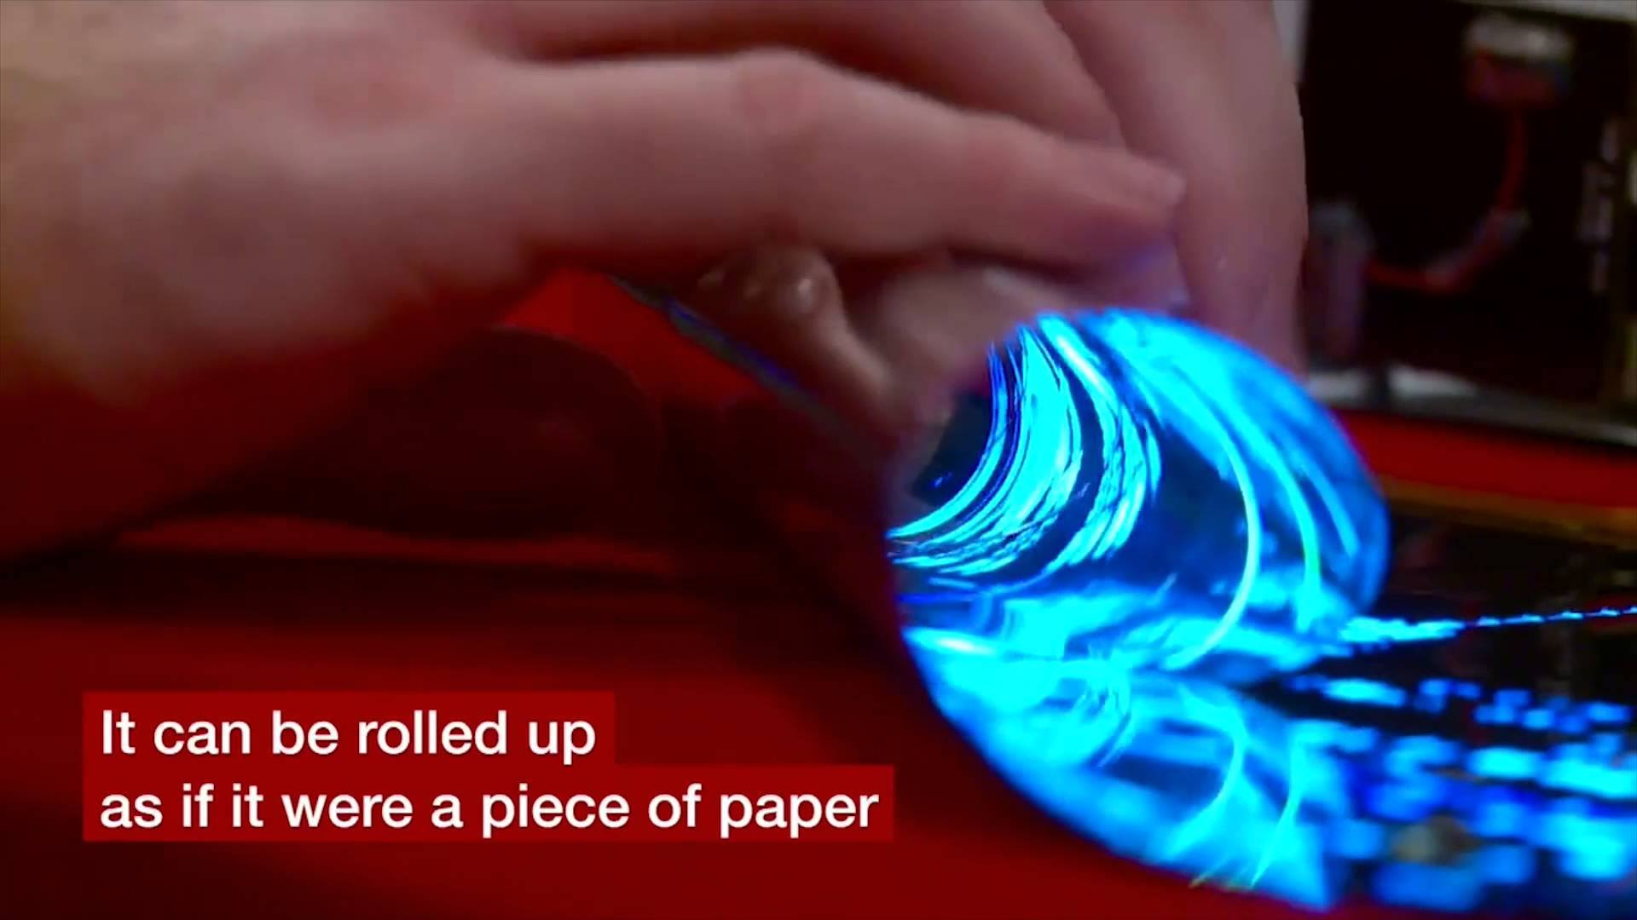
LG ROLLABLE DISPLAY
newspaper Industry
Facilitating Conditions: Platform Shifting
Performance Expectancy: Multifunctional & Dynamical
Ease of use: EXP of Convenience
Social Influence: Interaction with Readers
TRIZ
Boundary Breaking Down
Dynamization: Rigid to Flexible - Get more connected

Slide 5
Immersive journalism
newspaper Industry
Facilitating Conditions: Journalist Plus VR
Performance Expectancy: Empathy
TRIZ
Dynamization: Get more emotionally connected
Increasing dimensionality: 2D→3D
Increasing use of senses: visual; sound; environment

Slide 6
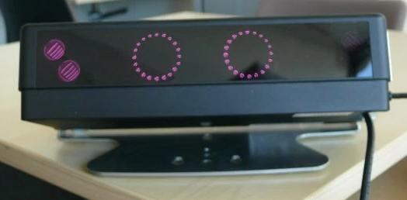
text 2.0
Book Industry
Text that knows its being read
Uses Eye Tracking Technology
Cognitive Understanding
Pre-Programmed Responses to the user
Enable hands-free interaction
To help differently-abled individuals- Tobii
TRIZ
Dynamization: More flexibility
Increase use of human sense
Richer customer experience
Improved Interaction control

Slide 7
Amazon Kindle Direct Publishing
Book Industry
Functionality- used by authors and publishers to independently publish their books directly to Kindle and Kindle Apps worldwide.
Technology used - MOBI format, E-ink
TRIZ
Dynamization,
Reduce complexity
Decrease human involvement

Slide 8
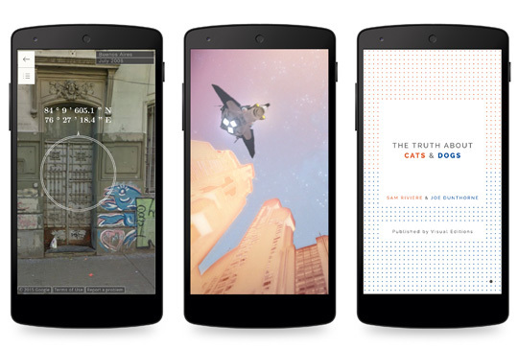
Google & Visual Editions at Play EBook
Book Industry
Functionality- Interactive eBooks
Technology used-Play Store, read through the web browser of your mobile device
TRIZ
Dynamization,
Increasing dimensionality
Increased use of the senses
Notes:
https://editionsatplay.withgoogle.com/#/detail/p_taCwAAQBAJ

Slide 10
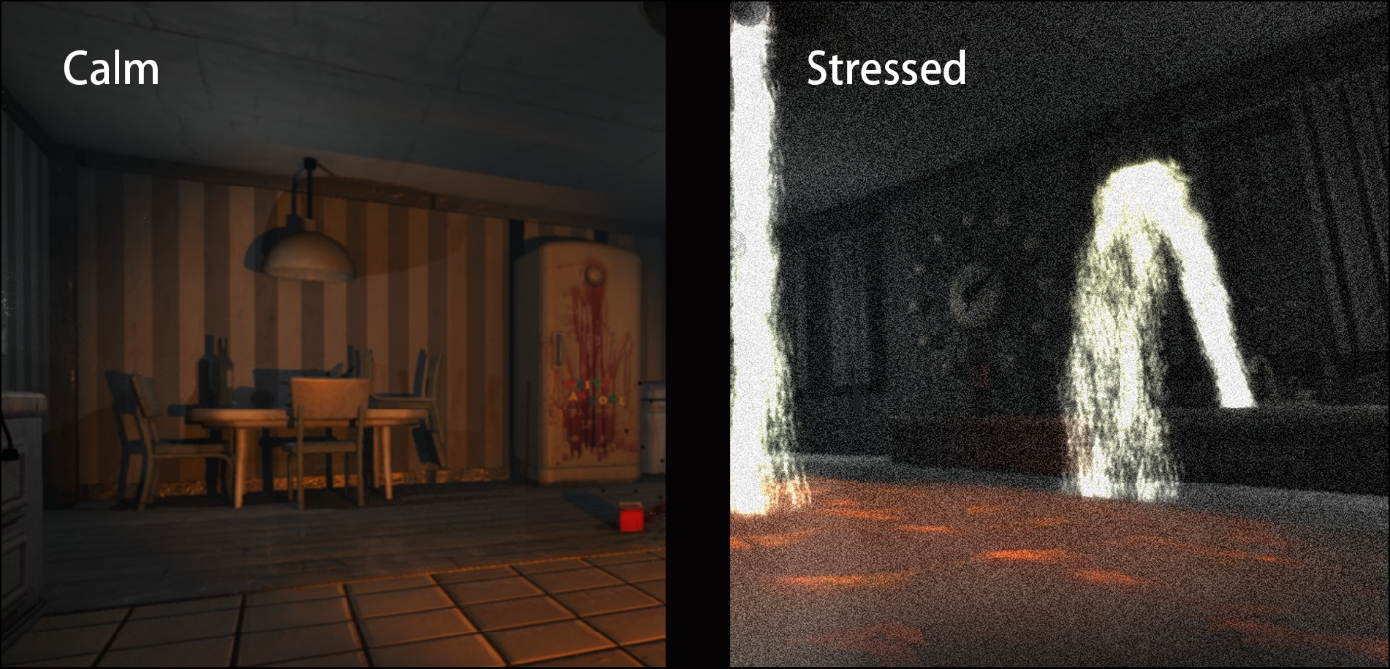
nevermind
Gaming Industry
Uses Biofeedback Technology
Detects indications of changes in emotional/physiological responses
Potential full-fledged therapeutic tool
Eye-controlled interaction
TRIZ
Dynamisation: More Flexibility
Increase use of senses
Segmentation

Slide 11
Chromecast 2.0 Gaming
Gaming Industry
Who created it?
What it does?
How it works?
What is it compatible with?
What’s the price?

Slide 12
Chromecast 2.0 Gaming
Gaming Industry
What is it’s application in gaming?
Examples?
TRIZ
Convenient at good price
More flexibility to play
Action coordination

Slide 13
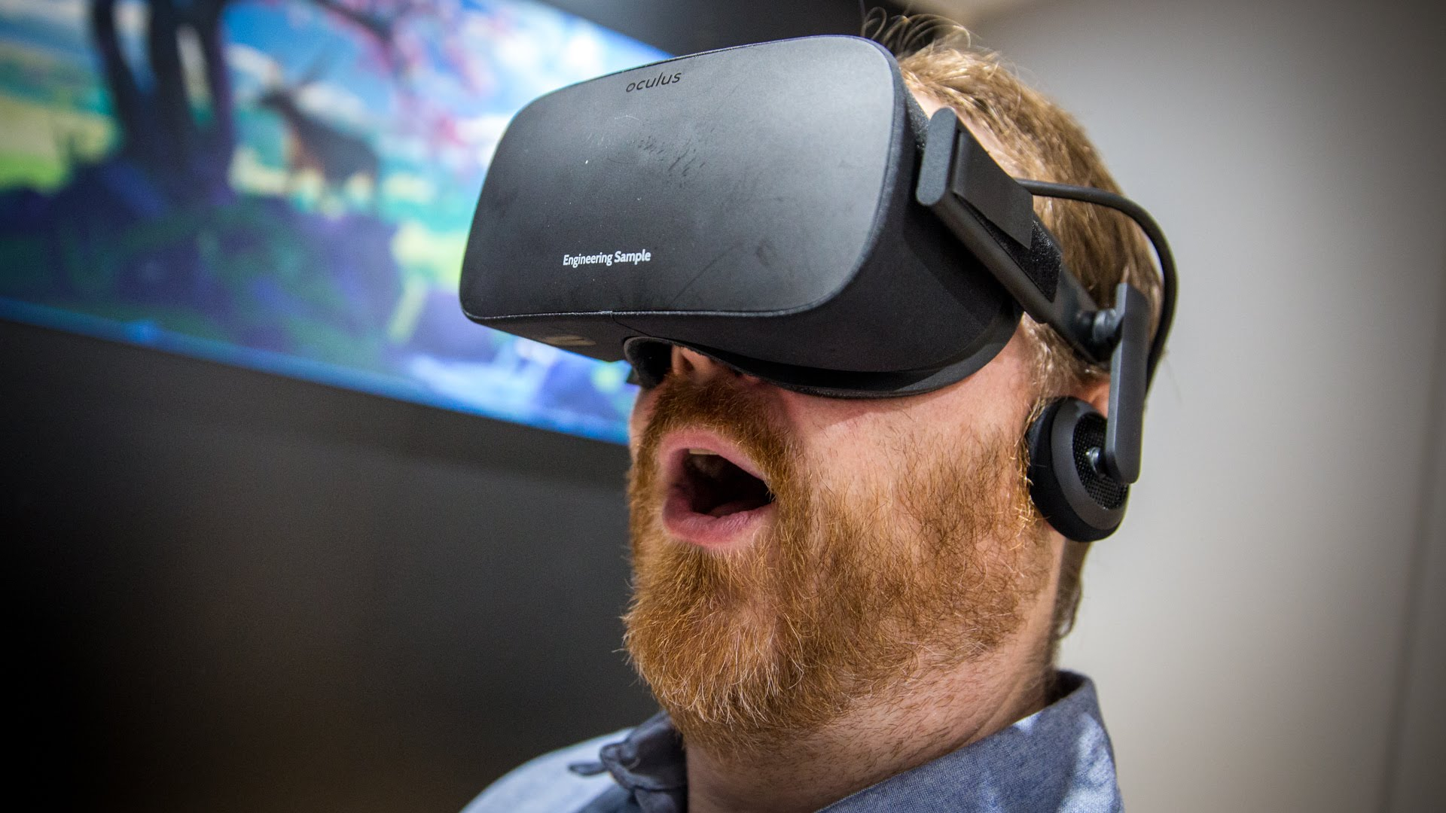
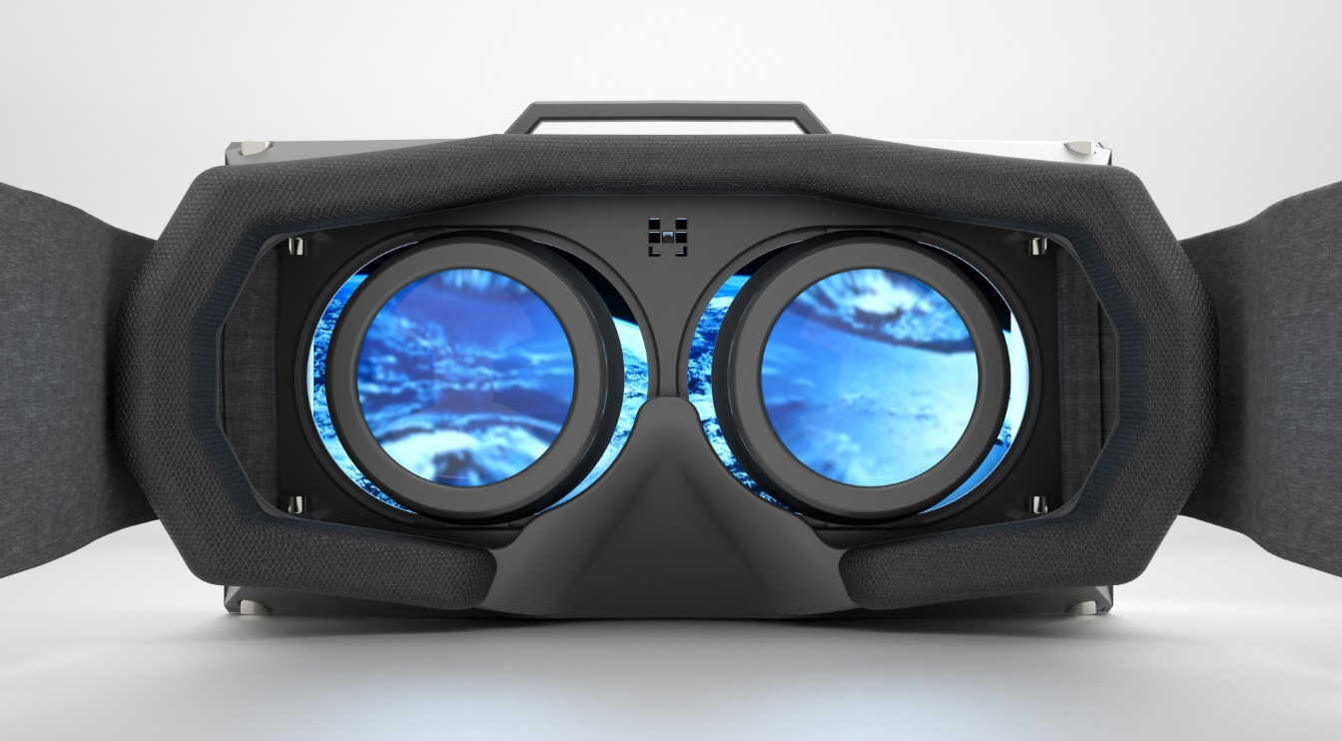
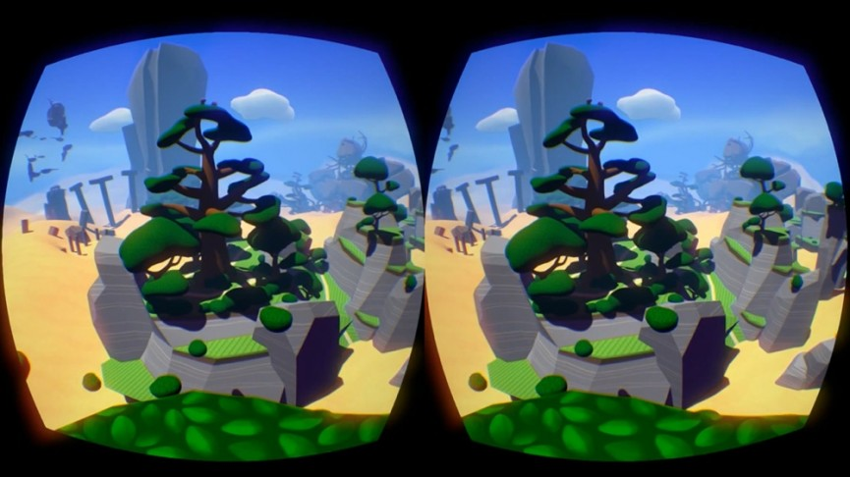
Oculus rift
Gaming Industry
Who created it and who currently owns it?
What it does?
How it works?
What is it compatible with?
What is the release date?
What is the price?

Slide 14
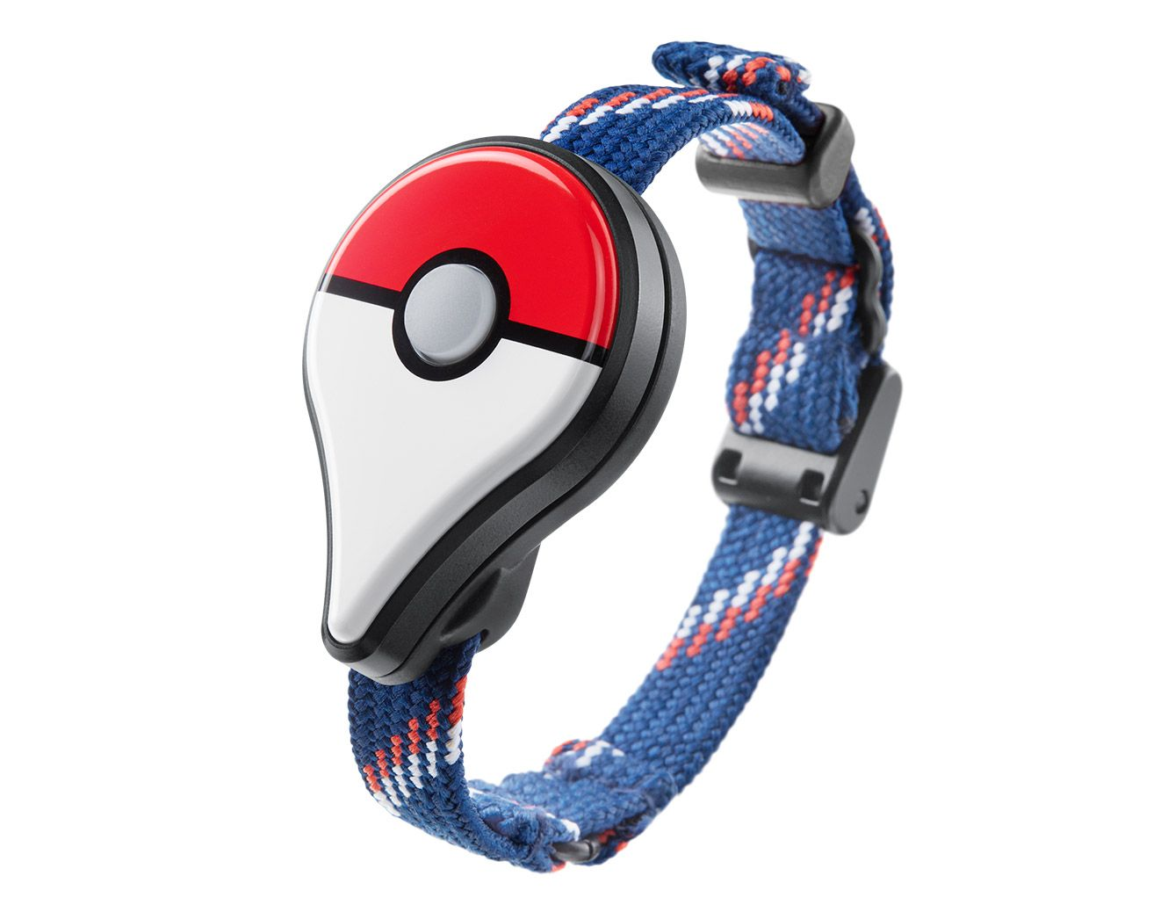
Pokémon GO
Gaming Industry
Who created it?
How to get it?
When is the release date?
How it works?
Any add-ons?
TRIZ
Convenient at good price
More flexibility to play
Decrease in complexity
to play Pokémon

Slide 15
THE END

