Slide 1
The Music Industry
KLEINPOORT Benjamin
DUBOUIS Lénaïc
AL HAKIM Hugo

Slide 3
What is the music industry ?
2014 : US$14.97 billion
BUT : Vinyl revenues rose by 54,7% !
Down 0,4% compared to 2013
Subscriptions : 23% of total revenues

Slide 4
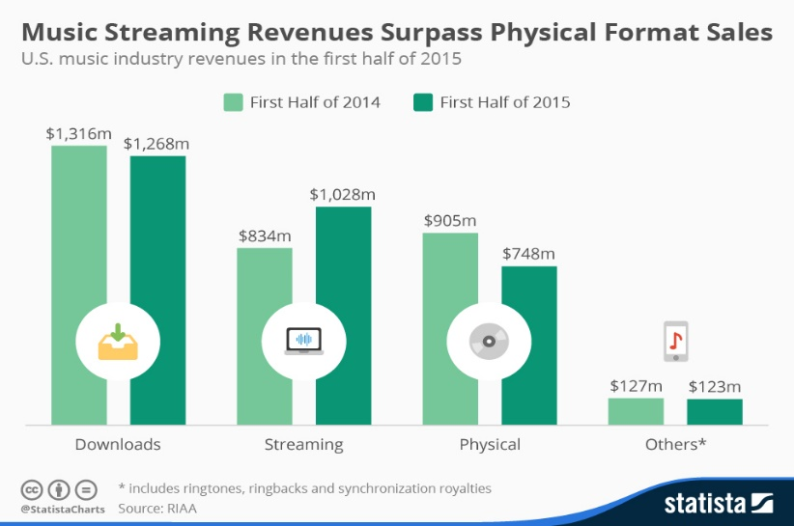
Today’s reality

Slide 5
So, is the music industry in crisis ?

Slide 6
New needs
Ease Of Use (EoU)
Mobility
Quality
FLAC ?
MP3 ?
Copyrights issues
What security ?
What’s new ?

Slide 7
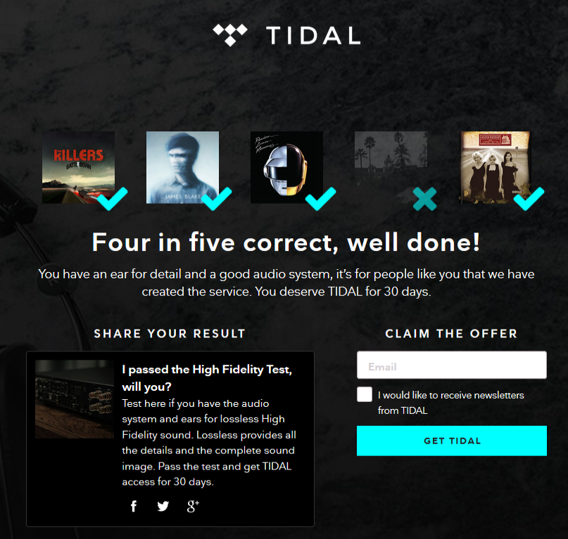
QUALITY? NOT REALLY…

Slide 8
Solutions
Popularization of better, more intuitive, more adapted softwares
Garage Band, Ableton, Virtual DJ
Streaming platforms
Freemium
Premium

Slide 9
Solutions
Creative Commons (“CC”)
Alternative to “All rights reserved”
Support free transfer and modification
Are they acceptable solutions ?

Slide 10
Music as an Experience
Innovation as a key element in producing and listening to music
IT IS NO MORE ABOUT ONLY LISTENING TO MUSIC
IT IS ABOUT THE EXPERIENCE.

Slide 11
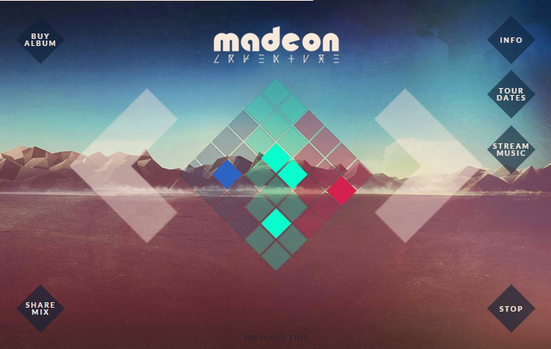
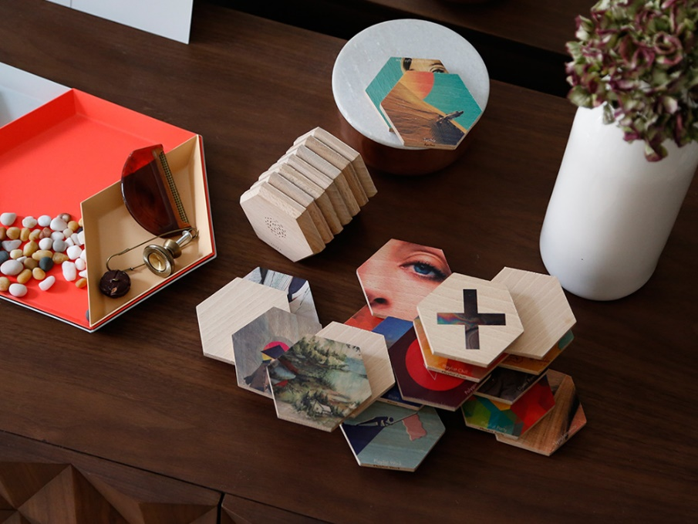
The “New Music”
Involving music consumers in the artist’s creative process
Madeon’s Adventure Machine
New means of consumption thanks to close field technologies
Qleek

Slide 12
QLEEK CASE

Slide 13
Hatsune Miku Case

Slide 14
Hatsune Miku Case
Crypton Future Media
YAMAHA Vocaloid 2 – Vocaloid 3
Holographic Concert – Japan
2007

Slide 15
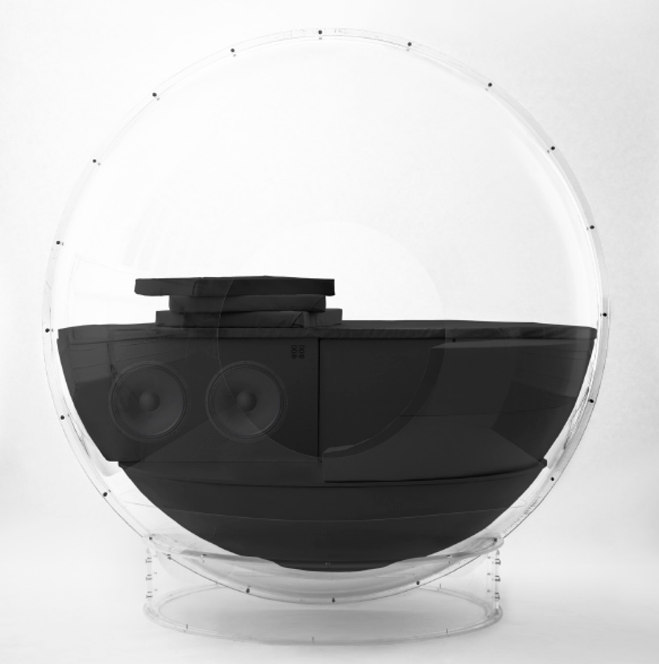
The music becomes you ….
AIVVY Q SELF-LEARNING HEADPHONES
You own smart headphones
AUDIOORB
“The ultimate music experience”

Slide 16
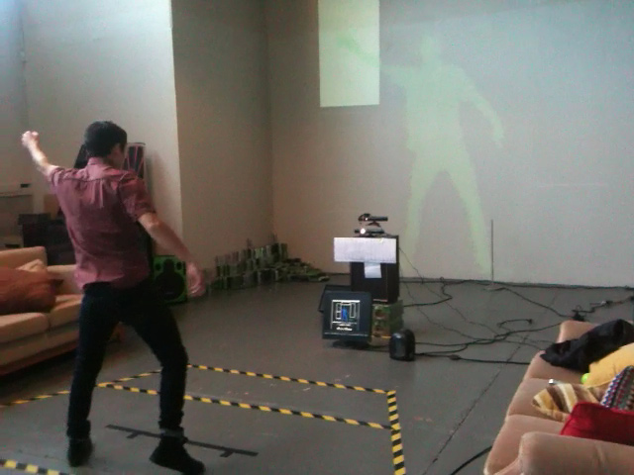
… and you Become The Music
Mi.Mu Gloves
V-Motion (+Abbleton)
Oculus Rift

Slide 17
Oculus rift

Slide 18
MI.MU Gloves

Slide 19
V-Motion PRoject

Slide 20
The Piracy “issue”
ThePirateBay ; KickAssTorrent
Are they revealing a deep problem in the industry ?
Piracy as a driver of change
Forced to innovate
Freedom & Choice

Slide 21
THE INDUSTRY IS NOT DEAD! IT IS AT THE HEART OF ITS REVOLUTION!

Slide 22
Thanks for your attention! QUESTIONS?

Slide 23
references
http://www.wired.com/2014/05/a-slick-product-that-gives-physical-form-to-your-digital-music/
http://www.greenroom.fr/81705-la-cassette-na-pas-dit-son-dernier-mot/
http://mimugloves.com/
https://gigaom.com/2015/03/06/the-music-industrys-broken-business-could-change-in-2015/
http://www.custom-logic.com/blog/v-motion-project-the-instrument/

