Slide 1
Logistics
Guillaume Petit, Constant Fagnou, Alexia Sampré

Slide 2
Agenda
The importance of logistics in a company
The life of a product:
The inbound: from the factory to the company
Internal movement inside the company
The outbound: From the company to the final client
Big Data and Logistics

Slide 3
1. The importance of logistics in a company
10-15%
The cost of logistics in the national GDP
Operational Excellence
Competitive Strategy gained with smart logistics
New Techonology Advances
“Some companies talk about innovation; others deliver it” Sundi Aiyer

Slide 4
2. Life of a product
Dropship – Transfix - Weft
Inbound
DHL - Oscaro
Internal Movement
Amazon - Shutl
Outbound

Slide 5
Inbound: 3 cases
Dropship Commerce
Transfix
Weft inc.

Slide 6
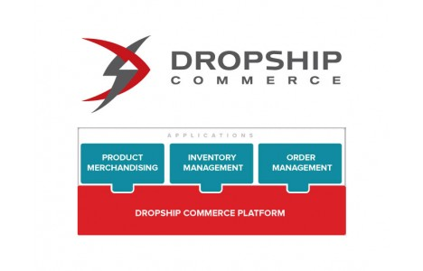
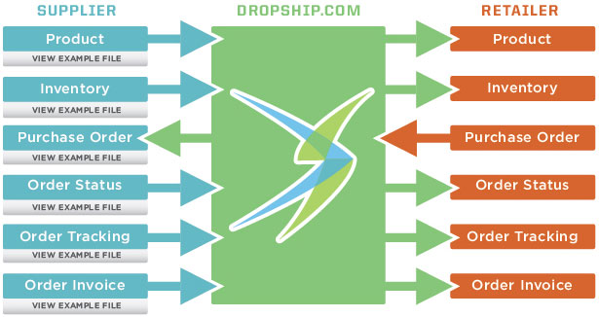
Dropship commerce
Problem: expensive to grow online business and basic drop shipping doesn’t work
Solution: Manage drop shipping programs and exchange vital data with trading partners through a single connection point.
Item information
Inventory
Order & shipment

Slide 7
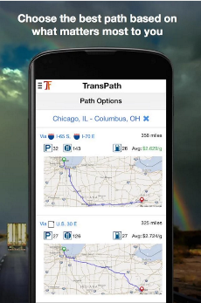
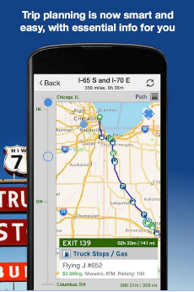
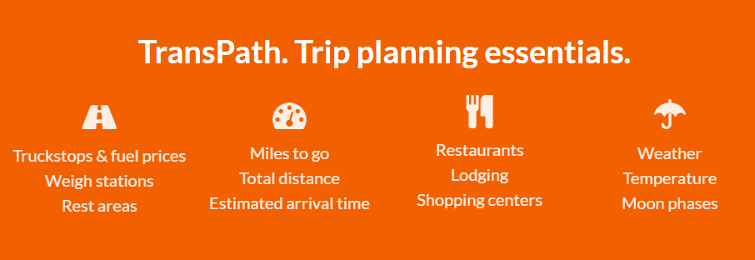
Transfix : « Technology driven, driver focused »
Problem: Waste of money because of the asymmetry of the information
Solution: Providing informations concerning trips and thus asymmetry information will match (trend 5)
- Fuel prices, weight stations, etc.
Users : Arnes and Noble, Samsung, SuperValu and J.Crew

Slide 8
Weft inc.
Problem: Lack of visibility in the supply chain management causing waste of money
Solution: Weft (trend 7 : Reducing complexity)
Real time Supply chain visibility (weather, port conditions, oil prices, etc,)
Avoid bottlenecks & delays
Keep cargo safe
Users: El Faro, Amazon’s ships

Slide 9
Internal Movement: 2 cases
DHL
Oscaro

Slide 10
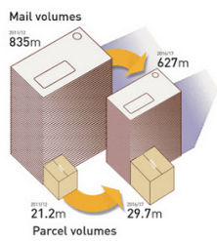
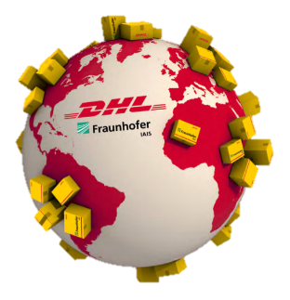
DHL: Parcel Volume Prediction
Use Big Data
Anticipate charge
Allocate efficiently the resources
Configure the distribution network
Improve trajectories
Predict evolution of the demand

Slide 11
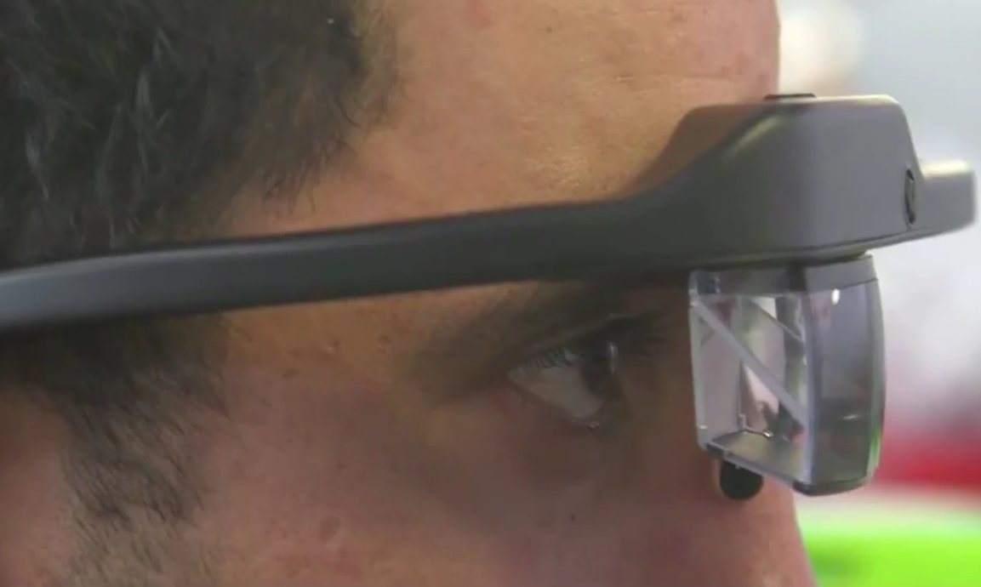
Oscaro.com
Company selling car spare parts
The motto is to deliver any spare part in less than 48h.
How to deal efficiently with more than 500.000 references in the warehouse ?
System re-optimized continuously
Optimization of time ,distance and costs
Adding extra information on our vision
Improved interaction control
Reduction of complexity
Training of employees shortened

Slide 12
Outbond: 2 cases
Amazon
Exemple 2

Slide 13
Amazon:3D printers delivery
Costs Cutting
Pattern 2013
No more stocks
Minimum Delivery time
Entire control

Slide 14
Friendshippr - Service using Facebook to map out travelling friends
Bringg – A SaaS mobile based platform for smart deliveries
Shutl - App for on-demand service using drivers with free space in cars
Interactive
Intelligent
User-friendly
Cheap
Case: The future of delivery and good transportation
Notes:
Bringg: https://www.youtube.com/watch?v=z5_2WBwr2JA
Friendshippr: https://www.youtube.com/watch?v=9NwE9X5Kv48
Shutl: https://www.youtube.com/watch?v=IhY928_TGt4

Slide 15
BIG Data and logistic

Slide 16
Case study: DELL
Dell Acquires StatSoft to Bolster Portfolio of Big Data Solutions
StatSoft delivers a full range of advanced analytics tools that help organizations forecast future trends to identify new customers and sales opportunities, forecast industry shifts, explore “what-if” scenarios, and reduce the occurrence of fraud and other business risks
Dell Uses Artificial Intelligence to improve sells.

Slide 17
References:
http://www.ecommerce-nation.fr/comment-linnovation-logistique-va-transformer-le-e-commerce-de-demain/
http://www.laposte.fr/entreprise/a-la-une/evenements/comment-l-innovation-logistique-va-transformer-le-commerce-connecte/conference-en-video
https://www.youtube.com/watch?v=wavawmA2EBo
http://www.journaldunet.com/solutions/expert/60022/innovation-it---quelles-perspectives-pour-la-logistique-en-2015.shtml
http://bringg.com/
http://www.shipwire.com/why-shipwire/
http://www.weft.io/
http://www.lenouveleconomiste.fr/lesdossiers/innovations-et-supply-chain-des-optimisations-en-cascade-23153/
http://www.generixgroup.com/
http://www.dropship.com/features
http://transfix.io/
http://www.weft.io/
http://logisticsviewpoints.com/2012/11/19/dell-uses-artificial-intelligence-at-global-command-centers/
http://www.dell.com/learn/us/en/vn/secure/2014-03-17-dell-acquires-statsoft-data-analytics-software
http://www.dell.com/learn/us/en/vn/press-releases/2015-04-29-dell-software-extends-analytics-momentum
http://www.bloomberg.com/research/stocks/private/snapshot.asp?privcapid=222820543
http://www.marketwired.com/press-release/transfix-beyond-uber-for-trucking-nyc-startup-launches-driver-centric-app-2027451.htm
http://recode.net/2015/01/20/transfix-brings-the-uber-model-to-the-800-billion-trucking-industry/
https://www.linkedin.com/company/weft

Slide 18
Thank you for your attention.

