Slide 1
Logistics
how to move things
Hannes Blaas LIU Weijie Alexis Guido

Slide 2
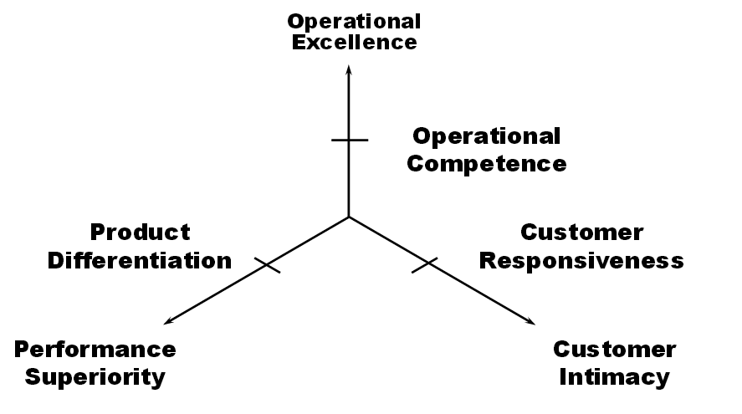
Competitive Strategies
Customer buying hierarchy step: Price
Notes:
Why is logistics important? If we compare the companies that excel at logistics, we see that they have something in common. They all are known for their relatively low prices, because they are in the Customer Buying Hierarchy step “Price”. They can offer these small prices, because they invested heavily in their logistics. Walmart was among the first to introduce computers, barcodes and even launched its own satellite to better process information. Today, the share of logistics of total costs is only half of those of the next competitor. Zara has a product to market time of a few weeks. If Madonna is on an Europe tour, she can sing before a Spanish audience wearing the same clothes she wore a couple of weeks ago in Amsterdam.

Slide 3
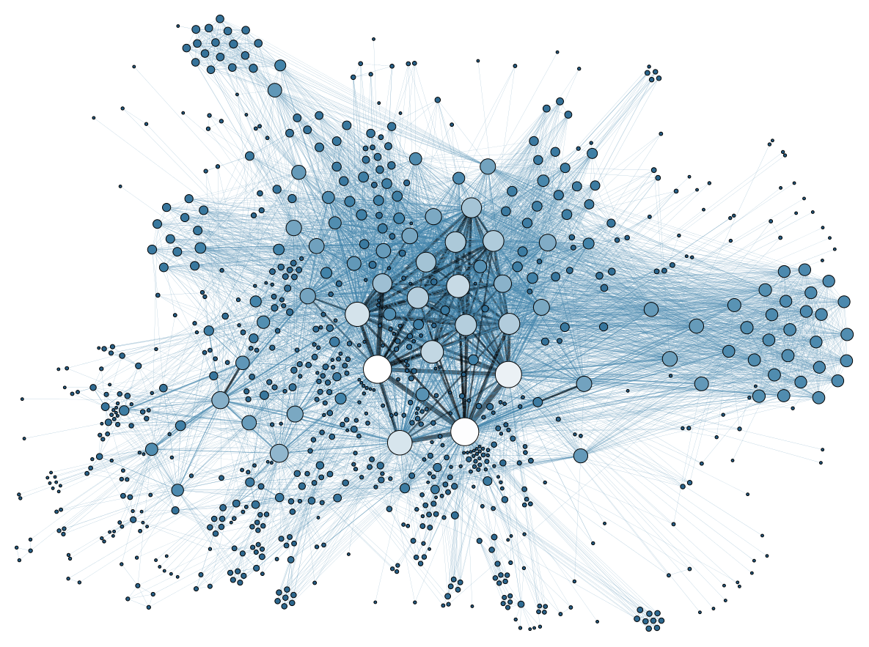
Structure
Inbound
Self-driving Trucks
CreateSpace
Internal
Movement
Autonomous warehouse robots
Augmented Reality
Automated forklifts
Outbound
Amazon Air Prime
3D-printer trucks
Amazon OMW
Big Data
Anticipatory shipping
Amazon Echo
Notes:
In logistics, we can distinguish between three activities a company needs to optimize: Inbound, Internal movement, and outbound. These activities are ideally highly integrated and embedded into a net of data.

Slide 4
Inbound

Slide 5
Self-driving Trucks
2015: World's First Licensed Autonomous Freightliner in Nevada
Launch in 2025
Daimler Video
Notes:
These cars have since driven over 1.7 million miles and have only been involved in 11 accidents, all caused by humans and not the computers

Slide 6
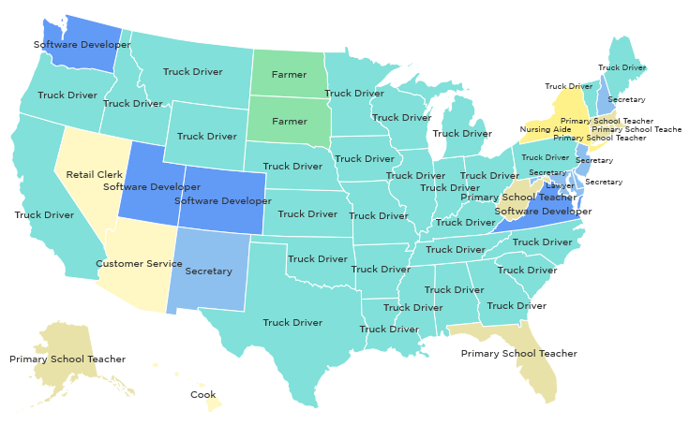
Self-driving Trucks
Decrease human involvement: Automated
3.5 mio professional truck drivers in the US alone

Slide 7
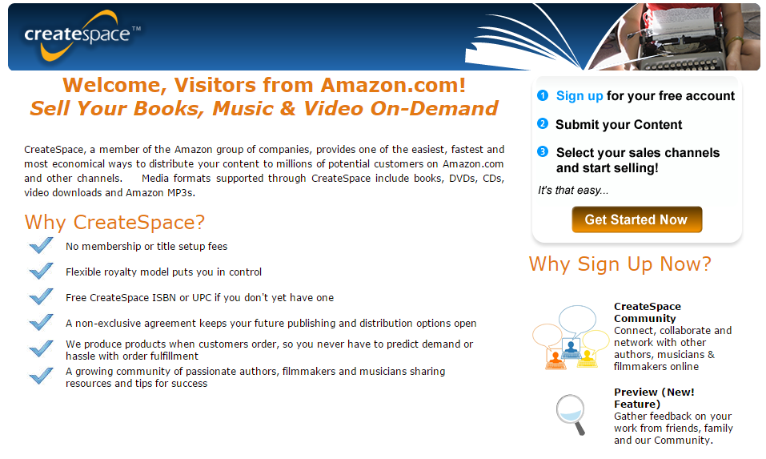
CreateSpace
Production on demand: not everything needs to be on stock
Increasing Asymmetry: Matched

Slide 8
Internal Movement

Slide 9
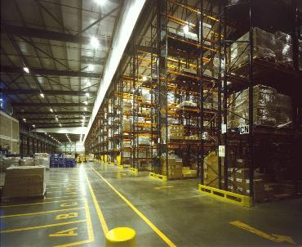
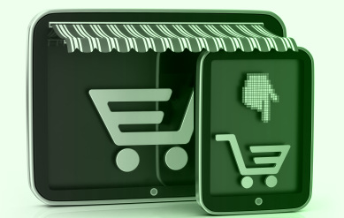
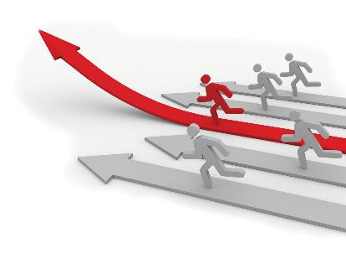
Challenges today
Inventory management
Growing demands of consumers
Growing number of competitors

Slide 10
 | Warehouse robots | Video1 | https://www.youtube.com/watch?v=quWFjS3Ci7A
 | Augmented reality glasses | What is it? How it works? | https://www.youtube.com/watch?v=I8vYrAUb0BQ
 | Automated forklifts | Video4 | https://www.youtube.com/watch?v=pkBteoGM6KY

Slide 11
Outbound

Slide 12
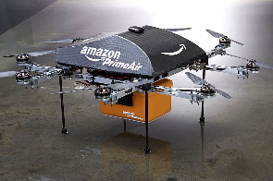
Amazon Air prime
Amazon Air prime delivery:
Amazon Air prime just $1 charge to have a drone deliver in 30 minutes or less.
The majority of purchases are eligible for drone delivery.
Drone deliveries would improve the efficiency of a same-day delivery service.
Related to incresing dimensionality
A new way to deliver purchase : AIR delivery
Amazon air prime vidéo
Notes:
http://www.businessinsider.com/delivery-fee-for-amazon-prime-air-2015-4?IR=T
http://www.amazon.com/b?node=8037720011
Amazon air prime vidéo
https://www.youtube.com/watch?v=98BIu9dpwHU

Slide 13
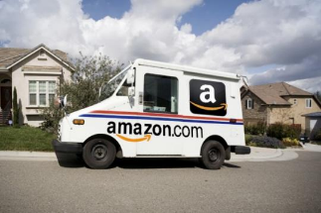
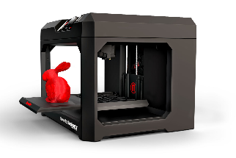
Mobile 3D Printing Delivery Trucks
How it work:
You purchase printable goods
Printing delivery truck start to print your product
During printing, truck is on the way of delivery adress
Fastest way to build and deliver goods in very short delay
Advantages:
Produce directly your goods (don’t need factory in another country)
Ease to use for the customers (apps)
Fast delivery delay
No storage cost
Amazon 3D printer truck video
Notes:
http://3dprint.com/46934/amazon-3d-printing-patent/
https://youtu.be/SkxKF2cxHgY
http://3dprint.com/46934/amazon-3d-printing-patent/

Slide 14
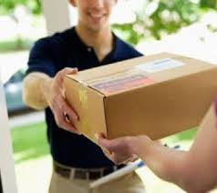
Amazon OMW
Based on crowdsourcing
Reduce delivery delay
Use regular people
Cost Less than standard supply chain
How it work :
The service — internally called "On My Way" — would recruit retailers in urban areas to store packages. Then regular people wanting to make deliveries could use an app to see where to pick up and drop off goods as they were going about their day.
Amazon On MY Way video
Notes:
Amazon on my way:
https://www.youtube.com/watch?v=5ZhwErxXBC4
http://techcrunch.com/2015/06/16/amazon-on-my-way-same-day-for-pay/

Slide 15
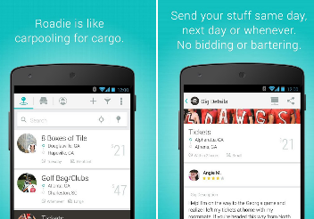
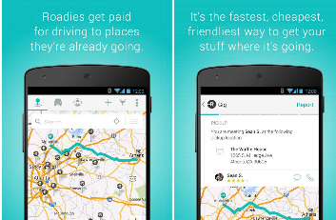
Roadie
Neighbor-to-Neighbor delivery
When you have something you need to send, just create a delivery in the Roadie app.
We’ll match you with a Roadie Driver who’s headed in the right direction.
It’s like carpooling, for cargo.
Advantages:
Costless
Safe
Ease to use (gamification)
Roadie video
Notes:
https://www.youtube.com/watch?v=xQVxnKVw0Jo
https://www.roadie.com/

Slide 16
Big Data
Notes:
Boundary Break down Theory -> distinct IT systems for company functions ->

Slide 17
Boundary Break Down
dynamization step: field
Notes:
Many boundaries -> Few Boundaries -> Integration and Intelligence from all of the data generated by a company or its environment
example for the field stage in the dynamization theory

Slide 18
Amazon Anticipatory Shipping
Increasing Asymmetry: Matched
Decrease human involvement: Autonomous & evolving
Notes:
Increasing Asymmetry: logistics matched to personal needs
Decrease human involvement: total automation

Slide 19
Amazon Echo
Reduction of complexity: Elimination of non-key subsystem
Increasing transparency: Transparent
Add video
Notes:
Reduction of complexity: nothing to touch
Increasing transparency: customer gets more and more transparent

Slide 20
Resources
https://upload.wikimedia.org/wikipedia/commons/thumb/f/f6/HAL9000.svg/2000px-HAL9000.svg.png
https://lh4.googleusercontent.com/WcNmXl6rws5y8uNkSeSVq9R1S7FaOQPrf1mbm-X8UasdYPgWnITwR8k0X4Q832E9627kK-b3ZbOJZDUlIM5zEp848PoxFGVlpGfqxNX48n7BIJx_OHs-gUSTcw
https://en.wikipedia.org/wiki/Value_chain
http://www.forbes.com/sites/timworstall/2014/04/11/both-amazon-and-walmart-are-really-logistics-companies-not-retailers
http://www.driverless-future.com/?cat=4
https://www.youtube.com/watch?v=KkOCeAtKHIc
https://www.createspace.com/pub/l/general_amazon.do?rewrite=true&ref=115576&utm_id=4458
https://medium.com/basic-income/self-driving-trucks-are-going-to-hit-us-like-a-human-driven-truck-b8507d9c5961
https://www.youtube.com/watch?v=HdSRUG4KTPA
http://www.usanfranonline.com/resources/supply-chain-management/walmart-keys-to-successful-supply-chain-management/#
http://www.businessinsider.com/delivery-fee-for-amazon-prime-air-2015-4?IR=T
http://www.amazon.com/b?node=8037720011
http://3dprint.com/46934/amazon-3d-printing-patent/
http://techcrunch.com/2015/06/16/amazon-on-my-way-same-day-for-pay/
https://www.roadie.com/

Slide 21
Thanks for your attention

