Slide 1
Trends in Digital Innovation Pierre Uys 19679041
Logistics Innovations

Slide 2
Introduction
G0-Jek is a hyperlocal transport, logistics and payment start-up company in Indonesia, Jakarta primarily.
Fleet size of over 200 000 drivers and includes motorcycles, cars and trucks.
What do they do???????
Pierre Uys

Slide 3
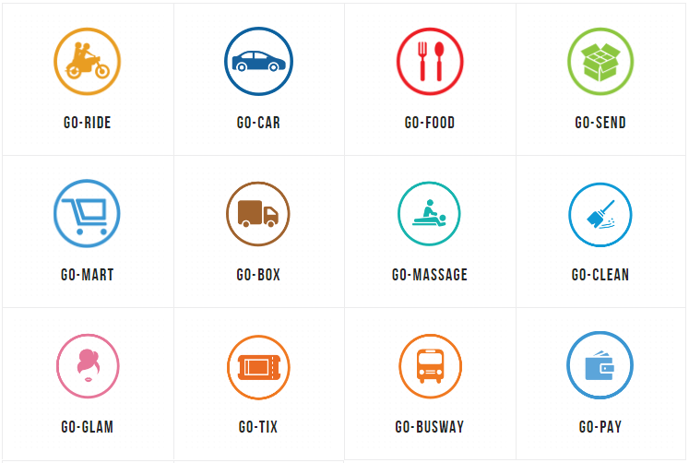
Pierre Uys

Slide 4
WumDrop: local South Africa
Introduction
They believe the last mile delivery business can be done better. A lot better.
With WumDrop’s integrated dispatch solutions and service obsessed drivers, you can put your trust in a third party delivery service that cares about your brand, your customer, and your bottom line.
We'll even send you a pic to prove it.
Pierre Uys

Slide 5
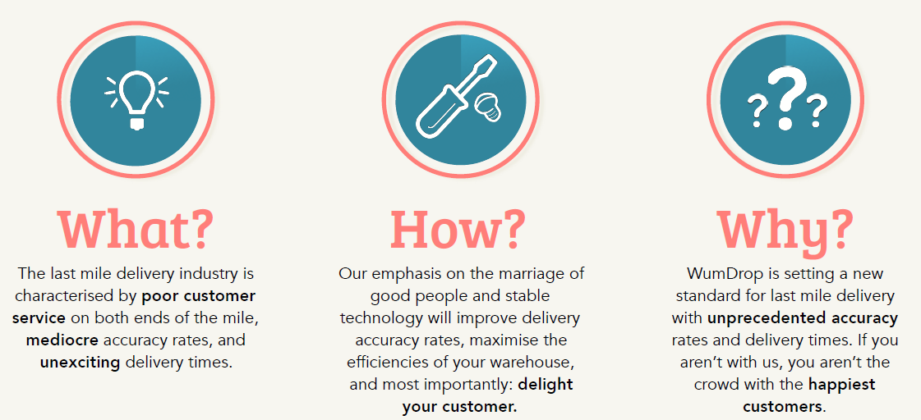
WumDrop
Pierre Uys

Slide 6
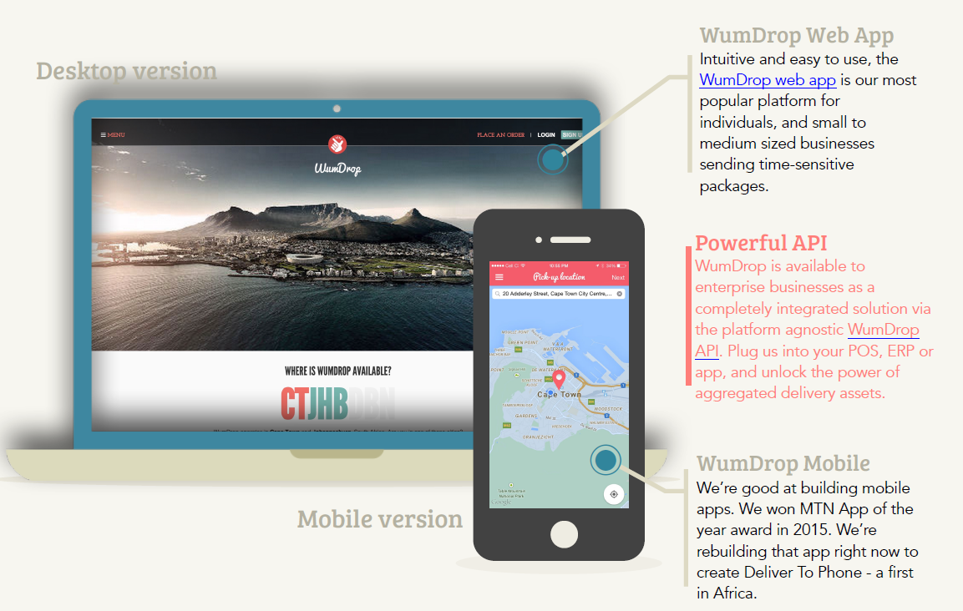
How Do Our Customers Use WumDrop?
Pierre Uys

Slide 7
WumDrop Pricing Strategy
Pierre Uys

Slide 8
WumDrop
Triz Trends
Customer buying hierarchy
Performance, Reliability, Convenience, Price
Dynamization theory
Single connection, flexible over a lot market places
Increasing Dimensionality
Accessibility, flow of the info
Pierre Uys

Slide 9
Hassim Muhammad

Slide 10
Video
Technology Trends in Shipping Intro Video (offline)
Connecting the oceans (offline)
Hassim Muhammad

Slide 11
Remote Container Management (RCM)
From a desk in Maersk Line’s Copenhagen headquarters, a technician has a multi-billion dollar view. On his screen is the precise location and operational details of 270,000 refrigerated “reefer” containers, carrying anything from bananas to pharmaceuticals to sashimi-grade tuna.
Hassim Muhammad

Slide 12
Remote Container Management (RCM)
Monitors temperature & humidity in the container
Handle alarms remotely
Complete faster pre-trip inspections
A container is now a digitally connected device that allows us to track where each container is across all the links in the supply chain.
Hassim Muhammad

Slide 13
Hassim Muhammad

Slide 14
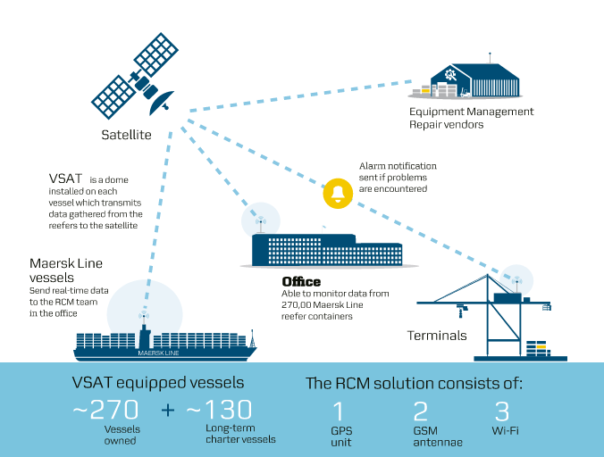
Hassim Muhammad
Notes:
The system enabling this is RCM, which stands for Remote Container Management. It’s simple technology – a modem, GPS, wireless SIM card and satellite link – deployed on a global scale, and it is changing the concept of supply chain visibility, and the costs and opportunities associated with providing it.

Slide 15
Remote Container Management (RCM)
Instead of counting on human eyes and hands to inspect and monitor reefers all over the world, the technology does it instead –
Removes costs
Removes the dangers associated with people walking among container stacks and handling electricity.
If the conditions inside the container change or the reefer malfunctions, an alarm instantly appears on the screens of the RCM teams on shore.
The alarm, which describes the problem and the level of urgency, also goes to the closest local repair vendor.
Hassim Muhammad

Slide 16
TRIZ
Boundary Breakdown
Customer Buying Hierarchy (competitive advantage)
Dynamization (Responsiveness, reduced risk)
Increased dimensionality (accessibility, info flow)
Increased Asymmetry (Improved communications)
Increased transparency
Decrease human involvement (errors, manual work)
Action coordination
Hassim Muhammad

Slide 17
Unmanned Vessels
The Future (offline)
We've Started (offline)
Hassim Muhammad

Slide 18
TRIZ
Boundary Breakdown
Dynamization (Responsiveness, reduced risk)
Decrease human involvement (errors, manual work)
Action coordination
Hassim Muhammad

Slide 19
Digital Innovation 1: Self driving trucks
Company: Uber Otto
Region: US
Disruption rating: 5/10
Problem/Opportunity: Truck drivers normally sleep in their truck when they are tired – this creates lots of idle or standing time for trucks. Driver fatigue also causes many fatalities.
How was the innovation applied: Otto created an autonomous vehicle that can safely deliver goods between two points. The driver is still required to navigate the truck onto highways and has the function to allow the driver to activate “auto pilot”. The underlying technology is based on satellite positioning devices which can be retrofitted to existing trucks i.e. a plug and play system.
Source: Tech Crunch.com available at https://techcrunch.com/2016/09/27/uber-otto-freight-services-2017/

Slide 20
Digital Innovation 1: Self driving trucks
Rion Henning

Slide 21
TRIZ Trends for Self Driving Trucks
Dynamization: Flexible and retrofitable.
Customer Buying Hierarchy: Due to a shift in focus from Performance to Reliability
Decreased human involvement: Hybrid approach without losing the human element
Increased use of senses: a combination of human and digital senses ie GPS etc

Slide 22
Digital Innovation 2: logistics marketplace
Company: DHL Global Logistics
Region: Germany
Disruption rating: 9/10
Problem/Opportunity: Cumbersome procurement of road transport logistics along with underutilisation of trucks and or empty truck loads
How was the innovation applied: DHL created a “virtual B2B marketplace (Uber of Logistics) that brings together shippers and transport providers” Further DHL states “The platform seeks to address common problems while searching for an appropriate and reliable transport service provider, such as lengthy price inquiries and comparisons, or delays in the Proof of Delivery process, by offering instant access to a large number of DHL pre-qualified and peer-rated providers for fast quotes and easy transport booking.”
Source: Lloyds loading list available at http://www.lloydsloadinglist.com/freight-directory/news/DHL-launches-%E2%80%98disruptive%E2%80%99-road-freight-platform/67791.htm#.WDSFQr8XbEY

Slide 23
TRIZ Trends for Logistics Marketplace
Boundry Breakdown: in traditional procurement
Dynamization: Flexible and easily implemented
Decreased human involvement: moving from traditional to digitised procurement

Slide 24
Jakkie Coetzee

Slide 25
Jakkie Coetzee

Slide 26
Jakkie Coetzee

Slide 27
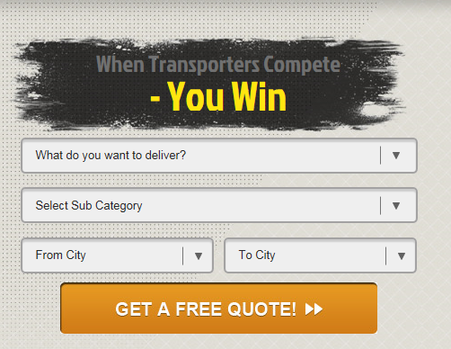
How it works
www.bidship.co.za
https://www.youtube.com/watch?v=mK9fBO36F3E (offline)
Jakkie Coetzee

Slide 28
The Company
Est. 2008
Headquarters: Quebec, Canada
TRIZ Trends:
Decreasing human involvement
Adding dimensions
Mission: to free human hands from tedious task, so companies and workers can focus where they truly create value.
Jakkie Coetzee

Slide 29
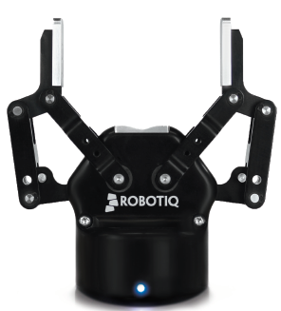
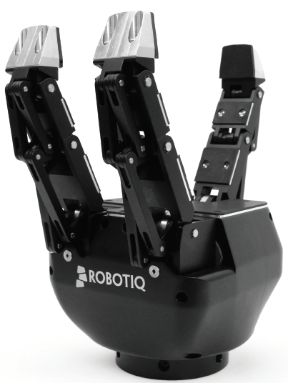
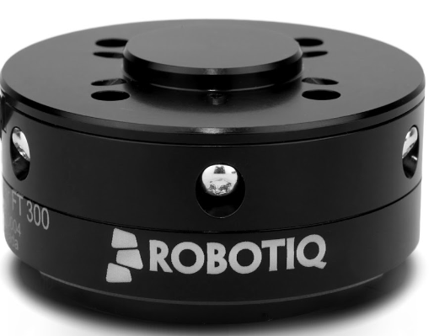
Products
2 Finger adaptive robot grippers 3 Finger adaptive robot grippers
/
Force torque sensors /
Jakkie Coetzee

Slide 30
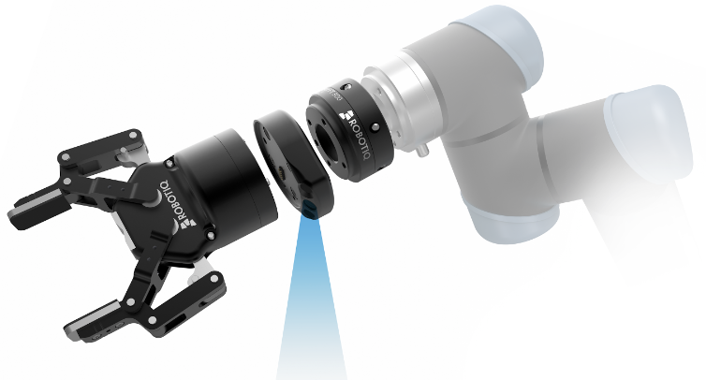
Recent innovation
Jakkie Coetzee

Slide 31
Charl Marias

Slide 32
Logistics
how to move things
Charl Marais (13070789)

Slide 33
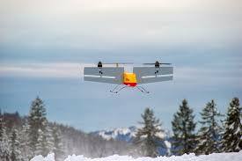
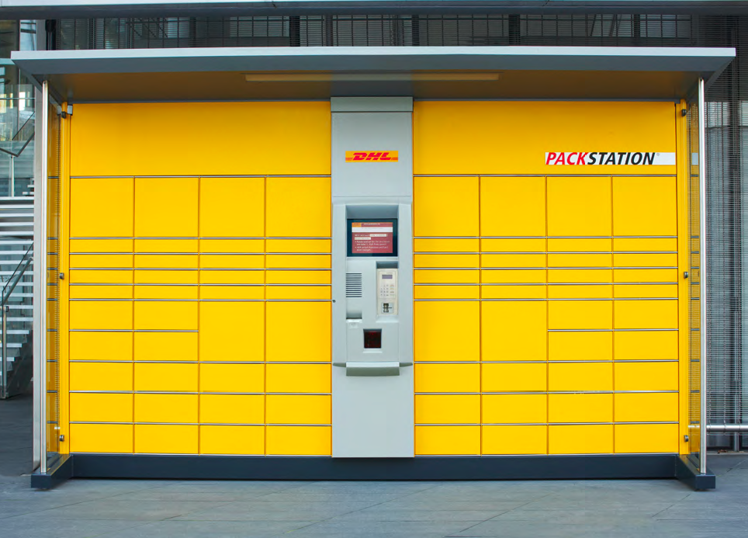
Unmanned Aerial Vehicle (UAV)
What? UAV - Parcelcopter 3.0
Why? Delivery of emergency (medical) supplies to geographically challenging remote / rural locations
Advantages: Cost, Quality and Coverage in “first and last mile delivery”
TRIZ: Trend 8 – Decreased human involvement
How? Transport to and from Packstation - Video
Charl Marais (13070789)

Slide 34
Unmanned Aerial Vehicles (UAV)
Charl Marias
Notes:
These cars have since driven over 1.7 million miles and have only been involved in 11 accidents, all caused by humans and not the computers

Slide 35
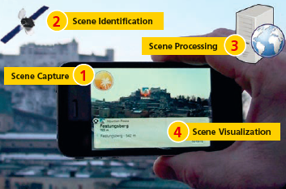
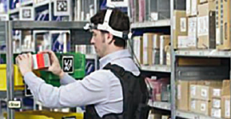
Augmented Reality
What? Pick-by-Vision – Optimized Picking (Warehouse)
Why? Wearable AR devices offers digital navigation to find shortest route and right item more efficiently
Advantages: Reduce picking errors and search time
TRIZ: Trend 12 – Increasing use of senses
How? DHL-RICOH - Video
Charl Marais (13070789)

Slide 36
Augmented Reality
Charl Marais (13070789)

Slide 37
Resources
https://www.youtube.com/watch?v=luc7KkCFKWY
http://www.dpdhl.com/en/media_relations/specials/parcelcopter.html
www.dhl.com/content/.../csi_augmented_reality_report_290414.pdf

Slide 38
Thanks for your attention

