Slide 1
Digital Innovations and Trends in Logistics
ACHYKGYOZ Ipekieliz
GILMANOVA Alina
HAPPI Nathalie
MUSTAFAYEVA Nigar
RAMIREZ Aleydis

Slide 2
FedEx
Multinational courier delivery services company
SYSTEM: COSMOS
(Customers, Operations, Service, Management, Online System)
HOW: Each time that a package changes location, information is recorded by sensors, then COSMOS keeps it.
PROBLEM: Late deliveries and lost packages
Trend 2: Customer buying hierarchy

Slide 3
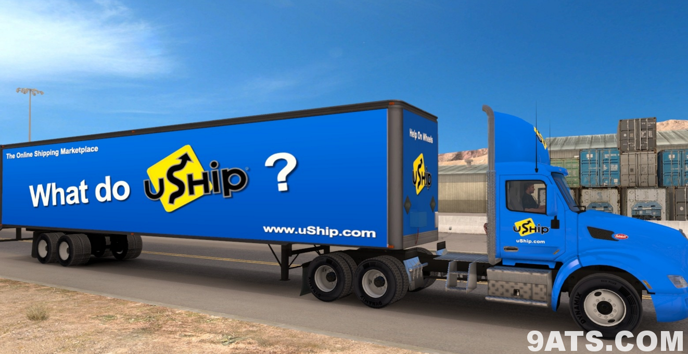
uSHIP
Leading online transportation market
SYSTEM: LTL (less than truckload)
HOW: Shipments arrangement made online, customer posts what needs to be ship, service providers (transporters) compete to win the customer, in order to fill the extra space in their trucks.
PROBLEM: Susceptible to damage during mobilization, Packaging articles, delivery time
Trend 3: Dynamization

Slide 4
uSHIP

Slide 5
iContainers
A freight forwarding service
Startup
Moving
Warehouse
Out-of-date
Digitize the ocean freight industry
Transparency

Slide 6
iContainers
SYSTEM: online option for door-to-door pickup
HOW : its platform allows users to browse options for freight services, shipping rates, and scheduling times
PROBLEM: Not enough visibility
Trend 6: Increasing transparency

Slide 7
Bellhops
Moving Service
Students
Startup
Small- and medium residential moves
Fit the needs of the DIY movers.
Trend 7: Trimming/reducing complexity

Slide 8
SYSTEM: DIY (Do it yourself system)
HOW : Customers can submit requests for movers through the app, online or over the phone
PROBLEM: No trucks

Slide 9
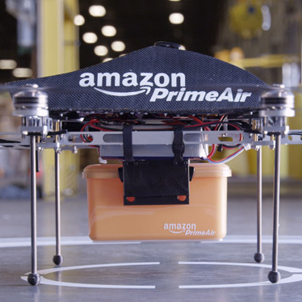
Amazon Air Prime
To enhance services, increase overall safety & efficiency...
Decreased human interaction
Trimming/ Reducing complexity
Notes:
AIr Prime is an innovation in outbound logistics, it is an example of trimming complexion, decreased human involvement & consumer expectation theories. It eliminates delivery trucks & postman, decreases human interaction & cuts down delivery time from 3-5 day to just 30 minutes. they quote that “AAP has a great potential to enhance their servies, it will increase the overall safety and efficiency of transportation systems. other than transport industries, the film industry also started changing their ways of filming.

Slide 10
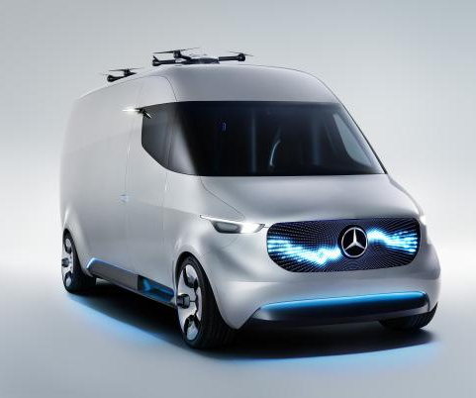
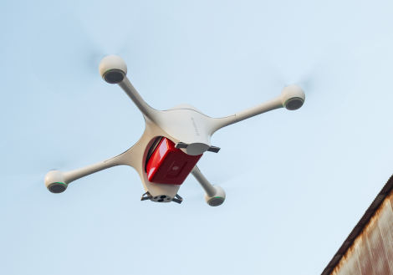
Mercedes-Benz & Matternet
“Autonomous drone systems hold the promise of vastly more efficient, faster and cheaper delivery”
Segmentation
Decreased human involvement
Notes:
Autonomous drone systems hold the promise of vastly more efficient, faster and cheaper delivery
Today, Mercedes-Benz Vans unveiled its Vision Van, showcasing a new end-to-end platform for last-mile delivery, featuring a fully automated cargo management system and Matternet delivery drones.
In Mercedes-Benz Vans, we found a partner that is not only synonymous with quality, safety, reliability and efficiency, but is also willing to imagine and create the future of transportation with us

Slide 11
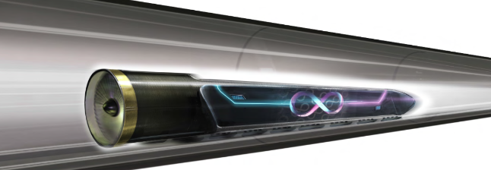

Slide 12
VOLVO SELF-DRIVING TRUCK
PROBLEM: tough conditions in mines.
AIM: improve the transport flow, decrease fuel consumption and provide safety.
SOLUTION: autonomous truck with sensors, which monitors surroundings, and avoids obstacles.
An onboard transport system gathers data to optimise the route and fuel consumption.
Trend 8: decrease human involvement

Slide 13
Software-as-a-Service
Solution: Salesforce CRM + Aspect Software; Result: Higher Visibility, JIT concept;
Trends: Boundary Breakdown; Consumer Buying Hierarchy; Reducing Complexity; Action Coordination; Listening/Communication
Solution: LeanTMS; Result: Visibility, standardization and lower costs;
Trends: Boundary Breakdown; Dynamization; Rhythm Coordination Design Point

Slide 14
Software-as-a-Service

Slide 15
Big Data
Solution: GT Nexus’s Сloud; Result: Higher Visibility, Inventory control, Improved Customer Relationships;
Trends: Dynamization; Increasing Transparency; Rhythm Coordination; Reducing Complexity; Action Coordination; Listening/Communication

Slide 16
THANK YOU!

Slide 17
REFERENCES
uShip. (2016). uShip - The Online Shipping Marketplace - Ship Freight, Furniture, Cars or Moves. [online] Available at: http://www.uship.com/cl/transporte-de-carga-parcial/ [Accessed 14 Sep. 2016].
Anon, (2016). Technological Innovation at FedEx. [online] Available at: http://www.fedex.com/ma/about/overview/innovation.html
iContainers (2016) Available at http://www.icontainers.com/
https://techcrunch.com/2016/06/07/icontainers-expedia-for-transporting-freight-internationally-raises-6-7-million/
http://www.dcvelocity.com/products/Transportation/20160126-icontainers-new-door-to-door-service-to-us-and-tawain-brings-transparency-and-convenience-to-industry/
https://www.serenacapital.com/2016/06/08/icontainers/
https://www.pehub.com/2016/06/3337510/
http://www.volvogroup.com/group/global/en-gb/_layouts/CWP.Internet.VolvoCom/NewsItem.aspx?News.ItemId=152149&News.Language=en-gb

Slide 18
REFERENCES
https://www.amazon.com/b?node=8037720011
http://www.digitalspy.com/tech/feature/a775701/9-things-you-need-to-know-about-the-amazon-prime-air-drone-delivery-service/
http://www.cbsnews.com/news/amazon-unveils-futuristic-plan-delivery-by-drone/
https://www.theguardian.com/technology/2016/jul/25/amazon-to-test-drone-delivery-uk-government
https://jonathanwichmann.com/my-lists/list-the-most-promising-start-ups-in-logistics/
https://techcrunch.com/2016/09/07/mercedes-benz-and-matternet-unveil-vans-that-launch-delivery-drones/
https://mttr.net/images/Matternet_Partners_with_Mercedes-Benz_to_Create_the_Future_of_Delivery_7SEPT2016.pdf
https://techcrunch.com/2015/04/23/matternet-to-test-the-first-real-drone-delivery-system-in-switzerland/
https://techcrunch.com/2016/09/07/mercedes-benz-and-matternet-unveil-vans-that-launch-delivery-drones/
http://wncn.com/2016/06/28/uber-of-moving-growing-in-the-triangle-area/
http://www.columbiamissourian.com/news/local/with-student-workforce-bellhops-offers-alternative-for-smaller-moving-jobs/article_bb755bf4-28f5-11e6-9ddf-9f5e23306b66.html
http://www.dailycamera.com/boulder-business/ci_29869818/bellhops-uber-moving-seeks-few-good-buffs-boulder
http://local12.com/news/local/need-help-moving-service-pairs-college-students-with-customers
http://www.post-gazette.com/business/tech-news/2015/08/06/Bellhops-seeks-to-perfect-the-DIY-moving-experience/stories/201507310120

