Slide 1
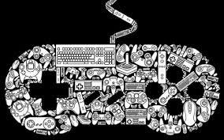
Games & Toys
Grégoire DUBOIS
Julien METIVIER
Jessica ROUILLON

Slide 2
Introduction
Implementations of new technologies bring new businesses
Interaction with the machines are much more developed
Community aspect took advantage on self-based games

Slide 3
FRAISE TAGADA

Slide 4
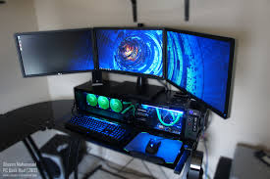
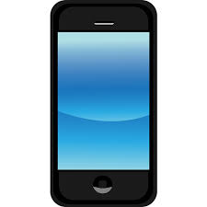
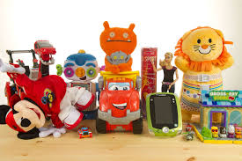
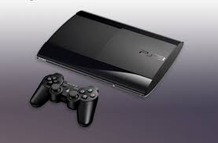
Games & Toys
Video games
PC
Console
Toys
Smart devices

Slide 5
Serious Game
A Video Game for your job
Video Games : Decision making, strategy, problem solving, fast reactions, creativity.
Use competition for efficiency
Trends: degrees of freedom, listening
Notes:
Serious Games:
-Video game for companies, that will permit employee to understand a business and acquire skills that video games can offer (games about
-Video games bring lot of different skills that you will use for work like…
-We can use the the spirit of competition in order to motivate people, for example, in order to help you guys in your attention towards our presentation, we decided to incorporate a game
-Help employees to learn freely about the company and make experience on the processes//Helps the interactions between employees, you have the sims, and you may have your task for the day, and recall for birthdays…

Slide 6
Serious Game

Slide 7
Quizz
Serious Game Permits Companies to:
Make the employees feel at home
Complete the formation of the employees
Help its employees in the understanding of the business

Slide 8
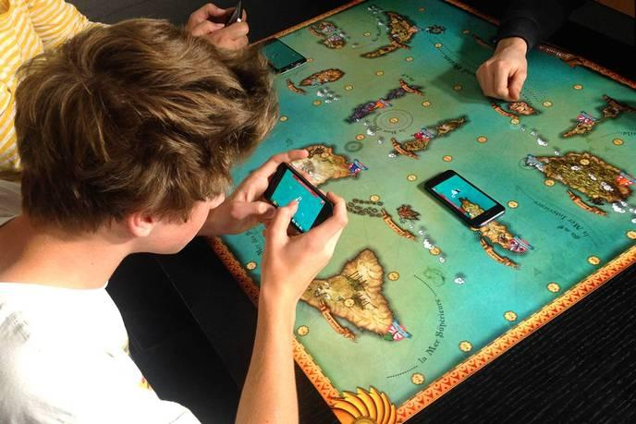
Your smartphone becomes your pawn
World of Yo-Ho
A board game in the universe of piracy
where your smartphone becomes the ship
Increasing dimensionality – Virtual embracing Reality
Helps companies to get a better visual, bigger picture of their projects
Example : EDF

Slide 10
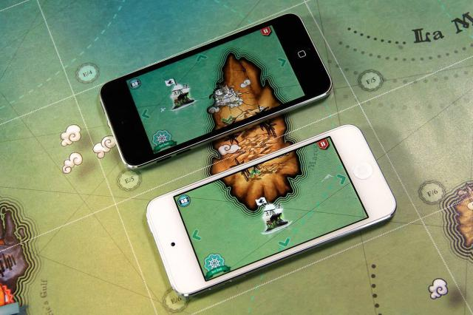
Quizz
What is the name of this game ?
World of Yolo
Word of Yow
World of Yo-Ho
Word of Yo-Hoo

Slide 11
Ingress technology
Made by Google
Augmented reality game in your own city
First aim was to develop Google Maps

Slide 12
New trend : Action coordination
Coordinating people who do not know themselves towards a common goal

Slide 13
Why useful trend ?
Go outside, meet people
You will have to coordinate with them
Historical side because famous monuments

Slide 14
Combining game and science to fight AIDS

Slide 15
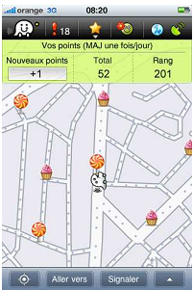
Avoid traffic congestion

Slide 16
Voice Recognition

Slide 17
Voice Recognition
Use voice to command your character in a video game
Developing technology
Many other applications
Trends: Simplicity, Expectation, Increasing the senses
Notes:
Developing technology:
-using the voice, you actually interact with the game, with the environment, this gives the possibility in the customers experience. Who played Halo in the room? Who would have which to interact with cortana during the game.
-it’s going to permit people that cannot use their hand, and in the future will assist pro gamers. But it is still in devellopement and as you will see in the video, it is not that fast.
-many applications: write stories on your computer, just by speaking, entering a journal, enter notes, this began with siri.
-Voice recognition helps people to reduce the difficulty between the language of the computer by making the computer learn your language//Help the customer to have a better experience with the game// Using a new sense

Slide 18
Quiz
Voice recognition will in the future:
Enable pro gamers into acquiring speed
Enable emotional connection between people and the game
Enable gamers to fall in love with the game

Slide 19
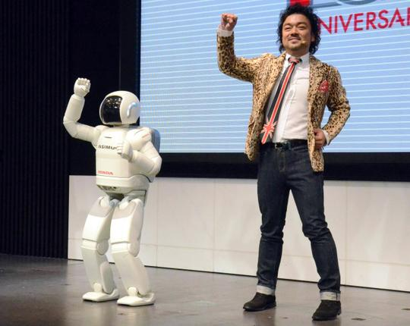
Robotic toys
Intelligent toys that are able to converse/interact with humans
For kids and adults
Lucrative & educational
Robots competitions
New findings
Breakthroughs

Slide 20
Robot

Slide 21
Quiz
Which organization benefits from technological advances thanks to robotic games ?
FBI
NSA
WWF
NASA

Slide 22
Quiz
What is the best-selling shooter game in the world ?
HALO | CALL OF DUTY
MARIO | GTA

Slide 23
The franchise still dominates the gaming industry.
Sales of Call of Duty have fallen for the past three years although
Opening QUIZ question !! : Why ?

Slide 24
Once something works, large developers are slower to change
INDIE games = Independent games
Due to new online distribution methods and development tools

Slide 25
INDIE game

Slide 26
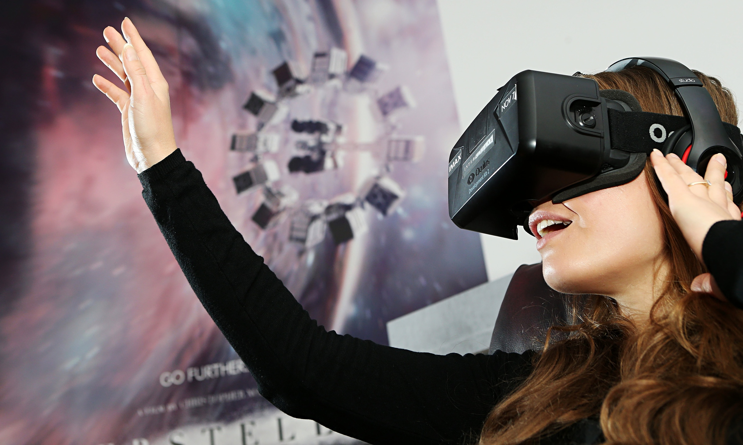
The Oculus Rift
A virtual head-mounted display
Living the game
Customer expectation : the “wow” creation that consumers needed
For work:
A big visual help for architecture and design
For the Army:
Real life situations – Prepare themselves to react accordingly and have greater awareness
For industries:
Good tool for advertising products

Slide 27
Last video ☺

Slide 28
Last Quiz ☺
Which trend does it also belong to ?
Segmentation
Increasing dimensionality
Design point
Increasing asymmetry

Slide 29
Conclusion
Innovation at the center of the industry
Need of the “new”
Not only games
Notes:
-innovation new ways of interacting with the game, new emotions
-people get bored easily, games have to get updates all the time
-those games are not only for having fun, but discovering the new world, our real world, new people, or even your future job and experiment on it

Slide 30
Thank you for your attention

