Slide 1
Information System in Hypermarkets
Mathias Antunes, Thanh-An Nicolas Lê, Marie El Guedj

Slide 2
Problems
Customer time is limited
Need to get market share, increase sales
Evolve with the market, with customers way of life, constraints and expectations
Stay attractive
Products traceability
Stocks optimization
Theft problem

Slide 3
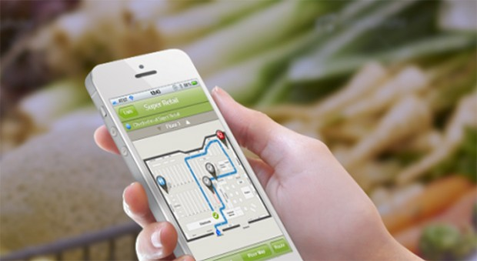
Case 1 - Aisle411
→ How it works ? (video)
Digital in-store maps
Product search and location
In-store navigation
Geo-targeted offers.
→ Opportunity ?
Consumer acceptance : ease of use
Increase customer satisfaction
Increase basket size
Get information on customer behavior
Adapted to the market evolution

Slide 5
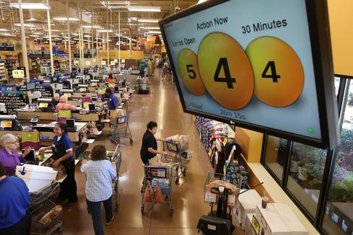
Case 2 – QueVision at Kroger
→ How it works ?
Infrared sensors over store doors
Cash registers
Screen that shows how checkout lines
are moving
→ Opportunity ?
Get real time data : evaluate the number of units of shoppers in line and their average wait of time
Ease of use for managers
Increase customer satisfaction : warn managers in order to regulate the number of open registers, limit waiting time

Slide 6
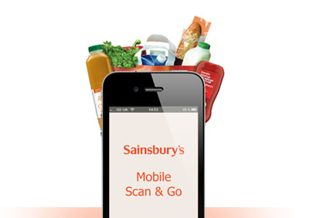
Case 3 – Sainsbury’s checkout application
→ How it works ?
Selecting item on the application
Pick up items in the stores
Paying on mobile phone
→ Opportunity ?
Earning time: customer satisfaction and expectations
Increase capacity of checking out in a store

Slide 7
Cases 1 & 2
→ Trends ?
Customer buying hierarchy: convenience
Listening / Communication
Increasing transparency
Customer expectation: new experience of shopping
Decrease human involvement

Slide 8
Case 4 – Tesco’s Groceries Google Glass App
→ How it works ?
The app on your Google Glass allows you to scan products or access the products you want in a database display by the glasses.
→ Opportunity ?
Do your groceries easily when in stores or do it from home whenever you need it.
→ Trends ?
-Customer Expectation
https://vimeo.com/100180149

Slide 9
Case 5 – Yihaodian
→ How it works ?
An app on your phone enables you to locate the virtual stores around you and with your phone you order the products like a physical grocery store.
→ Opportunity ?
Avoinding to queue, the crowd…
→ Trends ?
Human involvement
Boundary Breakdown
Notes:
Augmented reality

Slide 11
Case 6 – Future Food District Concept
→ How it works ?
The Future Food District is using robots instead of humans workers for the manual tasks. Touching screens are here to guide you for your purchases.
→ Opportunity ?
Improve the experience of the customer when they do their groceries
→ Trends ?
- Human Involvement

Slide 12
VIDEO

Slide 13
Case 7 – RFID
→ How it works ?
Radio-frequency identification (RFID) is a technology to record the presence of an object using radio signals
→ Opportunity ?
To optimize inventory control and reduce costs
To prevent expensive products to be stolen
→ Trends ?
Trend 4: Increasing dimensionality
Notes:
With the small RFID chip , Casino increased its inventory by leaps and bounds . The brand uses the radio frequency identification technology for six months in the labeling of his jewelry.
with the aim to optimize inventory control and reduce costs, Carrefour launched four pilot projects, to implant RFID, after two years: gain time for its review during the receipt of goods ( - 57%), Inventory ( - 78%) and return management suppliers ( - 85%).
Then a short video about RFID in TESCO (US)

Slide 14
VIDEO TESCO

Slide 15
Case 8 – Future RFID
→ How it Works ?
terminal directly scan each item in the basket thanks to the reading of RFID of these product
→ Opportunity ?
The objective is to minimize time spend in desk
It also permit to avoid human error
→ Trends ?
Trend8: decrease human evolvement

Slide 16
VIDEO FUTURE

