Slide 1
Grande distribution
Hypermarkets
Romain Le Cornec
Adrian Trentesaux
Louise Motte

Slide 2
Summary
Actual problems and opportunities in supermarkets
Making the shopping for the consumers faster
Scanner for fruits and vegetables
QueVision
Scan and go
RFID
Guiding the customers while shopping
« C-Où »
Smart Cart
Helping the employees of the shop
Panasonic powershelf
Facial recognition
The supermarket of the future

Slide 3
Actual problems and opportunities in a supermarket

Slide 4
Actual problems
Consumers have limited time to shop
All Supermarkets sell similar products → Need to differentiate from competition
Customer demand → Satisfy diversified customer needs
Crowding of supermarkets
Supply chain efficiency

Slide 5
Opportunities
Offer customers efficient and time saving supermarkets
Target specific consumer needs to offer identified and demanded products
Make grocery shopping fun and entertaining
Create highly efficient payment solutions and product scanning to avoid crowding
Manage efficiently stocks and shelf filling

Slide 6
Making the shopping time for the consumers faster

Slide 7
Scanner for fruits and vegetables
https://www.youtube.com/watch?v=4dIr_cY03Js
Regarder jusque 20 sec

Slide 8
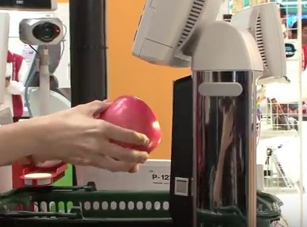
Object Recognition Scanner
Camera with a pattern and color software
Tested in Tokyo by Toshiba’ engineers
Trends related:
The Customer buying hierarchy theory
Trimming/reducing complexity
Advantages:
Reduces time, complexity and cost
Improve reliability
Disadvantages:
Pre-install a software with a database of products
Time: one year of installation

Slide 9
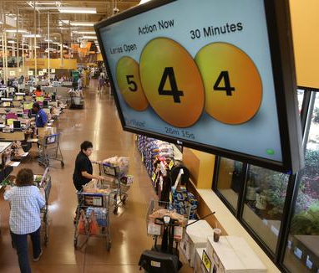
QueVision
A Scanner for Lines at Checkout Registers – Heat Sensor
Determines how long people wait
Helps facilitate choice of where to line up
Allows customers to leave more quickly
Created and used at Kroger in the US
Created to resolve issues of inefficiency
Indicated general waiting time of lines
Recommends which lines customers should use
Design Point Trend
Optimizes continuously the lines in front of registers
Increasing Transparency
Calculates waiting time and efficiency of cashiers

Slide 10
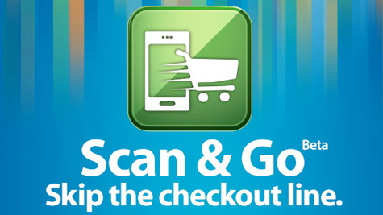
Scan and go
Scan & Go
Recognized the store you are in
Scan barcodes with smartphone using the app
Allows you to pay your basket in any register
Walmart, Samsclub & others
Has been improved upon many times
Pay directly from phone
QR Code -> Barcode -> RFID
Offered in more stores in the US
RFID Technology
Increasing Dimensionality
Product Description, Offers, Payment

Slide 11
RFID
Install RFID chips on products
Track what a consumer is buying and has in his cart
Self automated check out by identifying the prices and numbers of every products
Allow rapid and automatic store exit and reduce customer waiting
Trends related
Decrease human involvement
Customer buying hierarchy

Slide 12
Guiding the consumers while shopping

Slide 13
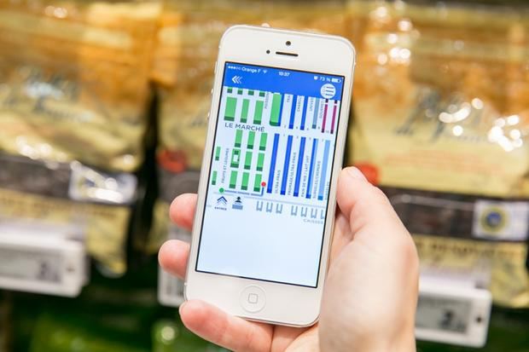
« C-Où »
Installed in one Carrefour supermarket (Villeneuve-la-Garenne)
Design an efficient path within the store with your shopping list through GPS system and RFID chips in shelves
Optimise shopping experience
Decrease time spent in the supermarket
Trends related
Customer expectation
Customer buying hierarchy

Slide 14
Smart Cart
Syncs shopping list from a smartphone to its tablet PC-equipped Smart Cart
Provides product info, tips, discounts in REAL TIME thanks to indoor location (UWB and Zigbee) and Wi-fi
Implementing by SK Telecom in Shanghai Lotus Supermarket
Trends related:
Decrease human involvement
Mono Bi Poly system

Slide 15
Helping the employees of the shop

Slide 16
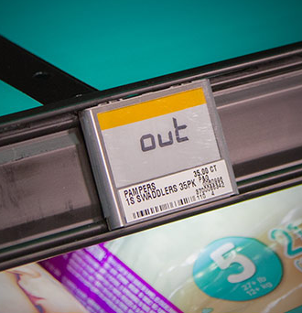
Panasonic Powershelf
Connected shelves with scales
Weight the shelf to check number of units remaining
Send a text to employees when no or few units remaining in order to keep products available for consumers
Increase supply chain efficiency and customer happiness
Trends related
Action coordination
Customer expectation

Slide 17
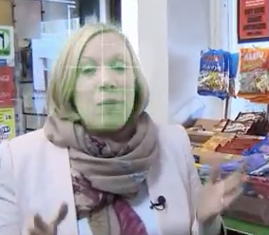
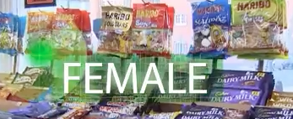
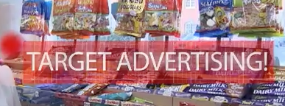
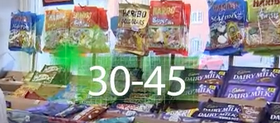
Facial Recognition

Slide 18
Recognizes only your sex and your category of age
Implementing in the UK by Tesco
Trends related:
Increase asymmetry
Segmentation theory
Problems:
Don’t ask the customers for its permission
What next? Tracking and identifying while you pay?

Slide 19
The Supermarket of the future
https://www.youtube.com/watch?v=8eumk2PA8W0
Toute la vidéo

Slide 20
What do you think?

Slide 21
Thank you for your attention !!

