Slide 1
Digital innovations
Retail market
Sias Fouche

Slide 2
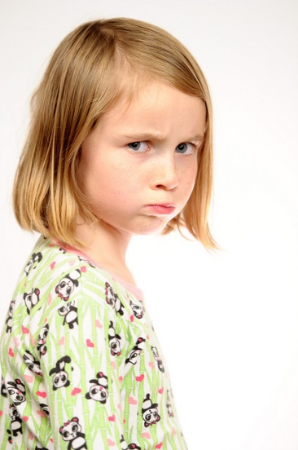
Shopping experience
Most dreaded question in our house.
“Wie gaan PnP toe?”
Why?
Trouble finding products
Products out of stock
No staff available to assist
Target stores in US (San Francisco)
Sias Fouche

Slide 3
Meet Tally
Sias Fouche

Slide 4
Tally assist with:
Providing real time info on self-stacks and product location
Frees up employees to help customers
Identify low stock and out of stock items
Improving overall shopping convenience (Customer buying hierarchy); Decreasing human involvement; Customer expectation
Sias Fouche

Slide 5
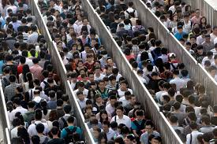
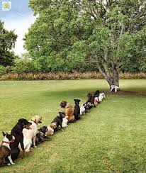
So I finally have my trolley packed……
The next challenge
Sias Fouche

Slide 6
Introducing Facepay
Used by 100% Genuine Food chain stores in Shanghai
Payment via hand and facial recognition
Customer stands in front of cash register, and allow scanning of his/her face and hands.
Customer is identified and linked to profile.
Profile is used to pay for groceries.
Advantages
Shortened queues
Avoid the “I forgot my wallet in the car” embarrassment.
Customer convenience; Reducing complexity; Element of boundary breakdown; Dynamization
Sias Fouche

Slide 7
Hypermarkets
Problems:
Online sector eating into brick and Mortar retail.
Changing consumer needs (Physical and Emotional)
People have reduced time for Grocery Shopping
Hedonic aspects related to Mall environments
Consumers utilize Malls and centres for eateries and Going out
Consumers are searching for convenience, Variety , Information and Time
Hassen Kajee

Slide 8
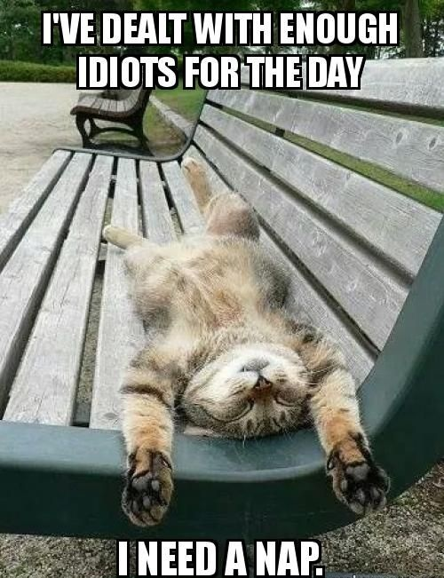
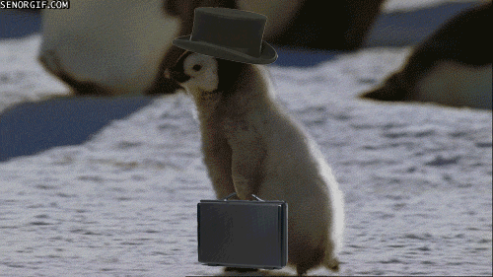
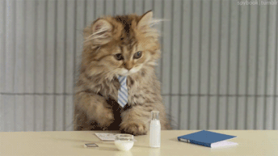
Our Lives ? , and after this, Grocery Shopping…..?, Really!
Hassen Kajee

Slide 9
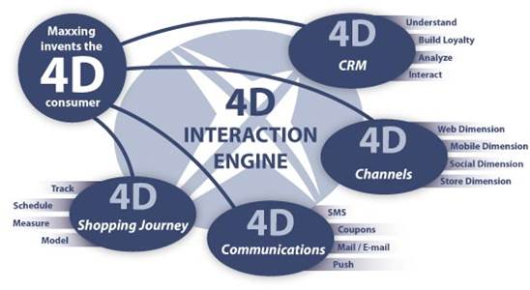
Opportunities
Creation of Hyper Omni Channel 4D environments
Create a store anywhere.
Utilising Apps, tech, logistics , peer to peer , Cameras
Shop from the restaurant (Future)
Shop from anywhere virtually using 3 dimension views with cameras being able to monitor inventory. Utilise the pokemon technology in Shopping.
Can be done using RFID tags per item?
Creation of Real Convenience.
Hassen Kajee

Slide 10
TRIZ
Eliminate Contradictions, Technology evolution
Customer needs to Shop for groceries but does not want to.
Customer needs to stop at garage for Milk and Bread, but does not want to.
Things needed at the same time(Groceries + Relaxation on couch or socializing etc), Inventive solution?….
Tools -------> Cellphone , App , Website , Cameras , Delivery system , Robots
Solution : Virtual assisted Shopping
Hassen Kajee

Slide 11
Innovations
Virtual Shopping making your store always available with a virtual live stream even at home merged with a quick payment and delivery network, https://www.youtube.com/watch?v=lSbtpXMA3KE (offline)
Experiential Shopping, where customers experience ease of shopping utilizing RFID equipment. https://www.youtube.com/watch?v=ewyTGmAIGgo (offline)
https://www.youtube.com/watch?v=ewyTGmAIGgo
Shopping in 2020 from Coca Cola. https://www.youtube.com/watch?v=H_ZJQqv6uAQ (offline)
Shopping in 2016 utilizing Shopbook.co.za.
https://www.youtube.com/watch?v=KqoWXA-RK_g&t=8s (offline)
Hassen Kajee

