Slide 1
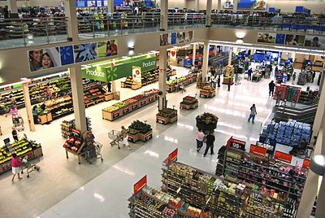
HYPERMARKETS INDUSTRY
GROUP MEMBERS: Marika Paola, Sweta Sanghamitra, Youwen Zhang

Slide 2
INNOVATION: SAP BUSINESS OBJECT
Https://www.sap.com/industries/retail.html
TRIZ TREND 1: BOUNDARY BREAKDOWN

Slide 3
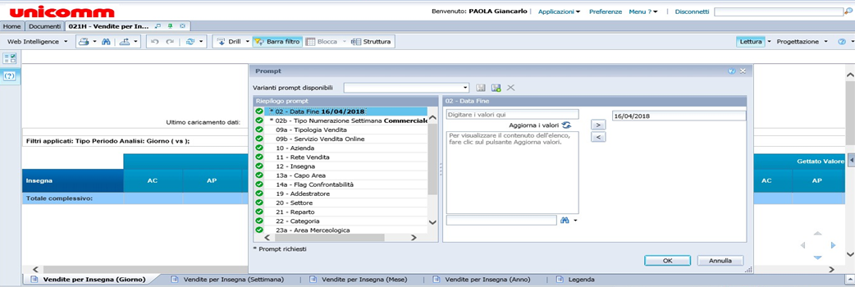
Ex: UNICOMM- Member of SELEX
Uses an ERF system called the SAP Business objects, connecting information from all the business unit.

Slide 4
INNOVATION: ONLINE E-COMMERCE SHOPPING
www.cosicomodo.it
TRIZ TREND 2 : CUSTOMER BUYING HIERARCHY
Hierarchy in the expectations of customers
Performance → | Reliability → | Convenience → | Price
Ability of all the products. | 24hrs service and you choose your pick up time. | You can find a time break for 20 mins , choose your items and put in the cart for billing online, and then later in the evening you come and receive your items from the shop. | You can filter the prices from low to high all at once instead of moving and going to all the shelfs.

Slide 5
INNOVATION : Cameras who detect people behaviour in supermarket
https://www.youtube.com/watch?v=NG4lFmSO7VQ&feature=youtu.be
https://select-statistics.co.uk/blog/how-do-supermarkets-use-your-data/
TRIZ TREND 3 : DYNAMIZATION
IMMOBILE | SINGLE | COMPLETELY FLEXIBLE | FIELD
No Customer Connection | Sales Person | Online( Fb, Twitter) | Spying

Slide 6
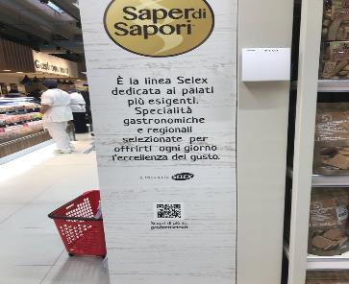
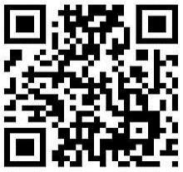
INNOVATION : QR CODES
TRIZ TREND 4 : INCREASING DIMENSION
The first picture shows a pillar which has barcodes by SELEX, Now if you scan the QR Code, you get all the information about the private label commodities of Selex brand.
Another example is the presence of QR codes on the flyers( pamphlet) that customers receive at home or that they can find in the supermarkets: there are QR codes for some specific products, for example the code on the meat page will give customers more information about meat, all the kind of cuts of meat

Slide 7
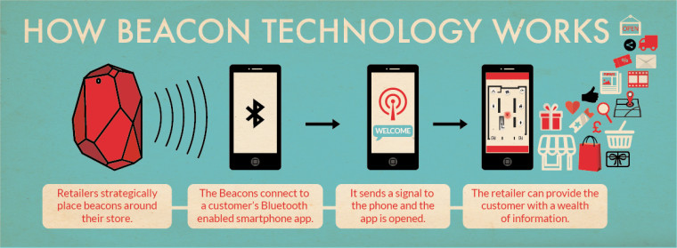
INNOVATION: BEACON TECHNOLOGY
TRIZ TREND 5: : INCREASING ASYMMETRY
BEACON : Beacons would be used to communicate information to consumers once they are in your shop.
Unicomm also holds a commercial centre called “Emisfero”, which uses Beacons Technology to draw the attention of the consumers, once they enter to the centre, they immediately get the notification about the specific store present in that centre. By this way you get to know the special offers present in that specific store at that period of time.

Slide 8
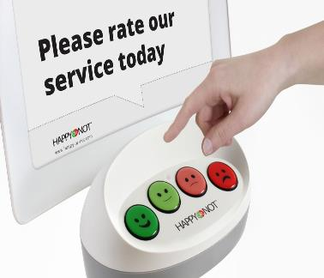
INNOVATION : “Happy Or Not”
TRIZ TREND 6: INCREASING TRANSPARENCY
https://player.vimeo.com/video/129204778
“HappyOrNot” with the help of this, Carrefour get feedback from consumers which helps to create the statistics of the customer satisfaction.

Slide 9
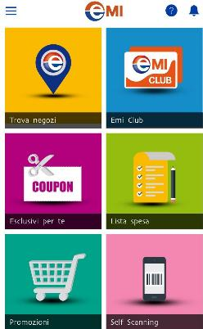
INNOVATION: CRM SYSTEM
TRIZ TREND 7 : TRIMMING / REDUCING COMPLEXITY
Thanks to the app called “Emi”, these Apps can know the frequency that how often the Consumer goes to the supermarket .
Thanks to the fact that customers insert fidelity card in the app they can know their behaviour of purchase items and how often they buy.

Slide 10
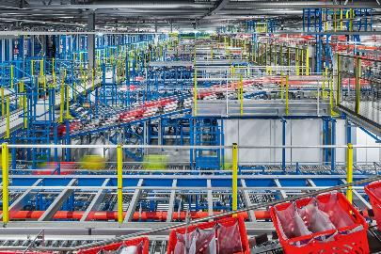
INNOVATION : ROBOTIC GROCERRY WAREHOUSE
TRIZ TREND 8 : DECREASE HUMAN INVOLVEMENT
https://www.youtube.com/watch?v=XJqsdprXF5c
Ocado, it is a grocery retail. They use robots, automated conveyor belts, shuttles, and cranes to pick up and carry food and other items at high-speed to trucks outside. The items and the deliverables is then delivered to customers.
Ocado has the most advanced automated warehouses in the world.

Slide 11
INNOVATION : VISUAL DISPLAY
TRIZ TREND 9 : CUSTOMER EXPECTATION EVOLUTION
file:///C:/Users/HP/Documents/Digital%20Trends/nrf-2016-coop.pdf
https://www.youtube.com/watch?v=hoDjfmFuw6Y
With this trend we notice that the company’s offering to customers is getting ever more value.
Coop is a system of Italian consumers' cooperatives which operates the largest supermarket chain in Italy.

Slide 12
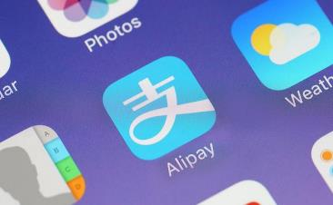
INNOVATION : CLOUD COMPUTING
TRIZ TREND 10 : RHYTHM CO-ORDINATION
The Rhythm co-ordination trend (we discuss here) is generally more applicable to time periods of minutes or seconds.
Ex – Alipay – Online Hypermarket.

Slide 13
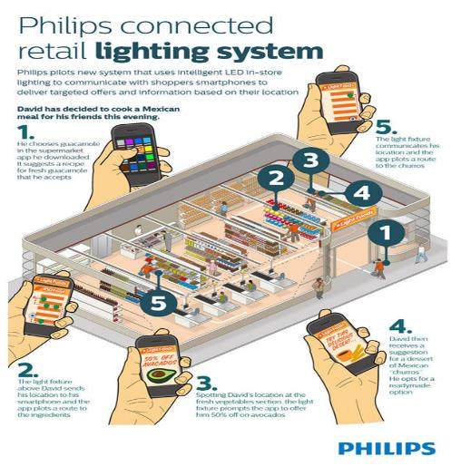
INNOVATION :LED RETAIL LIGHTING SYSTEM
TRIZ TREND 11 : SEGMENTATION
The lights can also react to events.
The lights are getting more adapted to our mood.
Ex: If David decides to buy guacamole, his mobile app will locate the route he should take to the food item's location. The app is then capable of prompting offers to David, alerting him on the discounts or offers that are available.
lighting system provides a simplistic way for shoppers at a grocery store to pinpoint exactly where they are and directs them to the products they need.

Slide 14
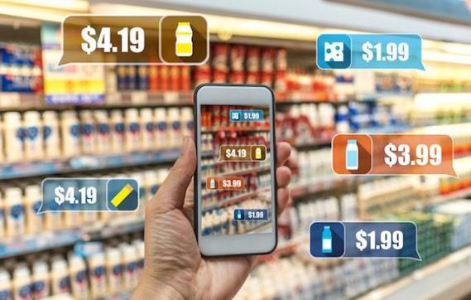
INNOVATION: AUGMENTED REALITY
TRIZ TREND 12 : INCREASING USE OF SENSES
https://www.youtube.com/watch?v=UQcJSZPpNhA
AR turns the surrounding environment into a digital interface by placing virtual objects in the real world, in real-time
As to show where the employee has to go. With augmented reality, an image is laid-over the employee’s normal view and does not disturb him from walking/driving safely. This is no doubt a great Fun and as well as saves time.

Slide 15
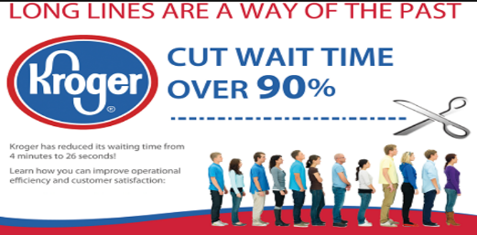
INNOVATION : QUEVISION TECHNOLOGY
TRIZ TREND 13 : ACTION COORDINATION
https://www.youtube.com/watch?v=Alovd0ygR3U
Kroger now uses infrared cameras to help decrease waiting times.
Sensors distributed throughout the store to detect how many customers are in the store at any given time, it helps in eliminating the Que and saves time of the buyers.

Slide 16
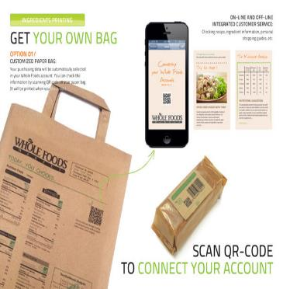
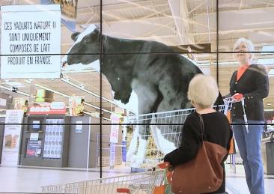
INNOVATION : VIDEO ADS OF ITEMS & CUSTOMIZED PRODUCTS
TRIZ TREND 14: MONO-BI-POLY
Your purchasing data will be automatically collected in your Whole Foods account . You can check the information by scanning QR code on your Customized paper bag. QR will be printed when check out.
The ads are broadcast on massive screens in the grocery stores so customers are directly exposed to the origins of their food.

Slide 17
INNOVATION : DIVERSIFYING CHANNELS
TRIZ TREND 15 : MONO-BI-POLY (SIMILAR)
Use of Online site , App for shopping with additional discounts and offers.
Consumers can now directly place and receive their order on specific day and time from the Warehouses of the Supermarkets via online mode.

Slide 18
INNOVATION : WIFI AND AERIAL VEHICLE
TRIZ TREND 16 : MONO-BI-POLY (INCREASING DIFFERENCES)
This is a trend which is not often seen. It talks about increasing differences , that how well is your product or service differentiated from others and how are the modifications increasing the efficiency day to day.
Use of WIFI in SK Telecom in Shanghai Lotus Supermarket
Use of Unmanned Aerial Vehicle used by Amazon Go supermarkets is delivering the Product on air once after your order is placed through online.
https://www.youtube.com/watch?v=MOSxuoDTh2I&app=desktop

Slide 19
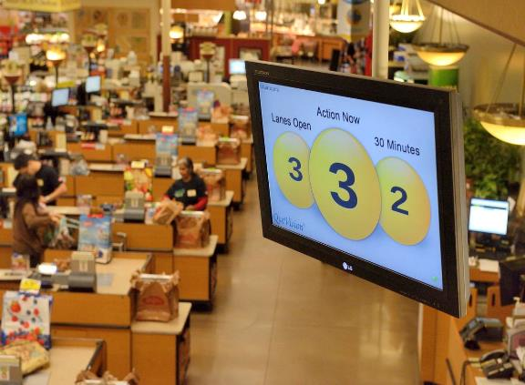
INNOVATION : VISUAL INFRARED SENSORS
TRIZ TREND 17 : DESIGN POINT
The Design Point trend considers the design of a system and investigates in which number of situations your design can function optimally.
The Use of Visual Camera on the top of the Supermarkets. They track wait time , determine when to open registers.
Success in 95% of stores. Eg Kroger Supermarket.

Slide 20
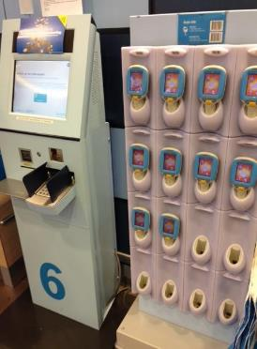
INNOVATION : WEARABLE SCANNING
TRIZ TREND 18 : DEGREE OF FREEDOM

Slide 21
INNOVATION : NESTING MONEY IN OTHER DEVICES OR SERVICES
TRIZ TREND 19 : NESTING UP
The nesting of many different devices in one integrated device.
A recent trend in the way payments are done using mobile devices. So, their cell phone functions like a bank card.

Slide 22
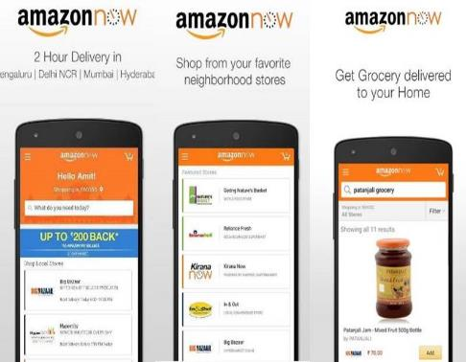
INNOVATION : LOYALITY CARDS AND ONLINE APPS
TRIZ TREND 20 : LISTENING/COMMUNICATION
Companies that are good in social media, follow this trend. The further they are in this trend, the more they learn about their consumers.
Supermarkets use loyalty cards to know what products you are buying.
Online Apps and commercial sites monitor your search, by this way they look at the products you search and offer offers and discounts in order to make customer buy. Eg Amazon now in India.

Slide 23
THANKYOU

