Slide 5
https://www.youtube.com/watch?v=EHMXXOB6qPA

Slide 6
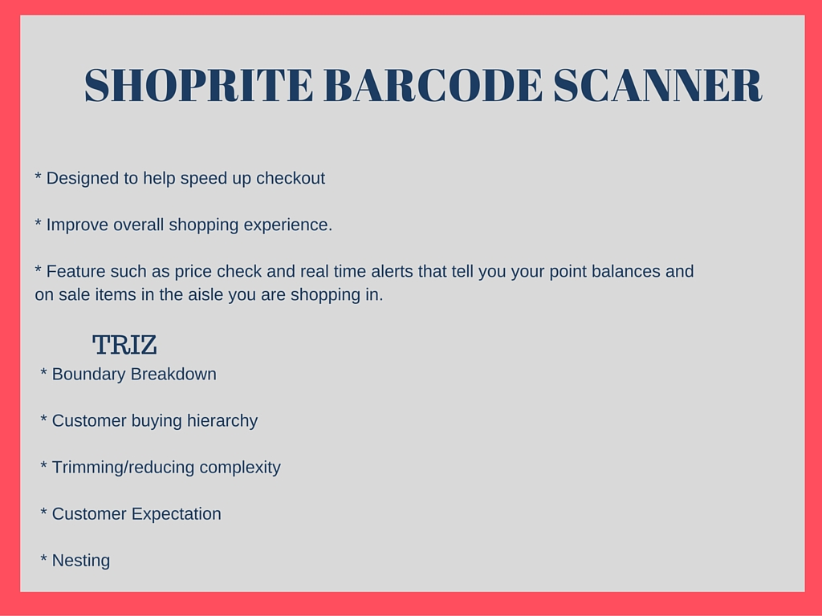
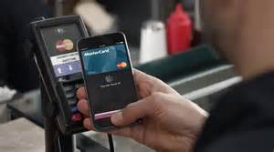

Slide 7
https://www.youtube.com/watch?v=09xpd2Y619Q

Slide 9
https://www.youtube.com/watch?v=Ev36MkWCEw0

Slide 11
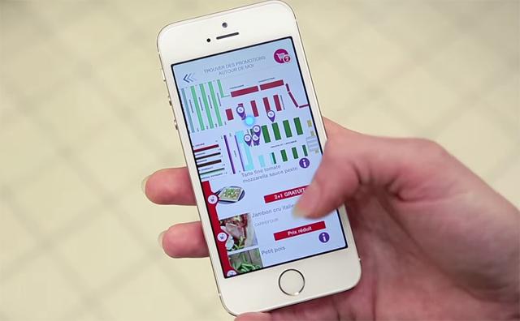

Slide 12
https://www.youtube.com/watch?v=uQw-o6bjrec

Slide 14
https://www.youtube.com/watch?v=ShNL3oU4Mi0

Slide 16
http://www.theverge.com/2015/11/4/9667462/hiku-button-grocery-list-ordering-shopping-walmart

Slide 18
https://www.youtube.com/watch?v=x0RL1M244VM

Slide 20
https://www.youtube.com/watch?v=4gy44ax2Ylg

