Slide 1
HOTELS&RESTAURANTS Trends in digital Innovations
BOMBLED Gréoire
CHEN Shanyue
LIU Xinyue
QU Haigang
SUZUKI Yu
14/9/2016

Slide 2
CASES in different countries
FRANCE: TILLER
SPAIN: DOW JONES
JAPAN: KURA SUSHI
CHINA: KFC&ALIPAY
DIANPING
PIZZA HUT
EATSA

Slide 3
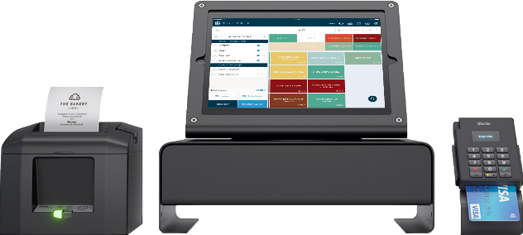
Bar/restaurant main problematics | Tiller solution | Trends
Order and payment duration | Ipad linked with the cash register and the kitchen | Decrease Human involvement Human + semi-automated tool
Regular accountancy | automatic accountancy Live relevant data
Stock management | Connected inventory
Food waste | Daily forecasts
Peak, off-peak periods |  | Rhythm coordination

Slide 4
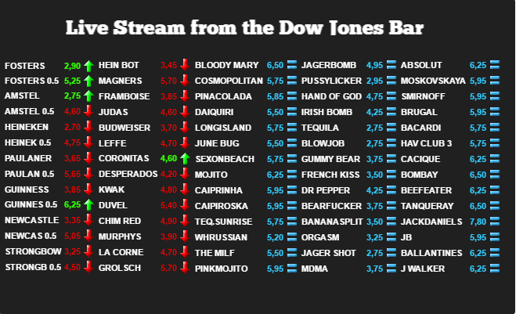

Slide 5
Customer expectation
Experience

Slide 6
PROBLEMS
Large population
Waste of use (time, money, labor)
Customer’s unique expectation

Slide 7
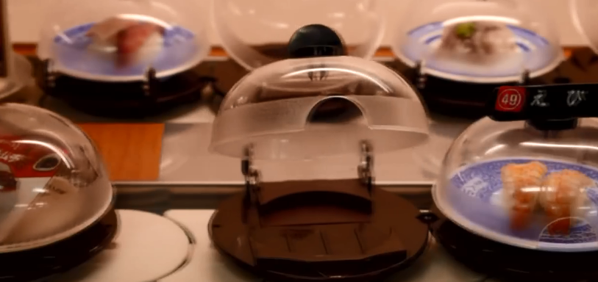
CASE
Automatic Ordering and Serving Machine -Technology used in sushi restaurant in Japan

Slide 8
TRIZ
Decrease Human Involvement
Customer Buying Hierarchy

Slide 9
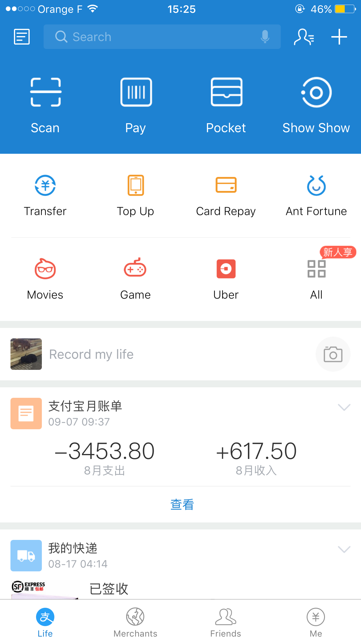
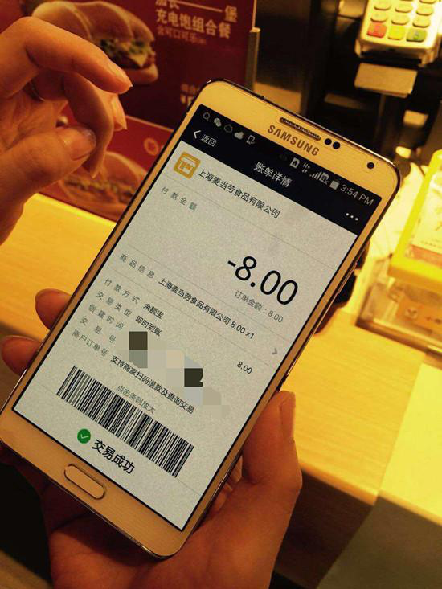
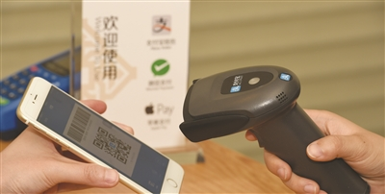
CASE
Easy Payment with QR Code -Alipay applied in KFC in China

Slide 10
TRIZ
Customer Buying Hierarchy
Increasing Dimensionality
Customer Expectation Evolve

Slide 11
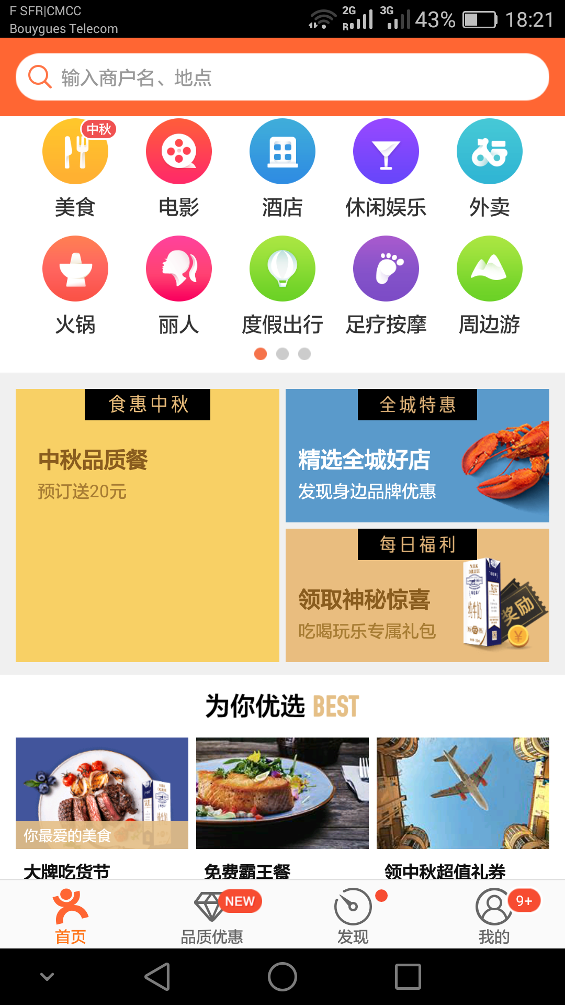
Reservation
Queuing
Order
Takeout
Pay
PROBLEMS
Long queuing time
Inconvenience
Bad customer experience

Slide 12
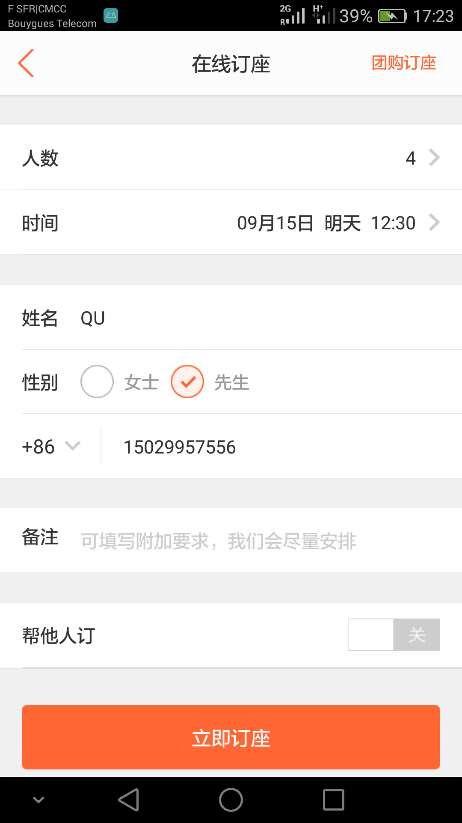
Reservation

Slide 13
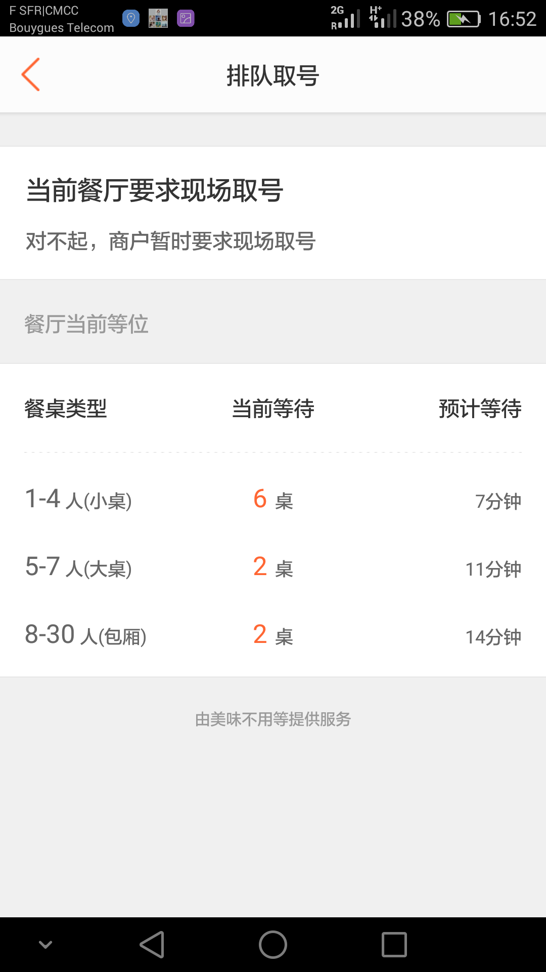
Queuing

Slide 14
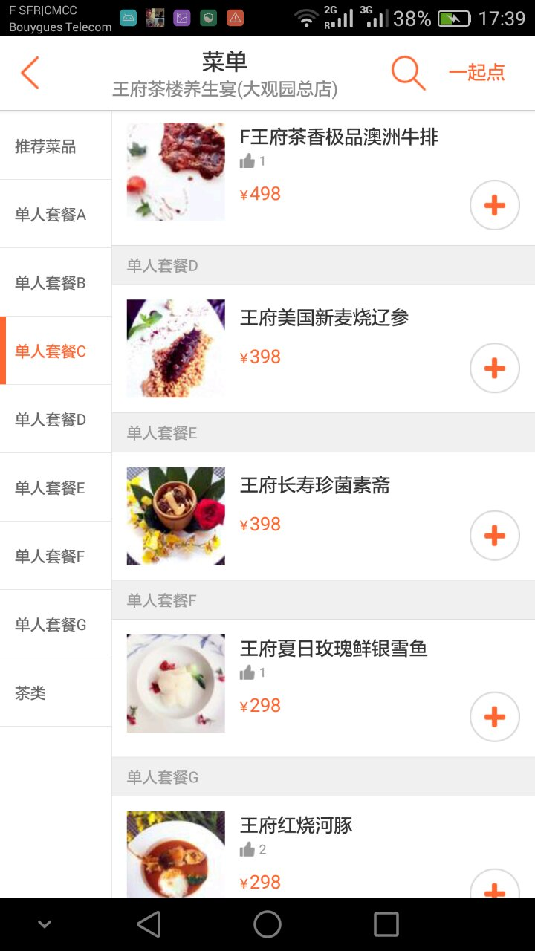
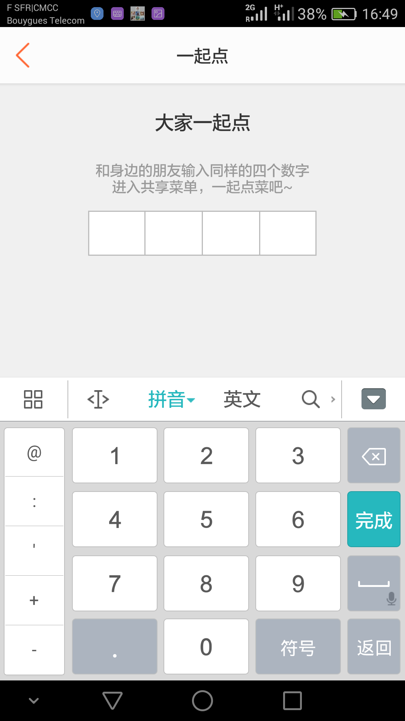
Order

Slide 15
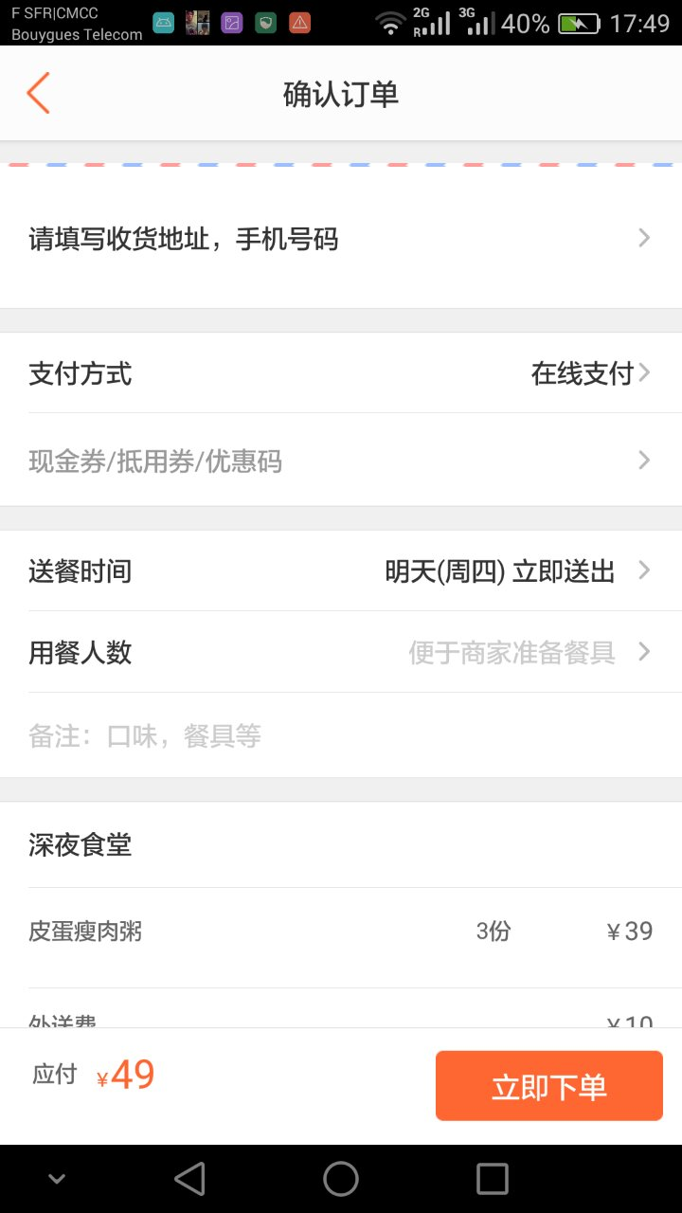
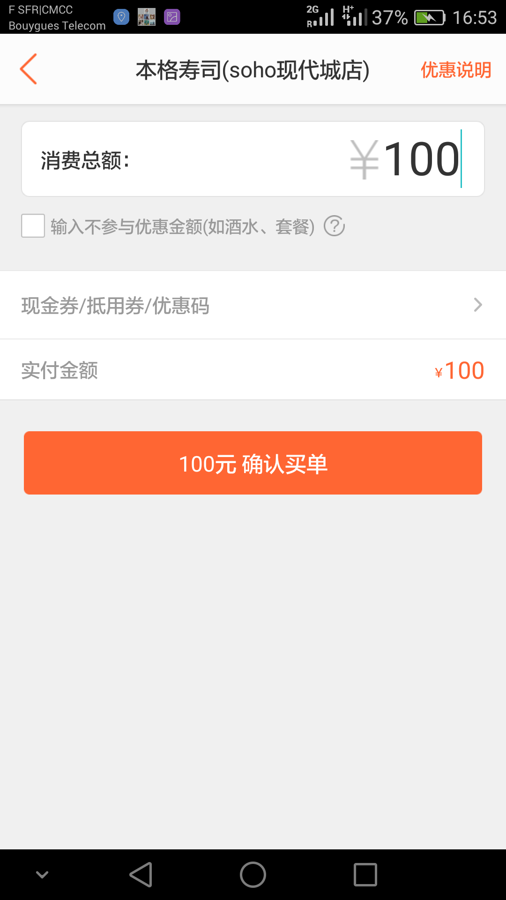
Taking out and Pay

Slide 16
TRIZ
Customer buying hierarchy
Decrease human involvement
Customer expectation

Slide 17
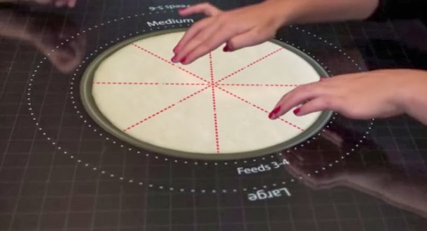
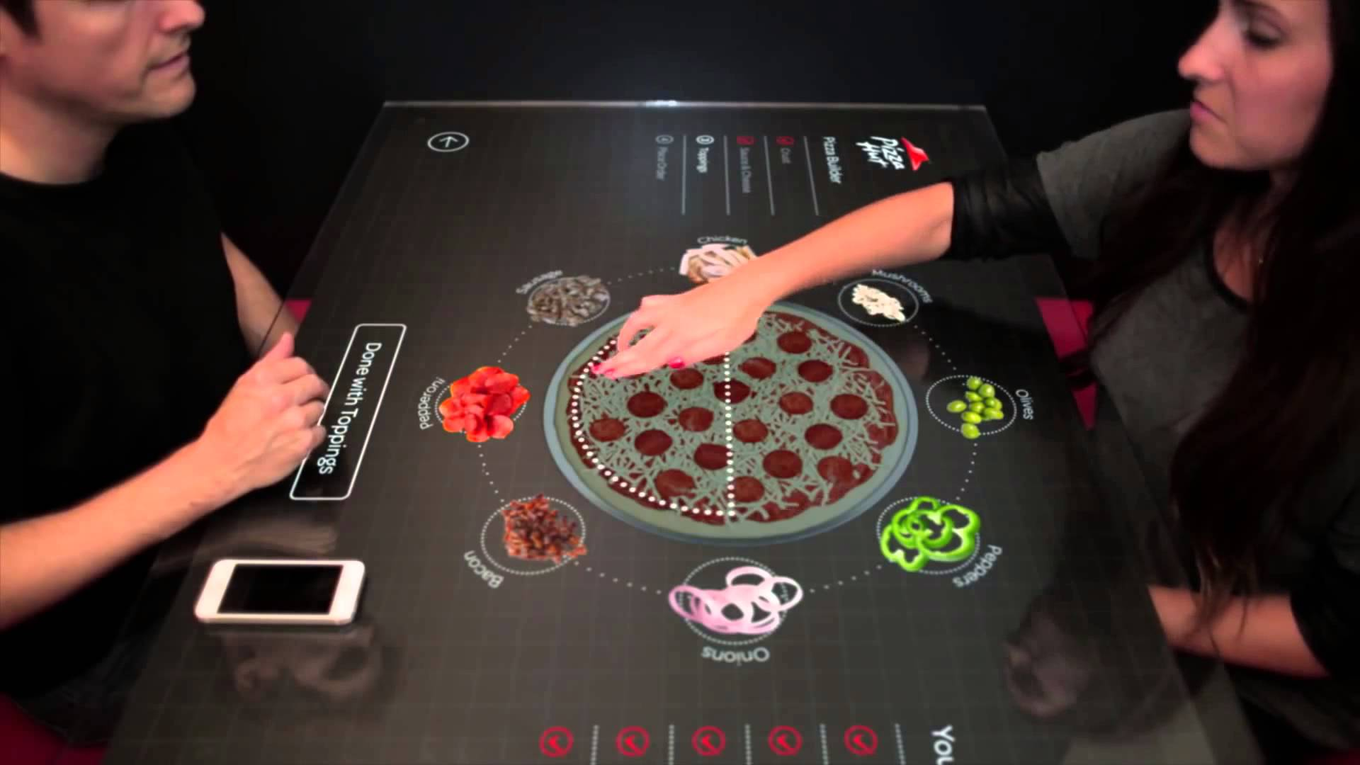
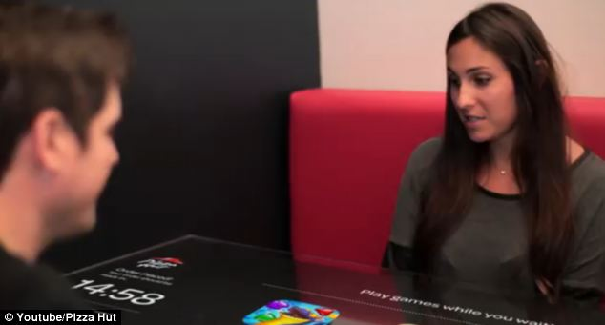
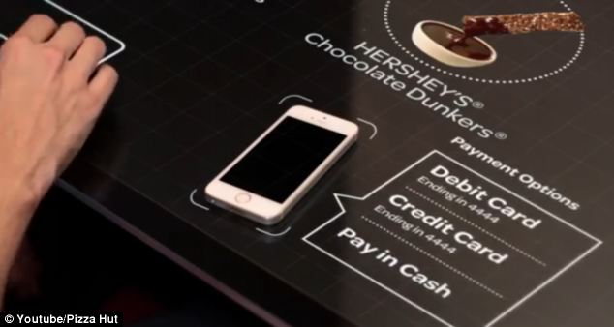
Pizza Hut
Problems
High labor cost
Takes long to take orders/ pay the bill
Customers’ expectation for making choices
Solution
2.Playing games
While you are waiting
1.Make your dream pizza
3.Pay by your phone
Trends
Degrees of Freedom
Customer Expectation
Decrease Human Involvement

Slide 18
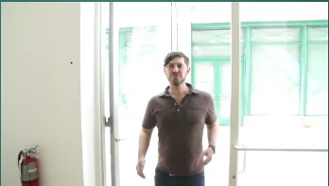
Eatsa
Problems
High labor cost
Takes long to take orders/ pay the bill
High cost for providing healthy/better quality food
Customer’s expectation for better taste
Solution
Trends
Degrees of Freedom
Customer Expectation
Decrease Human Involvement

Slide 19
CASES&TRIZ
FRANCE: TILLER
SPAIN: DOW JONES
JAPAN: KURA SUSHI
CHINA: KFC&ALIPAY
DIANPING
PIZZA HUT
EATSA

Slide 20
THANKS!

