Slide 1
Technology Innovations in Hotel Industry
By:
Jojo Thairon Tacumba
Cherry Kulshrestha
Nasir Mehmood
Rahul Chauhan

Slide 2
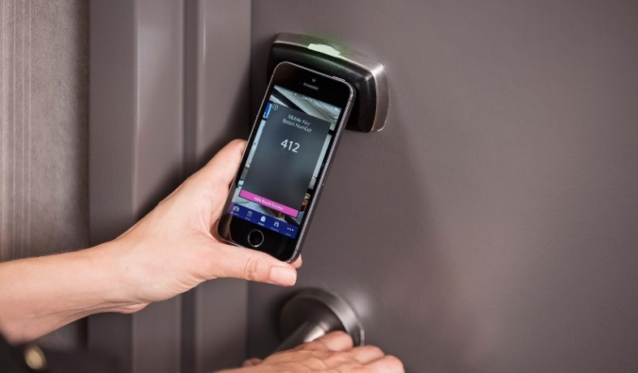
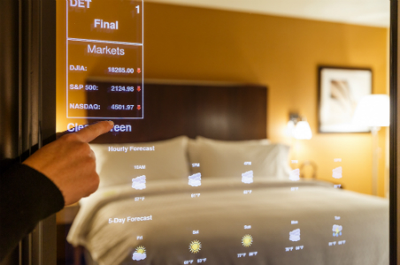
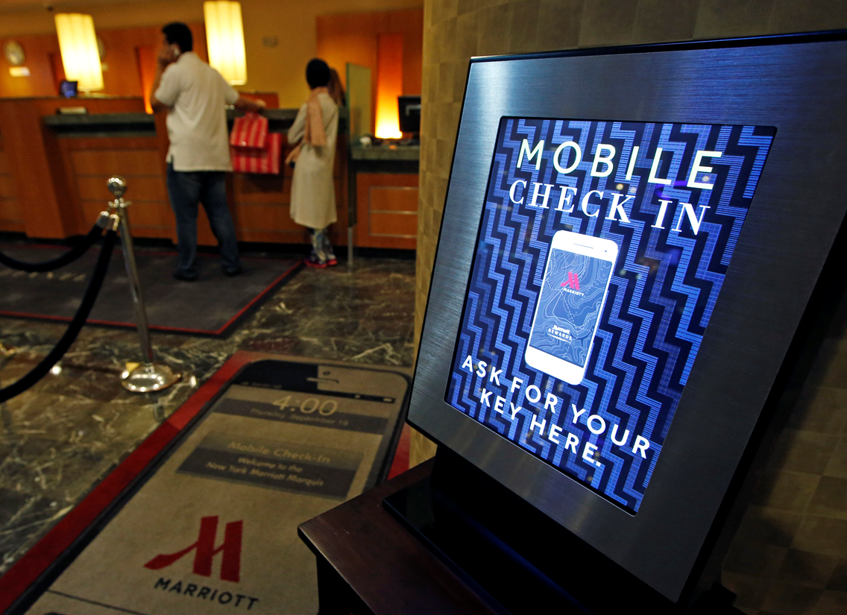
IMPACT OF IT IN HOTEL INDUSTRY

Slide 3
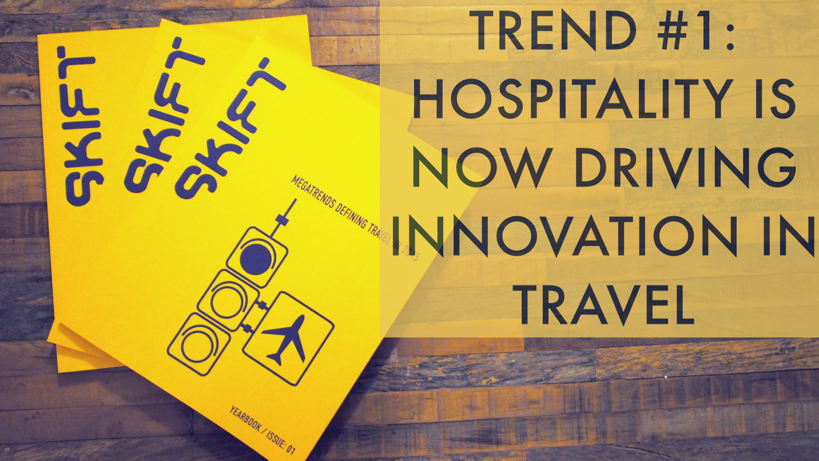
DIGITAL INNOVATIONS IN HOTEL

Slide 4
BENEFITS OF TECHNOLOGY IN HOSPITALITY INDUSTRY
Energy management systems (EMS) – Motion Sensor, Save energy, Cost Effective – ( Decrease Human Involvement Trend)
Electronic Distribution Systems (EDS) - Reach customers all over the world, Reservations at their fingertips (Dynamization Trend)

Slide 5
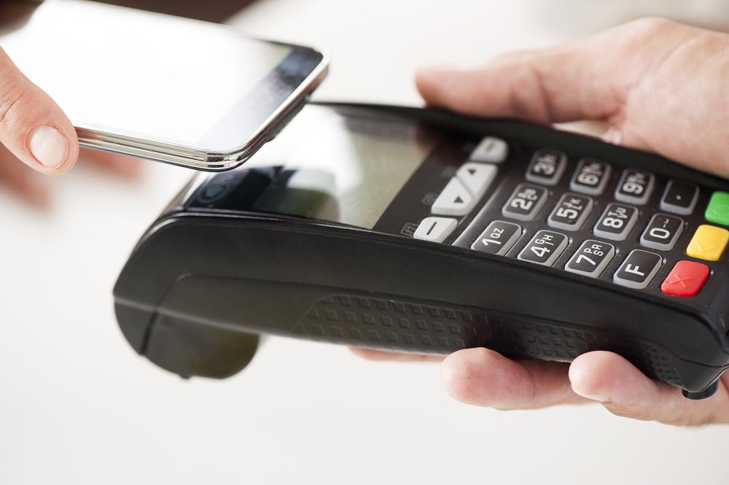
LATEST TECHNOLOGIES IN HOTELS
Mobile Communication & Automation
NFC Technology
Hotel Of The Future

Slide 6
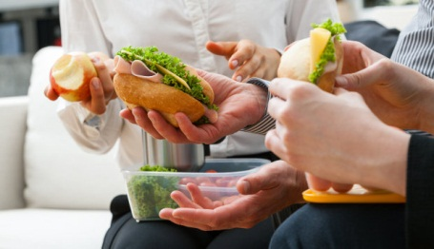
RESTAURANTS
Trend: Nesting (UP)’ Theory
No More Waiting Time in Your Restaurant
Less Waiting - More Enjoyment!
Make Most Out of Your Lunch Break

Slide 7
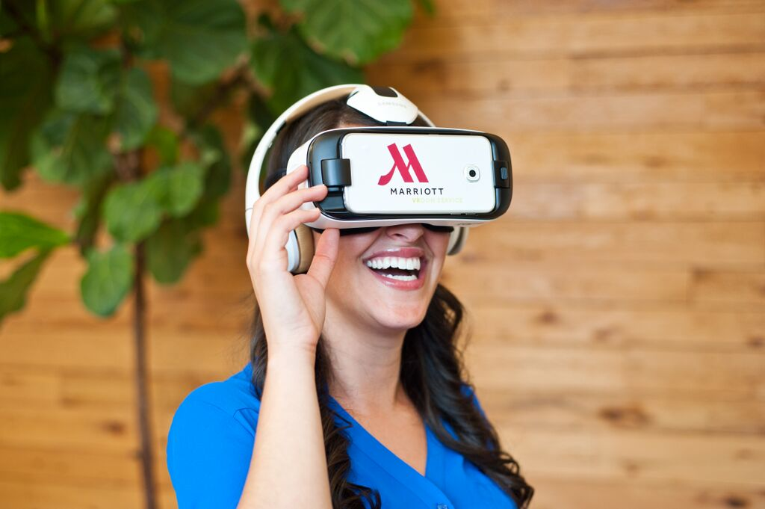
ATTRACTIONS & TOURS
Virtual Reality
Trend – Increasing Dimensionality
3D interaction, in real-time.
Achieved through input devices
Devices track movements
People’s Experience of VR in hotel Marriott
VR Postcards

Slide 8
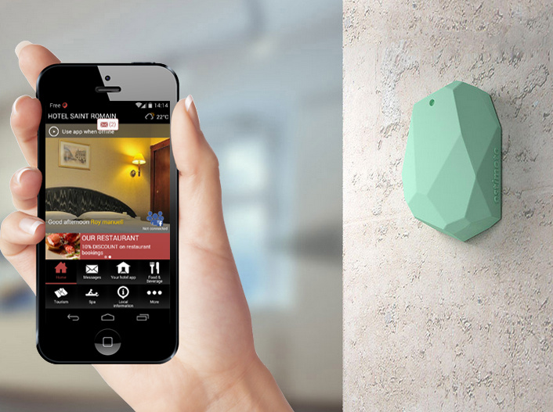
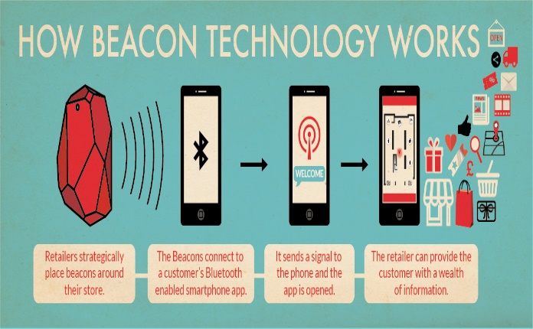
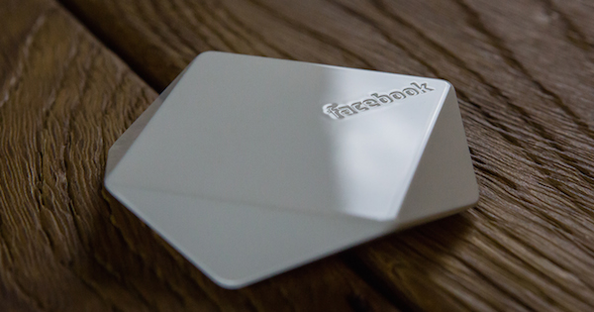
ATTRACTIONS & TOURS
Beacons
Trend - Customer Expectation
Are low-cost, low-powered transmitters equipped with Bluetooth Low Energy or BLE
Hotel apps + beacons can take away many of the hotel formalities
Beacon Technology

Slide 9
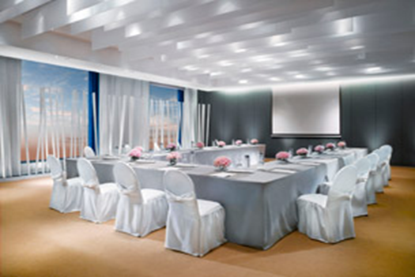
Meetings & Events
At Resorts World, over 5,000 guests received annually;
Over 8,000 events held annually;
US$ 350 million annual revenue;

Slide 10
Trend —Boundary Breakdown
Particulars | Many Boundaries | Few Boundaries | No Boundaries
Contemporary Practice | Booking meetings/events have to be done face-to-face; check availability; set-appointments; sales meetings; bookings; contracts; cash/check payments | Send email to sales team; review contracts through electronic copy; agreements done through calls/emails | N/A
Innovative Practice -Real time -Integrated -Cloud-based

Slide 11
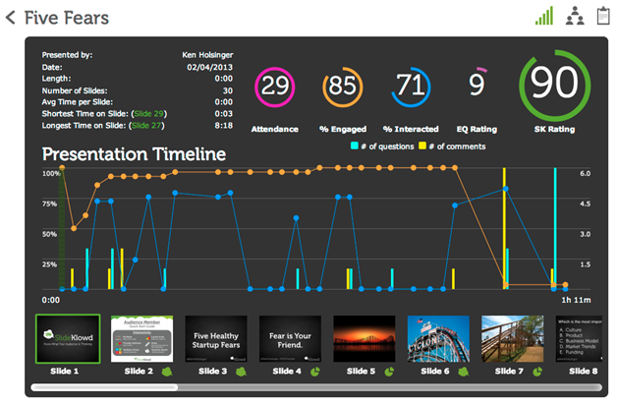
Trend —Increasing Transparency
Particulars | Opaque | Partial | Full
Contemporary Practice | Not seen through; isolated | Shared through the web but limited | N/A
Innovative Practice -Maximize engagement -Interactive & real-time -Information on the participants

Slide 12
Future Innovations
The World Beyond
Borderless World
Global Competitiveness
Comfort and Ease

