Slide 1
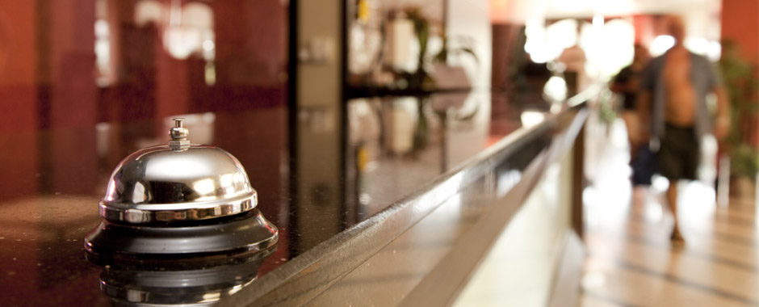
HOTEL & RESTAURANT TRENDS
Victoria Sidhu, Tania Ortiz & Lisa Kuhn

Slide 2
OVERVIEW
1
Problem Introduction: Case Example
2
Lastest Technology Trends in Hospitality Industry
Customer Booking
Customer Arrival
Customer Stay
3
TRIZ
3
Conclusion
Victoria Sidhu, Tania Ortiz & Lisa Kuhn

Slide 3
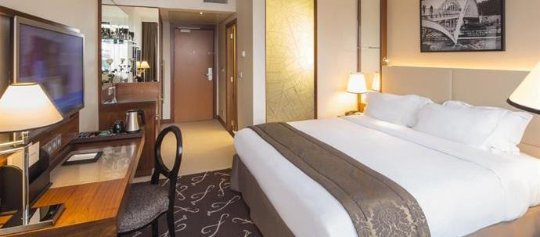
CASE EXAMPLE
HELP!
MÖVENPICK - Traditional hotel 4**** Paris
The hotel has a decreasing number of bookings and dissatisfied customers.
→ Why Is MÖVENPICK losing out and how can the hotel improve/update its service to meet customers future needs?

Slide 4
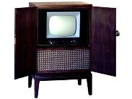
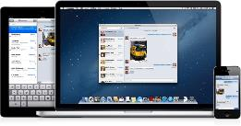
AUDITING THE CURRENT SITUATION IN THE HOSPITALITY INDUSTRY
IN THE PAST...
MÖVENPICK used to be ahead of the curve when it came techology...
→ attracting guests with TVs and other innovations that they could not dream of having in their own homes.
NOW THE OPPOSITE IS TRUE...
MÖVENPICK is far behind!
Travelers are familiar with advanced technologies they have in their living room & are often disappointed when hotel rooms do not meet their needs or expectations
On top, travelers now bring their own technological devices
What now? MÖVENPICK needs to be an innovative technology leader again exceeding expectations - No longer a service but an experience provider by adopting some of the latest IT trends in use.
Victoria Sidhu, Tania Ortiz & Lisa Kuhn
Notes:
Hoteliers have heard it before: The hotel industry used to be ahead of the curve when it came to technology, attracting guests with TVs and other innovations they couldn’t dream of having in their own homes.
Now the opposite is true: Travelers are familiar with the advanced technologies they have in their living room and are often disappointed when hotel rooms don’t meet needs or expectations.
Combine that with the ability for travelers to bring their own entertainment—through devices like smartphones and tablets and via Web content streamed through the likes of Netflix and Pandora—and the hotel industry is left with a lot of catching up to do

Slide 5
THE HOTEL EXPERIENCE 2.0
Victoria Sidhu, Tania Ortiz & Lisa Kuhn

Slide 6
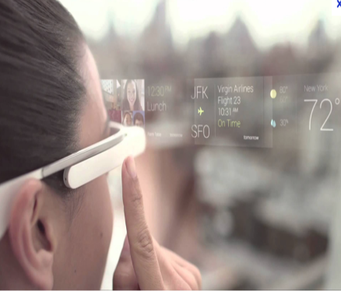
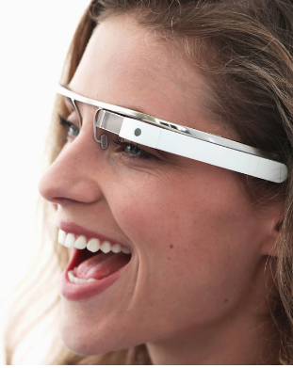
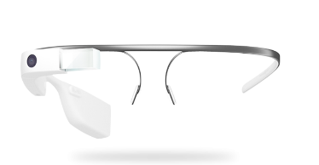
CUSTOMER BOOKING
1. AUGMENTED REALITY
App for Google Glass, called Hotel Near Me
Hotel reservation/booking via google glasses
Loaction via GPS
Searching nearby hotels, sort by price, see photos, and guides you right to the hotel door
Handeling via touch and voice commands
EXAMPLE: Destinia - http://www.hotelnearme.com
Victoria Sidhu, Tania Ortiz & Lisa Kuhn

Slide 7
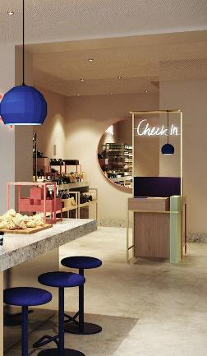
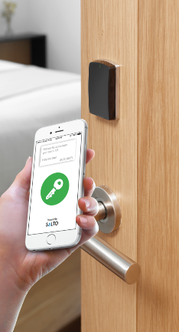
CUSTOMER ARRIVAL
2. DECREASE OF HUMAN INVOLVEMENT
No Staff or Reception Desk required
EXAMPLE: HTL Stockholm
3. REDUCE COMPLEXITY
Mobile keys as door openers
EXAMPLES:
→ HTL Hotels are successfully using mobile keys since June 2014
→ Hilton Worldwide Holdings is planning have a digital key for 170.000 of they rooms by 2016
Victoria Sidhu, Tania Ortiz & Lisa Kuhn
Notes:
1. Mobile keys
Many hotels have realized that many travelers nowadays want to experience the hotel on their own terms, hoteliers are working to allow the guest to use a smart devices to do so.
HTL, a new hotel brand that succeded in this. already offers guests the ability to check-in while in transit and receive a room key directly on their mobile phone.
“We don’t have a reception; we have hosts that are in the lounge. It’s always on your own terms,” said Gül Heper, commercial manager for HTL.
Guests wanting to use the mobile room key must download the HTL app, which is available via Google Play or iTunes. When enabled, the phone speaks to the door locks via a Bluetooth low-energy signal.
“Everything is secured with prepayment, and you don’t get a key unless you’ve prepaid,” Heper said. “It’s rather simple. You just stand in front of the door and press unlock.”
- See more at: http://www.hotelnewsnow.com/Article/14016/5-tech-trends-that-will-shape-hospitality#sthash.JbskRMVm.dpuf
Hilton Worldwide Holdings first started piloting the use of its “Digital Key” program—which allows guests to check in, choose a specific room and unlock their door all through their phone—in July and is approaching 1 million digital check-ins per month. The company expects to expand its use across Hilton Hotels & Resorts, Waldorf Astoria Hotels & Resorts, Conrad Hotels & Resorts and Canopy by Hilton through 2016, with adoption expected for more than 170,000 rooms across 250 U.S. properties.
- See more at: http://www.hotelnewsnow.com/Article/16712/Early-adopters-keen-on-keyless-entry#sthash.xVApkg1I.dpuf

Slide 9
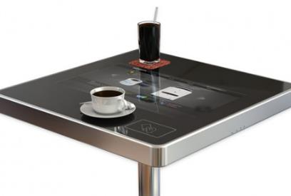
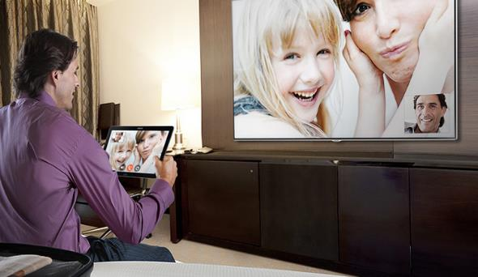
CUSTOMER STAY
4. CUSTOMER EXPECTATIONS
Interactive Dining Tables & Touchscreen Boards
Multi touch screen to create unique customer experience - connect, educate and entertain customers
Allows real time updates (special offers,
Access to more relveant information through browsing
Placing orders and paying immediately - waiters have time for other services
EXAMPLE: KioCafe
Visual Concierge
Tablet replaces the phone / facetime calls to the reception
Room service
Connection to live/human receptionist via video
Example: Radisson iConcierge app, NH Hotels, citizenM hotel
Samsung Interagted SmartRoom Technology
Victoria Sidhu, Tania Ortiz & Lisa Kuhn
Notes:
to create a unique customer experience and connect with millenials. Imagine customers visiting your restaurant and browsing the menu, placing their orders and paying for their meals with a payment card, all from the comfort of their very own digital table. The KioCafe can be used to entertain, educate and connect with customers, such as: Browsing menus Ordering food Accessing special offers Data capture of telephone and email for loyalty schemes Reading news websites Playing games Sharing on social media Reading 3rd party advertising (generate income for your business) The possibilities for additional features is completely possible through further development for each business, their systems and their rules. The KioCafe is available in Android or Windows versions, with the ability to bespoke the design, subject to minimum order quantity.
http://www.lifesizetouch.com/interactive-furniture/kiocafe/
While many hotels like to flaunt an in-room tablet or iPad to order room service or connect with concierge, NH Hotels Collection Eurobuilding’s tech rooms feature tablets that visually connect you with a live, human receptionist. You can see her (she cannot see you) while you order room service or call for valet, ensuring no snags involved.
6. VISUAL CONCIERGE
While many hotels like to flaunt an in-room tablet or iPad to order room service or connect with concierge, NH Hotels Collection Eurobuilding’s tech rooms feature tablets that visually connect you with a live, human receptionist. You can see her (she cannot see you) while you order room service or call for valet, ensuring no snags involved.
The new Radisson iConcierge app (launched early April on Android and iOS) allows guests to access a wide variety of services including the ability to order room service, book a spa appointment, set a wake-up call, get your luggage picked up, and grab a taxi.
Every guestroom at Tallahassee's boutique Hotel Duval comes equipped with a 23-inch Interactive Customer Experience (ICE) touch screen display. In addition to ordering housekeeping, dining, and valet services, guests can use them to check email, look up the weather, print boarding passes, and search local events and attractions. Other nice touches include the ability for brides and grooms to record a welcome video for their guests to play back on ICE-equipped in-room iPads.
Boston's Revere Hotel features a couple of iPads preloaded with the iKnow Concierge. In six different languages, the tablets help guests to access a wide variety of services, from finding a tailor to snagging tickets at a concert. Whether you're into finding food, spa, or sports, these devices can help you self-serve.
Megalomaniacs will love the innovative touch screen MoodPad. It lets you control the hotel room, including television, window blinds, temperature, coloured lighting, wake-up alarm themes and more for an ambient room experience, all with the flick of a finger.

Slide 10
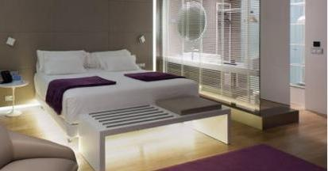
CUSTOMER STAY
4. CUSTOMER EXPECTATIONS
Floor Sensor Lights (at night)
Sensors detect motion
Automatically turns on dimmed lights under the bed and on the bathroom floor
Example: NH Hotels
Smart Window
Can turn into mirror/window/dashboard
Blinds can be programmed to close/open at a certain time
Example: Technology by CorningVision/Samsung
Victoria Sidhu, Tania Ortiz & Lisa Kuhn

Slide 12
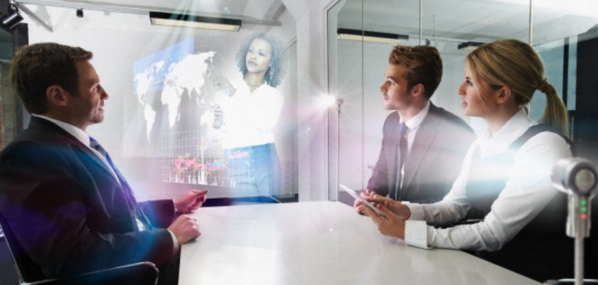
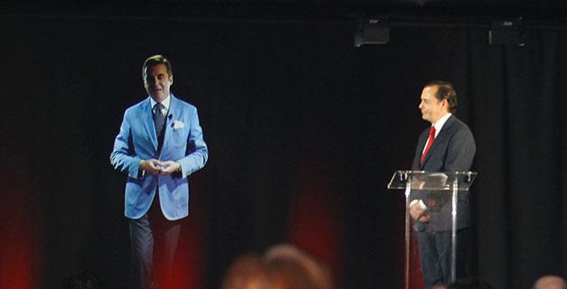
CUSTOMER STAY
5. INCREASING DIMENSIONALITY
Hologram presentation
Adds another Dimension to traditional Video-Conferences
3-D holographic projection technology
Image transmission
Location is not important anymore
Example: NH Collection Eurobuilding
Victoria Sidhu, Tania Ortiz & Lisa Kuhn
Notes:
Thanks to cutting edge, 3-D holographic projection technology, NH is the first hotel in the world to offer future-forward hologram presentations in its meetings. What exactly does this mean? A group can have a meeting at NH Collection Eurobuilding with a keynote speaker on stage — who’s actually in another country. The image is transmitted as if the person is there in real life.
It’s like Princess Leia in Star Wars — only these holograms are life-sized. Hugh Jackman recently hologrammed from Berlin into an NH meeting room in Madrid to promote his movie Chappie.

Slide 13
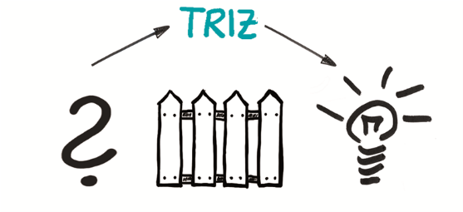
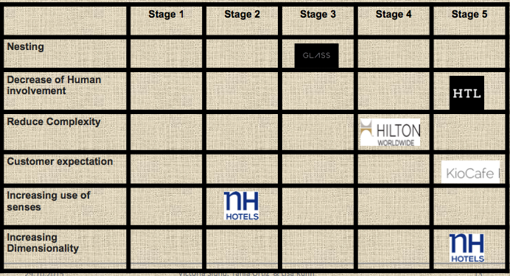
TRIZ
Victoria Sidhu, Tania Ortiz & Lisa Kuhn
Notes:
While many hotels like to flaunt an in-room tablet or iPad to order room service or connect with concierge, NH Hotels Collection Eurobuilding’s tech rooms feature tablets that visually connect you with a live, human receptionist. You can see her (she cannot see you) while you order room service or call for valet, ensuring no snags involved.
Thanks to cutting edge, 3-D holographic projection technology, NH is the first hotel in the world to offer future-forward hologram presentations in its meetings. What exactly does this mean? A group can have a meeting at NH Collection Eurobuilding with a keynote speaker on stage — who’s actually in another country. The image is transmitted as if the person is there in real life. It’s like Princess Leia in Star Wars — only these holograms are life-sized. Hugh Jackman recently hologrammed from Berlin into an NH meeting room in Madrid to promote his movie Chappie.

Slide 14
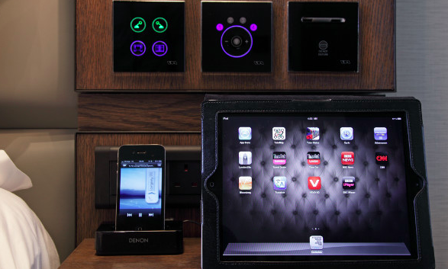
CONCLUSION
“Technology is never enough”
Victoria Sidhu, Tania Ortiz & Lisa Kuhn
Notes:
In conclusion, IT are very important for the Hospitality Industry. Customers already have a lot of technology in their own houses, so for the hotels and restaurant to impress and attract customer they really need new technology. Nowadays everything is so advanced that we can do many things that we can not imagine before. Its important to considerate that one innovation can create another one. There is the case of the ipads, an innovation that is helping other sectors to improve their services and people to change the way of live. Nothing is enough, there should be always the need of more.

Slide 15
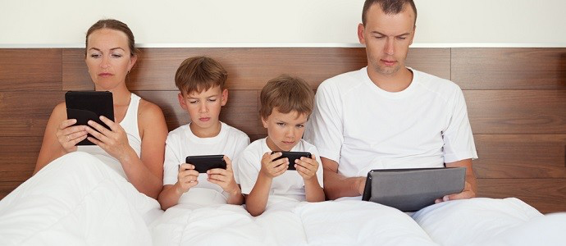
THANK YOU,
FOR YOUR KIND ATTENTION!
THANK YOU, FOR YOUR KIND ATTENTION!
Victoria Sidhu, Tania Ortiz & Lisa Kuhn

Slide 16
References
Google Glass App Identifies Hotel Guests Upon Arrival. URL: http://skift.com/2014/06/17/google-glass-app-identifies-hotel-guests-upon-arrival/. (Last accessed:28.10.2015).
NH Hotel Group High Tech Made Easy 2015 URL: https://www.youtube.com/watch?v=Xm-W3tMaWQU (Last accessed:28.10.2015).
NH Hotel Group, Technological Innovation for Business and Leisure. http://blog.nh-hotels.com/nh-hotels/nh-hotel-group-technological-innovation-for-business-and-leisure/.(Last accessed:28.10.2015).
5 tech trends that will shape hospitality http://www.hotelnewsnow.com/Article/14016/5-tech-trends-that-will-shape-hospitality. (Last accessed:28.10.2015).
Google Glass Hotel Near me. http://www.hotelnearme.com. (Last accessed:28.10.2015).
Victoria Sidhu, Tania Ortiz & Lisa Kuhn

