Slide 1
HEALTH INDUSTRY INNOVATIONS
Rudy de la Cruz
18950760

Slide 2
WEARABLE TECHNOLOGIES
Wearable technology is a category of technology devices that can be worn by a consumer and often include tracking information related to health and fitness.
Different wearable technologies are coming to the fore
Smartwatches, fitness bands, cellphones, smart scales, headphones
The wearables ensure that you track your own health
Take a holistic approach to your health
Rudy de la Cruz
18950760

Slide 3
WEARABLE MANUFACTURERS
Rudy de la Cruz
18950760

Slide 4
APPLE health video
Rudy de la Cruz
18950760

Slide 5
USING DATA TO DIAGNOSE PATIENTS
Companies are using consumer data from search engines and wearables to help make early diagnoses of illnesses
A more collaborative approach is being utilised between patients, doctors and app developers
Detection of illnesses such as cancer and autism can be detected much earlier
The progression and treatment of illnesses such as Parkinson’s disease can be monitored and the information being gathered is being used for the development of cures for these illnesses
The information sent by users via apps or searches is utilised for the early identification and treatment of illnesses
Rudy de la Cruz
18950760

Slide 6
BING SEARCH CANCER IDENTIFICATION
Rudy de la Cruz
18950760

Slide 7
RESEARCHKIT VIDEO
Rudy de la Cruz
18950760

Slide 8
TRIZ TRENDS
Boundary Breakdown
Adding dimensions
Increasing transparency
Trimming; Reducing complexity
Decreasing human involvement
Rudy de la Cruz
18950760

Slide 9
KAINOS EVOLVE Tamsin olsen -19633734
an Electronic Document Management (EDM) product to digitize patient records

Slide 10
Kainos Evolve has built an Electronic Document Management (EDM) product to digitize patient records, thereby making crucial information available to health and social care practitioners, in one place, at the touch of a button.
This also reduces inefficiencies in the system – specialists will not prescribe tests already performed by other specialists.
Tamsin Olsen

Slide 11
VIDEO
Tamsin Olsen

Slide 12
TRIZ TREND
INCREASING TRANSPARENCY
TRIMMING/REDUCING COMPLEXITY
BOUNDARY BREAKDOWN
Tamsin Olsen

Slide 13
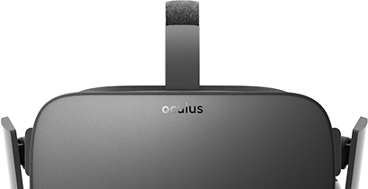
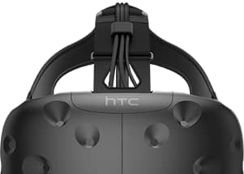
Virtual Reality
Main applications:
training (consumers & medicine students both)
remote health practitioner consultations
treatment of phobias and mental conditions (eg. PTSD)
Companies involved:
Sharecare, ImmersiveTouch, Bravemind, Nicklaus Children's Hospital
TRIZ Trends:
increasing dimensionality, trimming, boundary breakdown
Rihan Schalkwyk

Slide 14
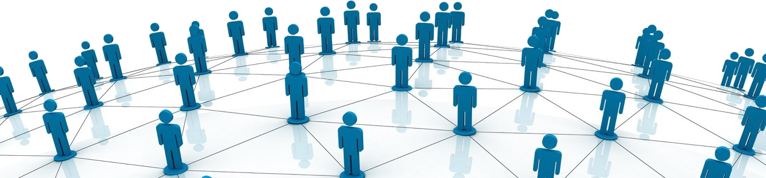
Blockchain
Main applications:
smart contracting between health practitioner and patient
managing medical allowances
Companies involved:
Most notably SAP and Philips
TRIZ Trends:
Trimming, Boundary Breakdown, Dynamization
Rihan Schalkwyk

Slide 15
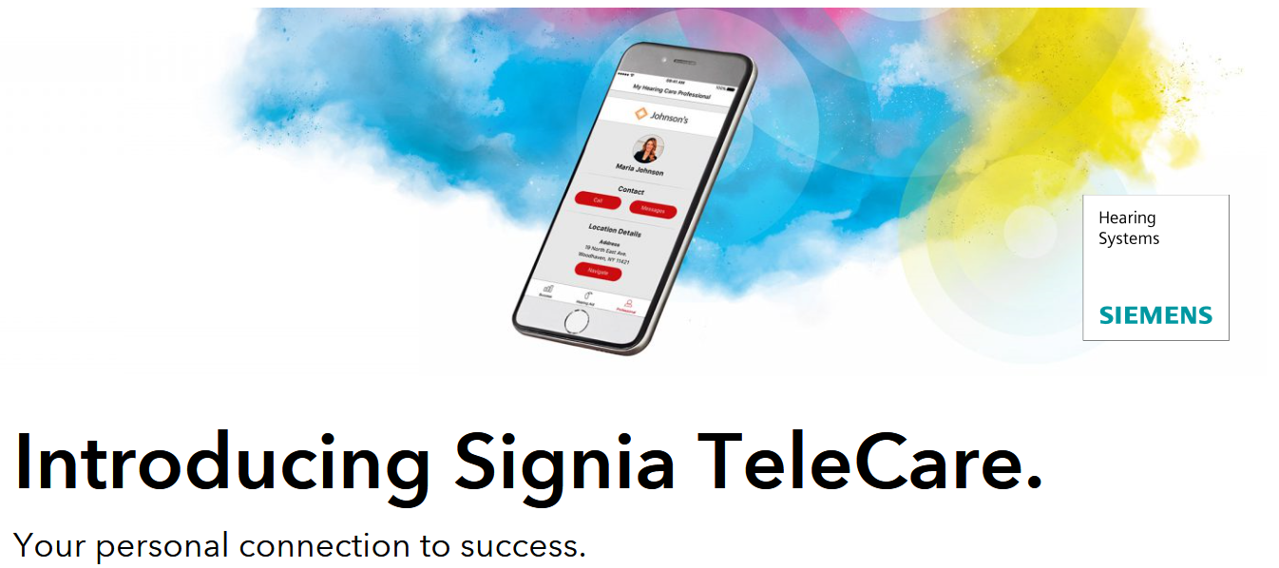
Douw van der Merwe - 18154689
Notes:
Last day of class: 5 minutes per student to present:
- Problems/opportunities companies in the industry are confronted with.
- What technologies are used to resolve the problems?
- What functionality the technology offers?
- What TRIZ trends are behind it? (Put on slide! Discuss very short.)

Slide 16
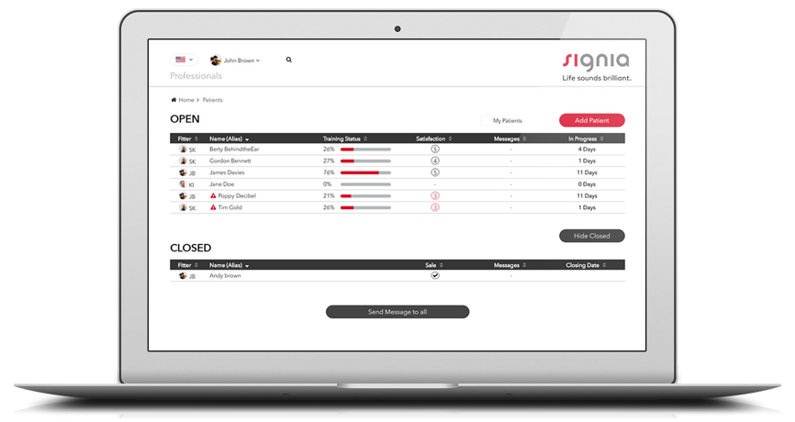
Douw van der Merwe
Notes:
Signia TeleCare is a revolutionary application designed and built by Hearing Care Professionals to help you set a new standard of care.
From your computer to your customer’s smartphone – TeleCare offers you a whole new way to be closer to customers than ever before. Wherever your customers may be.
Using an intuitive smartphone app for hearing aid wearers and an easy-to-use professional portal, TeleCare delivers the future of hearing health care to you. It enables you to achieve a new level of success and growth in your business based on higher quality of service, efficient trialing and happier customers.

Slide 17
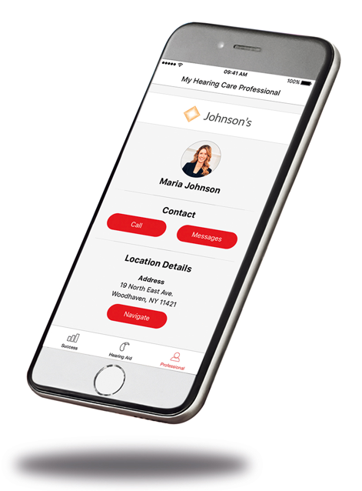
Today’s hearing aid wearers are empowered and proactive in their health and well-being. They are increasingly focused on immediacy, real-time connectivity, personal comfort, and have come to expect the highest standard of care. Many wearers live a busy, active lifestyle with no time to waste.
At the same time, a Hearing Care Professionals are facing the commoditization of the hearing care industry and is being challenged to set a new standard of care that will differentiate you from competitors.
TeleCare, by Signia, aims to fix a current “blind spot” in hearing care: During the most crucial moment – when a customer is using their hearing aids for the very first time – despite best efforts, they are on their own during the initial and critical weeks of acclimatization.
Douw van der Merwe

Slide 18
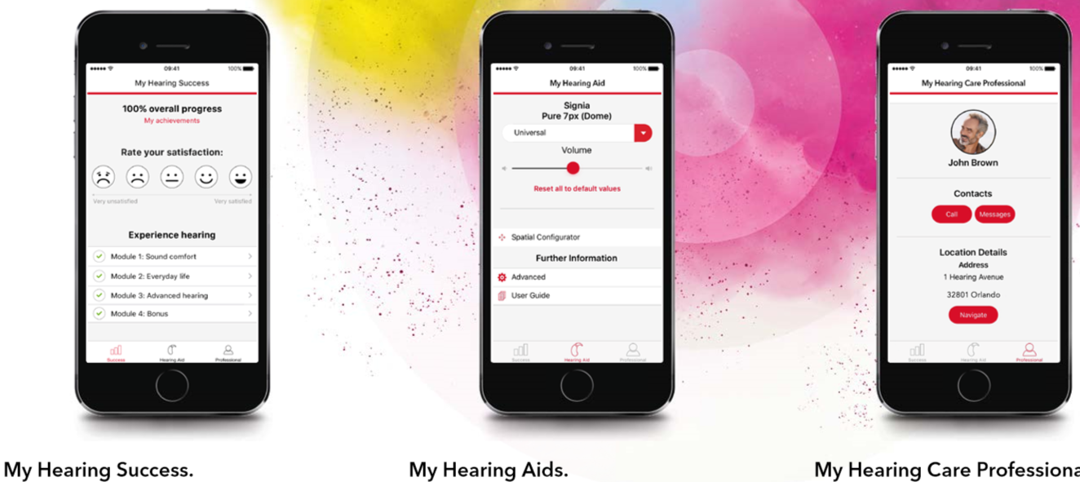
Signia TeleCare offers you five key advantages:
Excite and motivate customers.
Transparency on customer satisfaction in real time.
Stay closer to customers through easy communication.
Make customers happy – wherever they are, wherever you are.
All customers can experience the benefits.

Slide 19
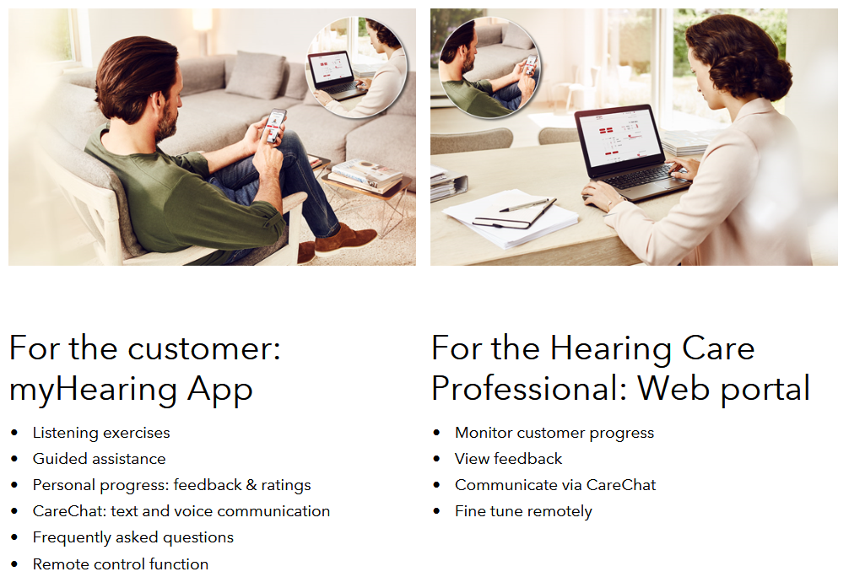
TRIZ TRENDS
Boundary Breakdown
Dynamization
Increasing Asymmetry
Increasing transparency
Trimming/reducing complexity
Decrease human involvement
Customer Expectation
Increasing use of senses
Action coordination
Douw van der Merwe

Slide 20
Douw van der Merwe

Slide 21
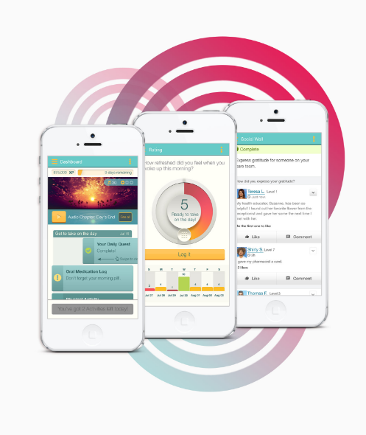
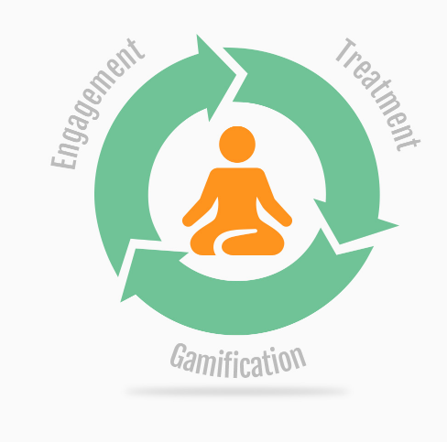
Douw van der Merwe

Slide 22
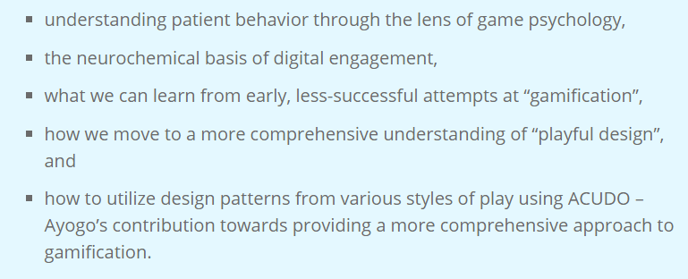
Douw van der Merwe

Slide 23
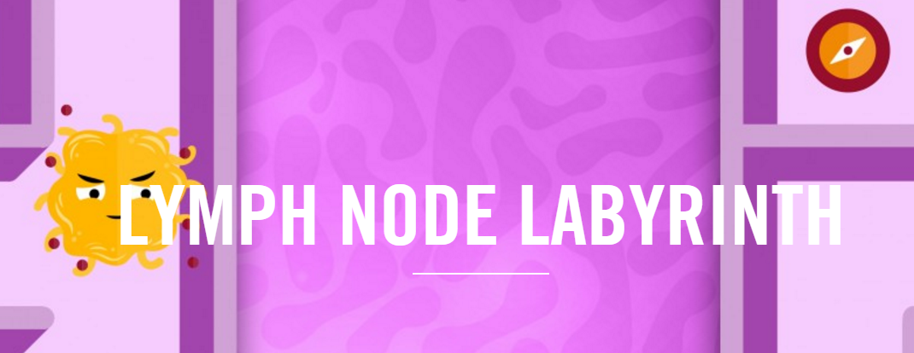

Slide 24
TRIZ TRENDS
Boundary Breakdown
Increasing Asymmetry
Increasing transparency
Trimming/reducing complexity
Increasing use of senses
Action coordination
Douw van der Merwe

Slide 25
Computational systems biology
Reinhardt Scholtz

Slide 26
Idea in brief
By gathering vast amounts of personal biological data, algorithms can be developed to advise users on their health and warn them about potential dangers
Reinhardt Scholtz

Slide 27
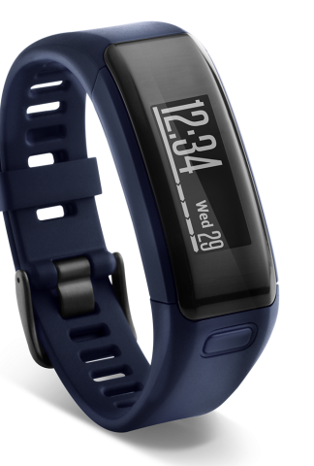
The how
Lifeq partners with companies such as tomtom, garmin and adi.
Lifeq developed a sensor which it sells to garmin without making a profit & in return gets the data about the end user.
Data such as heart rate, sleep phases, blood lactate levels, calorie intake & stress is gathered.
The data is stored in the cloud and mined.
Computational systems biology is used to develop mathematical models about user health.
With a vast amounts of data being analysed, lifeq can start predicting certain health occurrences such as heart attacks.
Reinhardt Scholtz

Slide 28
video
LifeQ video
Reinhardt Scholtz

Slide 29
Triz trends
Dynamization
Increasing transparency
Decreasing human involvement
Customer expectation evolution
Nesting
Listening/communication
Reinhardt Scholtz

Slide 30
SMART SLIPPERS
Reinhardt Scholtz

Slide 31
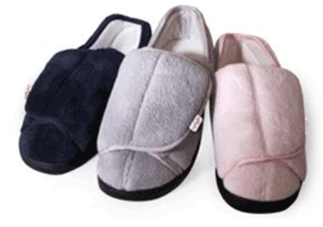
Idea in brief
By putting sensors in slippers, we can gather a host of data which can be analysed and provide value to users.
Reinhardt Scholtz

Slide 32
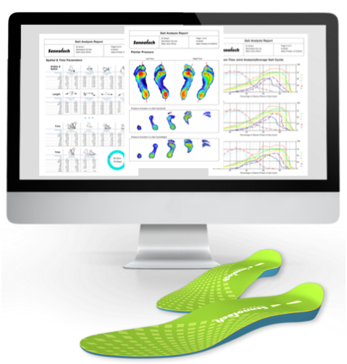
The how
SENSORS WHICH ARE CONNECTED (Iot) ARE PLACED IN SLIPPERS (pressure, acceleration & distance/paths)
data concerning pressure points & movement collected and stored in the cloud
Data compared to many other users to detect irregular movements
Algorithms of normal & irregular movements developed
Reinhardt Scholtz

Slide 33
VIDEO
AT&T video
Reinhardt Scholtz

Slide 34
TRIZ TRENDS
Dynamization
Increasing transparency
Decrease human involvement
nesting
Listening/communication
Reinhardt Scholtz

Slide 35
Organova
Organs grown as they are needed precisely tailored to the needed demand.
Scholtz Van Heerden
15633705
Notes:
As discussed previously we are limited on because we have not developed organs to sense specific stimuli
Not just perceiving why not interacting?
Why not have additional limbs to interact with the world around us?
That is for us who are able bodied but it means so much for those who are fully paralyzed with the addition of our next technology.
But now we move onto our next innovation how to control this system because implants can seem excessive for a bit of extra functionality.
8000 people a year
121000 people on the waiting list

Slide 36
Trends
Trimming
Dynamization
Increasing Dimensionality
Scholtz Van Heerden
15633705
Notes:
Dynamization Might be a kit at a car crash that immediately begins to print organs as soon as it gets provided with the instruction to

Slide 37
Emotiv
Brain computer interface:
Cheaper
Open source
Hackers
Scholtz Van Heerden
15633705
Notes:
Hackers are the future
With dropping prices in advanced brain interface hackers and those people who truly push the envelope of what we do with technology will expand immensely. In conjunction with the advances in bionics the idea of paralysis may be a thing of the past.
Trends
Transparency
Simplicity

Slide 38
Trends
Trimming
Transparency
Empathic Listening
Design point
Scholtz Van Heerden
15633705

Slide 39
Digital innovations in Healthcare
Sherrard Govender
15012107

Slide 40
Innovations
Towards a Digital hospital: Albert Luthuli Central Hospital
Ingestible sensors: Barton Health
Sherrard Govender

Slide 41
Towards a digital hospital: Albert Luthuli Central Hospital
Problem: Records management & storage challenge in a Public Hospital
Opportunity: To save lives through faster access to accurate information
Solution
Paperless & filmless environment
Always on electronic information platform
Ubiquitous, instant access for clinicians
Sherrard Govender

Slide 42
Towards a digital hospital: Albert Luthuli Central Hospital
Outcomes
Transformed hospital processes & patient care
Improved physician decision making
Telemedicine facility: elderly & rural patients
Emergency care in real-time
TRIZ Trends: Boundary breakdown, Customer buying hierarchy, Dynamisation
Sherrard Govender

Slide 43
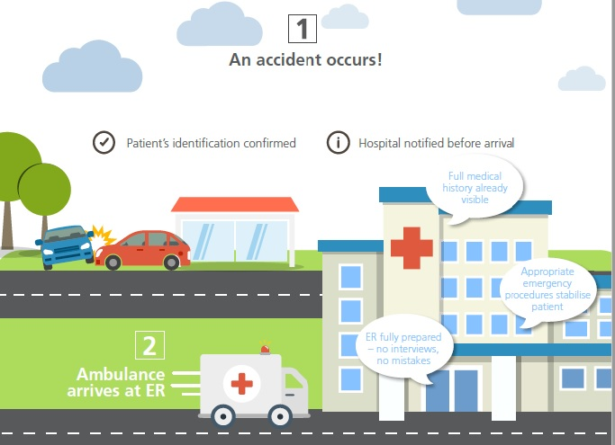
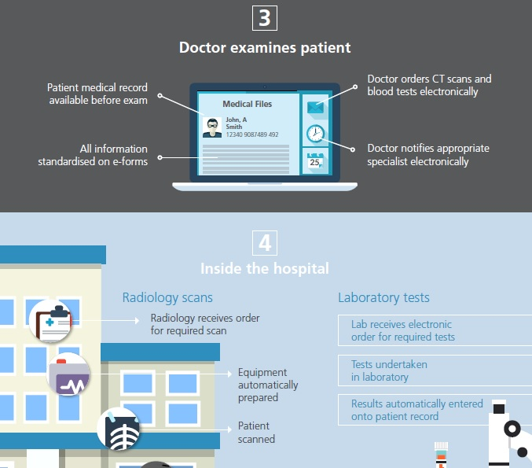
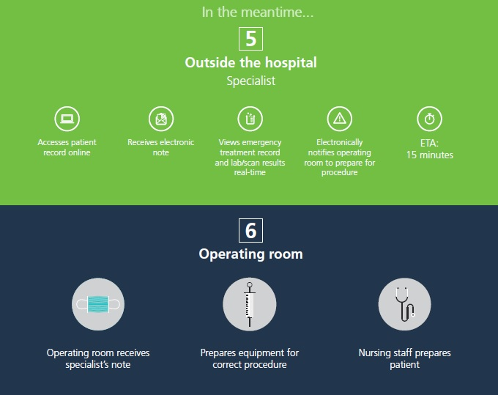
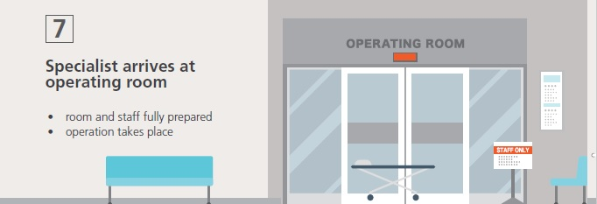
Emergency care in real-time
Sherrard Govender

Slide 44
Ingestible Sensors: Barton Health
Problem: >50% of prescribed medications are not taken as directed ¹
Opportunity: More effective patient therapy, whilst saving costs
Solution
Encapsulated sensor
Stomach activation
Transparent vitals relayed to physicians mobile
Sherrard Govender
1 (source: www.proteus.com)

Slide 45
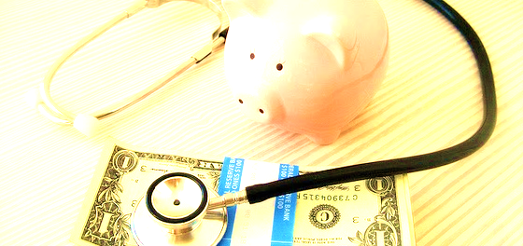
Ingestible Sensors: Barton Health
Outcomes
No unnecessary, costly changes in treatment
Better insights for the physicians
Better care and optimised therapies for the patients
TRIZ Trends: Boundary breakdown, Increasing transparency
Sherrard Govender

Slide 46
Thank You

