Slide 1
Health trends in digital innovations
By: Alexis PINEDA
Omar SAAD
Marco VON BARGEN

Slide 2
Companies and their TRIZ
Company name | Trends | Trend #
Patients like me | Boundary breakdown - Increasing transparency - Listening communication Theory | 1 - 6 - 20
Medtronic | Customer buying hierarchy - Decrease human involvement | 2 - 8
IBM and Pfizer IoT | Dynamization - Increasing transparency - Listening communicating theory | 3 - 6 - 20
Xilloc | Increasing dimensionality | 4
Inthellia Theurapetics | Increasing Asymmetry | 5
Isabel | Trimming / Reducing Complexity - Mono-Bi-Poly (Similar) | 7 - 15
Live Health Online | Customer Expectation evolve - Action coordination - Degrees of Freedom | 9 - 13 - 18
Cerebro | Rhythm coordination theory - Design point | 10 - 17
Apple Watch | Segmentation - Mono-Bi-Poly (Various) - Nesting Up | 11 - 14 - 19
EnChroma | Increasing use of senses | 12

Slide 3
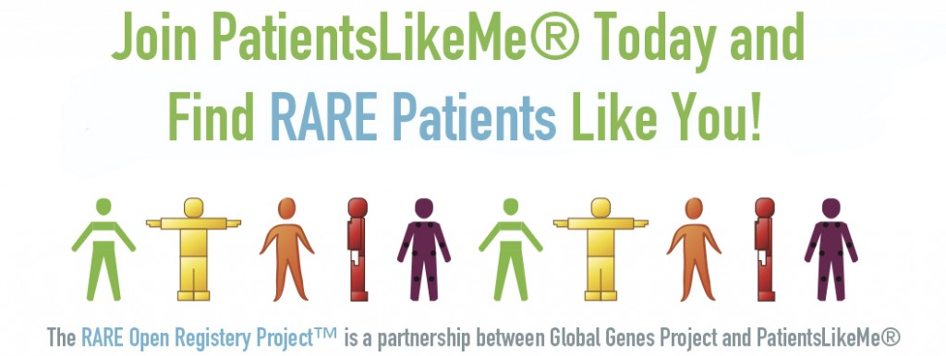
Patients like me: Medical Platform
A digital health learning system that uses the most advanced technologies to help you better understand wellness, aging, and disease from patients with the same health complications
Trend # 1: Boundary breakdown
Trend # 6 : Increasing transparency
Trend # 20: Listening Communication theory

Slide 4
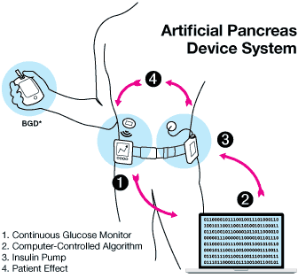
Medtronic: Artificial Pancreas Device System
Trend # 2: Customer buying hierarchy
Trend # 8: Decrease human involvement

Slide 5
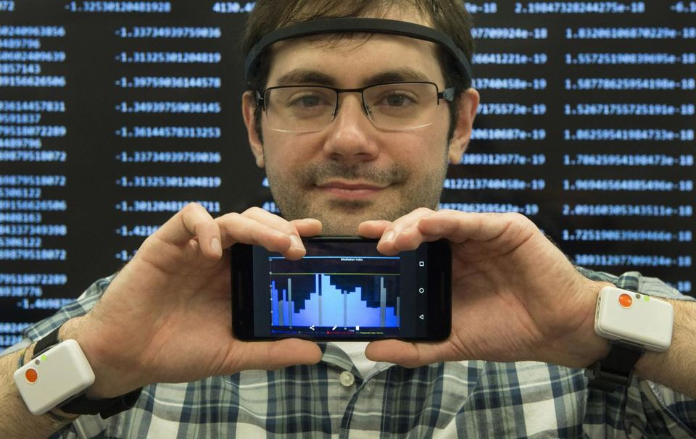
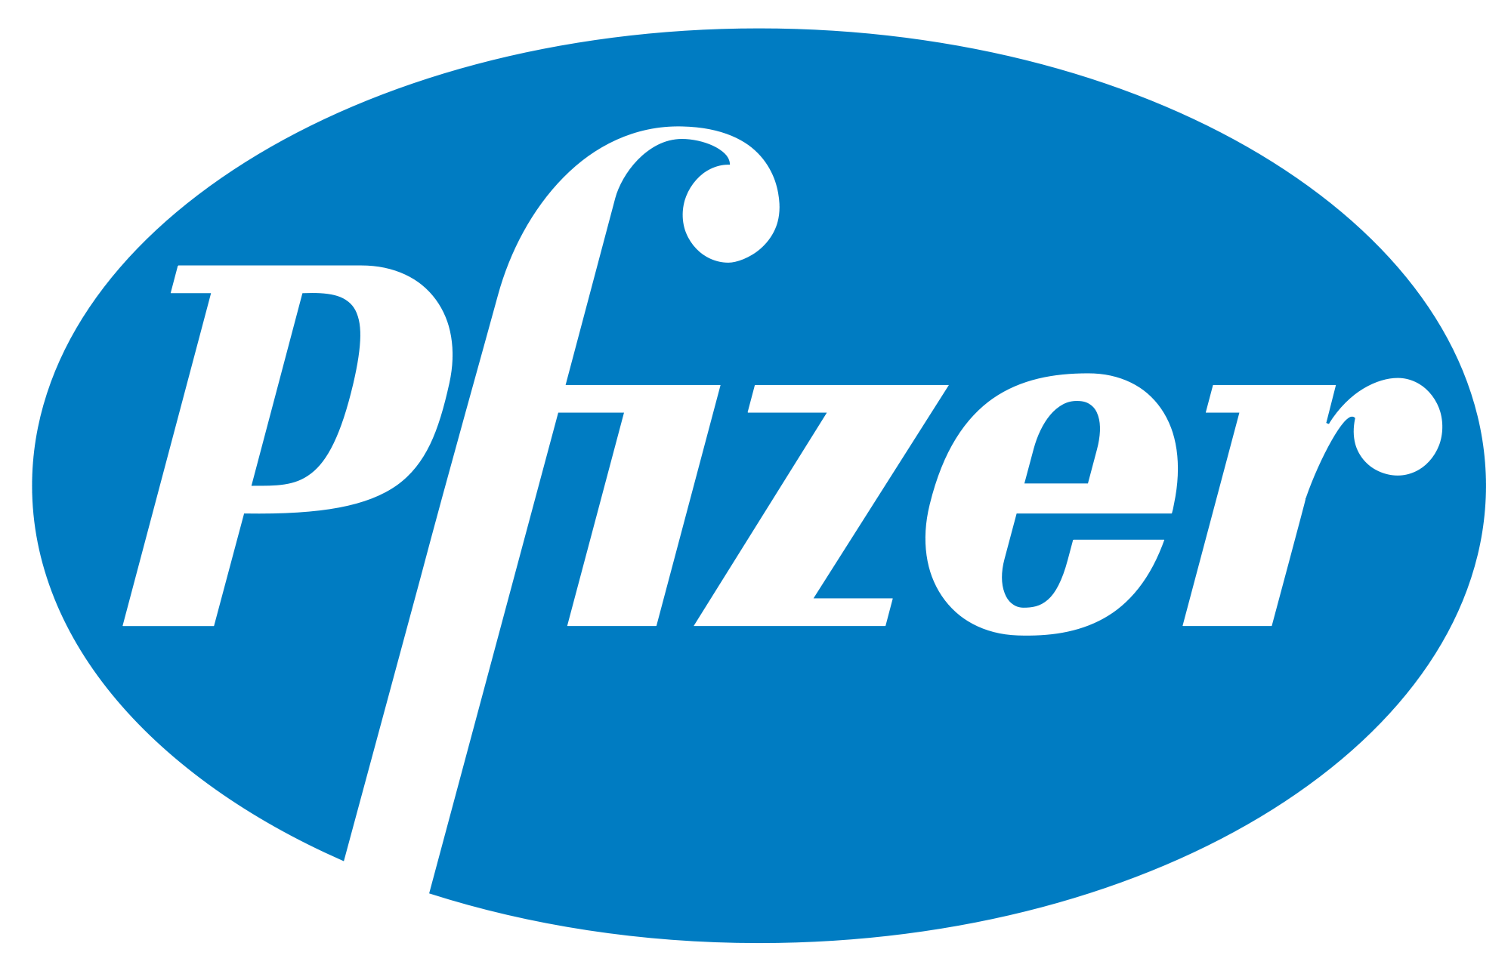
Pfizer/IBM - Internet of Things
The internet of things (IoT) is now connecting many health devices as sensors with patients and doctors to track in real-time the evolution of diseases.
Trend # 3: Dynamization
Trend # 6: Increasing transparency
Trend #20: Listening communication theory

Slide 6
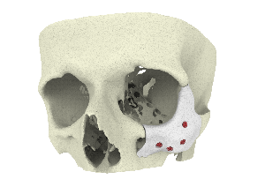
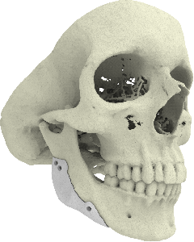
Xilloc: 3D printing of bones
3D printed CT-Bone implant for mandible augmentation
3D printed CT-Bone implant for zygoma augmentation
Trend # 4: Increasing Dimensionality

Slide 7
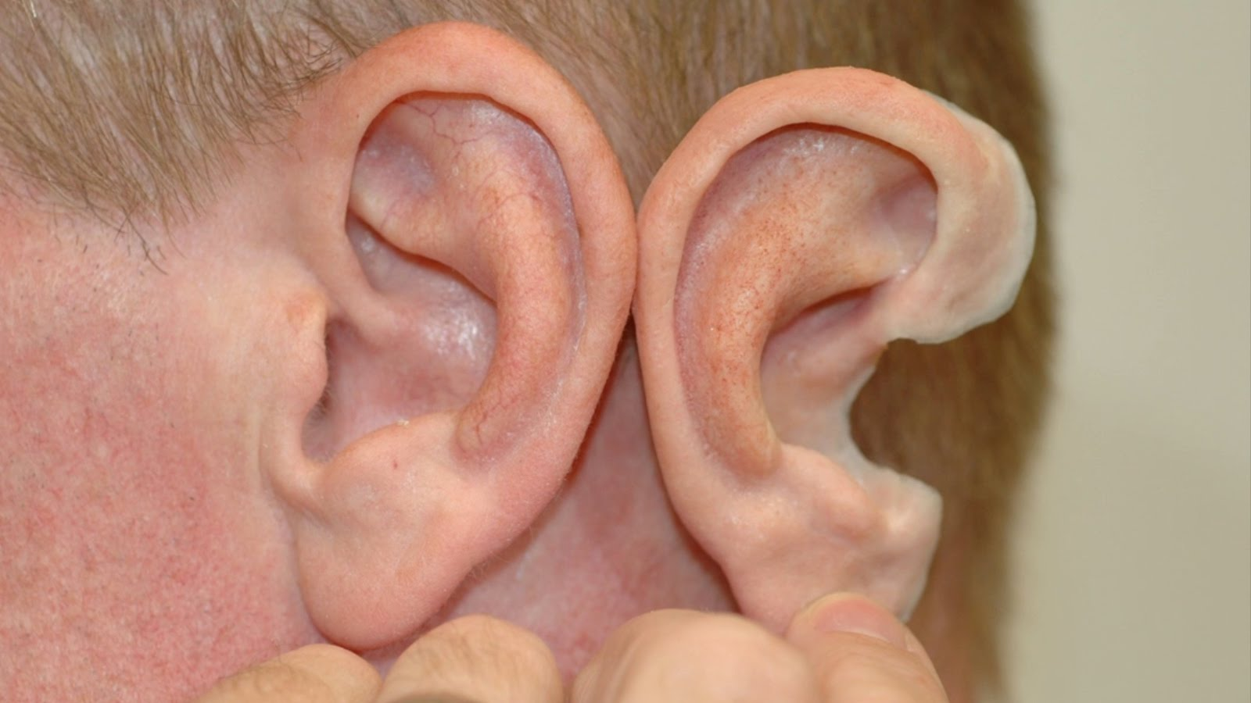
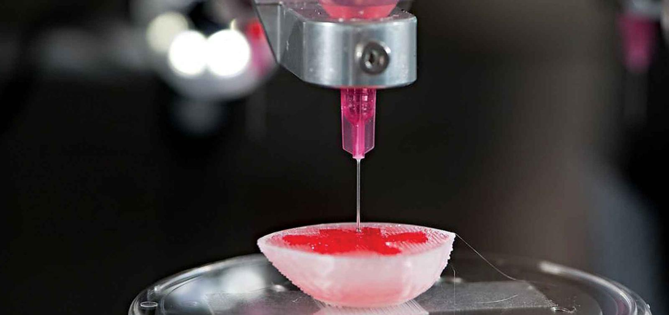
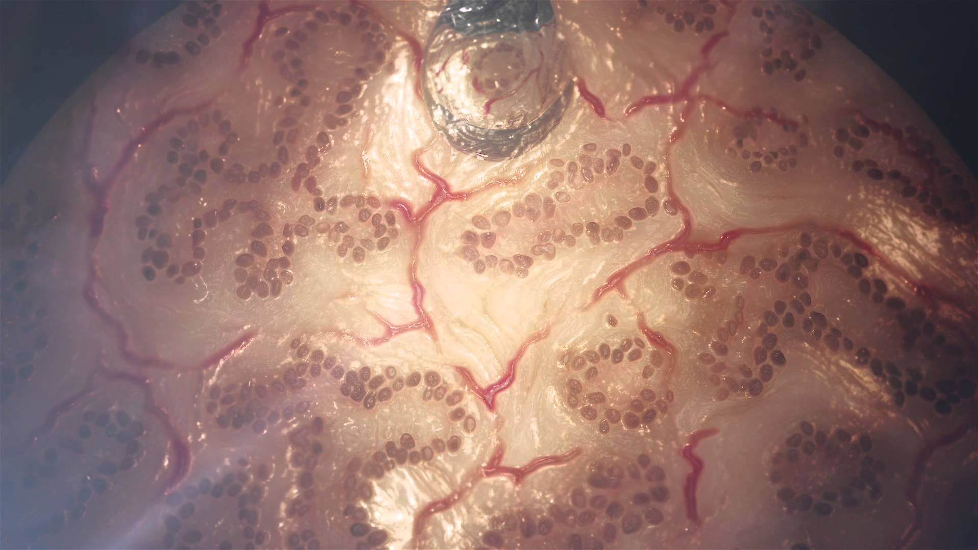
3D printing examples
Replicate Human ears
Blood vessels
Synthetic Organs
Printed drugs
Trend # 4: Increasing Dimensionality

Slide 8
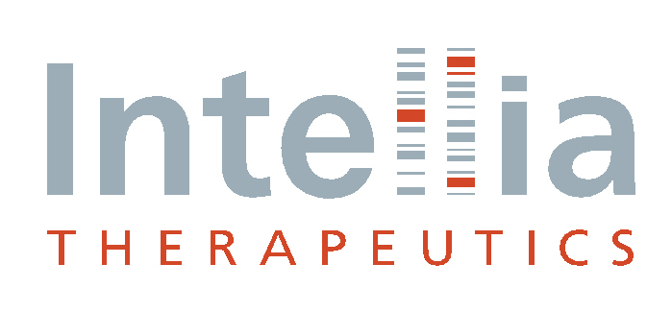
Intellia Therapeutics: Genome editing
Developing potentially curative genome editing treatments that can positively transform the lives of people living with severe and life-threatening diseases.
Trend # 5: Increasing asymmetry

Slide 9
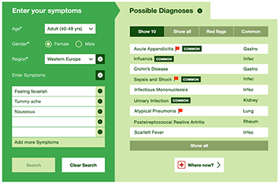
Isabel: Disease Pattern Recognition Engine
Platform (DPREP)
Use of medical database of diseases presented from the last two decades and link them with the clients to help them diagnoze their symptoms
Trend # 7: Trimming / Reducing complexity
Trend # 15: Mono-Bo-Poly (Similar)

Slide 10
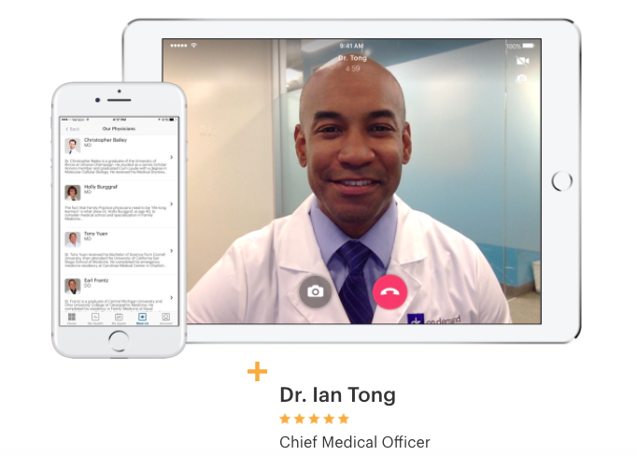
Live Health: Online video conference
with certified doctors
A platform that can link patients with doctors through a live video call whenever they want and wherever they were
Trend # 9: Customer expectation evolve
Trend # 13: Action coordination
Trend # 18: Degrees of Freedom

Slide 11
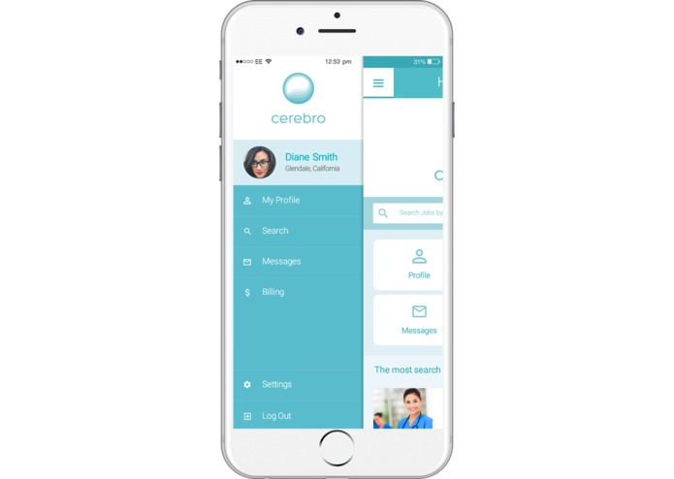
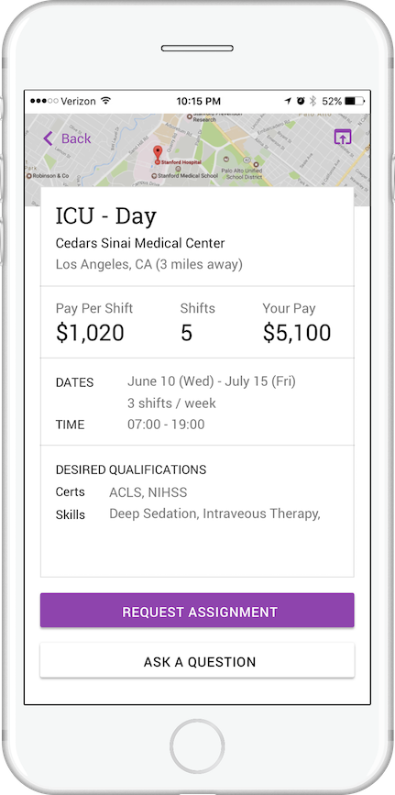
Cerebro: AI Nurse staffing platform
An AI Platform that connects hospitals with nurses, it is a labor market place for ready to work clinicians
Trend # 10: Rhythm coordination
Trend # 17: Design point

Slide 12
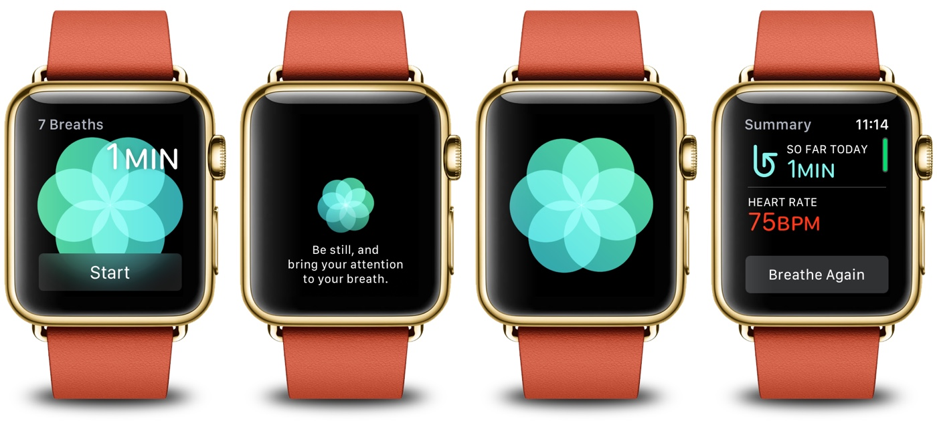
Apple Watch: Fitness and health tracker
The Apple Watch detect and measures your heart rate during the day making constant reports and collecting data. It can identify when you are stressed and suggest you to use the breath app in order to relax.
Trend # 11: Segmentation
Trend # 14: Mono-By-Poly (various)
Trend # 19 : Nesting up

Slide 13
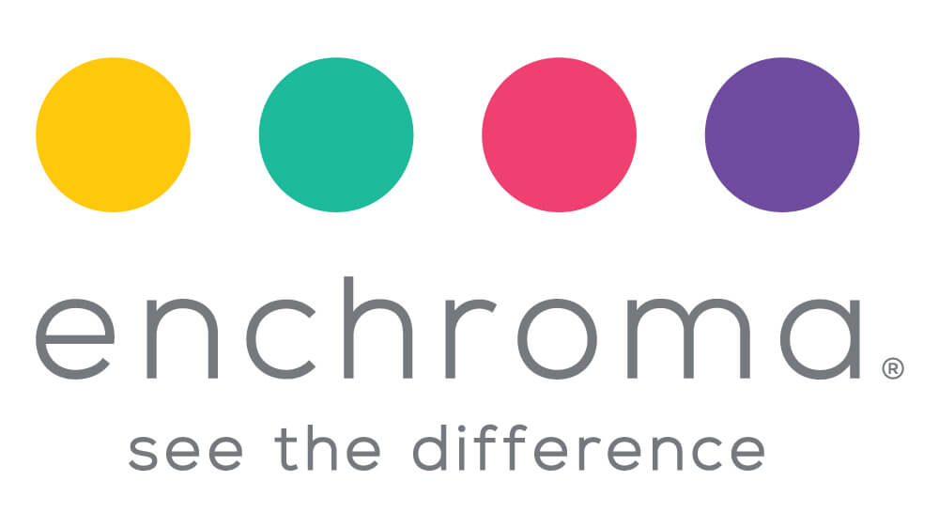
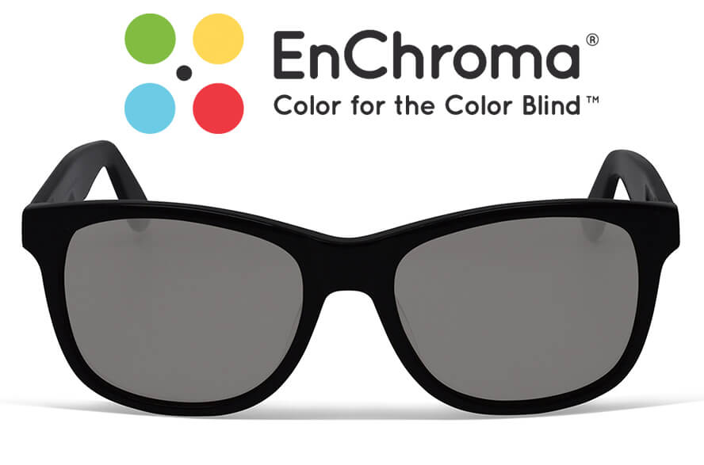
EnChroma: Glasses for the colorblind
EnChroma created glasses for the colorblind people to help them see colors
Trend # 12: Increasing use of senses

Slide 14
Thank you
&
Stay healthy

