Slide 1
Trends In Digital Innovations - Health Industry
“Innovation makes Life Easy and Simple”
Ajay Srinivaas Venkataraman
Ajith Kumar
Ronit Shirsat
Akshay Karande

Slide 2
Robotic
Decreasing Human Involvement Trend
In touch VITA FDA Class II
Most advanced robotic device with AutoDrive capabilities
Active Patient Monitoring
Doctor on different locations.
Major Customers Dignity Health, Grande Rond Hospital, Pinnacle Health.
http://www.cordamed.net/EN/rpvita.html

Slide 3
Light Bulbs That Disinfect & Kill Bacteria
Decreasing Human Involvement Trend
Sanitizing light that doesn’t harm humans
Kenall Manufacturing, North American Markets
Kills bacteria in the air, and on hard and soft surfaces

Slide 4
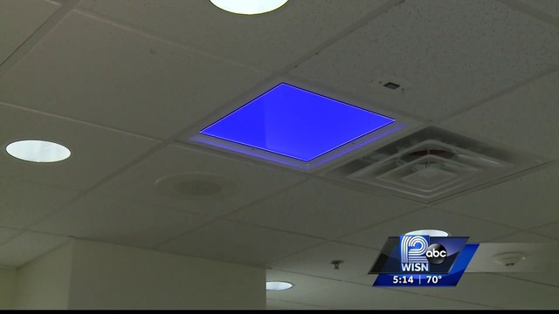
The 405nm emitted from Indigo-Clean reflects off walls and surfaces, penetrating harmful micro-organisms
Environmental Disinfection over a period of 8 Hours
Froedtert Hospital, Milwaukee,USA.

Slide 5
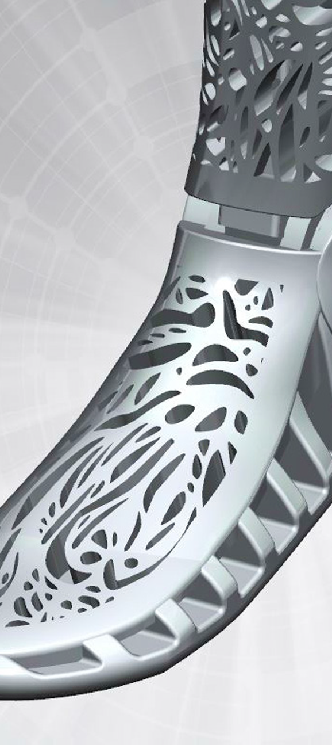
3D Prosthetic Parts
Increasing Asymmetry, Reducing Complexity Trend
Project Daniel in Nuba
Cyborg beast

Slide 6
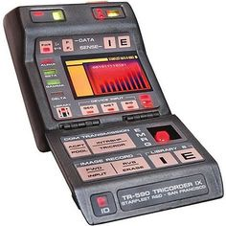
Star Trek Style Tricorder
Decreasing Human Involvement
Tricorders, used in the Star Trek universe, refer to the device’s three primary functions :sensing, computing and recording
With the help of device, a patient with a heart condition can collect a personal electrocardiogram (ECG), a record of the heart’s electrical activity
While the patient touches electrode-carrying sensors attached to the phone’s case, an associated app displays the patient’s heart rate and flags irregular rhythms known as atrial fibrillations sends data to Doctor.

Slide 7
AdhereTech – Wireless Pill Bottles
Design Thinking Trend
System automatically analyses information and secures data on Dashboard
Bottles collect and send real time data
Patients can receive automated Phone Calls, Customized Alerts for missing of dosage
Changes Colour for due time dosage

Slide 8
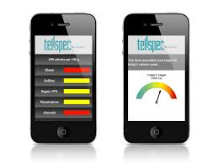
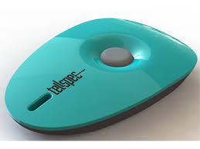
TellSpec - Isabel Hoffmann
Design point Trend
Quickly determines the chemical compounds in a given food, medicines and even plants
In milliseconds the ingredients and molecular make-up will appear on the User’s smart phone
User has to specify whether the sample is solid food, a liquid or vegetable/fruit
European Statistics - 220 to 250 million people

