Slide 1
Financial Services Banking & Stocks
Ingrid Svendsen, Simen Kindem & Thea Tofthagen

Slide 2
Agenda
Contactless payment
Mobile Banking
Security Systems
Peer-2-Peer lending
Bitcoin
Peer-2-Peer Payment
Stocks

Slide 3
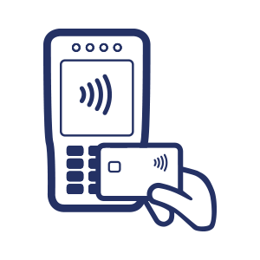
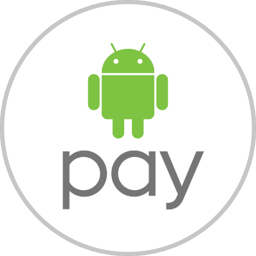
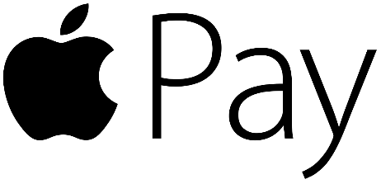
Contactless payment
Quick
Simple
Safe
NFC or RFID
Android Pay
Apple Pay
Credit/Debit cards

Slide 4
Mobile Banking
Will most likely take over for the online bank
Very common → variation in activities
E.g. deposit checks
HSBC, Santander, Bank of America, Axis
Complex applications
E.g. Axis→ Lime

Slide 5
Lime by Axis Bank
Axis Bank

Slide 6
Security Systems
Login to mobile banking
Digital secure key
HSBC, DNB, Santander
Fingerprint
DNB, Royal bank of Scotland, Bank of America
Transfer money
Voice recognition → Token payment
Axis Bank
Fingerprint
Axis Bank

Slide 7
Fingerprint scanning

Slide 8
Peer-2-Peer Lending
Fast growing
Zopa, Lending Club, Prosper, The Grey Market
Zopa → Safeguard trust

Slide 9
Peer-2-Peer Lending
Innovations:
Risk management
Technology
Cross border investment
Payment system outside banking
E.g. Bitcoin

Slide 10
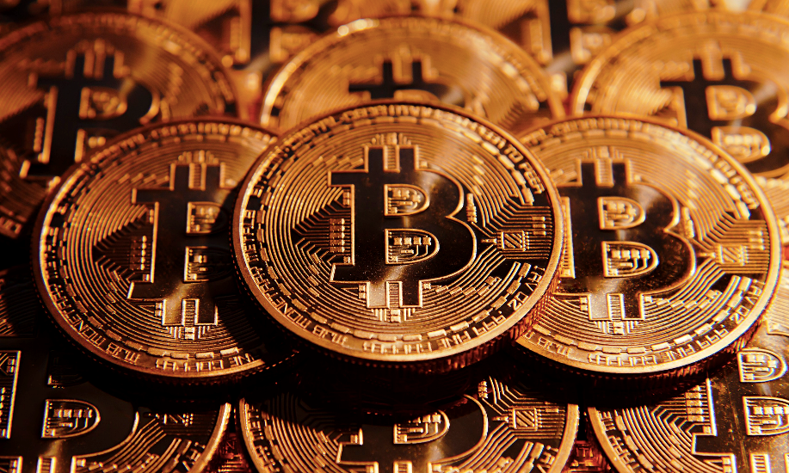
Bitcoin
Bitcoin is the largest digital currency
Isn't it only for criminals?

Slide 11
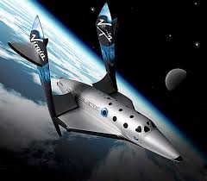
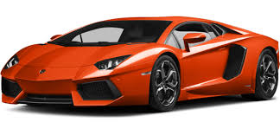
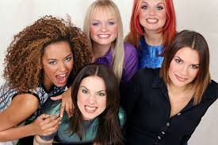
Bitcoin
Virgin Galactic
Will fly tourists to space
Accept Bitcoin as payment
Lamborghini
Accepts Bitcoin from February 2015
First motor company
Mel B
Spice girl member ”Scary Spice”
Started accepting Bitcoin
First musician

Slide 12
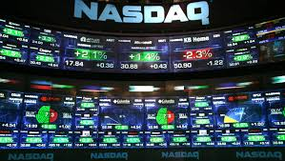
NASDAQ
NASDAQ opens for Bitcoin trading
People starting to understand the concept
Triggered to learn more

Slide 13
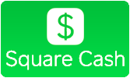
Peer-2-Peer Payment
Different providers in different countries
Transfer and request money
Easy and fast payment

Slide 14
Stocks
Large downsizing in the market departments
Computers simplifies
Maybe more to come?

Slide 15
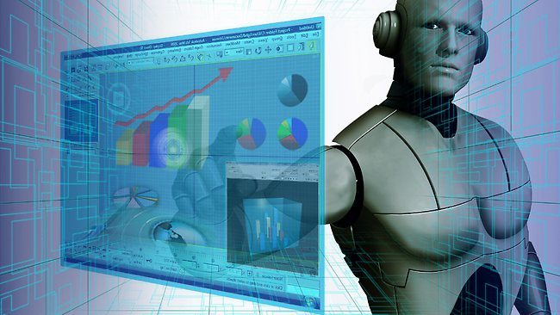
The Wolf of Wall-Tweet
$110 530 – $2 400 000 in one day
Scanning Trading-Tweets
New and powerful algorithm

Slide 16
How did it do it?
3 seconds to make a prediction
Faster then any human

Slide 17
Conclusion
Trend 2 → Customer buying hierarchy
Why do consumers accept?
User friendly, social influence, useful
Facilitating conditions→ can we always use it?
Trend 15 → Mono-Bi-Poly (similar)
Trend 18 → Degrees of freedom
Trend 19→ Nesting up

Slide 18
Any questions?

