Slide 1




TRENDS IN DIGITAL INNOVATIONS
FINANCAL INDUSTRY
KARIN PAULINA ROZARIO
LI YUTONG
XU TONG

Slide 2

CONTENTS
1
2
3
4
5
ALIPAY
HSBC
METROMILE
ZOPA
BRAC BANK

Slide 3

0
1
P A R T
ALIPAY
THIRD PARTY PAYMENT PLATFORM

Slide 4


BACKGROUND
· Alipay overtook PayPal as the world's largest mobile payment platform in 2013.
· In the fourth quarter of 2016, Alipay had a 54% share of China's US$5.5 trillion mobile payment market, by far the largest in the world.
· Internationally, more than 300 worldwide merchants use Alipay to sell directly to consumers in China.
· It currently supports transactions in 18 major foreign currencies, and Ant Financial also introduced a series of expansion to other countries.
· Established in Hangzhou, China in February 2004 by Alibaba Group
· Re-constructed in June 2010 due to the licensing regulations for third-party payment providers issued by Chinese government.
· Alipay launched a financial product platform called Yu'E Bao in 2013.
· Alipay's parent company was re-branded as Ant Financial Service Group in2015.
· Alipay unveiled their facial payment service.

Slide 5
THIRD PARTY PAYMENT PLATFORM
· Redundant paying procedure and insufficient popularization of credit cards
· QR Code
· Existence of a large number of applications which have different functions
· Integration
PROBLEMS
INNOVATIONS
· Third-party payment platforms' incapability of deals on credit
· Sesame Credit & Ant Credit Pay
· Customers' need to gain profit by saving
· Yu'E Bao

Slide 6
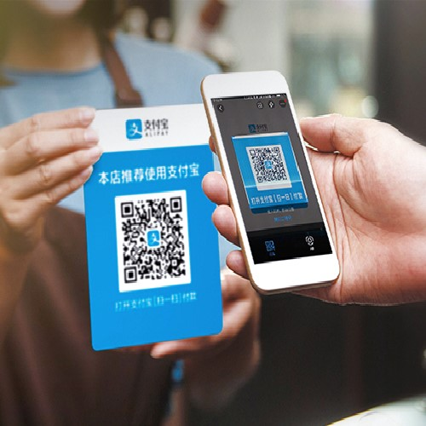

QR Code
· Quick Response Code can be read by an imaging device and processed. The required data are then extracted from patterns that are present in both horizontal and vertical components of the image, as depicted below.
· All users of Alipay, including huge chain supermarkets, small shops&vendors, and individuals can get access to it.
· Customers can validate their payment through passwords, fingerprints, voice recognition, and face recognition.
· A new type of QR code was introduced to serve multiple third-party payment platforms.
TRIZ Trends:
· Increasing dimensions
· Reducing Complexity
· Decreasing Human Involvement
· Increasing use of senses

Slide 7
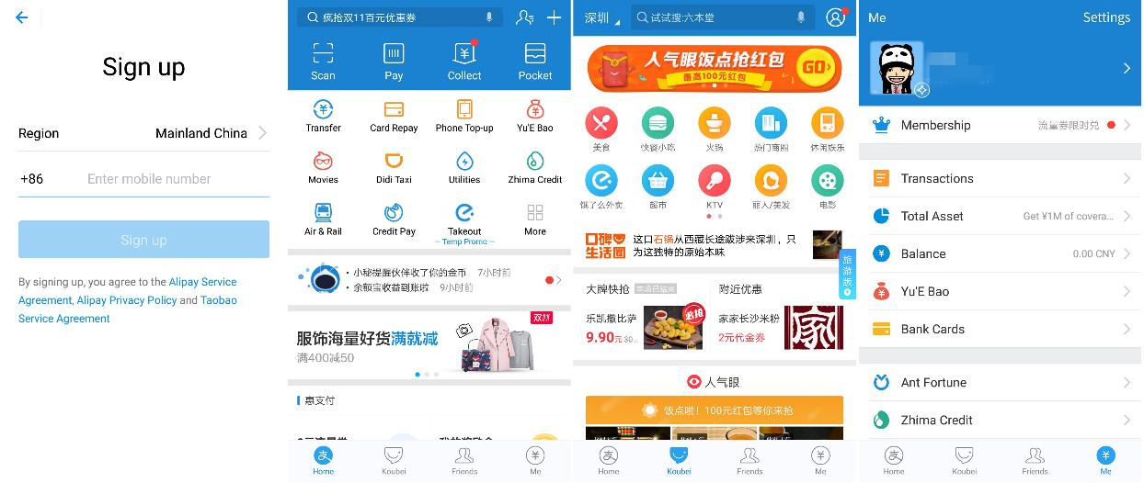
Integration
· Close cooperation with Alibaba Group's subsidiary companies like TaoBao, Tmall, and all the financial products of Ant Financial Services Group.
· Integration with other companies like Uber, Didi Taxi(taxi booking apps), Elema(takeout app), Youku(Internet video portal), Fliggy(airline and train ticket booking app) and so on.
· More and more functions of living payment are developed and Chinese people can basically pay for everything through Alipay and do not have to carry cash or even credit card to everywhere.
TRIZ Trends:
· Nesting up
· Customer expectation evolve
· Mono-Bi-Poly(various)

Slide 8
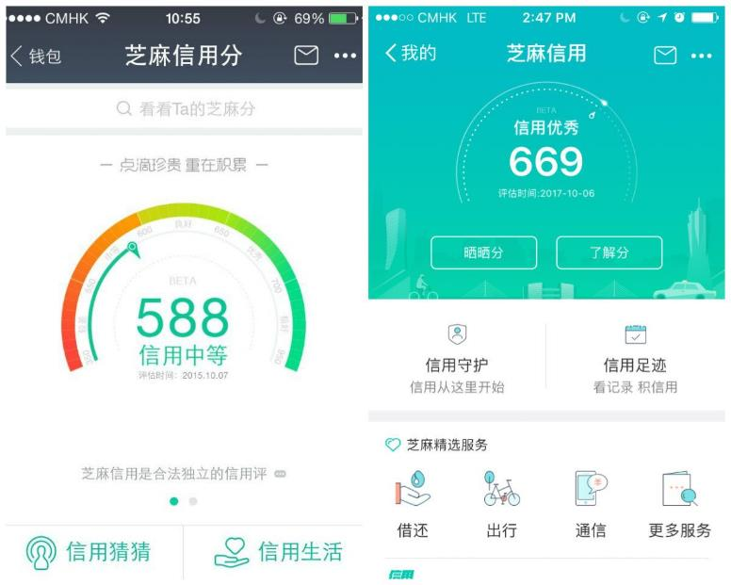
Sesame Credit& Ant Credit Pay
· Alipay initially combined third-party payment platform with approaches on credit paying.
· Sesame credit will evaluate users' financial and consuming performance to give them a score which indicates different credit lines.
· Users can apply for rises with their credit lines.
· TRIZ Trends
Design point
Decreasing human involvement

Slide 9
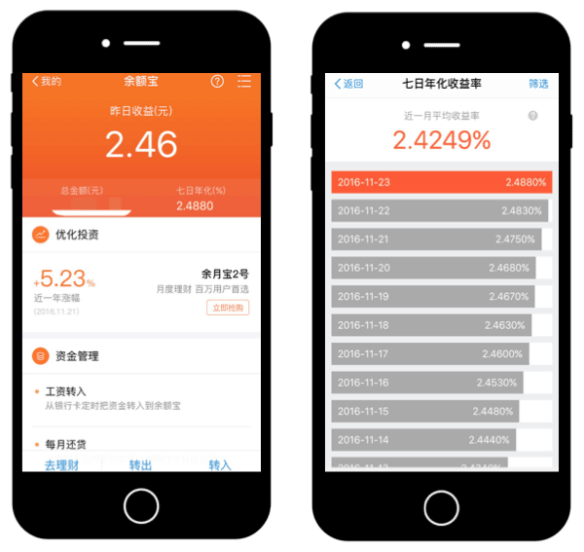
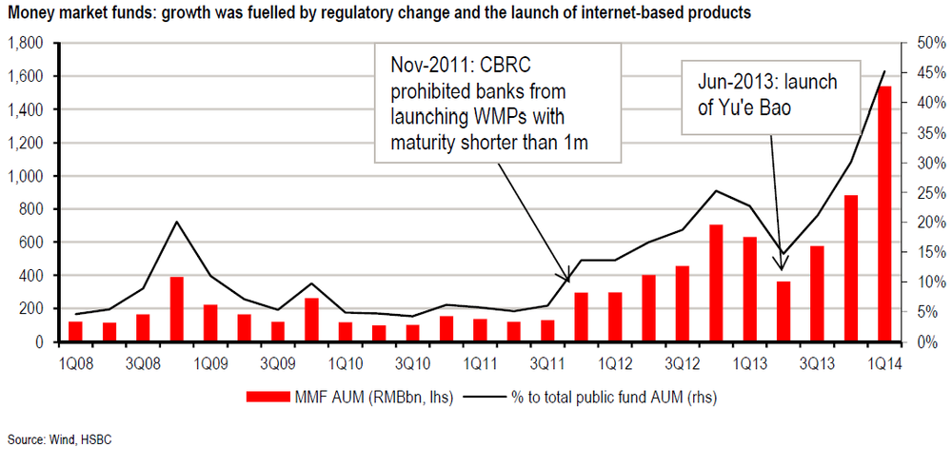
Yu'E Bao
· Yu'E Bao provides value-added services and currency-management services.
· Main features: no service charge, easy operation, no entry barriers
TRIZ Trends:
Customer buying hierarchy
Customer expectation evolve

Slide 10

0
2
P A R T
HSBC
BANK

Slide 11

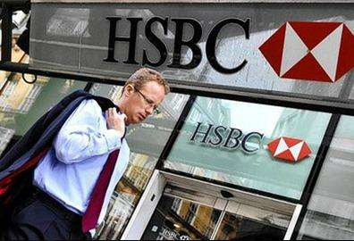
BACKGROUND
· Established in March 1865 by Thomas Sutherland to meet coastal region of China and Hong Kong's urgent need of financing.
· Initially HSBC dealt with businesses including TF(trade financing), gold bullion trading, foreign exchange services and so on.
· In 1900s, HSBC has already expanded its services to 16 countries and regions.
· From 1970s, HSBC continued its expansion through acquisition.
· HSBC bought Marine Midland Bank in the US in the 1980s and the newly created HSBC Holdings plc made a recommended offer for full ownership of the UK’s Midland Bank in 1992. Following the acquisition, HSBC moved its headquarters to London.
· Currently HSBC is one of the world’s largest banking and financial services organizations with 38 million customers from 67 countries and territories who are provided with four global businesses: Retail Banking and Wealth Management, Commercial Banking, Global Banking and Markets, and Global Private Banking.
· HSBC reported profits of US$17.2 billion before tax in 2017 and named “World's Best Bank” in the Euro money Awards for Excellence.

Slide 12
Bank: HSBC
· Customers' needs for more motilities in their financing
· HSBC Nudge
· Traditional pattern with a third-party organization dealing with information of transactions has its drawbacks of high operational charges, asymmetry of information and aggravation of frauds
PROBLEMS
INNOVATIONS
· Blockchain Technology

Slide 13
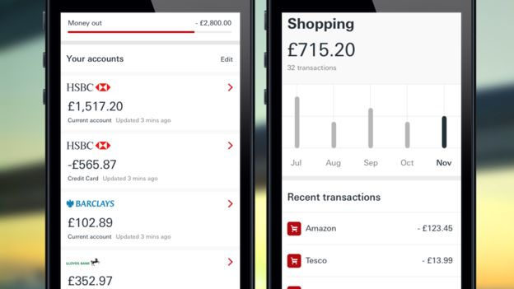
HSBC Nudge
· This application will help people track what they spend money on, and will "nudge" them if they exceed their spending limits.
· It lets people break down their spending into easily visible categories such as groceries, entertainment, coffee and utility bills.
· Customers will also be able to add accounts from 21 rivals including Lloyds and NatWest, to keep track of all their balances in one app.
TRIZ Trends:
Increasing asymmetry
Decreasing human involvement
Improved listening
Mono-Bi-Poly(similar)

Slide 14


Blockchain Technology
· Blockchain technology refers to a reliable database which is collectively-maintained through decentralized and trustless approaches.
· Blockchain technology can transparentize the whole procedure of transactions and provide the intact information flow.
· Blockchain technology can also speed up the transactions and eliminate frauds.
TRIZ Trends:
Increasing transparency
Reducing complexity

Slide 15

0
3
P A R T
METROMILE
INSURANCE

Slide 16
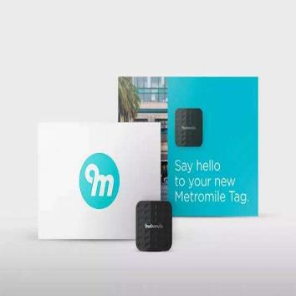
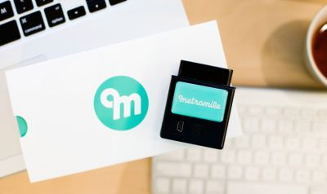
BACKGROUND
Metromile is a san Francisco-based car insurance startup that offers pay-per-mile insurance and a driving app
It was founded in Redwood City, CA in 2011 by David Friedberg and Steve Pretre.
Pay-per-mile insurance is a type of usage-based insurance where the user pays a base rate along with a fixed rate per mile. The billing model is intended to benefit low-mileage drivers and does not take driving style or behavior into account (for determining rates or discounts). To measure mileage, the Metromile Pulse device is plugged into the onboard diagnostic (OBD-II) port of the car. The OBD-II port is the same port that mechanics use to diagnose issues that trigger a car’s “check engine” light. The device then transmits mileage data to servers. Metromile provides a full customer service team and 24/7 claims team.

Slide 17
LENDING COMPANY
Seventy percent of American car owners overpay for insurance because they don’t drive much.
Metro Mile used “Per Mile Car Insurance Policy”
PROBLEMS
INNOVATIONS

Slide 18

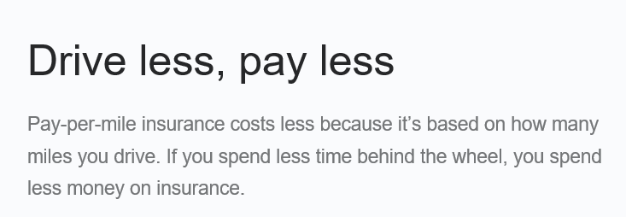

PAY PER MILE INSURANCE
In car insurance industry, people typically pay a fixed fee for using car the entire tear.
Seventy percent of American car owners overpay for insurance because they don’t drive much.
Metro Mile comes out of stealth to launch its per mile car insurance. People will pay at the moment they will use car.
TRIZ TREND:
Rhythm Co-Ordination

Slide 19

0
4
P A R T
ZOPA
LENDING COMPANY

Slide 20

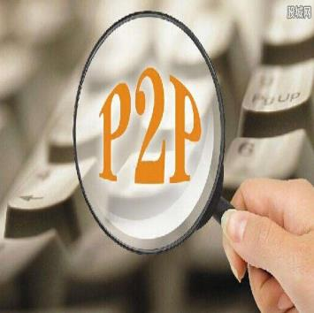
BACKGROUND
Zopa is a UK online personal finance peer to peer company founded in 2004. It launched in the UK in March 2005.Zopa was the first peer-to-peer lending company and one of the earliest fetch firms.
In September 2016, the first portfolio of Zopa loans was securitized on the European markets.[
In November 2016, Zopa announced that it would apply for a banking license in order to offer customers a broader set of personal finance products.[
In January 2017, Zopa became the first UK based peer-to-peer lending company to lend more than £2 billion worth of loans. Zopa became fully regulated by the Financial Conduct Authority in May 2017. Following FCA authorization, and HMRC approval as an Individual Saving Account(ISA) manager, Zopa started offering its Innovative Finance ISA products in June 2017.

Slide 21
LENDING COMPANY
In the past people had to go to classic financial institutions to get loan.
Now a days Peer-to-Peer lending platforms such as Zopa, enable us to loan money from anybody
PROBLEMS
INNOVATIONS

Slide 22

Peer to Peer: Zopa
TRIZ TREND:
Dynamization
Peer-to-peer lending, also abbreviated as P2P lending, is the practice of lending money to individuals or businesses through online services that match lenders with borrowers

Slide 23

0
5
P A R T
BRAC BANK
BANK

Slide 24


BACKGROUND
BRAC Bank is a private commercial bank in Bangladesh focused on Small and Medium Enterprises (SME)
BRAC Bank was founded on 4 July 2001 to reach the large number of unbanked people which were not covered by traditional bank. The main concept of the bank was to facilitate Small and Medium Enterprises (SME)
Financial services of BRAC Bank are -SME Banking, Retails Banking, Card Service (Credit & Debit), Foreign Exchange & Related Services, Wholesale Banking & Custodial Service.
Type: Public Limited
Industry: Financial Services Banking
Headquarters: Dhaka, Bangladesh
Number of Employees: 8000
Parent: BRAC, IFIC
Website: www.brcbank.com

Slide 25
LENDING COMPANY
Introduces ERP, ORACLE
Using QUEUE management system
They were facing problem with sharing operational data
Queue was alarming sign for BRAC Bank
PROBLEMS
INNOVATIONS

Slide 26


BRAC Bank : ERP, Oracle technology https://www.youtube.com/watch?v=_v3xK2WChIw
ERP delivers a single database that contains all data for the software modules, which would include: Accounting & Financials, Human Resources, Customer Relationship Management.
ERP technology allows BRAC bank a unified global financial management process and a flexible operating model to quickly respond to changing regulatory mandates and shifts in the marketplace.
TRIZ TREND:
Boundary Breakdown

Slide 27

BRAC Bank: Queue Management
In retail banking industry, queuing remains one of the most common reasons for customer disgust. Despite technological advances such as online and mobile banking, customers still complain about their bank.
BRAC Bank is using queue management system at their branches to improve customer flow and experience.
This system improves the level of service, enables focused improvement for specific customer segments and branch operations
TRIZ TREND:
Action Coordination

Slide 28
THANK
YOU

