Slide 1
Digital Innovations: Finance
Niel Joubert
Tshepo Masoeu

Slide 2
Robo-advice: Sygnia Asset Management
Financial advisors and analysts are replaced by robo-advisors that have the data needed to make split-second, informed decisions.
What is a Robo-Advisor?
<VIDEO>

Slide 3
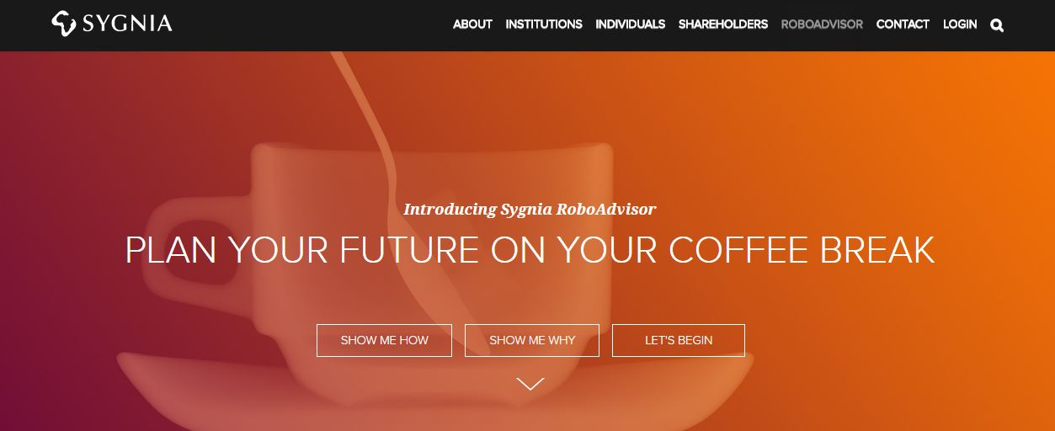
How does it work?
Everything online
Provide Sygnia with user information, goals and risk tolerance
Robo-advisor uses algorithms and AI to construct porfolio
Constant management of portfolio

Slide 4
Problems / Opportunities
Accessible to anyone
Low cost
Easy to understand
Technology instead of emotions
Transparency

Slide 5
TRIZ
Segmentation (more specific information per customer)
Decrease human involvement
Increasing Asymmetry
Increasing Transparency
Trimming complexity

Slide 6
Chatbots: Mastercard
Chatbots use artificial intelligence (AI) to simulate intelligent conversation through written or spoken text
Do basic banking on chat platforms like WeChat, Slack, Facebook Messenger and WhatsApp
Check bank balances, pay accounts, see where money was spent
<VIDEO>

Slide 7
Problems / Opportunities
Connect to customers through channels they are actively using
Provide immediate and 24/7 response
Free up staff to focus on more complex customer issues that require deeper human insight
Bank can learn what individual customers regularly ask for

Slide 8
TRIZ
Segmentation (more specific information per customer)
Decrease human involvement
Boundary Breakdown
Nesting
Listening / Communication

Slide 9
What is the technology
Discovery VitalityDrive
It is a unique driver behaviour programme that rewards for driving well. The better you drive, the greater your rewards.
Once you join, you will have to install DQ-Track which uses the latest technology to measure your driving behaviour and provide you with a range of state-of-the-art vehicle and passenger safety features.
Your DQ-Track will measure your braking, acceleration, cornering, speeding, distance, late-night driving and cellphone use. The prices of securities fully reflect available information.
They says they will not use DQ-Track information in the event of a claim, other than to confirm the time and place of an incident

Slide 10
How it works
This smartphone-enabled DQ-Track is made up of two components – the Discovery Insure app, and the tag.
The app, which is available for Apple and most Android smartphones, uses accelerometer, gyroscope and GPS data to measure your driving behaviour. The tag, which is placed on your car’s windscreen, will verify that you are driving your car, collect and store information when there is no cellphone reception, and create smartphone battery efficiency.
ImpactAlert detects a severe accident and provides immediate emergency assistance, if required.
Weather warnings will give you real-time weather alert SMS’s to help you avoid damage to your vehicle.

Slide 11
TRIZ
Customer buying hierarchy (All other things being equal, customers are likely to buy a product in the cheapest store)
Transparency (More transparency about pricing)
Segmentation (more specific information per customer)
Degrees of freedom (get more service)

Slide 12
Video – Discovery Vitality-Drive

Slide 13
What is the technology
Acorns Saving App (USA)
Acorns is an investment App that allows users to “round up” their purchases and invest the spare change into various portfolio structures.
The idea is to create an easy entry into the stock market for younger, new investors, removing traditional entry barriers such as high fees and buy in prices.

Slide 14
How it works
The Round-Up transfers come from monitoring your linked account and rounding up the purchases to the nearest dollar.
For example, if you spent R22.43 at the petrol station this week, R0.57 will be added to your Round-Up balance. Once the total reaches R5, the money is withdrawn from my bank account and added to my Acorns investment.
Acorns constructs and optimizes 5 diversified portfolios with help from the Nobel Prize winning economist Harry Markowitz.
It costs significantly less than a stockbroker and easy to use.

Slide 15
TRIZ
Customer buying hierarchy (All other things being equal, customers are likely to buy a product in the cheapest store)
Trimming (We can for example create convenience for the customer through trimming)
Segmentation (more specific information per customer)
Decrease human involvement (saving made easy)

Slide 16
Video – Acorns

