Slide 1
Digital Innovations in Finance
Karla Alejandra Gonzalez Bejarano
Anna Sannino
Raphael Levi

Slide 2
Agenda
P2P insurance
Using IoT in the insurance industry
Social banking
Safety measures for online banking
Blockchain technology

Slide 3
Insurance

Slide 4
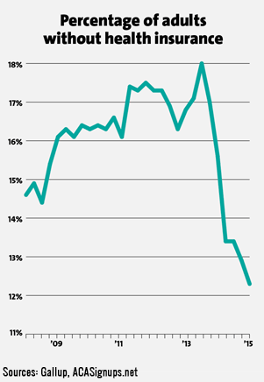
P2P Insurance
In some countries, health care is complicated
Very expensive to get a good insurance policy
Obamacare in the US ➔ 13% american without insurance

Slide 5
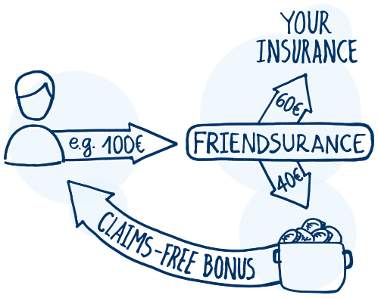
Policy owners with same insurance type gather together
Part of their premium is paid into a cash pool
No claims, get the money back
Small claim, claim free bonus decrease for everyone

Slide 6
The benefits of P2P Insurance
If the cost of insurance is reduced, many uninsured people will buy an insurance policy
Drop in fraud because everyone is connected socially
Rejection bad risk pro les
Reduction of cost of sales, process costs, and administration cost

Slide 7
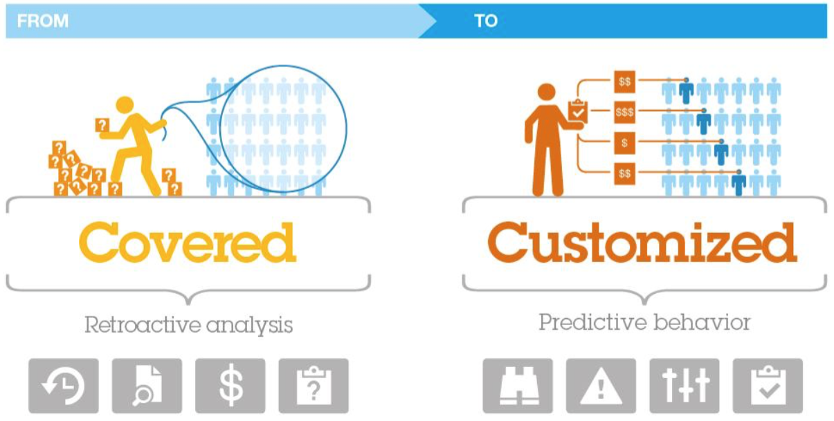
The insurance market upheaval

Slide 8
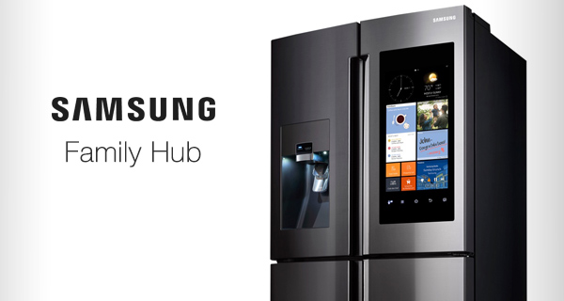
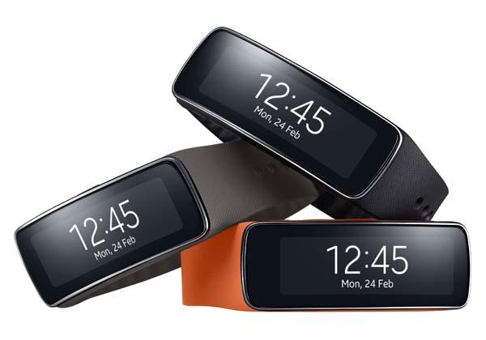
New data gathering
Best way to adapt a product is to know the customer
IoT ➔ Object or network helping to gather and transmit information from and to specific objects

Slide 9
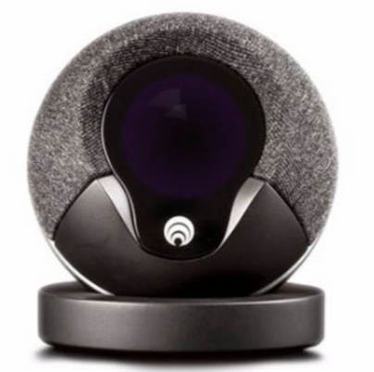
Cocoon and Aviva
Security system for any house
Using your phone, you can control your entire house
Sends a message if detects anormal activity
reduce turn-around time for initiation of claims by tracing the exact location and circumstances responsible for the claim

Slide 10
Banking

Slide 11
Customers’ expectations challenges in the Banking Field
Real time-responses
Personalization and convenience
Faster and easier online banking transactions in business-to-business, business-to-consumer and consumer-to-consumer interactions

Slide 12
Application for swift transactions between clients of the same or different banks, in a social network format.
Simple, fast and secure
Unrestricted Network
Registration: Mobile Number, IBAN, Defining PIN
Activation: Code via SMS
Authentication: Unique PIN

Slide 13
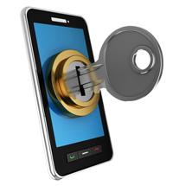
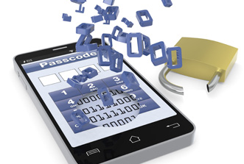
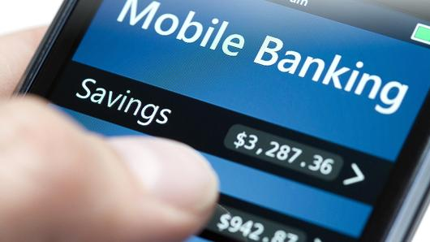
Threats in mobile and online banking
New account fraud
Need to verify identity in high-risk transactions like Log in, Transactions or password resets
Account fraud or Account takeover through Remote Access Tools
Man-in-the-Browser and Man-in-the-App attacks
Data manipulation
Spoofing

Slide 14
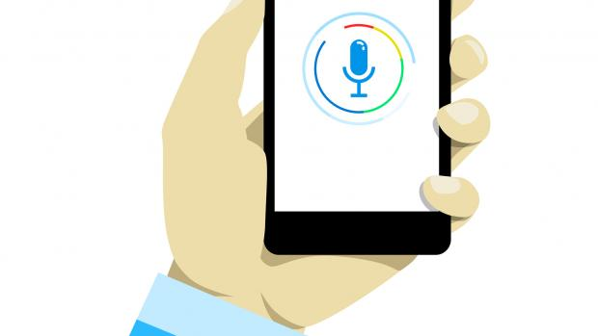
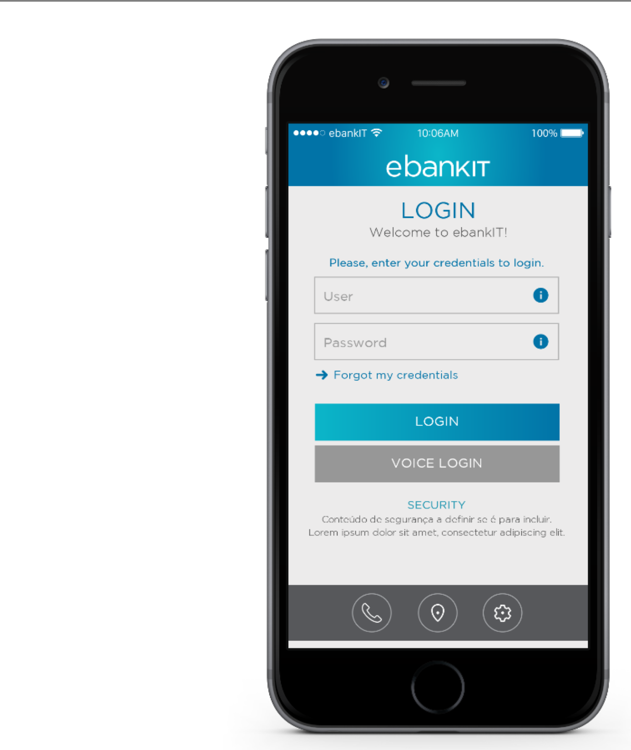
VOICE BANKING
In a simple, intuitive way, customers can give instructions and receive feedback by voice to interact with their finances, integrated with their car software and mobile apps.

Slide 15
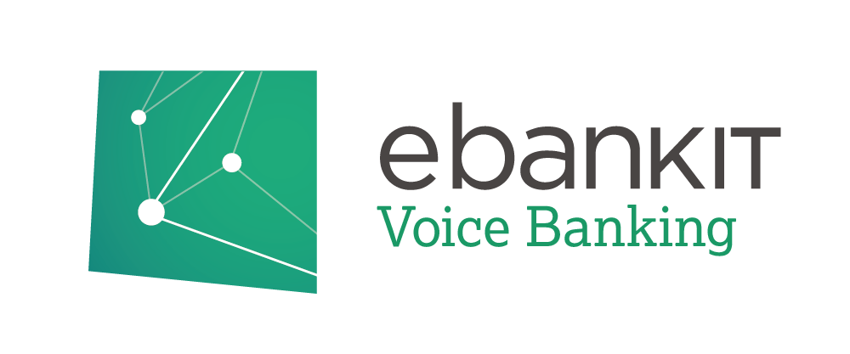
Quick and convenient login procedure
Shorter time and lower costs of customer service
Unified verification process
The highest level of security
Allows customers to verify their identity simply by speaking, making it easier and faster to gain access to secure banking services

Slide 16
BioCatch Protects Over 33 Million Global Banking Customers
BioCatch analyzes over 500 parameters to create a unique user profile that cannot be lost, stolen, or imitated.
Cognitive traits typical of eye-hand coordination, behavior patterns, usage preferences, device interaction patterns, and responsiveness to Invisible Cognitive Challenges
Physiological factors include left/right handedness, press-size, hand tremor, arm size, and muscle usage.
Contextual factors like device ID, network, geolocation, transaction and navigation behaviors.

Slide 17
Stock

Slide 18
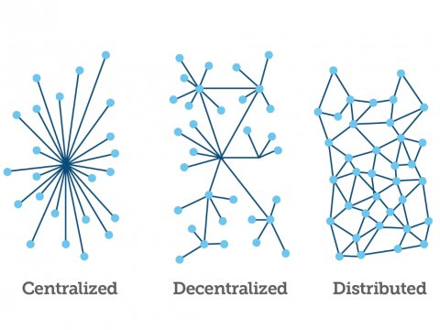
TECHNOLOGY TO POWER OPEN FINANCE
Simple
Secure
Safe
Distributed database that keeps track of what happens in the bitcoin market and to avoid fraud.
Each transaction represents a chain block.
It uses peer-to-peer technology and anyone can download it from the web, making it a network node.

Slide 19
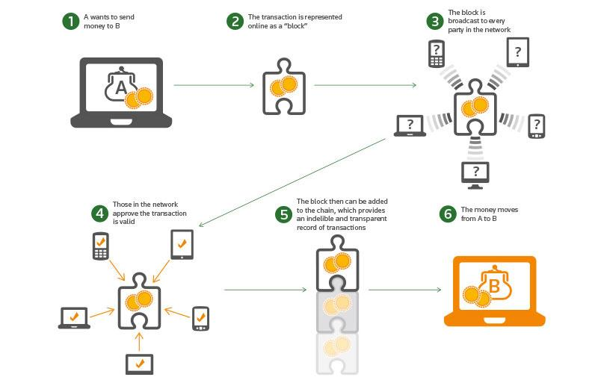
How Blockchain works

Slide 20
“Insurance for the sharing economy needs to be flexible and responsive to customer needs. Our distributed ledger approach, developed by Z/Yen Group, offers the opportunity to coordinate the provision of products between counter-parties in near real-time and to radically cut the cost of this coordination.”
Alex Steinart, SafeShare Global Co-Founder states

Slide 21
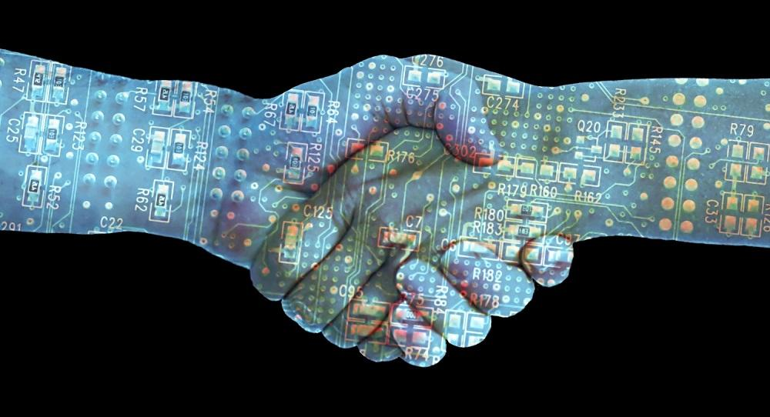
Reduce the probability of frauds
Automate the process
Lower costs
Increase the speed
Strengthen security
SafeShare uses blockchain technology to offer coverage to the users of Vrumi, a startup that allows people to rent out spare rooms in their houses for businesses to set up an office.

Slide 22
Trends
 | P2P Insurance | IoT in Insurance | Social banking | Biocatch | Voice Banking | Blockchain
Boundary Breakdown | X |  |  |  |  | X
Customer buying hierarchy |  |  | X | X
Dynamization |  | X | X |  | X
Increasing Dimensionality
Increasing Asymmetry |  |  | X | X
Increasing Transparancy | X |  |  | X |  | X
Trimming/reducing complexity | X | X | X |  | X | X
Decrease human involvement |  | X |  | X
Customer expectation | X |  | X |  |  | X
Rhythm co-ordination

Slide 23
Trends
 | P2P Insurance | IoT in Insurance | Social banking | Biocatch | Voice Banking | Blockchain
Segmentation
Increasing use of senses
Action Coordination | X |  |  |  |  | X
Mono-Bi-Poly Various
Mono-Bi-Poly Similar |  |  |  | X
Mono-Bi-Poly(increasing differences)
Design point |  |  | X
Degrees of freedom | X |  |  |  | X
Nesting
Listening/communication |  |  |  | X

