Slide 1
Finance Industry
Mansi Pithva
Silly Patniak
Alfredo Ravard
Nishant Arunagiri

Slide 2
Agenda
Part A - 5 Finantial Trends & Companies
The Bank of Asia
Clarity Money
Sygnia Asset Management
eBankIT
Lemonade
PartB – Discovery Insure
Digital Innovation
UTAUT
Business Model & Barriers

Slide 3
Agenda
Part A - 5 Finantial Trends & Companies
The Bank of Asia
Clarity Money
Sygnia Asset Management
eBankIT
Lemonade
PartB – Discovery Insure
Digital Innovation
UTAUT
Business Model & Barriers

Slide 4
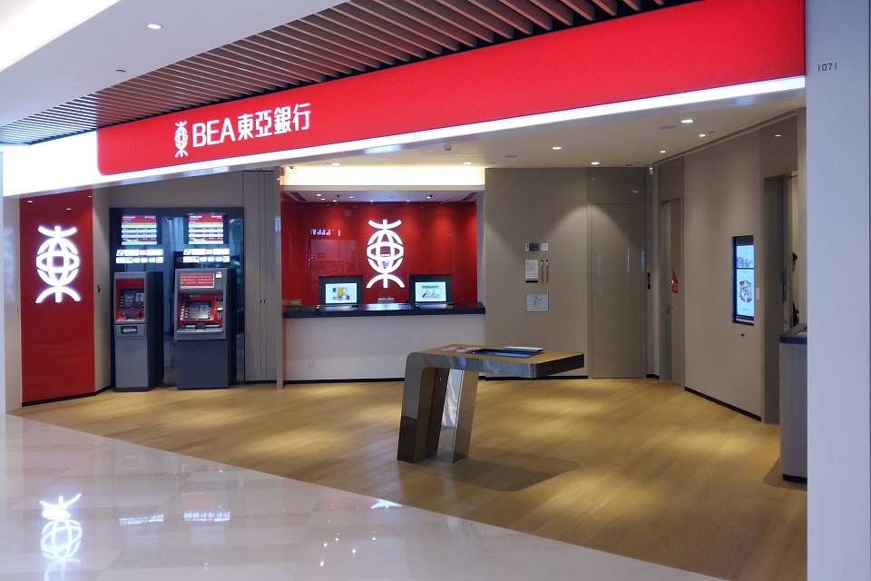
BANK OF EAST ASIA
To appeal to young, tech-savvy consumers and to perfect its Omni-channel offerings,
INNOVATION
Trends
Customer buying hierarchy
Decreasing Human involvement
Trimming/reducing complexity

Slide 5
Agenda
Part A - 5 Finantial Trends & Companies
The Bank of Asia
Clarity Money
Sygnia Asset Management
eBankIT
Lemonade
PartB – Discovery Insure
Digital Innovation
UTAUT
Business Model & Barriers

Slide 6
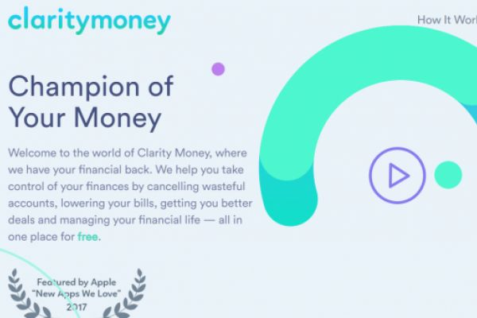
CLARITY MONEY
INNOVATION
Trends
Nesting Up
Dynamization

Slide 7
Agenda
Part A - 5 Finantial Trends & Companies
The Bank of Asia
Clarity Money
Sygnia Asset Management
eBankIT
Lemonade
PartB – Discovery Insure
Digital Innovation
UTAUT
Business Model & Barriers

Slide 8
Robo-Advisor
Financial advisors and analysts are replaced by Robo-advisors that have the data needed to make split-second, informed decisions.
Everything online
Provide Sygnia with user information, goals and risk tolerance
Robo-advisor uses algorithms and AI to construct portfolio
Constant management of portfolio

Slide 9
Robo-Advisor
Accessibility : Robo-Advisors can be helpful to any investor no matter the amount of wealth and are accessible 24/7
Low Fees : Without any human interaction, the fees are drastically reduced
Transparency : Robo-Advisors are transparent on fees, portfolios, trades, etc…
Efficiency : Every change in the portfolio can be instructed efficiently
Diversified : Robo-Advisors are based on the ‘Modern Portfolio Theory’ providing managed risk exposure through diversified portfolios
Well-Designed : Easy and intuitive features allows a comfortable user experience

Slide 10
TRENDS
Decreasing Human Involvement
Increasing Asymmetric
Increasing Transparency
Trimming Complexity
Segmentation

Slide 11
Agenda
Part A - 5 Finantial Trends & Companies
The Bank of Asia
Clarity Money
Sygnia Asset Management
eBankIT
Lemonade
PartB – Discovery Insure
Digital Innovation
UTAUT
Business Model & Barriers

Slide 12
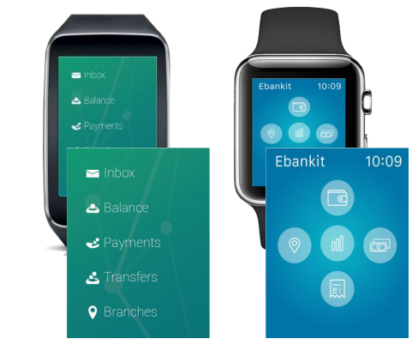
Trend Name in TRIZ:
Degrees of freedom
Customer expectation
Mono-Bi-Poly (various)
ebankit:
Sought after digital channel by various bank clients
Incredibly quick operations available from your favorite watch(Android & ios)

Slide 13
Agenda
Part A - 5 Finantial Trends & Companies
The Bank of Asia
Clarity Money
Sygnia Asset Management
eBankIT
Lemonade
PartB – Discovery Insure
Digital Innovation
UTAUT
Business Model & Barriers

Slide 14
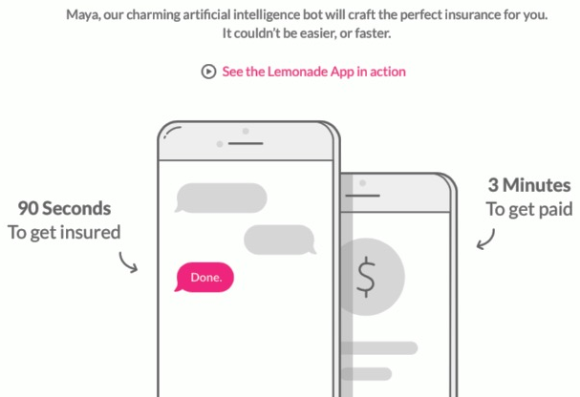
Trend Name in TRIZ:
Customer buying hierarchy
Rhythm co-ordination
Listening/Comunication
Lemonade Summary:
P2P Insurance start-up
Small Group of policyholders that pay premium
No broker
Similar business model as mutual insurance found
Donations at the end of the year

Slide 15
Agenda
Part A - 5 Finantial Trends & Companies
The Bank of Asia
Clarity Money
Sygnia Asset Management
eBankIT
Lemonade
PartB – Discovery Insure
Digital Innovation
UTAUT
Business Model & Barriers

Slide 16
Agenda
Part A - 5 Finantial Trends & Companies
The Bank of Asia
Clarity Money
Sygnia Asset Management
eBankIT
Lemonade
PartB – Discovery Insure
Digital Innovation
UTAUT
Business Model & Barriers

Slide 17
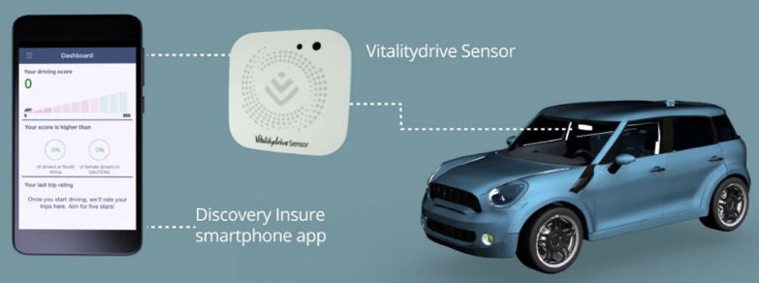
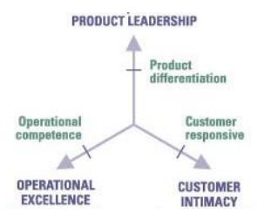
Sensor & App Innovation:
Collect telemetry data
Acceleration
Speed
Breaks
Cornering
Compare your driving
Get rewarded
Discovery Insure:
Insurance company
Clear Vision to create a vision of better drivers
Better drivers, fewer accidents

Slide 18
Digital Innovation:
Telemetry data
Trips in detail
Impact alert
Instant customer attention
Emergency Assistant
Vehicle Panic button
Weather warnings & safety tips
Find my vehicle
Trends:
Nesting
Increasing Asymetry
Mono-Bi-Poly (increasing differences)
“Sign up by phone and they go install it to your home or office”

