Slide 1
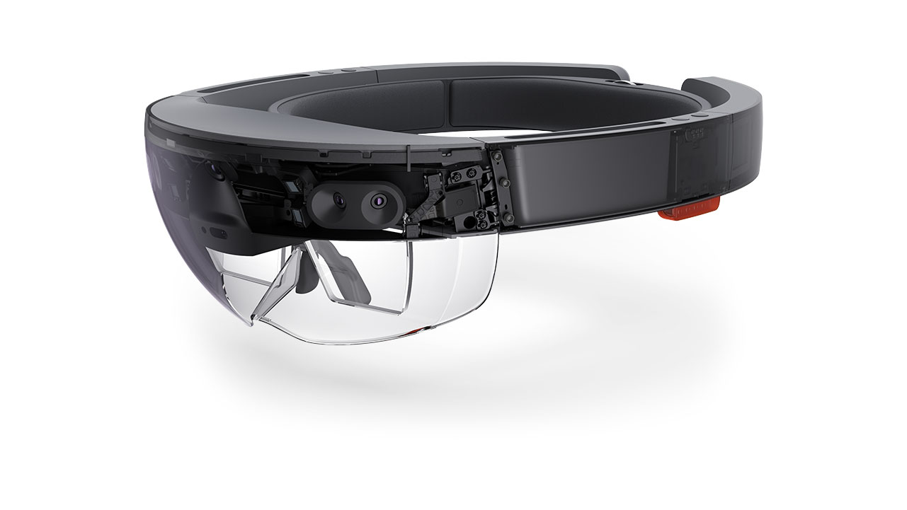
TRENDS IN DIGITAL INNOVATION
E D U C A T I O N S E C T O R
W A R R E N K E N N A R D

Slide 2
VR|AR|MR for EDUCATION

Slide 3
V I R T U A L R E A L I T Y
The computer-generated simulation of a three-dimensional image or environment that can be interacted with in a seemingly real or physical way by a person using special electronic equipment, such as a helmet with a screen inside or gloves fitted with sensors.
A U G M E N T E D R E A L I T Y
A technology that superimposes a computer-generated image on a user's view of the real world, thus providing a composite view.
M I X E D R E A L I T Y
Mixed reality (MR), sometimes referred to as hybrid reality, is the merging of real and virtual worlds to produce new environments and visualizations where physical and digital objects co-exist and interact in real time.

Slide 4
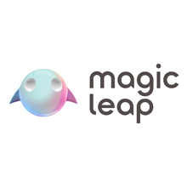

Slide 5
Offline version
Offline version
V R I D E O I N T E R M I S S I O N

Slide 6
BLOCKCHAIN | EDUCATION

Slide 7
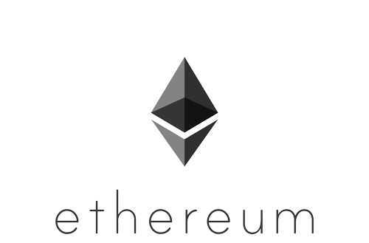
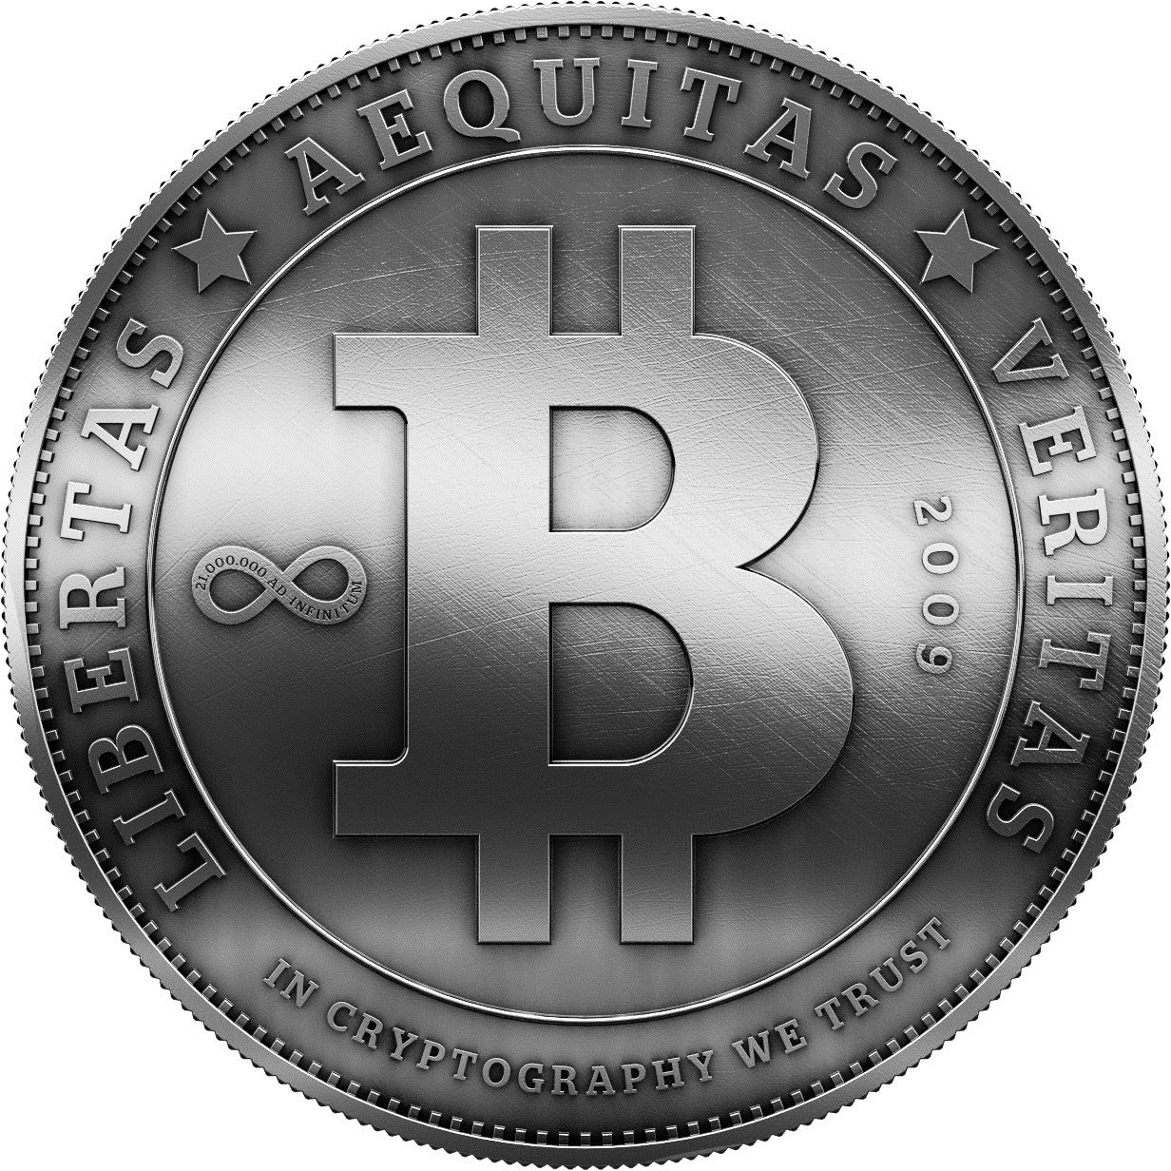

Slide 8
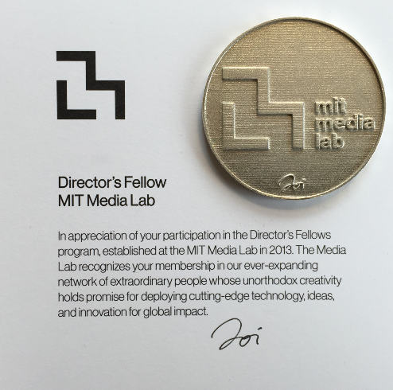
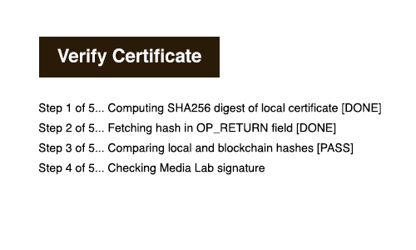

Slide 9
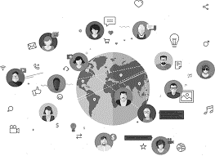
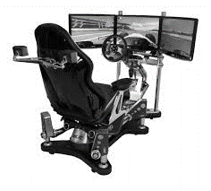
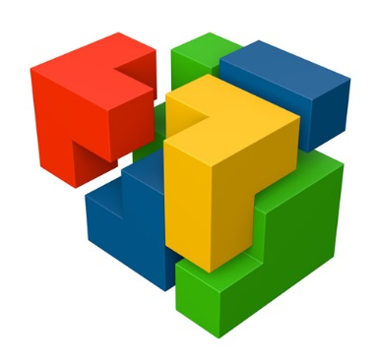
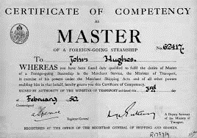
C O N C L U S I O N
|
Boundary breakdown | Increasing dymensiality | Increasing asymmetry | Decreasing human involvement | Customer expectation evolution | Increasing use of senses | Degrees of Freedom | Nesting
Increasing transparency | Trimming/reducing complexity | Decreasing human involvement | Degrees of Freedom

