Slide 1
Clothing industry
Beatriz Chufani
Marc Etterlin
Ophélie Franco

Slide 2
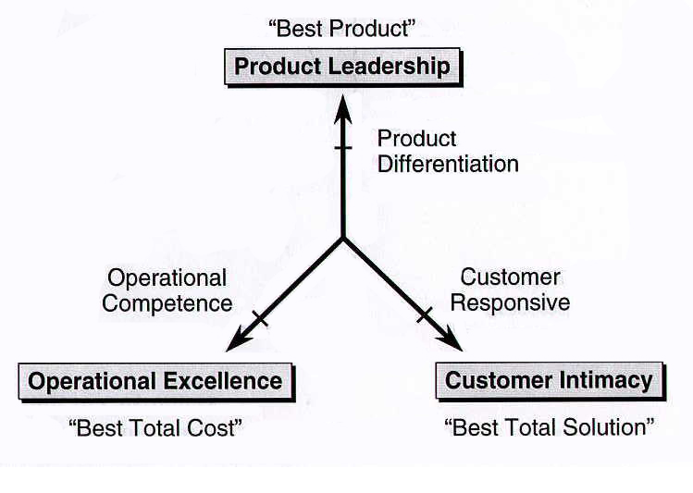

Slide 3
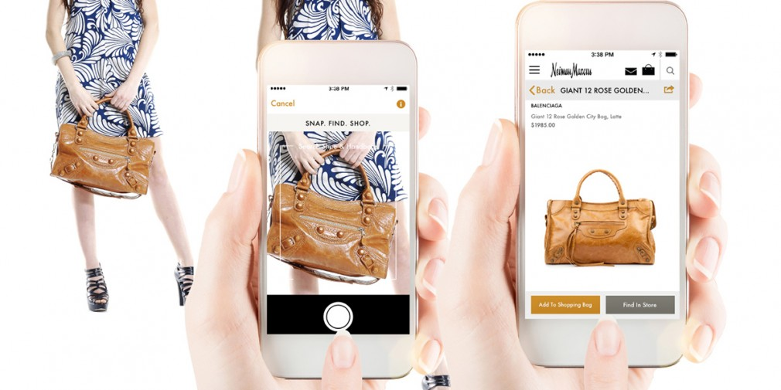
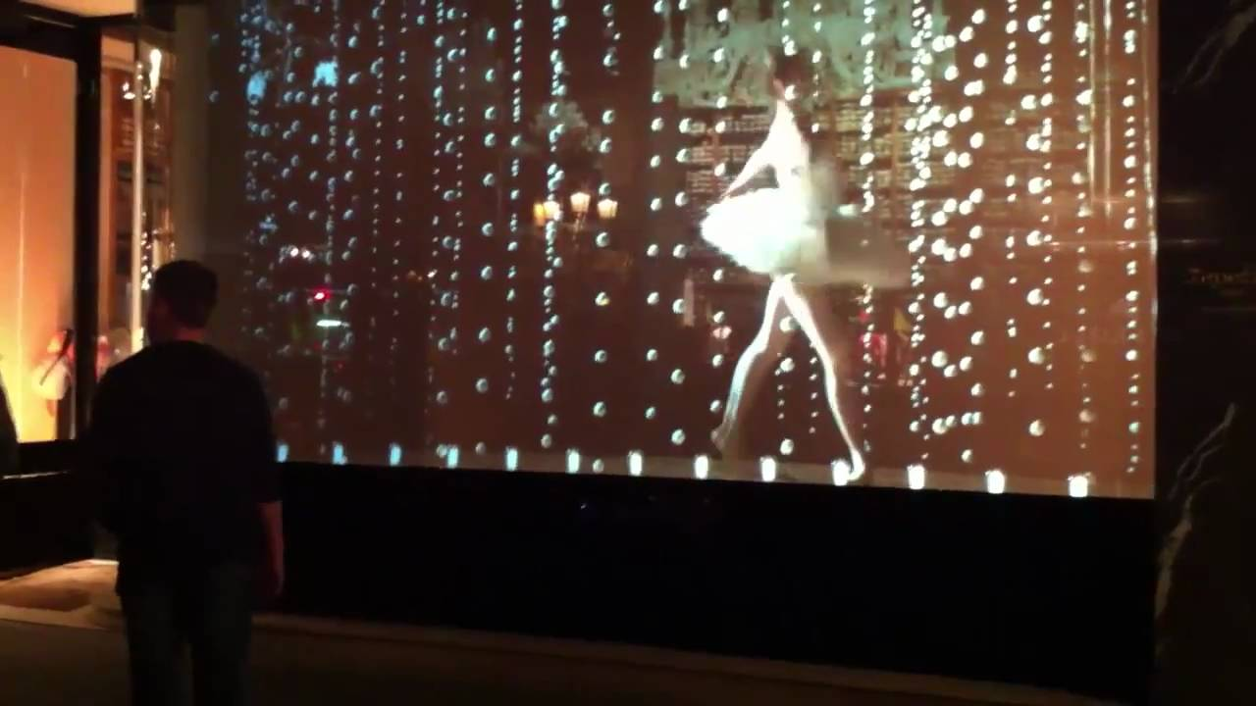
Customer intimacy
Slyce app
Interactive window displays
Interactive hangers

Slide 4
Customer intimacy - Slyce
Boundary breakdown
Problem : Consumers want to be able to buy clothes they see on the streets easily
Enables to scan clothes, shoes, bags… and to immediatly get a purchasable link
Used by shoes.com, Shoe Carnival and Urban Outfitters

Slide 5
Slyce Video

Slide 6
Costumer intimacy - Interactive window displays
Dynamization
Problem: Window displays takes a lot of space, which could be used more efficiently
Giving the opportunity to customers to ‘play’ with the window display
Keeping the brand and products exciting for the customers
Used by Repetto, Nike…

Slide 7
Nike Video

Slide 8
Customer intimacy - Interactive hangers
Dynamization
Problem: Prove that clothes sell better when worn by a model, but this is not possible in shops
Interactive hangers with RFID tag
Used in Vanquish stores

Slide 9
Product Leadership
Ralph Lauren Polo Tech Shirt
3D try on visualization technology
Percko

Slide 10
Product Leadership: Ralph Lauren Polo Tech shirt
Increasing dimensionality
Problem: No way to accurately measure biometric stats through a shirt.
Polo tech shirt with silver fibers, and sensor filled black boxes that track biometric stats such as steps, heart rate, breathing depth and energy exertion which gets sent to a smartphone or tablet.
Measure health in a more accurate way.

Slide 11
Product Leadership: Ralph Lauren Polo Tech shirt

Slide 12
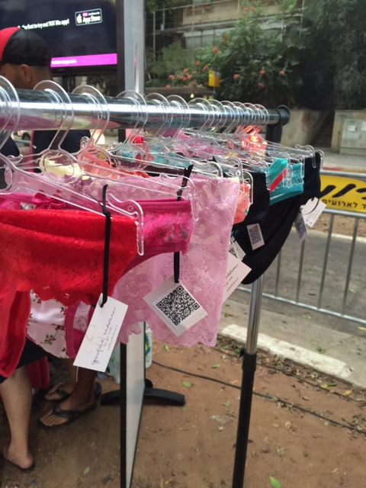
Product Leadership : 3D Try-on visualisation technology
Increasing Dimensionality
Problem: It’s hard to find the right size of underwear
This technology enables you to find out your measurements. Afterwards, it can help you find the perfect underwear in the store
Used at Infime in Israel

Slide 13
Product Leadership : Percko
Customer expectation
Problem : Back-Problem is a serious society problem
If you walk with a stoop it remains you to walk straight
Sensor technology
Percko

Slide 14
Operational Excellence
Air Dye Colorep
Online Shops - Zalando

Slide 15
Operational-Excellence: Air Dye Colorep
Rhytm co-ordintation theory
Problem: too much water and energy waste produced to make fabric.
A new process to dye fabric which saves approximately 75 gallons of water and uses less than 85 percent of energy when dying one pound of fabric.

Slide 16
Operational Excellence: Online Shop
Customer expectation
Problems: Store visits are taking time
Scan as many products
Online Shops - store space, vendors
Zalando

Slide 17
Questions?

