Slide 1
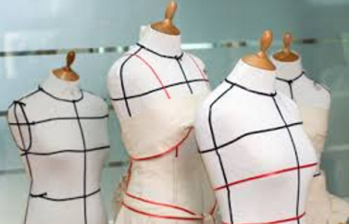
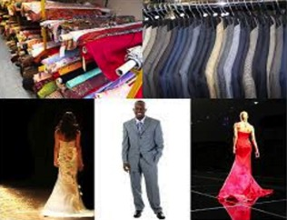
Innovations in the Retail fashion industry
LESLEY BUCHANAN 14843005
KIM OOSTHUIZEN 18851703
LIONIE SCHUTTLE 14840219
CHARMAINE SWEMMER15421422

Slide 2
LESLEY BUCHANAN

Slide 3
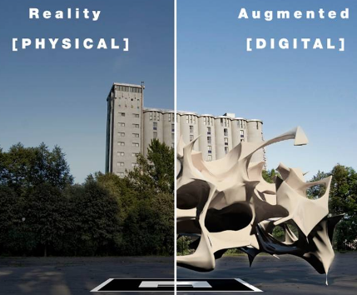
Retail fashion industry – augmented reality and shop beacon
2 Innovations
LESLEY BUCHANAN (14843005)

Slide 4
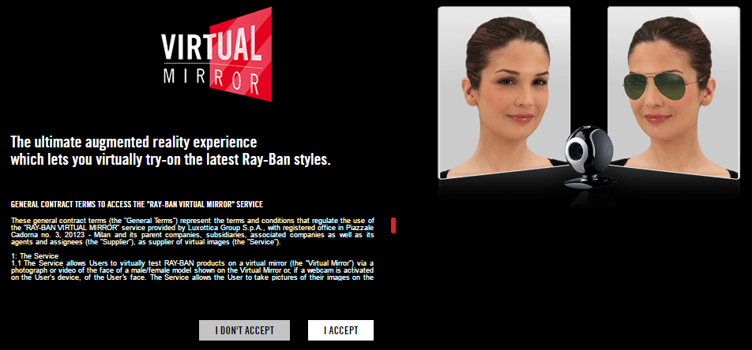
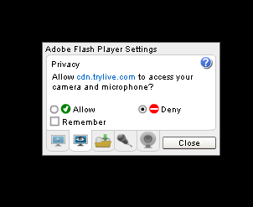
Retail fashion industry - augmented reality
LESLEY BUCHANAN (14843005)

Slide 5
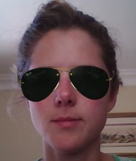
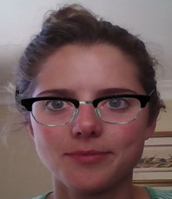
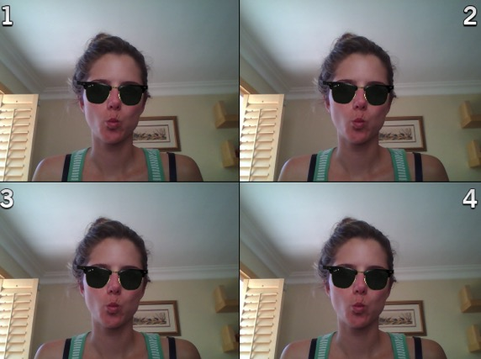
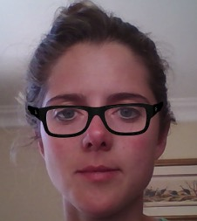
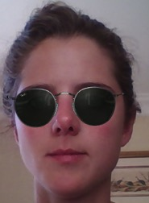
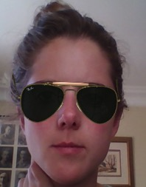
Retail fashion industry – Augmented reality – virtual mirror
LESLEY BUCHANAN (14843005)

Slide 6
Retail fashion industry – Augmented reality – virtual mirror – triz trends
Adding Dimensions (element of 3D)
Customer buying hierarchy (Performance and Convenience)
Trimming/reducing complexity (reduce complexity of trying on sunglasses or eye wear)
Customer expectation (creating a customer experience)
LESLEY BUCHANAN (14843005)

Slide 7
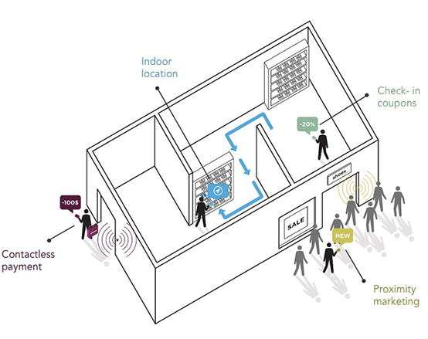
Retail fashion industry - ibeacon (shop beacon)
iBeacon is the name for Apple’s technology standard, which allows Mobile Apps (running on both iOS and Android devices) to listen for signals from beacons in the physical world and react accordingly.
LESLEY BUCHANAN (14843005)

Slide 8
Retail fashion industry - SHOP BEACON
LESLEY BUCHANAN (14843005)

Slide 9
Retail fashion industry - SHOP BEACON
SHOP BEACON:
Location specific rewards
Deals
Discounts
Product recommendations
Department info
Link to @ home browsing behaviour to deals in store
LESLEY BUCHANAN (14843005)

Slide 10
Retail fashion industry - SHOP BEACON
Retailers Advantages:
Analytics
Drive foot traffic
Alerts customers
Customised loyalty program
VIP Service for your customers
Drive online sales
Customer Advantages
Bluetooth – low energy required
Customisation (personal preferences)
Product information and location
Convenience – no physical cash required, price check, store locator, rewards etc.
LESLEY BUCHANAN (14843005)

Slide 11
Retail fashion industry – SHOP BEACON – triz trends
Customer buying hierarchy (Performance and Convenience)
Increasing Asymmetry (Customisation based on consumer preferences (stores, items etc.), location etc.)
Trimming/reducing complexity (reduce complexity of shopping for items)
Customer expectation (creating a customer experience)
Mono-bi-poly (various) (related services/products that could be provided to strengthen your offering – shop beacon sends signals to different apps (Retail apps, Shopkicks (customer rewards), links to payment systems/apps, location app)
LESLEY BUCHANAN (14843005)

Slide 12
LIONIE SCHUTTLE

Slide 13
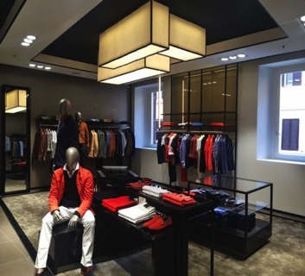
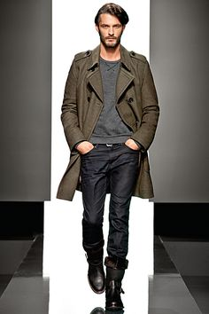
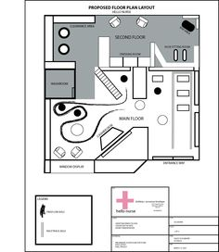
Heat sensors
The problems Hugo Boss was confronted with:
Experienced poor customer loyalty in the competitive clothing retail sector
Sales were not conducted fast enough
Increase product availability for customer convenience
Store layout

Slide 14
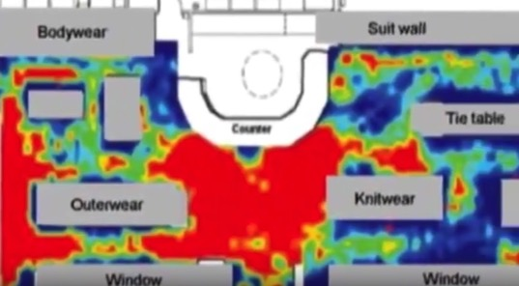
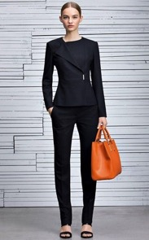
Heat sensors
How heat sensors are used at Hugo Boss:
Infrared cameras detects energy (heat) → Electronic signal → Thermal image on video monitor
Hugo Boss is now able to identify high and low traffic areas in stores and which products sell from which shelves by tracking customer movement
Optimise product display and create the ideal atmosphere in specific store areas

Slide 15
Heat sensors
TRIZ Trends:
Customer buying hierarchy – increasing customer convenience
Increasing asymmetry - customisation by tweaking store areas and product display for a specific type of customer
Bigdata – continuous updates of instore movements
Action co-ordination – providing the right products in the right sizes
Video clip:
https://www.youtube.com/watch?v=yDvY1WfsD9c

Slide 16
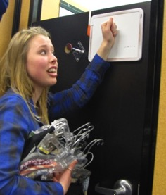
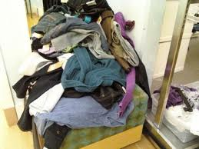
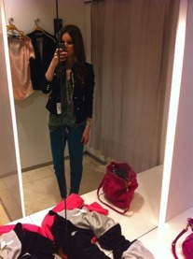
MAGIC MIRRORS
The problems Rebecca Minkoff was confronted with:
Transform the current customer retail experience in physical stores
Improve the omni-channel experience
Create retail stores for the future

Slide 17
MAGIC MIRRORS
How magic mirrors are used at Rebecca Minkoff:
Magic mirrors rely on a recommendation engine that draw from in-store and catalogue inventory (ebay developed the soft-and hardware).
Clothes has RFID tags – activates room
With the mirror customers can:
See products on a digital screen display
Adjust the lighting of the fitting room
Ring a stylist for help
Sync data with your mobile app – remember what you liked
Receive recommendations – stylist can bring you the matching items
Checkout – easy payment via app
Also, there is no cameras in the room ☺

Slide 18
MAGIC MIRRORS
TRIZ Trends
Increasing dimensionality – 4D
Trimming / reducing complexity – between customer and company (registers in your app what you bought) & product (suggest more complimentary products).
Segmentation – Adapting the atmosphere/lighting of the fitting room based on the mood of the event where you will wear the specific garment.
Video clip:
https://www.youtube.com/watch?v=6G3JIyG_GeY&list=PLM2XX_D7N_wvERvJs77xbNHpOxLTLKlcf&

Slide 19
CHARMAINE SWEMMER

Slide 20
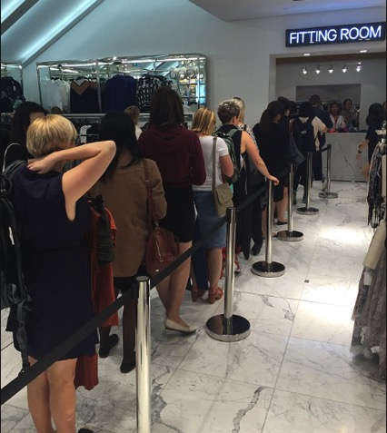
problems and opportunities in clothing industry
PROBLEMS FOR CUSTOMER...
Challenge to find right style, colour, size item on sales floor
Small fitting room
Limited items to try on
Cumbersome
Queue twice – to fit and to pay
OPPORTUNITIES FOR CUSTOMER…
Improve customer experience
Buy more
OPPORTUNITIES FOR RETAILER…
Remain competitive
Increase sales
Improve sales floor utilisation
Decrease labour cost
PROBLEMS FOR RETAILER...
Convenience of Online shopping
High labour cost
Sub-optimal space utilisation
Charmaine Swemmer 15421422

Slide 21
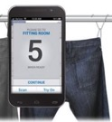
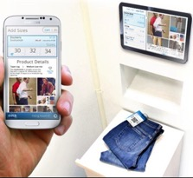
Technology and functionality
US based department store Macy‘s worked with Hointer to revamp the changing rooms of Manhattan Beach store, Californian, to provide a new customer expereince and increase sales
Smart Changing room...
scan item with Macy‘s mobile app on sales floor
choose colour and size, the item is delivered to change room via chute
request more items without leaving the change room
return unwanted items into return chute
mobile app recommends complementatry items
selected items are added to shopping list
fast payment at kiosk
Charmaine Swemmer 15421422

Slide 22
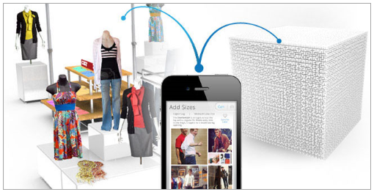
The smart changing room …macy’s go!
Ranked 1st
2016 International Digital Innovation
Macy's Changing Room
TRIZ trend behind technology?
Trimming / reducing complexity
Customer buying hierarchy
Decrease human involvement
Increasing Asymmetry
Dynamization
Charmaine Swemmer 15421422

Slide 23
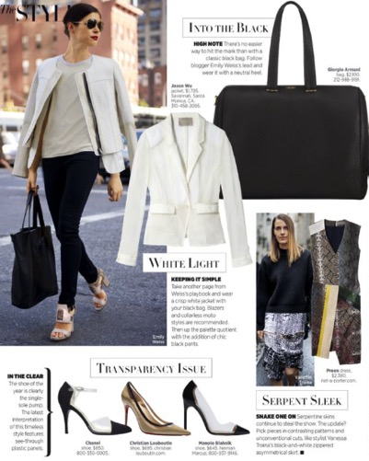
problems and opportunities in clothing industry
PROBLEMS FOR CUSTOMER...
Where to find items
Limited time to shop - waste time to search for items
Frustration due to out-of-stock
OPPORTUNITIES FOR CUSTOMER…
Convenience
Easy to follow Fashion
OPPORTUNITIES FOR RETAILER…
Increase sales
Cross selling
PROBLEMS FOR RETAILER...
Lost sales
Dissatisfied customers
Convenience of Online shopping
Charmaine Swemmer 15421422

Slide 24
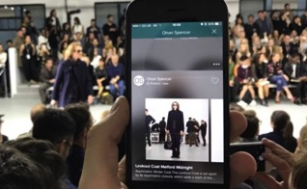
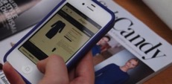
Technology and functionality
London-based online store Snap Fashion developed a mobile app with which photos of any clothing item in magazines, social media sites, blogs, TV or on a person can be taken – the visual search technology quickly finds the items amongst the 100+ UK retailers and can be bought immediately
Shop fashion in a Snap...
take picture of item from any source and upload picture
the visual search engine uses algorithms to break down the image
search across participating retailers‘ inventories to find a match
select and buy item
Charmaine Swemmer 15421422

Slide 25
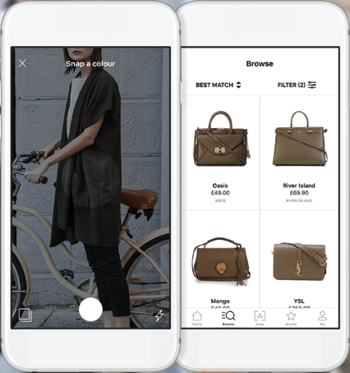
Shop fashion in a snap
Ranked 9th
2016 UK Digital Innovation
Snap Fashion
TRIZ trend behind technology?
Increasing Asymmetry
Trimming / reducing complexity
Customer buying hierarchy
Dynamization
Decrease human involvement
Charmaine Swemmer 15421422

Slide 26
Kim oosthuizen

Slide 27
Kim Oosthuizen

Slide 28
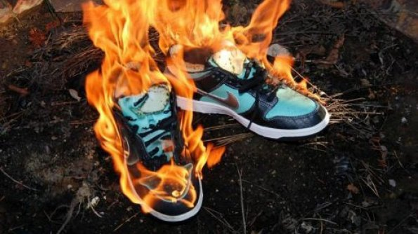
Company: Under armour
Kim Oosthuizen
Opportunity: Offer digital platform for serious athletes

Slide 29
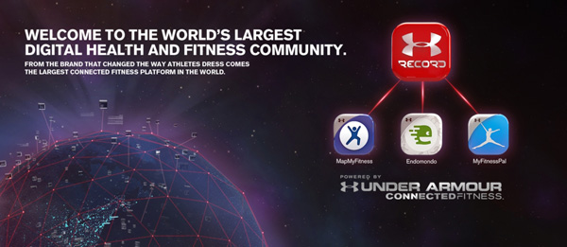
Company: Under armour
Kim Oosthuizen
Technology: UA HealthBox™, the world’s first Connected Fitness system created specifically to measure, monitor, and manage the factors that determine HOW YOU FEEL.
Purchased several apps including MyFitnessPal, MapMYFitness, and Endomondo, for $710 million. Their apps have 130 million users combined, and more than 60% of who are women

Slide 30
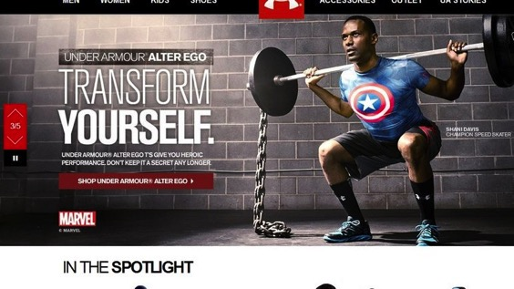
Company: Under armour
Kim Oosthuizen
TRIZ trends: Customer experience, Nesting (UP), Mono-Bi-Poly

Slide 31
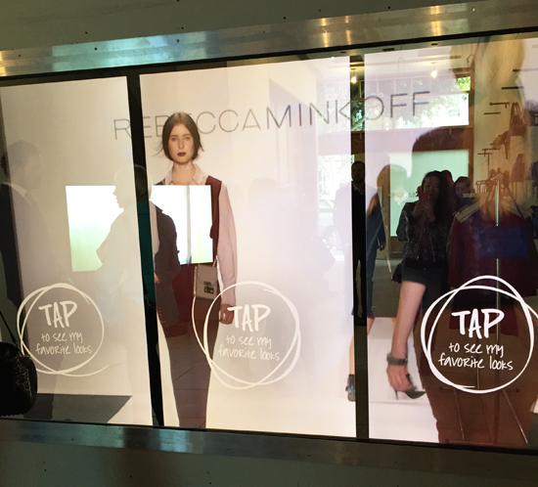

Slide 32
Company:
Kim Oosthuizen
Opportunity: create a store that mimics the shopping experience of a website or mobile app

Slide 33
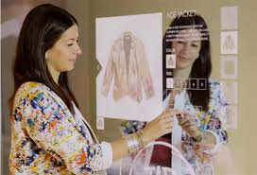
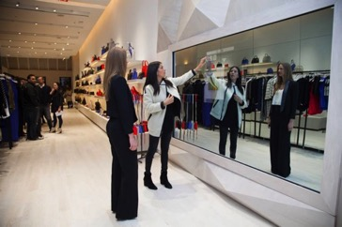
Company:
Kim Oosthuizen
Technology: “Connected store” eBay technology using RFID, CRM, Apps, Smartphones, Magicwall in fitting rooms, and ecommerce infrastructure

Slide 34
Company:
Kim Oosthuizen
TRIZ trends: “dynamization”, customer experience, Increasing use of senses, Mono-Bi-Poly

Slide 35
Thank you

