Slide 1
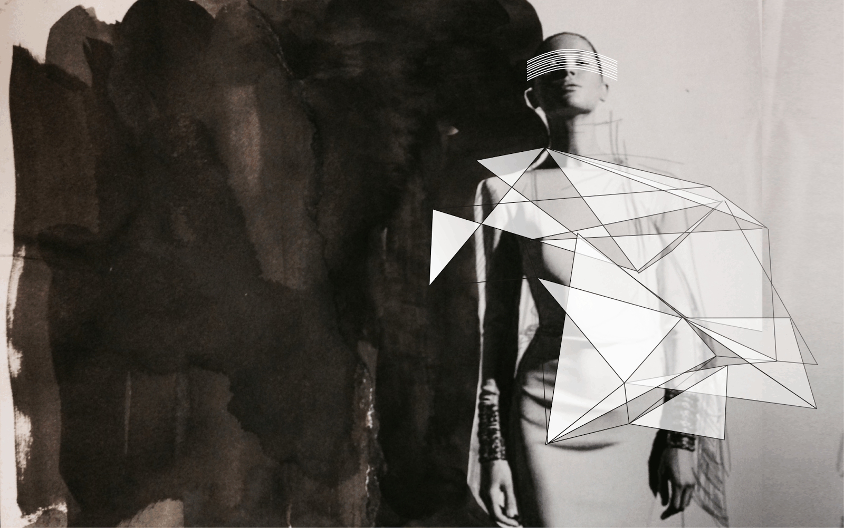
Trends in Digital Innovations
Digital Innovations in the Fashion Industry
Instructor. Dr. GOETHALS FRANK
Alina Klose, Holly Taylor, Ngalla D. Gaye, Rao Muhammad Abdulla, Yeseul Oh
15, September, 2016

Slide 2
The Fashion Industry
Problem
Technology is developing rapidly and fashion brands are under pressure to keep up
Consumer motivation: if a consumer prefer to buy something more innovative as opposed to fashionable
The competition between retail (bricks and mortar ) and e-commerce stores –
consumers are time poor
Opportunity
Transformation of the whole shopping experience through digital innovation
Embracing digital trends to translate to the fashion world
Technology provides a tool for fashion brands to differentiate from it’s competitors
Alina Klose, Holly Taylor, Ngalla D. Gaye, Rao Muhammad Abdulla, Yeseul Oh 15/09/2016

Slide 3
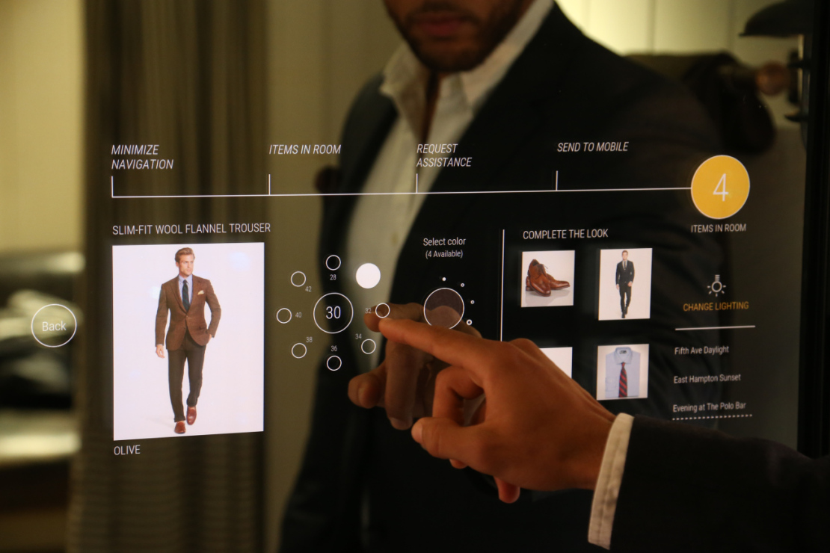
Case 1.
The competition between retail and e-commerce stores – consumers
are time poor
Transformation of the whole shopping experience through
digital innovation
Interactive Mirrors using RFID and touch screen functions. Change the lighting in fitting rooms, request a different size, browse through items, interact with a sales associate
Alina Klose, Holly Taylor, Ngalla D. Gaye, Rao Muhammad Abdulla, Yeseul Oh 15/09/2016

Slide 4
Source: https://www.youtube.com/watch?v=vFF95SvTfRE
Alina Klose, Holly Taylor, Ngalla D. Gaye, Rao Muhammad Abdulla, Yeseul Oh 15/09/2016

Slide 5
Case 1. Ralph Lauren
TRIZ TRENDS
Trend 2
Customer buying
hierarchy
Trend 7
Trimming/reducing complexity theory
Functionality, reliability, convenience, price
Elimination of non-key components
Alina Klose, Holly Taylor, Ngalla D. Gaye, Rao Muhammad Abdulla, Yeseul Oh 15/09/2016

Slide 6
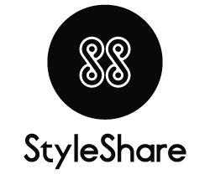
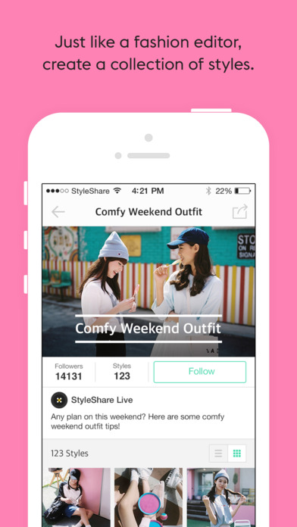
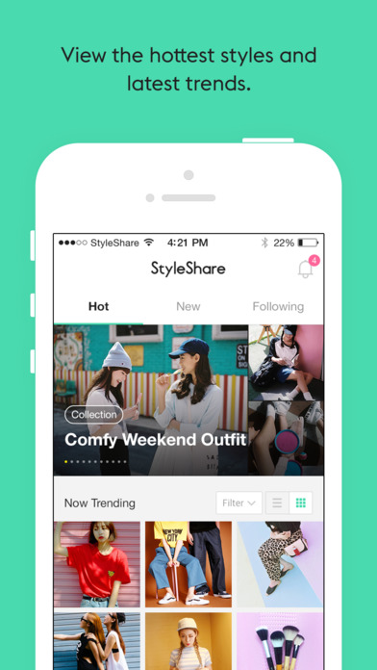
Case 2.
Information sharing community
online
Flea Market
offline
Styleshare Store
online retailer
A social media platform where users can share fashion/beauty product information.
Alina Klose, Holly Taylor, Ngalla D. Gaye, Rao Muhammad Abdulla, Yeseul Oh 15/09/2016
Notes:
유저에게는 정확한 상품정보를, 브랜드에게는 홍보 및 판매채널을 제공해 소비자, 공급자 모두에게 유익한 플랫폼으로 거듭나는 것이 목표
News Article
http://www.apparelnews.co.kr/naver/view.php?iid=61101

Slide 7
Case 2. Style Share
TRIZ TRENDS
Trend 1
Boundary Breakdown
Trend 6
Increasing Transparency
Nomadic platform all across
digital and reality
Reviews from users, non-exclusive
Alina Klose, Holly Taylor, Ngalla D. Gaye, Rao Muhammad Abdulla, Yeseul Oh 15/09/2016

Slide 8
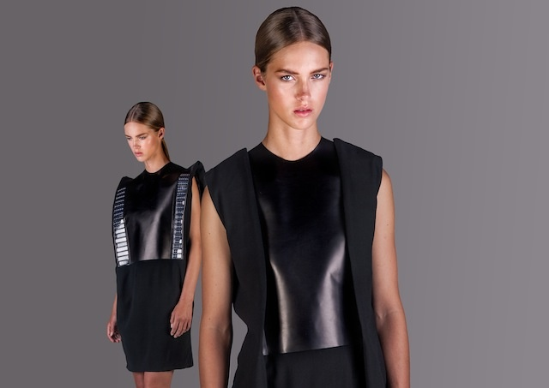
Case 3.
What do people need?
CRM
Good looking design
cloth
Solar panel
technology
2hours of wearing the clothe, you can charge up your phone battery 0 to 100 percent.
Sustainable Fashion
Using solar energy, she created fashionable and energy-efficient future for the wearable technology
Flaw : washable solar panel
Alina Klose, Holly Taylor, Ngalla D. Gaye, Rao Muhammad Abdulla, Yeseul Oh 15/09/2016
Notes:
http://thecreatorsproject.vice.com/show/make-it-wearable--the-concepts-solar-powered-fashion-designer-pauline-van-dongen-video

Slide 9
Alina Klose, Holly Taylor, Ngalla D. Gaye, Rao Muhammad Abdulla, Yeseul Oh 15/09/2016
Notes:
https://youtu.be/rhUqDy4tg50

Slide 10
Case 3. Pauline van Dongen
TRIZ TRENDS
Trend 9
Customer Expectation
Trend 19
Nesting Up
Functional Services, Transformation
Integrated higher level of system
Alina Klose, Holly Taylor, Ngalla D. Gaye, Rao Muhammad Abdulla, Yeseul Oh 15/09/2016

Slide 11
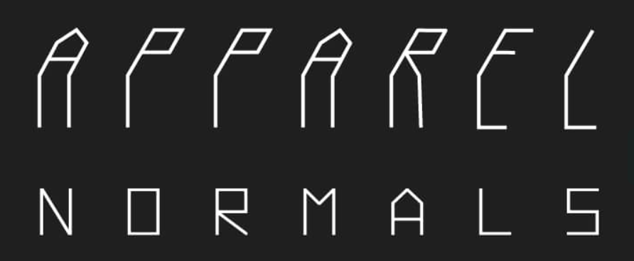
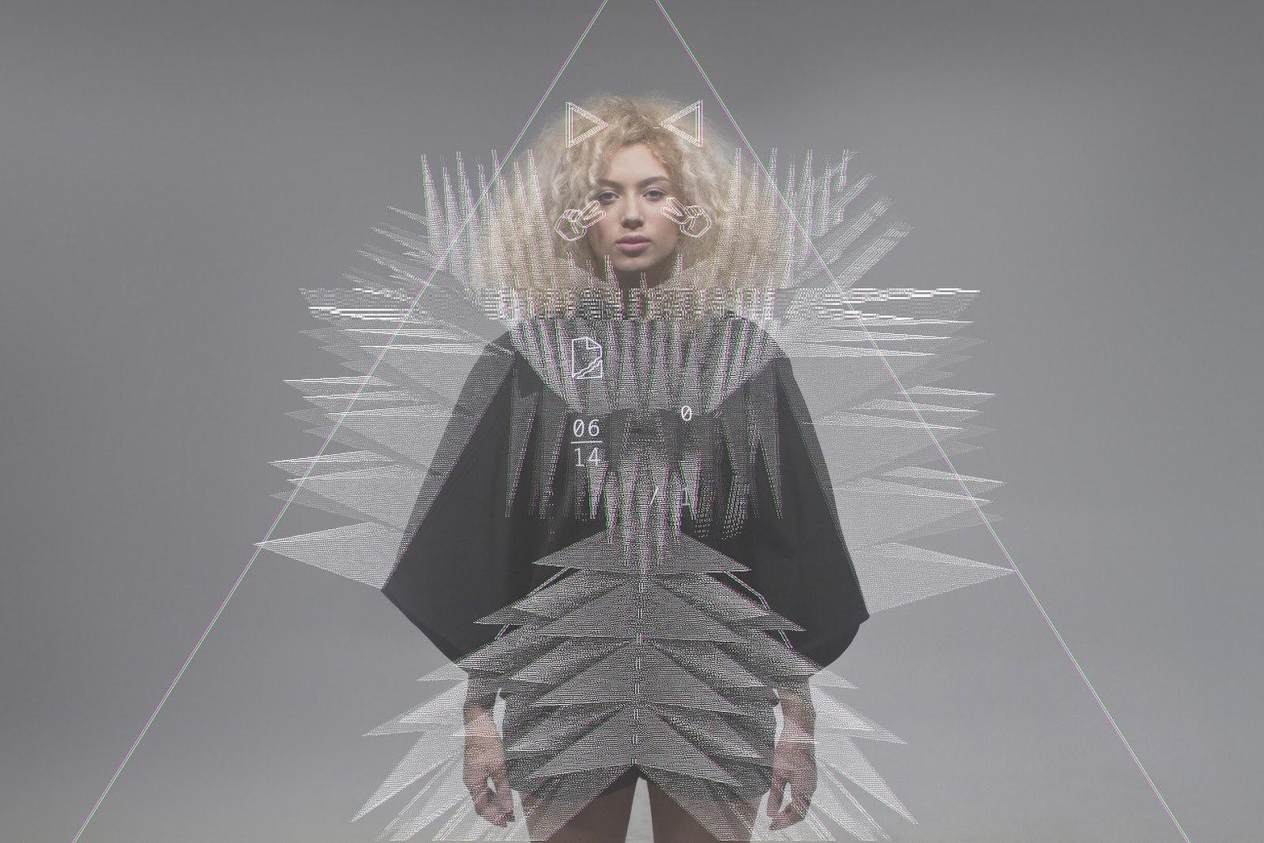
Case 4.
Augmented Reality Fashion.
With a triangular shaped cloak and an iOS application, a digitalized visual appears on the screen which expresses a mod of the user.
Triangular Cloak
Cloth
iPhone / iPad
Portable Digital Device
Twitter / Facebook
Big Data
Alina Klose, Holly Taylor, Ngalla D. Gaye, Rao Muhammad Abdulla, Yeseul Oh 15/09/2016
Notes:
http://thecreatorsproject.vice.com/blog/augmented-reality-clothing-has-arrived-with-the-iappareli-project

Slide 12
Alina Klose, Holly Taylor, Ngalla D. Gaye, Rao Muhammad Abdulla, Yeseul Oh 15/09/2016
Notes:
https://vimeo.com/145379121 – documentary

Slide 13
Case 4. NORMALS APPAREL
TRIZ TRENDS
Trend 4
Increasing Dimensionality
Trend 12
Increasing Use of Senses
Trend 11
Segmentation
4D
Sight, Touch,
Hearing, Socializing, etc
Mood Variable
Alina Klose, Holly Taylor, Ngalla D. Gaye, Rao Muhammad Abdulla, Yeseul Oh 15/09/2016

Slide 14
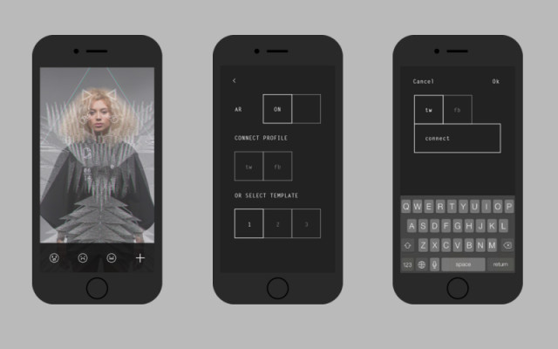
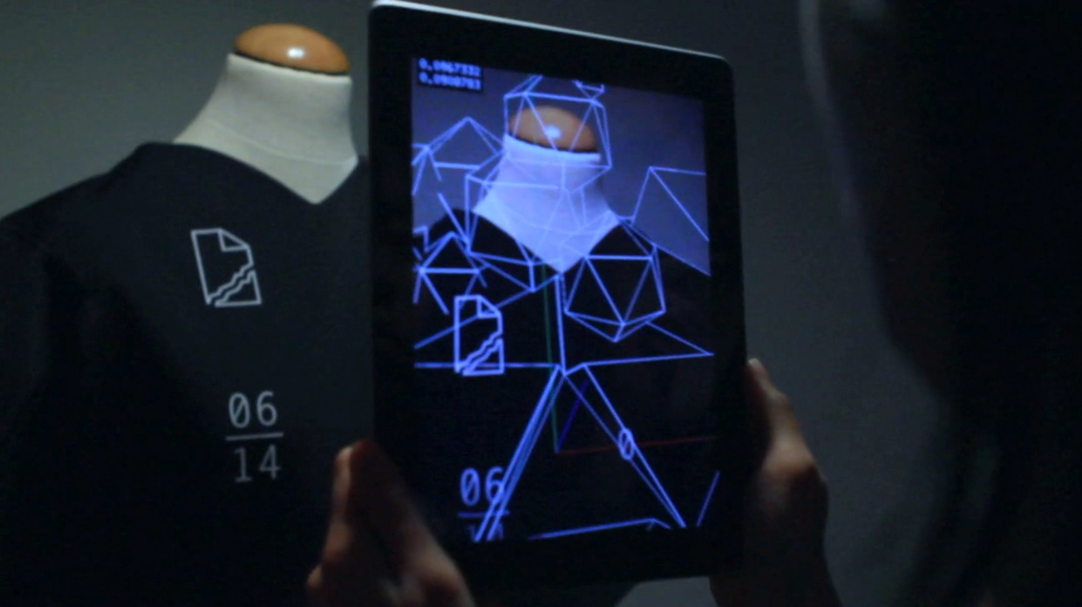
Case 4. NORMALS APPAREL
Customer Acceptance
Sustainable Competitive Advantages
Hedonic Motivation
Enjoy
Unique
One and only
Personalization
Data – Visualization
Data – Sound
Free Publicity
Open Source
(for manufacturers)
Accumulation of Data
Variation
Alina Klose, Holly Taylor, Ngalla D. Gaye, Rao Muhammad Abdulla, Yeseul Oh 15/09/2016

Slide 15
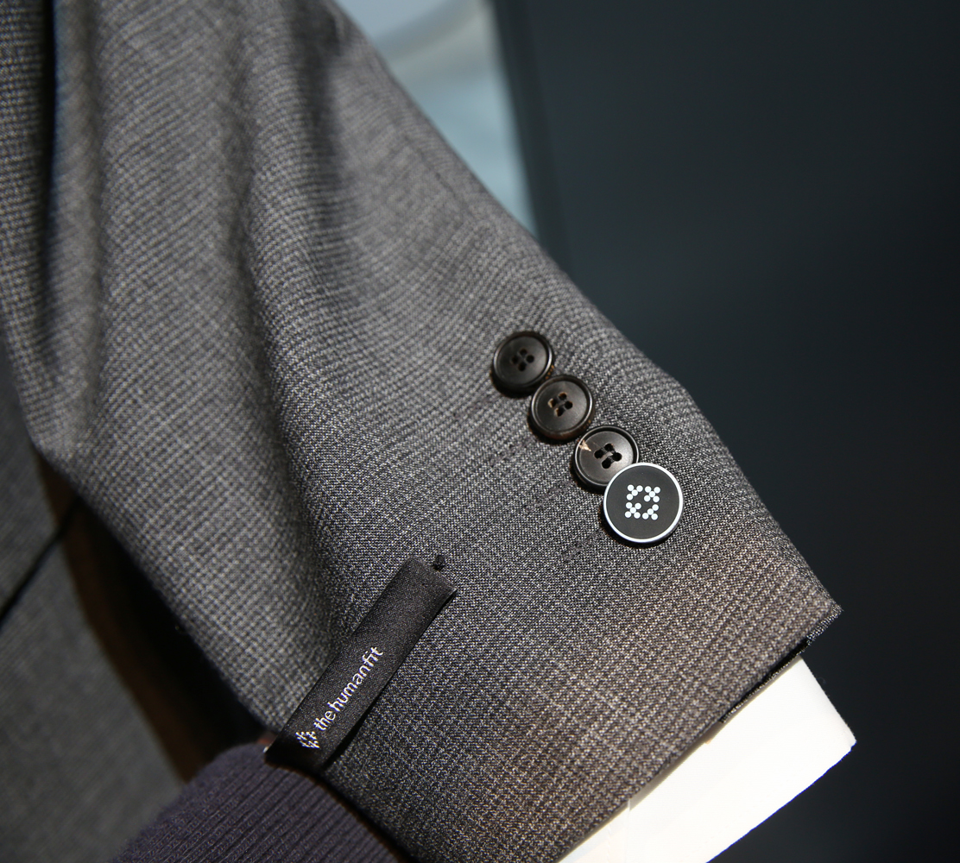
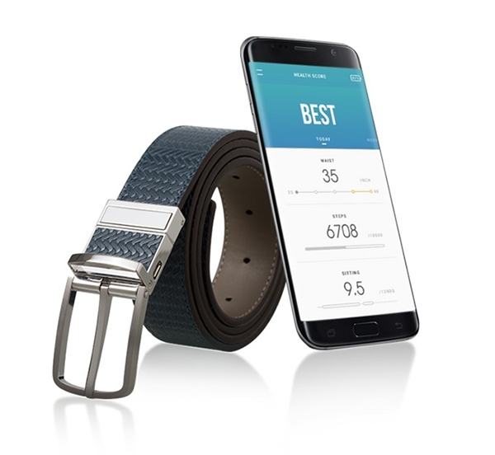
Case 5.
Smart Suit
High-end suit with NFC buttons
Unlock phone, exchange digital business cards, set modes on the phone
Excusive mobile app.
Wellness Belt
Indicates how many steps, how long user was sitting
Eating habits
Measures waistline size
Specially-designed app.
Huge competition: Apple.
Establish in the fashion industry.
Translate digital trends to fashion.
Smartcloths mostly fitness-focused.
Alina Klose, Holly Taylor, Ngalla D. Gaye, Rao Muhammad Abdulla, Yeseul Oh 15/09/2016

Slide 16
Source: https://www.youtube.com/watch?v=vCvqFf08Fhs
Alina Klose, Holly Taylor, Ngalla D. Gaye, Rao Muhammad Abdulla, Yeseul Oh 15/09/2016

Slide 17
Case 5. SAMSUNG The Human Fit
TRIZ TRENDS
Trend 3
Dynamization
Trend 14
Mono-Bi-Poly
More flexibility and connections for customer.
Offers with different value propositions, which complement each other.
Trend 9
Customer Expectations
Trend 19
Nesting-Up
Evolving customer expectations. Deliver an experience.
Integrating functionalities.
Alina Klose, Holly Taylor, Ngalla D. Gaye, Rao Muhammad Abdulla, Yeseul Oh 15/09/2016

Slide 18
Case 6.
Innovative idea for the Swarovski look
Keep up with evolving technology
Recognition as innovative brand
3D print for fashion
3D Printed Lingerie
Industrial technology in high-tech couture.
Made from hundret 3D printed snowflakes.
Printed in lightweight nylon, decorated with millions of Swarovski crystals.
3D printed bracelet for sale.
Alina Klose, Holly Taylor, Ngalla D. Gaye, Rao Muhammad Abdulla, Yeseul Oh 15/09/2016

Slide 19
Source: hthttps://www.shapeways.com/blog/archives/2383-victorias-secret-snow-angel-spreads-her-3d-printed-wings-video.html
Alina Klose, Holly Taylor, Ngalla D. Gaye, Rao Muhammad Abdulla, Yeseul Oh 15/09/2016

Slide 20
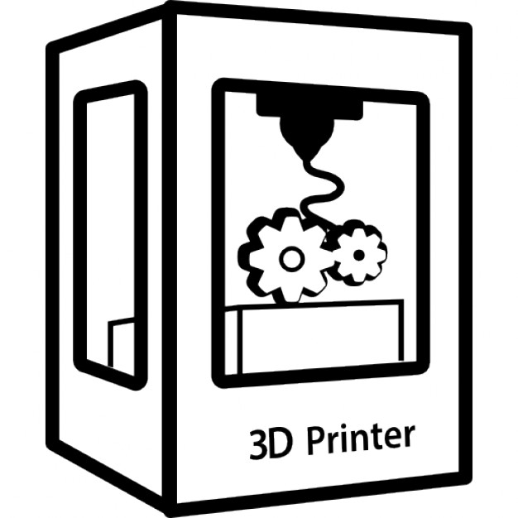
Case 6. Victoria’s Secret
TRIZ TRENDS
Trend 4
Increasing Dimentionality
Trend 7
Reducing Complexity
Additive manufacturing / 3D printing.
Elimination of non-key subsystems.
Trend 8
Decrease Human Involvement
Trend 9
Customer Expectations
Replace tailors through 3D printer.
Evolving customer expectations for fashion show/products.
Alina Klose, Holly Taylor, Ngalla D. Gaye, Rao Muhammad Abdulla, Yeseul Oh 15/09/2016

Slide 21
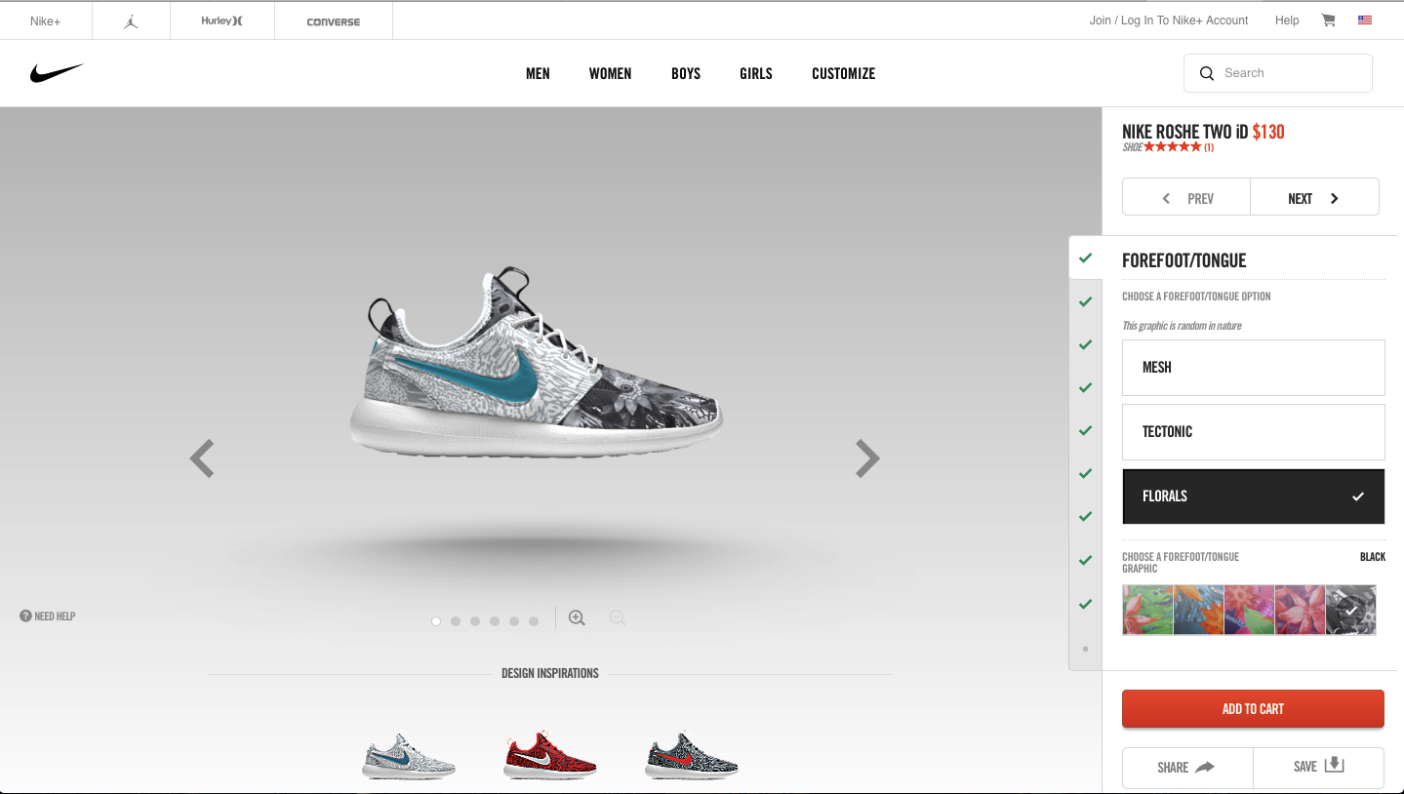
Case 7.
Consumer motivation: Passive role in the development process.
Customer co-creation: active role in the design process.
Customization
Select the desired style.
Customize the colours, material, feature, fit options & add a personalized iD.
Delivery within 4 weeks.
Alina Klose, Holly Taylor, Ngalla D. Gaye, Rao Muhammad Abdulla, Yeseul Oh 15/09/2016

Slide 22
Case 7. NIKEiD
TRIZ TRENDS
Trend 1 Boundary Breakdown with customers.
Trend 3 Dynamization: more flexibility of customers.
Trend 5 Increasing Asymmetry between NIKE customers & products.
Trend 18 Degree of Freedom: More dimensions on which a choice can be made to create asymmetry.
Alina Klose, Holly Taylor, Ngalla D. Gaye, Rao Muhammad Abdulla, Yeseul Oh 15/09/2016

Slide 23
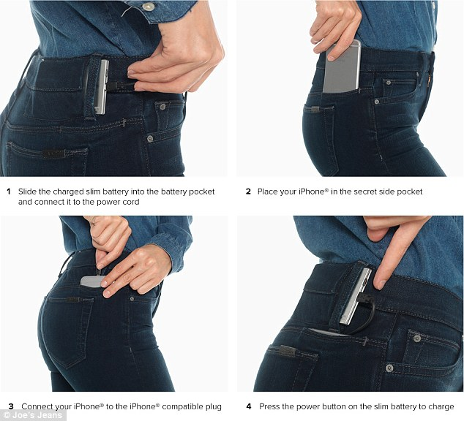
Case 8.
Inefficiency: Gap in the market
Innovation: Two in one
Joe’s Jeans Phone-Charger:
Extend the battery life of your device while on the go
Built-in protection system to prevent over-charging and over-incharging
Led monitoring system for battery level
Alina Klose, Holly Taylor, Ngalla D. Gaye, Rao Muhammad Abdulla, Yeseul Oh 15/09/2016

Slide 24
Alina Klose, Holly Taylor, Ngalla D. Gaye, Rao Muhammad Abdulla, Yeseul Oh 15/09/2016

Slide 25
Case 8. Joe’s Jeans
TRIZ TRENDS
Trend 19
Nesting up
Structure connected into a higher level system
Trend 15
Mono-Bi-Poly (Similar)
Bi-system
You offer more and more things with more or less the same value proposition
Alina Klose, Holly Taylor, Ngalla D. Gaye, Rao Muhammad Abdulla, Yeseul Oh 15/09/2016

Slide 26
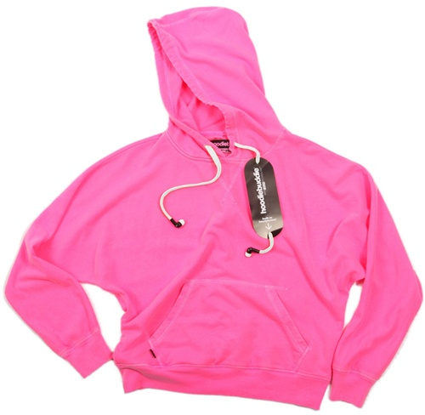
Case 9.
Sustainability
Opportunity: Mash-up between form and function, style and common sense, and comfort and utility
Contains a standard headphone jack in the front pocket that plugs into any headphone-compatible device
Audio travels through embedded cables within the HoodieBuddie to the headphones
Hoodie is machine washable (even the headphones)
Alina Klose, Holly Taylor, Ngalla D. Gaye, Rao Muhammad Abdulla, Yeseul Oh 15/09/2016

Slide 27
Alina Klose, Holly Taylor, Ngalla D. Gaye, Rao Muhammad Abdulla, Yeseul Oh 15/09/2016

Slide 28
Case 9. Hoodiebuddie
TRIZ TRENDS
Trend 16
Mono-Bi-Poly (Increasing differences)
You start offering things with different properties or you offer things that do the opposite of your initial offering.
Alina Klose, Holly Taylor, Ngalla D. Gaye, Rao Muhammad Abdulla, Yeseul Oh 15/09/2016

Slide 29
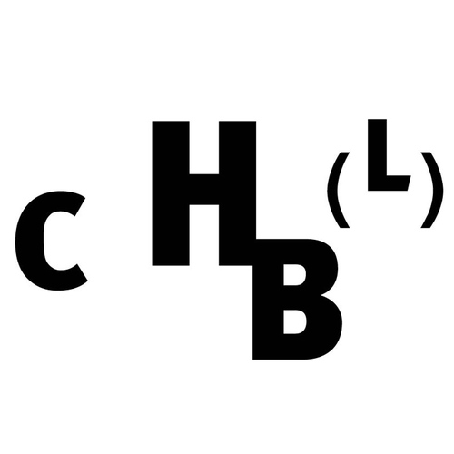
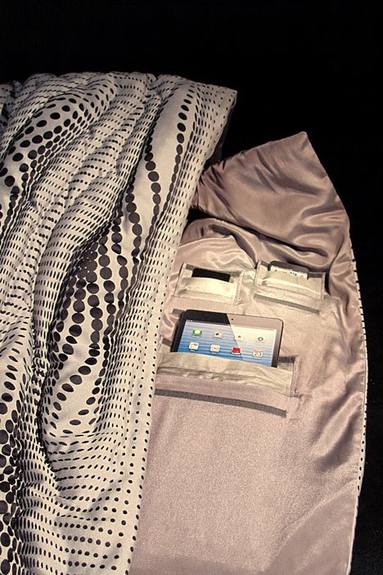
Case 10.
Consumer motivation: It enables its user to disappear: Google cannot find you anymore. You are no longer reachable on your mobile phone and no information from your credit card can be captured.
Differentiation: A wearable items to aid privacy
1. Metallic fibres designed to shield against tracking devices.
2. Phone and internet signals
should be blocked from reaching
these devices when stored inside.
3. It is lined with pockets that accommodate smartphones, tablets and other devices of different sizes.
Alina Klose, Holly Taylor, Ngalla D. Gaye, Rao Muhammad Abdulla, Yeseul Oh 15/09/2016

Slide 30
Case 10. CHBL
TRIZ TRENDS
Trend 16
Degree of Freedom
Trend 3
Dynamization
More flexibility of customers.
You can choose to disconnect yourself from social media and phone to have privacy.
Alina Klose, Holly Taylor, Ngalla D. Gaye, Rao Muhammad Abdulla, Yeseul Oh 15/09/2016

Slide 31
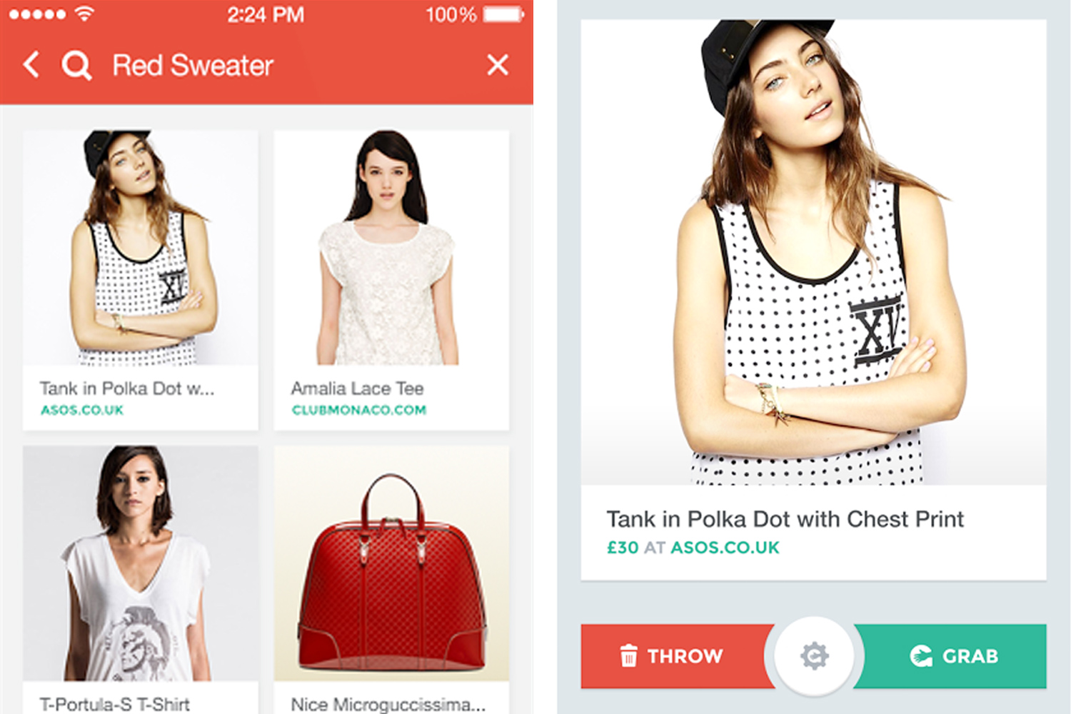
Case 11.
“Tinder” style functionality that allows you to swipe through collections from different brands, picking out& purchasing items you like.
Grabble has won the reputation for being the “Tinder for fashion” as it allows user to swap right for like functionality and it’s very addictive as well.
It‘s a super fast way for find the look that you like.
It allows the customer to create the digital wardobe by pressing the “like“ button.
You can also purchase the garments directly through your smartphone.
Alina Klose, Holly Taylor, Ngalla D. Gaye, Rao Muhammad Abdulla, Yeseul Oh 15/09/2016

Slide 32
Source: https://www.youtube.com/watch?v=1afWOe6dhtU
Alina Klose, Holly Taylor, Ngalla D. Gaye, Rao Muhammad Abdulla, Yeseul Oh 15/09/2016

Slide 33
Case 11. Grabble
TRIZ TRENDS
Trend 4
Degree of Freedom
Trend 7
Trimming/Reducing Complexity
You are having more than ever freedom to choose the color, size and style of your clothes.
Elimination of the pain for visiting outlets for shopping.
Alina Klose, Holly Taylor, Ngalla D. Gaye, Rao Muhammad Abdulla, Yeseul Oh 15/09/2016

Slide 34
A Future Outlook
Both fashion and technology will
continue to thrive simultaneously…
Alina Klose, Holly Taylor, Ngalla D. Gaye, Rao Muhammad Abdulla, Yeseul Oh 15/09/2016

