Slide 1
TRIZ Project: Airlines and Train Industry
Gäel Avazzeri – Juan Cárdenas – Deborah Taurino
Prof. Frank Goethals

Slide 2
Trend 1:
Skywise - Airbus

Slide 3
Trend 1: “Boundary Breakdown” Theory
Many boundaries | Few boundaries | No boundaries

Slide 4
Trend 2:
RFID- Delta Airlines
Video: https://www.youtube.com/watch?v=byLJYMlYKoA

Slide 5
Trend 2: “Customer Buying Hierarchy” Theory
Performance | Reliability | Convenience | Price
Better customer service | More reliable source of information for the client. | Customer can access to live information directly from his smartphone. | No extra cost. It is included in the flight ticket.

Slide 6
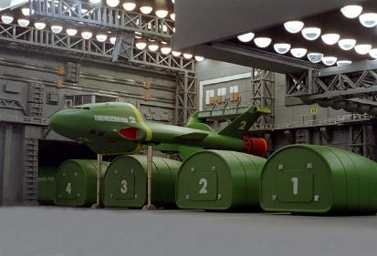
Trend 3: Removable Cabin - Airbus
Video: https://www.youtube.com/watch?v=AR09DmBrR7I

Slide 7
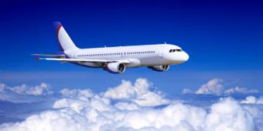
Trend 3: “Dynamization” Theory
Rigid System | System with some flexibility | Fluid System

Slide 8
Trend 4:
Airplanes’ chairs printed in 3D – Altran

Slide 9
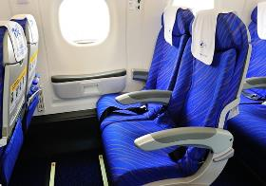
Trend 4: “Increasing Dimensionality” Theory
Point | 1D | 2D | 3D | 4D

Slide 10
Trend 5:
Big Data

Slide 11
Trend 5: “Increasing Asymmetry” Theory
Symmetrical System | Partial Asymmetry | Matched Asymmetry

Slide 12
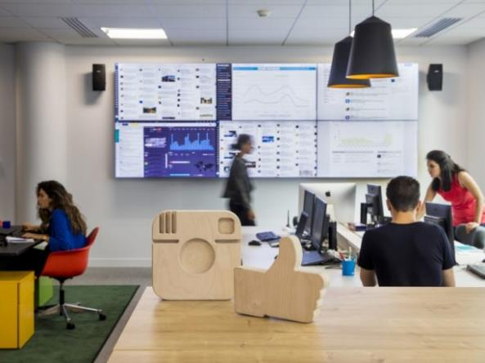
Trend 6:
SNCF’s Social Room
Video: https://www.youtube.com/watch?v=mwfOwsyFfn8

Slide 13
Trend 6: “Increasing Transparency” Theory
Opaque | Partially transparent | Transparent
Before the Social Room
With the Social Room

Slide 14
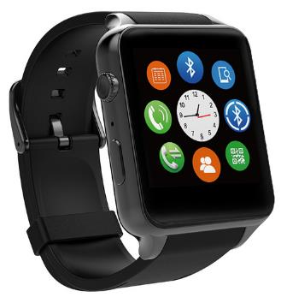
Trend 7: Connected watch - Altran

Slide 15
Trend 7: “Trimming/Reducing Complexity” Theory
Complex system | Elimination of non-key components | Elimination of non-key subsystem | Trimmed system
Setting systems of a plane for flight attendants.

Slide 16
Trend 8:
Self-Service Bag Drop
Video: https://www.youtube.com/watch?v=WGO9SmTrfV0

Slide 17
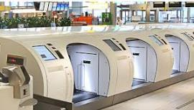
Trend 8: “Decrease Human Involvement” Theory
Human | Human + tool | Human+ semi-automated tool | Human + automated tool | Automated tool | Autonomous tool with Autpoesis

Slide 18
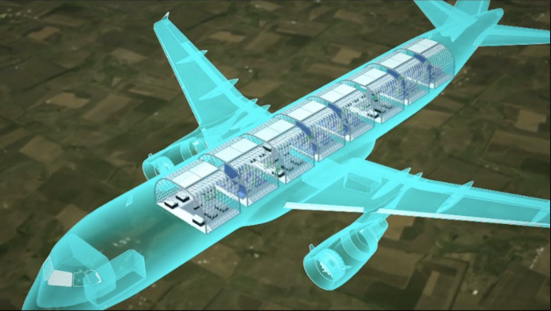
Trend 9:
Transpose - Airbus
Video: https://www.youtube.com/watch?v=dx8i0kiUYVo

Slide 19
Trend 9: “Customer Expectation” Theory
Commodity | Product | Service | Experience | Transformation

Slide 20
Trend 10: Flex Seat - Recaro/Airbus

Slide 21
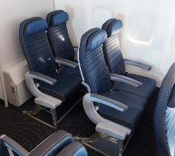
Trend 10: “Rhythm Co-ordination” Theory
Continuous action | Periodic action | Use of resonance

Slide 22
Trend 11:
Illumination & Mood
– Virgin Atlantic
Video: https://www.youtube.com/watch?v=byLJYMlYKoA

Slide 23
Trend 11: “Segmentation” Theory
Tighter control over customer’s behaviour.
Useful to provide a better service.
Alongside Big Data → Powerful tool of marketing and sales.

Slide 24
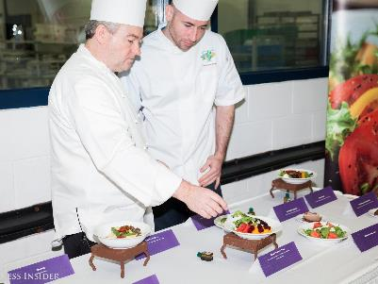
Trend 12: Elaboration of Meals by Michelin-starred chefs - Airbus

Slide 25
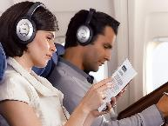
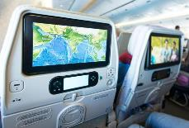
Trend 12: “Increasing Use of Senses” Theory
1 sense | 2 senses | 3 senses | 4 senses | 5 senses

Slide 26
Trend 13:
Autonomous Cabin
Trolley - Altran

Slide 27
Trend 13: “Action Coordination” Theory
 | Non-Coordinated Action | Partially coordinated action | Fully coodinated action | Different actions during intervals
Meal Logistics and customer service

Slide 28
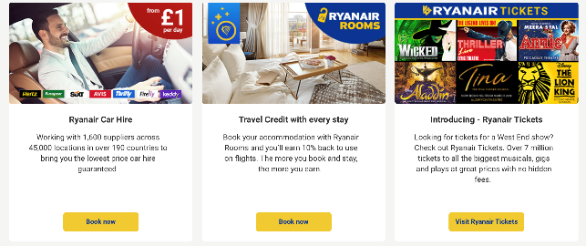
Trend 14:
Ryanair’s Online
Service Offering

Slide 29
Trend 14: “Mono-Bi-Poly (Various)” Theory
Mono-system | Bi-system | Tri-system | Poli-system

Slide 30
Trend 15: Face
Recognition – China’s transportation system

Slide 31
Trend 15: “Mono-Bi-Poly (similar)” Theory
 | Mono-System | Bi-System | Tri-System | Poly-System
Customer’s Boarding Pass
Paper-based Boarding Pass
E-Billet Boarding Pass

Slide 32
Trend 16: Cartoon Safety Video – Virgin Atlantic
Video: https://www.youtube.com/watch?v=byLJYMlYKoA

Slide 33
Trend 16: “Mono-Bi-Poly (increasing differences)” Theory
Similar elements | Elements with biased characteristics | Element plus negative element
Flight safety booklet or live demonstration
Digital and entertaining safety video

Slide 34
Trend 17:
Transpose - Airbus
Video: https://www.youtube.com/watch?v=dx8i0kiUYVo

Slide 35
Trend 17: “Design Point” Theory
System optimized for single situation | System optimized for two situations | System optimized for several situations | System re-optimized continuously

Slide 36
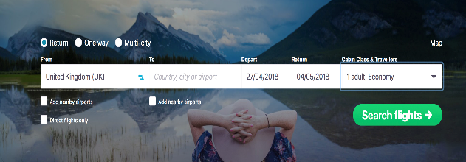
Trend 18:
Skyscanner
Business Model

Slide 37
Trend 18: “Degrees of Freedom” Theory
1 DOF | 2 DOF | MULTIPLE DOF

Slide 38
Trend 19: Mood Blanket
– British Airways
Video: https://www.youtube.com/watch?v=byLJYMlYKoA

Slide 39
Trend 19: “Nesting (Up)” Theory
 | Independent Structure | Structure Connected into higher level system | Completely integrated into higher level system
Blankets are getting smarter
Blankets
+
Brain neuro sensors

Slide 40
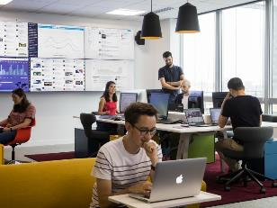
Trend 20:
SNCF’s Social Room

Slide 41
Trend 20: “Improved listening” Theory
Ignoring | Pretending to listen | Selective listening | Attentive listening | Empathic listening
Before the Social Room
With the Social Room

Slide 42
Gäel Avazzeri – Juan Cárdenas – Deborah Taurino
Prof. Frank Goethals

Slide 43
References
http://www.airbus.com/newsroom/press-releases/en/2017/06/airbus-launches-new-open-aviation-data-platform--skywise--to-sup.html
https://www.telegraph.co.uk/travel/news/Ludicrous-aircraft-innovations-that-will-never-get-off-the-ground/
https://www.usinenouvelle.com/editorial/l-idee-folle-d-airbus-pour-reduire-le-temps-d-embarquement-dans-ses-avions.N365537
http://ignition.altran.com/en/article/four-innovations-set-revolutionise-plane-cabins/
https://www.digitaldoughnut.com/articles/2017/march/how-airlines-are-using-big-data
https://w3.accelya.com/blog/4-ways-airlines-can-use-big-data-to-make-customers-love-them
https://www.sncf.com/fr/service-client/nous-contacter/reseaux-sociaux
https://lareclame.fr/icibarbes-sncf-parole-annonceur-beatrice-chavanel-167344
http://www.futuretravelexperience.com/2011/08/is-self-service-bag-drop-the-future-of-baggage-processing/
www.tourhebdo.com/actualites/transport/ces-cinq-innovations-qui-feront-lavion-de-demain-444625.php
http://www.air-cosmos.com/aircraft-interiors-2017-recaro-et-airbus-presentent-le-flex-seat-92807
https://www.ausbt.com.au/virgin-atlantic-s-new-a330-has-seductive-mood-lighting
https://www.lexpress.fr/styles/saveurs/avion-dans-les-coulisses-des-plateaux-repas-de-leur-elaboration-a-leur-service-a-bord_1797988.html
www.passengerselfservice.com/2017/09/biometrics-wuhan-train-station/
http://viajarnews.com/innovaciones-tecnologia-aerolineas/
https://flytranspose.com/introducingtranspose-a9b6640403f3

