Slide 1
Trends in digital innovations
Airlines

Slide 2
Trends in digital innovations
Mari cairns
12184713
MBA Modular 2014 E2

Slide 3
"To most people, the sky is the limit. To those who love aviation, the sky is home"
Anonymous

Slide 5
Windowless planes - concept
Mari cairns 12184713
Airlines transport 37 billion passengers per year
Implications Efficiency and Effectiveness
Windowless planes - concept stage
Weight implications in planes; space and seating; optimise design
#9 Customer Expectation Theory
#12 Increase use of Senses
#18 Degrees of Freedom Theory

Slide 7
Happiness blanket - British airways
Mari cairns 12184713
Focus Passenger Experiences
British Airways piloted "Happiness Blanket"
Changes colour based on Brainwaves; Transmitted via Bluetooth; from Headband worn; Neuro sensors
#9 Customer Expectation Theory
#11 Segmentation Theory (mood variable)
#12 Increase use of Senses

Slide 8
Trends in digital innovations
sylvanus retief
18661076
MBA Modular 2014 A

Slide 9
Sylvanus retief 18661076
"During any given flight, it's estimated that travel time, fuel use, and flight path are 18% to 22% inefficient"
General Electric

Slide 10
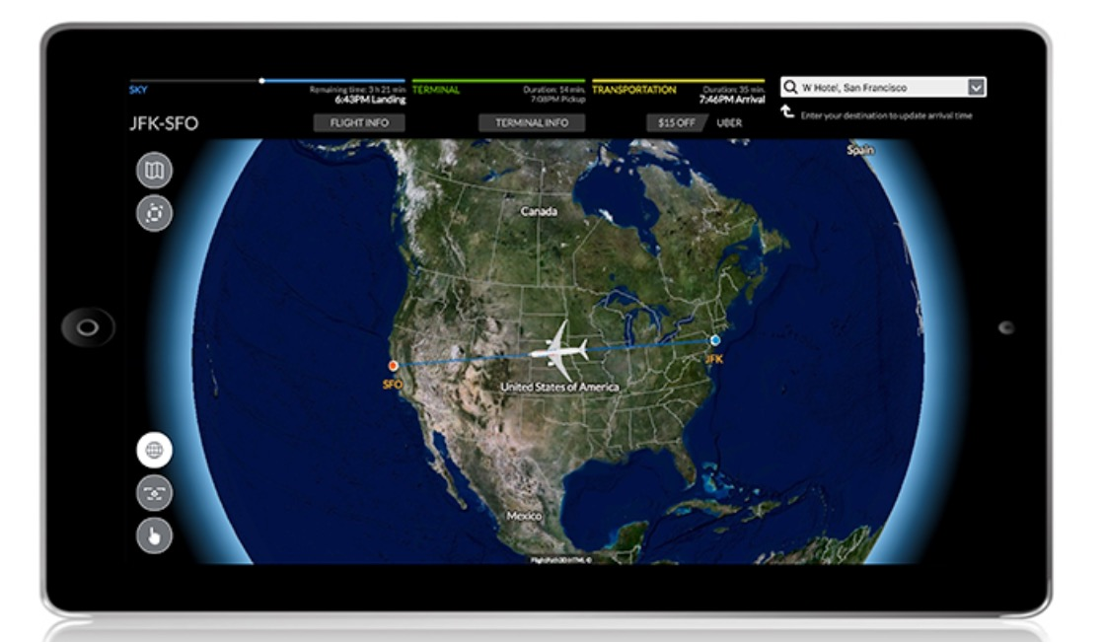

Slide 11
Seamless travel experience - flight PATH 3D
Sylvanus retief 18661076
Moving Maps
"Aircraft to Door"
Real Time
Additional Ideas
#13 Action Co-ordination
#17 Design Point Theory

Slide 12
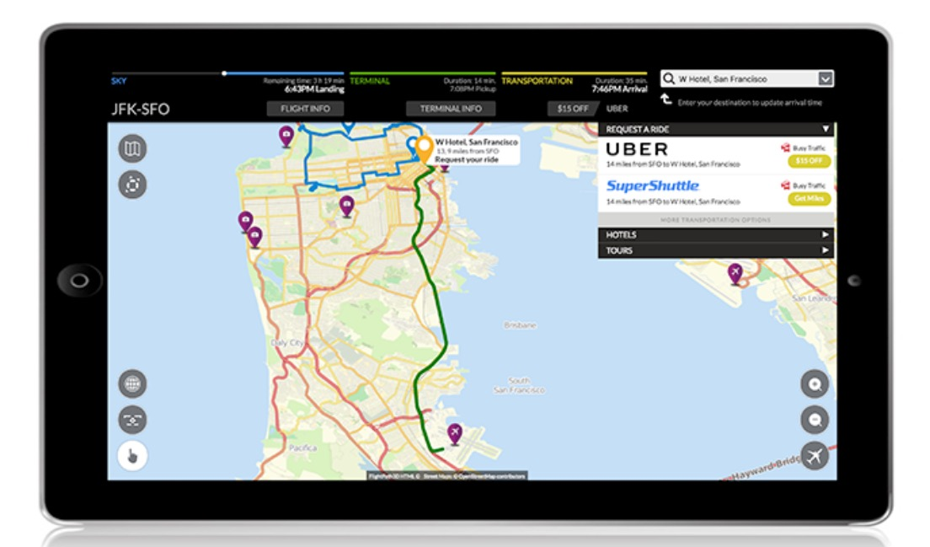
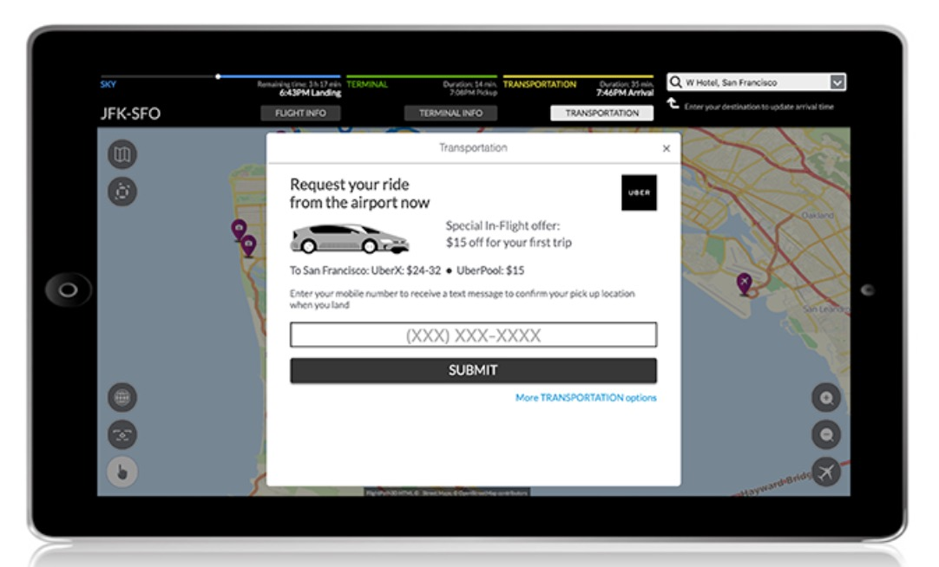

Slide 13
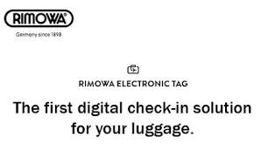
Electronic luggage tags - rimowa
Sylvanus retief 18661076
Simplicity
Tracking
Cost
Current and Future Airlines
#2 Customer Buying Hierarchy
#7 Trimming/ Reducing Complexity
#8 Decrease Human Involvement
#17 Design Point Theory

