Slide 1
Trends in the Airline Industry
Presented By:
Sena Nur Inal
Yang Fan
Anum Khan
Muhammad Ahsan Jamil Khan

Slide 2
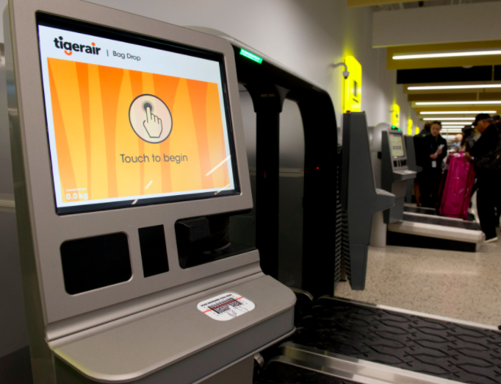
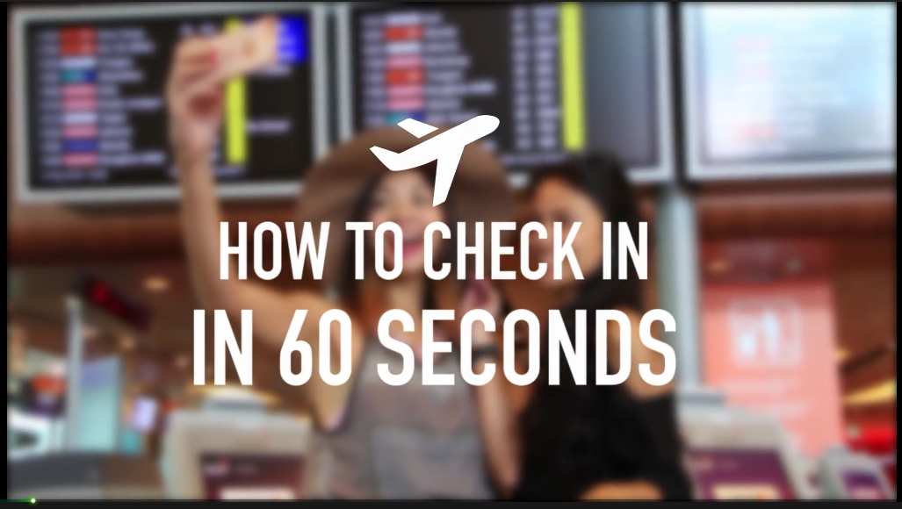
Functions:
Print boarding passes on the spot and check-in
Assist customers to change flights or purchase optional add-on items. E.g. extra luggage or extra leg room seating
Causes for implementation:
To avoid long queues at boarding gates.
Improve the customer experience and enhance on time performance
To save employees from spending too much time on boarding
Trends:
- Decrease human involvement
- Customer expectation
Self-service check-in

Slide 3
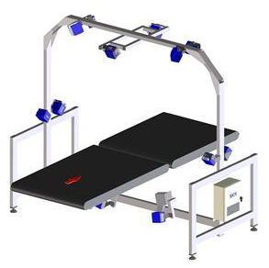
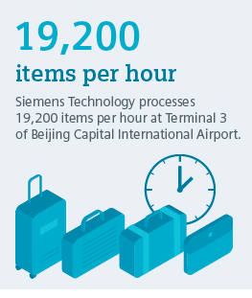
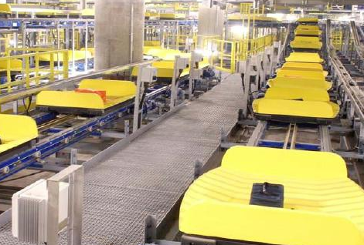
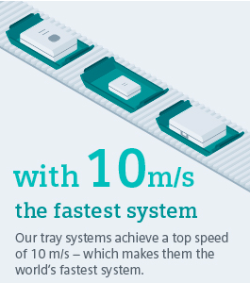
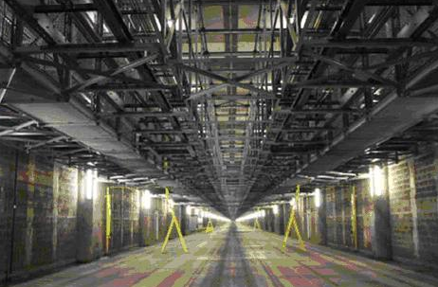
Siemens automated baggage check-in system
-combines tray technology and conveyor belt with intelligent software applications
Functions:
transport , sorting, tailored solutions for baggage handling
Print tags load onto the right flight
Objectives:
Track suitcase accurately
Save baggage handling timings
reduce management workload
Avoid baggage losses
Increasing customer experience
Trends:
time reducing complexity
Decrease of human involvement

Slide 4
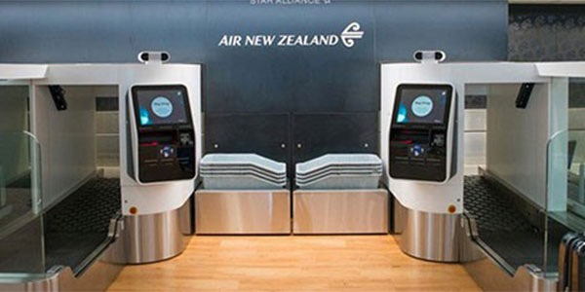
Biometric-enabled self-service
Baggage drops units were introduced that
stored and image of the passenger upon
dropping of the luggage by facial
recognition technology.
No need to present all documents
Facilitate the process by using biometrics technology
Provide a more seamless airport journey to the passengers

Slide 5
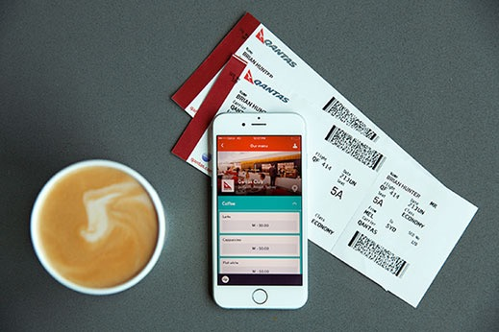
Coffee ordering service
Qantas partnered with Skip (an app that
allows customers to skip queues),
allowing them to order and pay for their
coffees. Customers simply receive
a text when their order is ready for them
to pick up at the airport.
Flexible and high quality service
Take care of the passenger’s wellbeing during the waiting process
Design point
Nesting
Dynamization

Slide 6
Octopus cards are used to make buying more convenient
Payment cards that are used on the ground can be used in the air
Food, beverages, discounted transportation and event tickets, and on board upgrades for HK Express’ extra legroom ‘sweet seats’.
Payment terminals with Octopus’ sensor technology
Hold card near the sensor and the payment is made
U.S JetBlue: in-flight payments through Apple Pay.

Slide 7
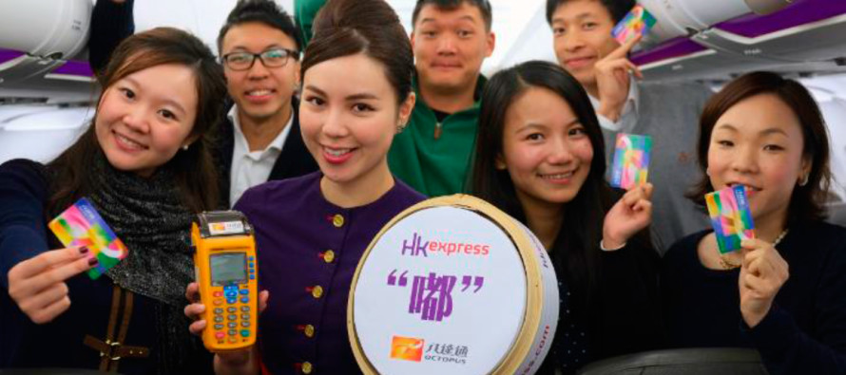
TRIZ Trends Applied
Trend 2: ‘Customer buying hierarchy’
Trend 7: ‘Trimming Reducing Complexity’
Trend 9: ‘Customer Expectation Theory’

Slide 8
Air New Zealand
Screen share to watch with neighbours
In flight planner is shared, questions can be asked to the crew
Collaboration with YouTube to upload content
100 short videos will be played in flight

Slide 9
TRIZ Trends Applied
Trend 3: ‘Dynamization’
Trend 9: ‘Customer Expectation’
Trend 12: ‘Increasing use of senses’
Trend 19: ‘Nesting’

Slide 10
Lufthansa uses Virtual Reality
Airlines now a days are using different methods to upgrade thier customers to premium classes to increase revenue per seat
Lufthansa airline upgraded its departure gates with officers holding virtual reality devices.
``Lufthansa uses this innovation to upgrade its customers to premium class by showing customers a 360 degree view of the premium cabin``.
By doing this Lufthansa hoped passengers booked in Economy would become more interested to purchase an upgrade.

Slide 11
According to Lufthansa: “Because what legroom and premium service really mean in Premium Economy can be best demonstrated in three-dimensional form.”

Slide 12
https://www.youtube.com/watch?v=OPRcbFrp9Y4

Slide 13
References
http://www.airlinetrends.com/2015/03/14/hk-express-octopus-card/
https://www.travelchinaguide.com/cityguides/hongkong/airport-express-pass.htm
http://www.airlinetrends.com/2010/05/11/air-new-zealand-social-ife/
https://www.google.fr/search?q=hong+kong+airport+express+octopus+card&rlz=1C1NHXL_enFR728FR728&espv=2&source=lnms&tbm=isch&sa=X&ved=0ahUKEwi8_ILirbPTAhUD6xQKHT2eA6kQ_AUIBygC&biw=1366&bih=662&dpr=1#imgrc=m5Y2SxmH0vpnoM:

Slide 14
References
http://www.airlinetrends.com/
https://investor-relations.lufthansagroup.com/fileadmin/downloads/en/charts-speeches/LH-the-way-forward-e-2014-07.pdf
https://blog.business-model-innovation.com/tag/lufthansa/

