Slide 1
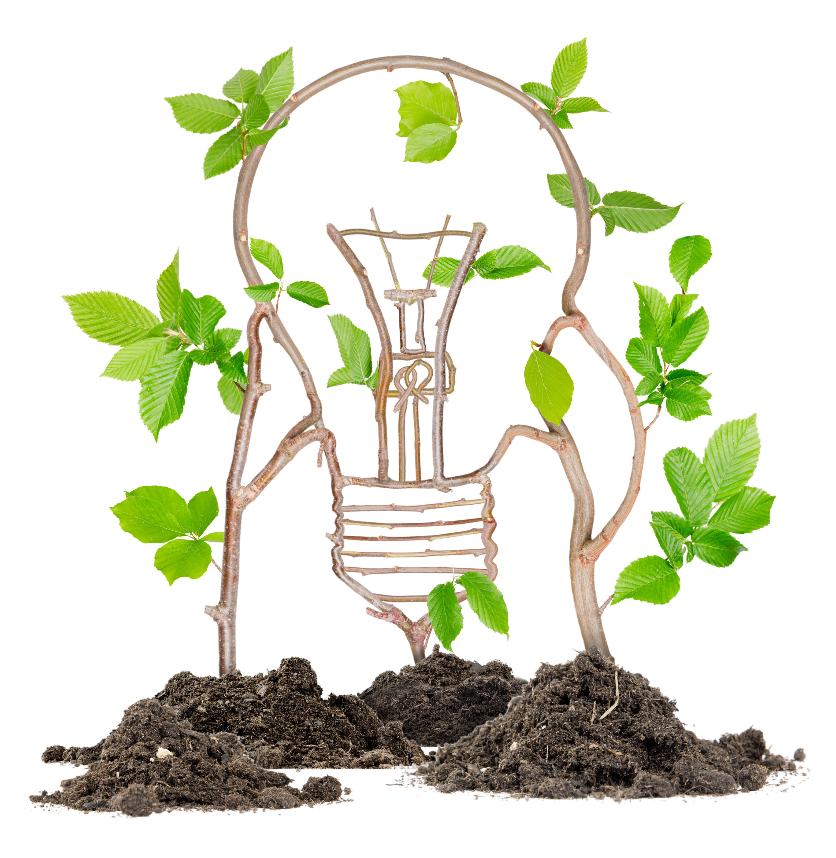

TRENDS IN DIGITAL
INNOVATION
INDUSTRY: AGRICULTURE
TARINA DU TOIT (14407426)
LANI SCHOLTZ (13796666)
Leon van Zyl (16200608)
Frans Sabbat (18917747 )
Notes:
As a agricultural scientist I am a big fan of using new technologies that provide farmers with more sustainable practices, such as using water more efficiently and reducing fertilizer application to only what is required by the crops.

Slide 2
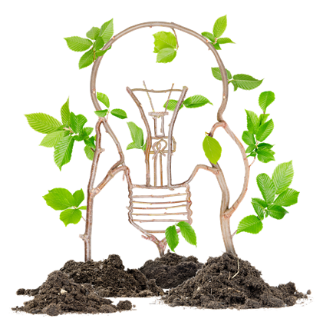

FRUITLOOK
THE OPPORTUNITY:
Rising input costs and increased competition for water are forcing farmers to find innovative ways to use water more efficiently.
THE SOLUTION:
South African initiative funded by the Western Cape Government
FruitLook allows farmers to track water-use efficiency and identify crops under stress.
Tarina du Toit (14407426)
Notes:
As a agricultural scientist I am a big fan of using new technologies that provide farmers with more sustainable practices, such as using water more efficiently and reducing fertilizer application to only what is required by the crops.

Slide 3
FRUITLOOK
HOW:
FruitLook uses SEBAL (Surface Energy Balance Algorithm for Land) technology to calculate parameters to improve farm management.
Remote-sensing measures the solar radiation reaching the crop, reflecting off the plants, and heating up the soil surface.
By combining radiation data with climatic data FruitLook supplies parameters that assist farmers to monitor evapotranspiration (water use), water use-efficiency, plant-growth and the nitrogen status of a crop.
Tarina du Toit (14407426)

Slide 4
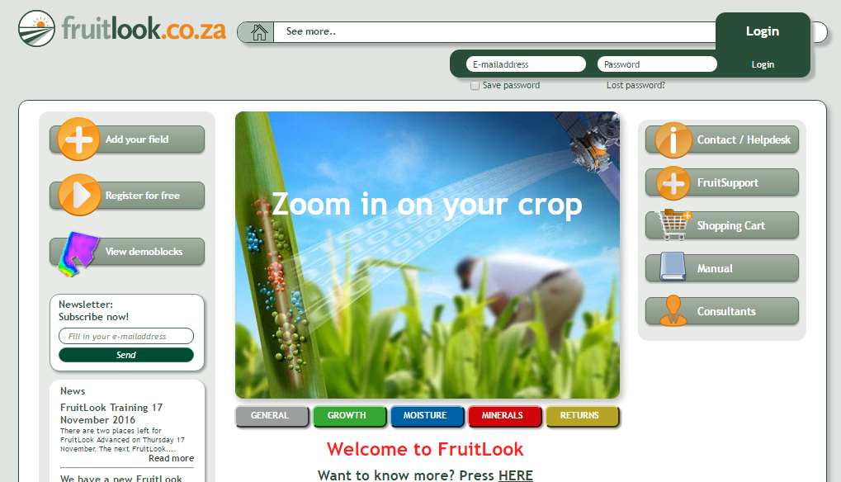
Tarina du Toit (14407426)
Notes:
Open web portal that farmers can access for free

Slide 5
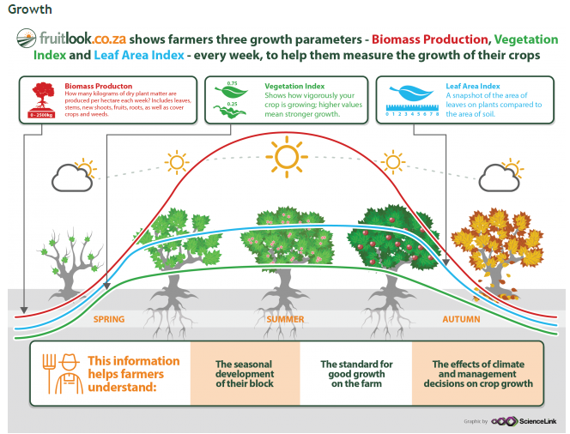
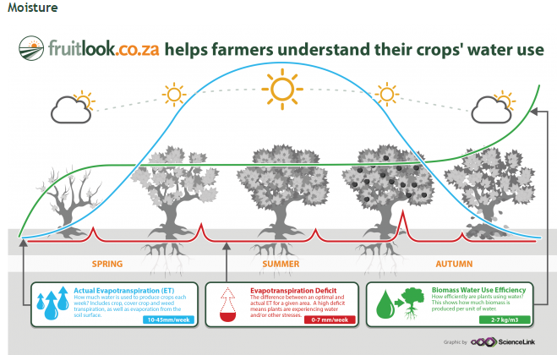
Tarina du Toit (14407426)
Notes:
.

Slide 6
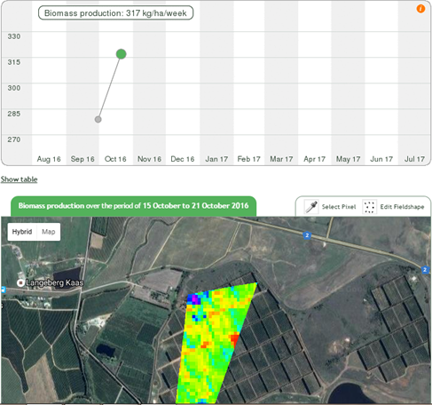
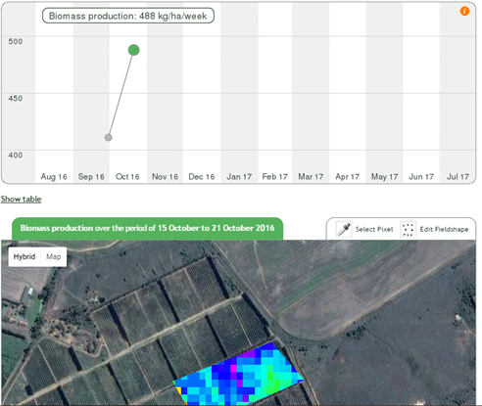
Example
Tarina du Toit (14407426)
Notes:
Stressed plants radiate more heat than unstressed plants. “When plants are under stress, their stomata close to prevent water loss, and this causes heat build-up.

Slide 7

Quantum VRT - Drones for Good
THE OPPORTUNITY:
Copter systems that have been used for agricultural monitoring has not been very efficient: short flight times & energy required
THE SOLUTION:
Quantum VRT Drones
Tarina du Toit (14407426)
Notes:
Until recently Drone Technology has been mainly associated with military projects.

Slide 8
Quantum VRT - Drones for Good
Tarina du Toit (14407426)
Notes:
Video

Slide 9
Trends
Dynamization
Decrease Human Involvement
Design Point
Tarina du Toit (14407426)
Notes:
Until recently Drone Technology has been mainly associated with military projects.

Slide 10
Dairy industry
The opportunity
  KPI
    Milk production (R3.40/kg)
    Milk solids i.e. protein content for cheese making (minimum 3.6%)
    Fertility rate i.e. days open before next conception (+/- R150/day)
    Health – influences all of the above and treatment costs
  Current measurements of these KPI’s
    Individual cow monitors to capture milk production data
    Lab tests for individual and bulk tank testing
    Visual, feed intake and behavioural signals
Lani Scholtz (13796666)

Slide 11
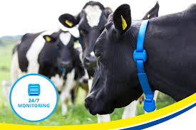
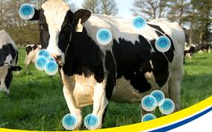
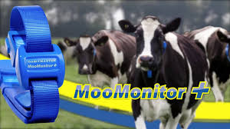
MooMonitor
The solution – wearable technology
Moo Monitor allows you to check cow information about:
  Milk production
  Milk quality
  Feed intake
  Health
  Activity
  Reproduction
Lani Scholtz (13796666)

Slide 12
Feed quality
Opportunities
Desktop NIR machine that test the nutritional values of feed and raw materials
Only batch testing, very manual and time consuming.
  Feed mills work 24h which means that lab employees will also need to be there or do the testing the day after…to late.
  Quality in one batch can differ greatly
Solutions
Real time testing of raw materials as it goes into and out of the silo or mill
Real time adjustment to feed formulations to adapt to the changes in manufacturing which improves the quality of nutrition
Lani Scholtz (13796666)

Slide 13
SiloKing
Lani Scholtz (13796666)

Slide 14
Trends
Decrease Human Involvement – less time spent doing visual herd inspection + less manual feed testing and people on shift
Increase use of senses – smell, feel, sight of raw materials as well as animal condition
Mono-Bi-Poly (similar) – improved functions for MooMonitor (gas emissions or body temperature linked to illness) + NIR can measure more nutrients (mineral, vitamin and amino acids)
Design point – optimise and plan more efficient on farm and feed mill
Tarina du Toit (14407426)
Notes:
Until recently Drone Technology has been mainly associated with military projects.

Slide 15
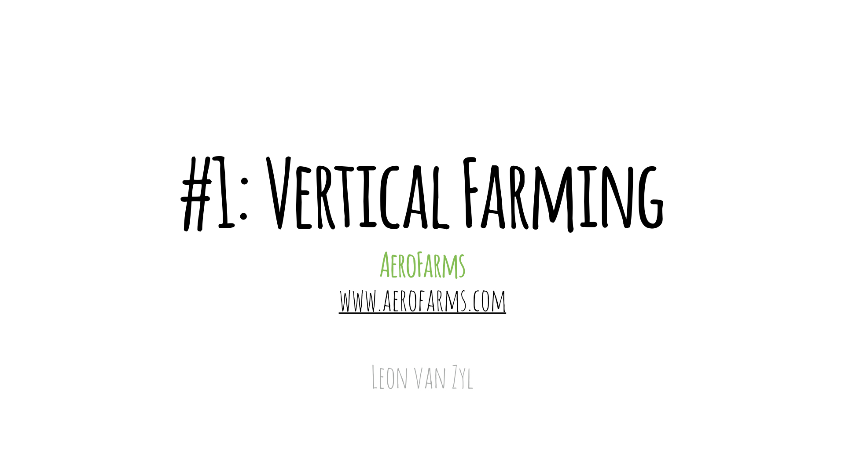

Slide 16
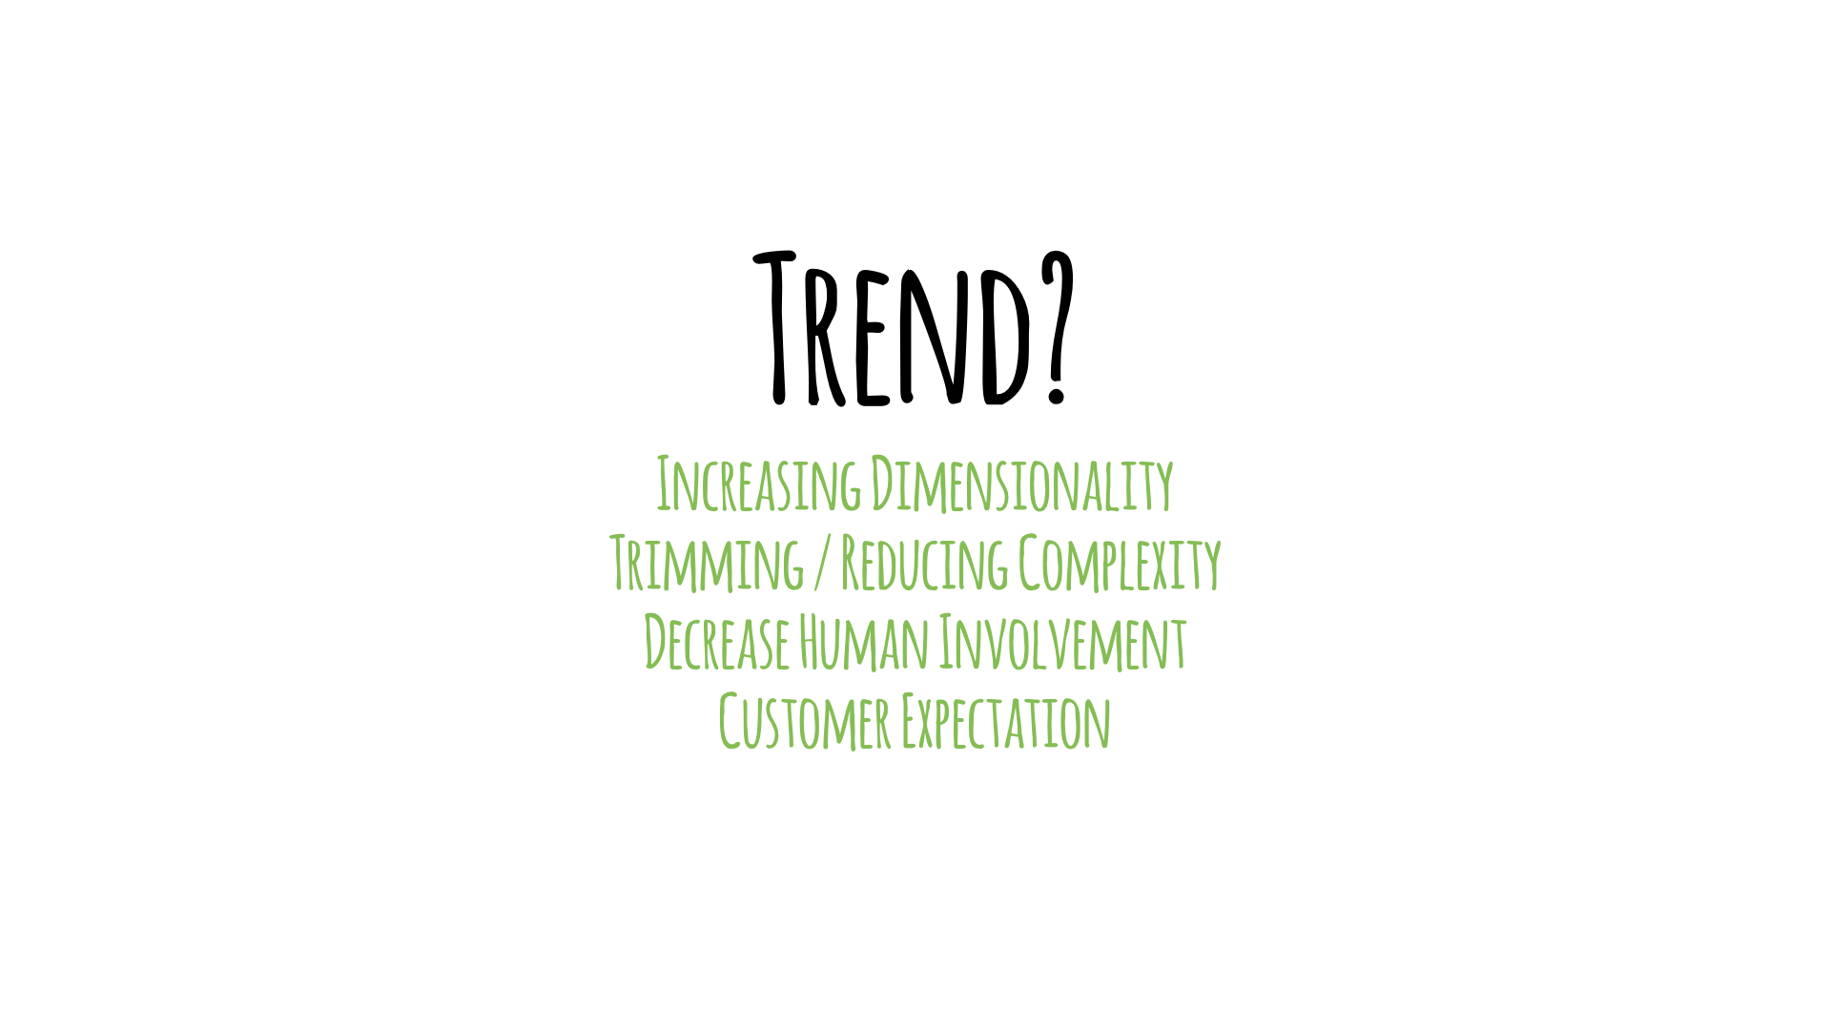

Slide 17
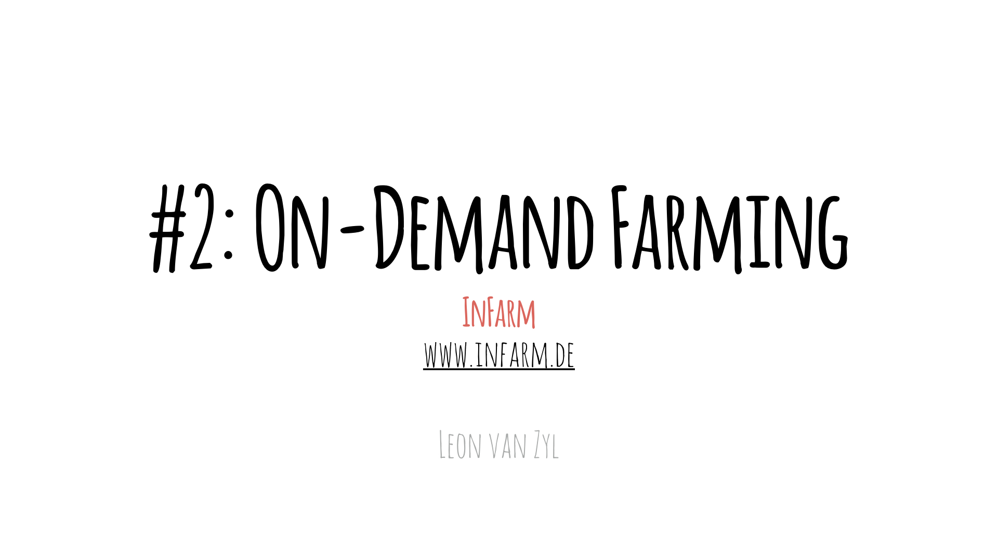

Slide 18
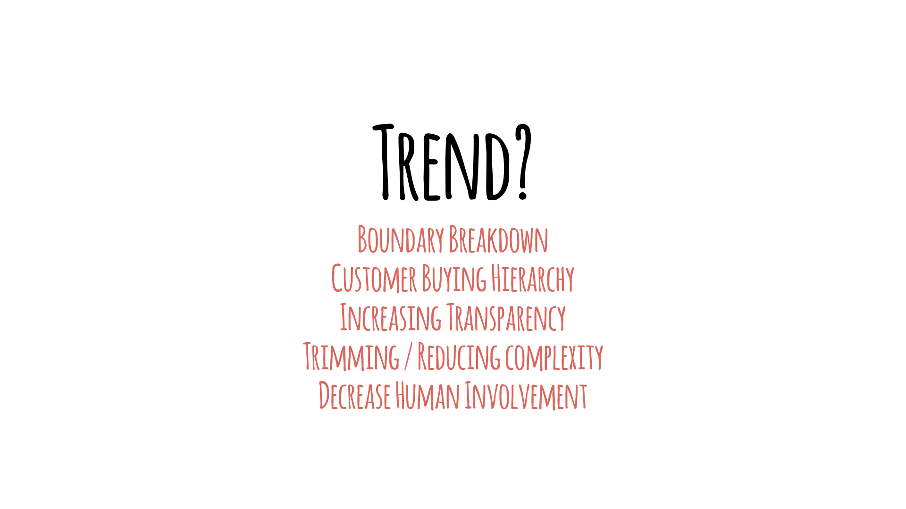

Slide 19
Using drones (UAV’s) in Agriculture
To better monitor his big farm, and make better decisions;
Farmer Robert Blair, in Kendrick, Idaho, built an unmanned aircraft himself (later also bought a multi-rotor hexacopter, a UAV).
He equipped the home-made drone with up to four cameras to “scout” about 1,500 acres of wheat, peas, barley and cow pasture.
Drones also equipped with other sensors to survey crops, monitor for wheats, disease, accuracy of spraying for pesticides and use of fertilizers. (checking for any missing spots n fields, etc)
With the use of “remote sensing’’ he use the drones to get a birds-eye view of his cows and fields (taking pictures)
"remote sensing" generally refers to the use of satellite- or aircraft-based sensor technologies to detect and classify objects on earth, using electromagnetic radiation.
Since very well received by the industry and invited as public speaker on the matter.
July 2013
Frans Sabbat

Slide 20
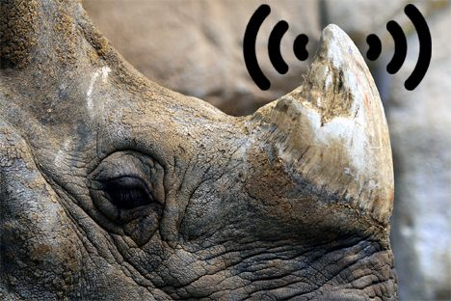
Rhinos Wear GPS Devices In South Africa
To help protect rhinos against poachers;
the Mafikeng Game Reserve in South Africa decided to install GPS locating devices on the horns of the rhinos. (Satellite Monitoring)
Scientists drill a small hole into a 'dead' portion of the animals' horns and placing the tracking device inside this hole. This is a quick procedure and causes no pain to the rhino.
This small tracking chip helps park officials to monitor the movement of the animals and to alert them of any possible threats. (ie no movement or rapid high speed movement)
The satellite locating device can be monitored by cell phone, allowing officials to know the location of the rhinos at all times.
July 2013
Original photo: Jim Epler / CC
Frans Sabbat

Slide 21
Trends
Trends | Assessment comment
Trend 1: Breakdown barriers | Big data, intelligence (computer analysis). Satellite Communication (GPS). Distances: Cover more land space easier.
Trend 7: Trimming/reduce complexity | Reduced cost and waste with less workers, more effectiveness. Monitoring remotely on smart mobile devices.
Trend 8: Decrease human involvement | Less protectors of the rhinos or farm workers. Less effort to manage farm and patrol land to monitor rhinos.
Trend 13: Action coordination | Based on Rhino movements, data analysis. Relying on the technology. Where fertiliser not effective and fix that patch.
Trend 19: Nesting (UP) | Farmer Blaire attached cameras and various sensors to UAV to take pictures of landscape. Add-ons possible, If rhinos or UAV equipped with more chips, eg RFID, can monitor various, ie. Health of rhinos, drones for safety or security patrols.
Trend 20: Listening/communication | Attentive Listening- Using computers to analyse the gathered information. Tracking of rhinos to protect.
July 2013
Frans Sabbat

Slide 22
THANK YOU

