Slide 1
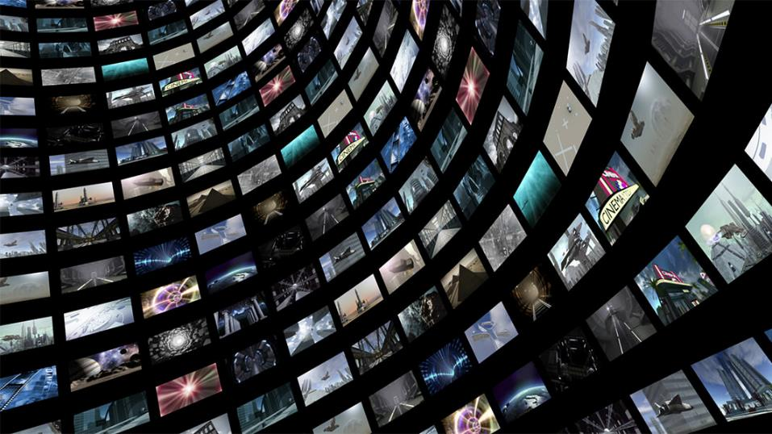
Television & Film
Charlotte Bonami - Zareen Shah - Leone Luzzati

Slide 2
ALTICE ONE
Netflix is increasingly partnering with cable operators, such as Altice.
Altice One: all-in-one device which combines the latest video, internet and connectivity technologies into one immersive experience. As a result, it eliminates the need for a separate cable box, modem, router and streaming device.

Slide 3
ALTICE ONE
TREND 1: BOUNDARY BREAKDOWN
TREND 7: TRIMMING/REDUCING COMPLEXITY
TREND 19: NESTING UP
Notes:
boundary breakdown with competitors
With the Altice one, you don’t need to touch the remote control, but you can give instructions to your TV to quickly find your favorite shows, tune to channels, open apps, get recommendations and more. => voice commands: trimming/reducing complexity
also: Xfinity X1 from Comcast

Slide 4
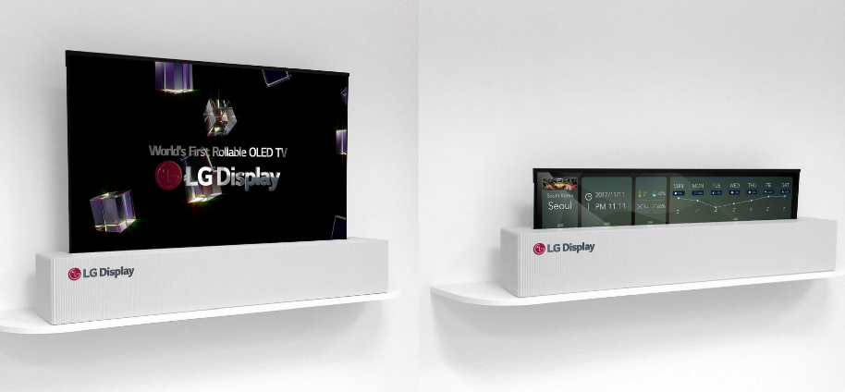
LG ROLLABLE OLED TV DISPLAY

Slide 5
LG ROLLABLE OLED TV DISPLAY
TREND 2: CUSTOMER BUYING HIERARCHY
TREND 3: DYNAMIZATION
TREND 18: DEGREES OF FREEDOM

Slide 6
HOLOLENS IN FILM-MAKING
Hololens glasses put holograms into our real living space and record what we see with a camera.
TREND 4: INCREASING DIMENSIONALITY
TREND 18: DEGREES OF FREEDOM
Notes:
You might stream Netflix on a wall or build a Minecraft castle on your coffee table, as high resolution holograms
Filming a movie gets easier since you see the non-existent creatures through hololens while shooting
https://www.youtube.com/watch?v=wB66zwP3OZo 0:35-1:35
You can watch a movie with hololens and that too whereever you want. You just need to drag the tv to another space. You can change the size of screen as well
https://www.youtube.com/watch?v=ciW6WY21t0U&t=70s

Slide 7
“Providing a revolutionary cinematic experience which stimulates all five senses, the 4DX includes high-tech motion seats and special effects including wind, fog, lightning, bubbles, water, rain and scents, in both 2D and 3D formats”.
TREND 9: EVOLVING CUSTOMER EXPECTATIONS
TREND 12: INCREASING USE OF SENSES
TREND 14: MONO-BI-POLY (VARIOUS)

Slide 8
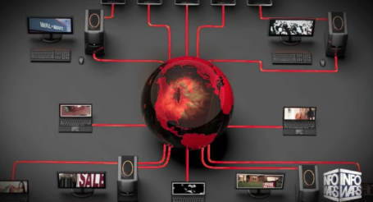
LG SMART TV WITH BUILT-IN CAMERA WITH FACE RECOGNITION AND MICROPHONE
Built-in camera allows LG to scan customers’ body language and audio sending it to third party advertisers. In this way, the latter can air perfectly-timed commercials recognizing its customers’ moods.
TREND 6: INCREASING TRANSPARENCY (OF CUSTOMERS)
TREND 11: SEGMENTATION (OF CUSTOMERS)

Slide 9
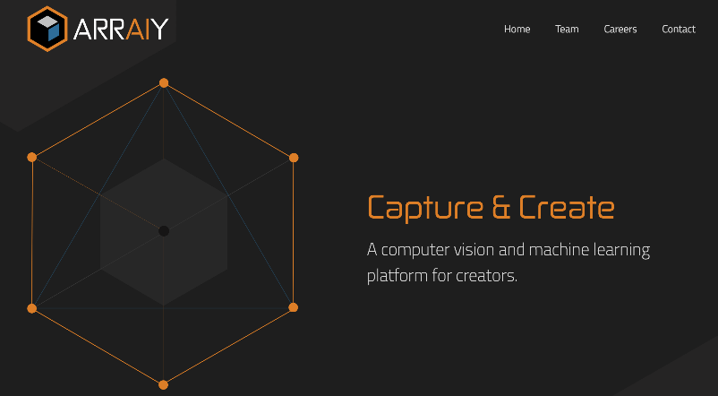
ARRAIY

Slide 10
ARRAIY
ARRAIY is a computer vision and machine learning platform specifically designed for the automation of digital effects of films, games and TV.
Automation of “rotoscoping”
Rotoscoping: the process of separating certain parts of footage from the background
Rotoscoping by hand can take dozens of hours, but Arraiy can do it in a fraction of the time
TREND 8: DECREASE HUMAN INVOLVEMENT
Notes:
new type of artificial intelligence
Arraiy’s creators are training the system to rotoscope — the process of separating certain parts of footage from the background (for example) separating an actor from the green screen behind them) with years’ worth of human-created visual effects as training tools.

Slide 11
NETFLIX DYNAMIC OPTIMISER
New encoding method which employs AI techniques to match the level of compression to a scene’s individual content rather than the show as a whole (shot-by-shot compression)
Goal Deliver the highest quality possible for your connection, constantly checking your data speed = maximizing data utilisation, especially targeting mobile users
How? From Title Level Encoding to Shot-By-Shot Compression
Result? Only use the bandwidth that each individual shot needs, instead of having your entire episode use the bandwidth needed for the shot with the most visual information
TREND 10: RHYTHM COORDINATION
TREND 2: CUSTOMER BUYING HIERARCHY
Notes:
https://gadgets.ndtv.com/entertainment/features/dynamic-optimiser-is-netflix-s-secret-weapon-against-buffering-1665242

Slide 12
AGILE PRODUCER by End Cue
By leveraging AI, the Agile Producer platform revolutionizes the pre-production process: realizing efficiencies, reducing cost, and saving production time.
Coordinating actions within an organization
E.g. the platform automatically generates a storyboard and shot list based on the script, allowing the director and the storytellers to work seamlessly together
TREND 13: ACTION COORDINATION

Slide 13
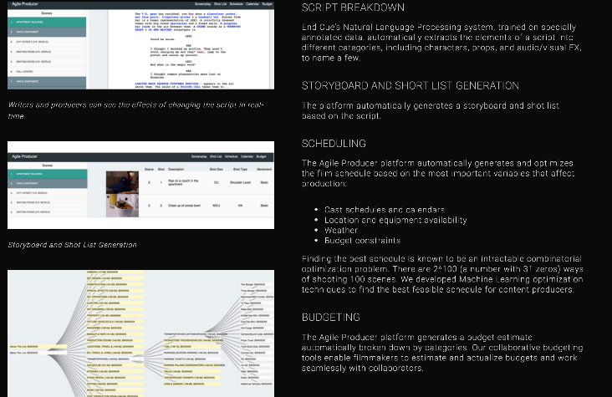
END CUE'S AGILE PRODUCER

Slide 14
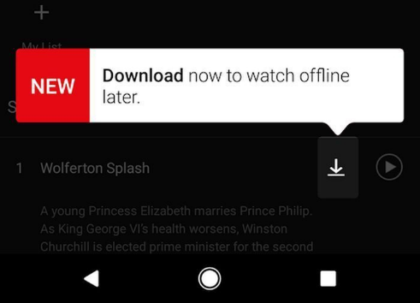
NETFLIX DOWNLOAD AND GO
TREND 15: MONO - BI - POLY (SIMILAR)
TREND 18: DEGREES OF FREEDOM
TREND 2 CUSTOMER BUYING HIERARCHY

Slide 15
“THE WALL” by Samsung
Notes:
Demonstrates how television is evolving to offer consumers an outstanding viewing experience, while acting as a centralized connected smart hub to enhance everyday life. BUT: still extremely expensive

Slide 16
“THE WALL” by Samsung
THE WALL is the the world’s first modular microLED 146-inch TV, transforming into any size and delivering incredible brightness, color gamut, color volume and black levels.
The microLED technology featured in The Wall eliminates the need for color filters or backlight (each microscopic LED can emit its own light), yet allows the screen to offer consumers the ultimate viewing experience
Consumers can add or remove some panels to customize the television size to suit their needs.
TREND 16: MONO-BI-POLY (DIFFERENCES)
TREND 5: INCREASING ASYMMETRY
Notes:
Demonstrates how television is evolving to offer consumers an outstanding viewing experience, while acting as a centralized connected smart hub to enhance everyday life. BUT: still extremely expensive

Slide 17
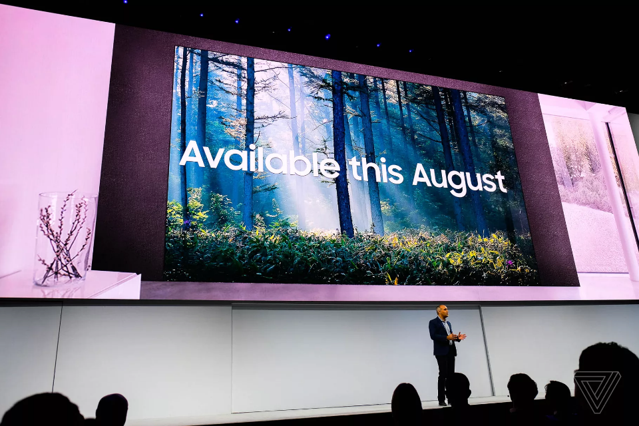

Slide 18
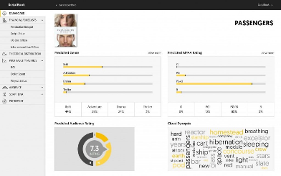
SCRIPT2SCREEN
Decision support system for the entertainment industry that provides AI based script analysis and financial forecasts for film and television, developed by Antwerp startup ScriptBook.
Unifying technology (data mining, machine learning, natural language processing) and storytelling
Filmmakers can see the effect of e.g. adding a female lead to the story
Storytellers can adapt on the fly, leveraging the results from the AI analysis = agile storytelling
TREND 17: DESIGN POINT

Slide 19
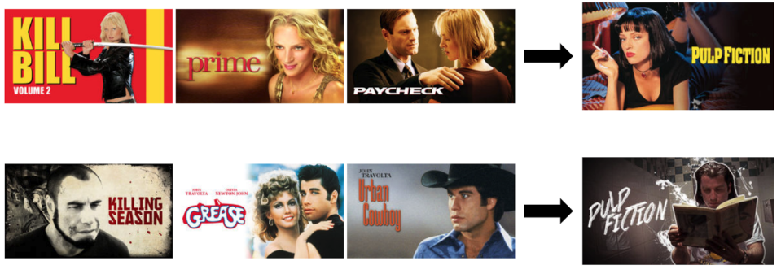
NETFLIX’S PERSONALIZED RECOMMENDATIONS THROUGH PERSONALIZED VISUALS
“How to convince the member that the title is worth watching?”
Using personalized artwork
How? Using online machine learning: contextual bandit model

Slide 20
NETFLIX’S PERSONALIZED RECOMMENDATIONS THROUGH PERSONALIZED VISUALS
TREND 20: IMPROVED LISTENING
TREND 5: INCREASING ASYMMETRY

Slide 21
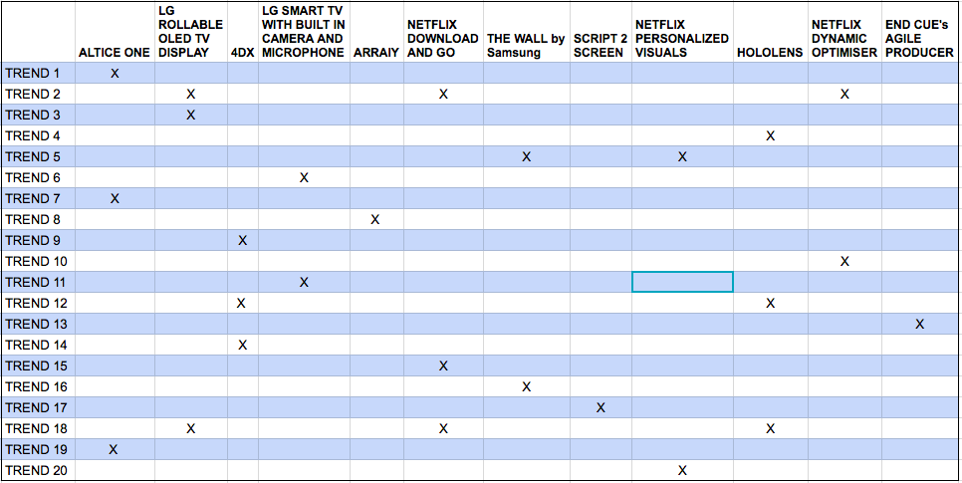
SUMMARY: INNOVATIONS & TRENDS

Slide 22
THANK YOU

