Slide 1
Sports & Game Industries
20 TRENDS IN DIGITAL INNOVATIONS
Lorenzo Molteni, Shahruq Tariq, Paolo Bignami

Slide 2
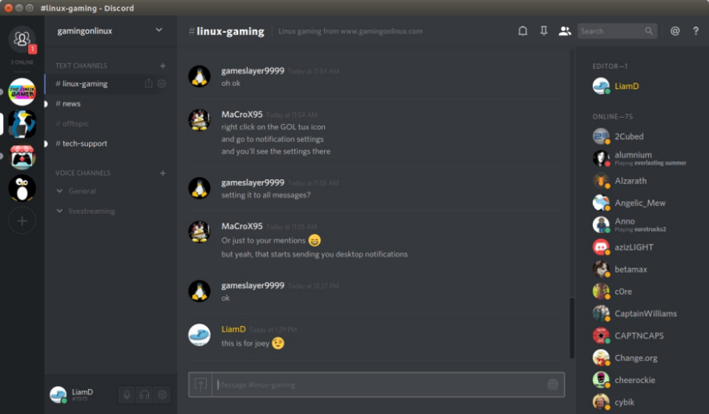
T1:Boundary Breakdown
Discord
Discord is a good example of such platform which bring the gaming community to a single forum,
it is a proprietary freeware VoIP application
designed for gaming communities. Discord runs on
Windows, Android, iOS, Linux, and in web
browsers.
Developers and publishers with verified servers
can use data from Discord to create a "rich
presence" within their games, allowing players to
connect their game profile to their Discord profile.

Slide 3
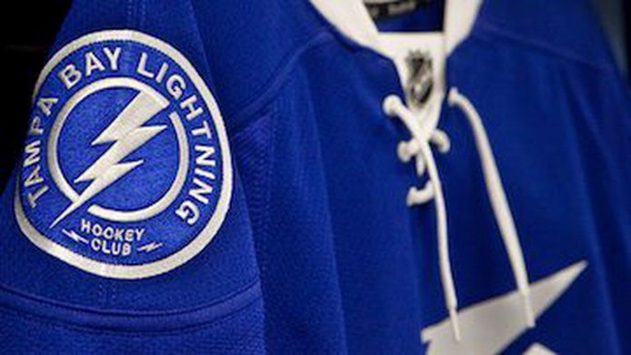
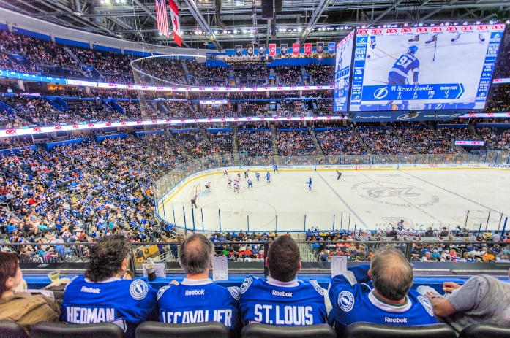
T2: Customer Buying Hierarchy
Tampa Bay Lighting RFID Jerseys
In 2011, the team saw a drop in home attendance, due to a decline in on-ice performance, economic recession and management problems.
They developed an RFID-based loyalty program for its season-pass holders: the solution consisted in a passive tags sewn into Lighting jerseys worn by fans, in addition to RFID readers deployed at concession stands and stores.
This allows user to receive discounts for food, beverage, souvenirs and tickets; it also can help the management better control activity at concession stands and in stores.
Tampa Bay Lighting nearly doubled the number of customers in just one year.

Slide 4
T3: Dynamization
Big Data in NBA
An innovation that is trying to go in the direction of a field where everything is interconnected is the usage of Big Data to analyze game situations in many sports.
In the NBA, nearly every team now has data analysts on their staff who work with coaches and player evaluators to maximize individual athlete’s talents and identify undervalued players.
In 2009, the league began using a video system that tracked the movement of every player on the court, and the ball. These new data have pushed forward the league’s analytics movement, allowing data scientists to use machine learning and cartography to better assess which players were actually helping their team win.
Rise of the three-point shot
Evaluating defense
Scouting new players

Slide 5
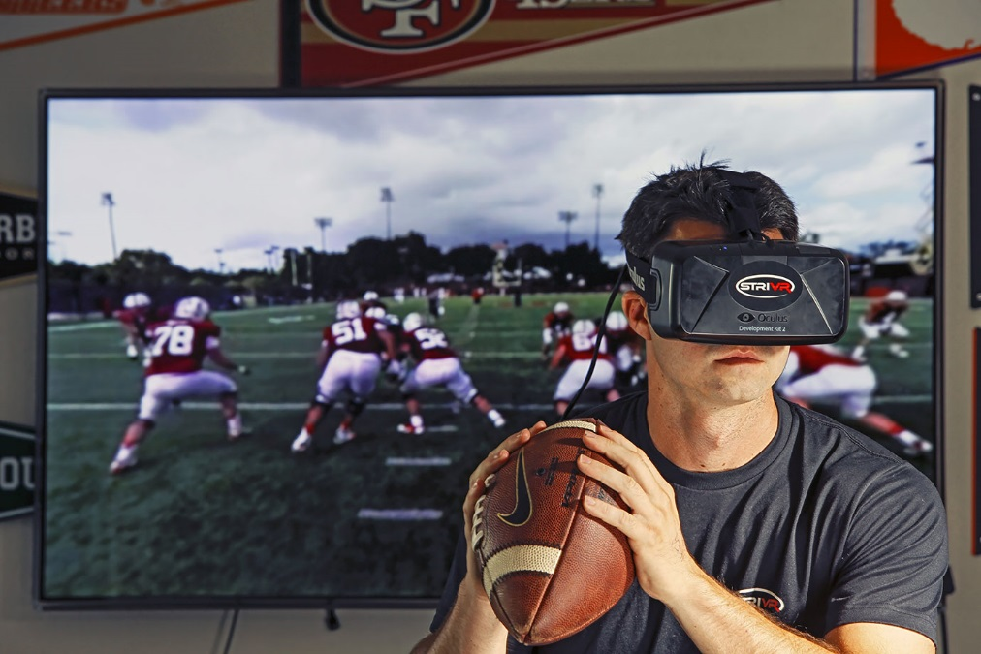
T4: Increasing Dimensionality
Virtual Reality at Gillette Stadium
The virtual reality is use with different scope in sport environment:
Some professional football teams use VR for training session where the players don’t need to be on field.
New England Patriots use the VR with the fans. It allows to bring them inside the Pats locker room of Gillette Stadium.
People could bring every aspect of the game without leaving their couch.

Slide 6
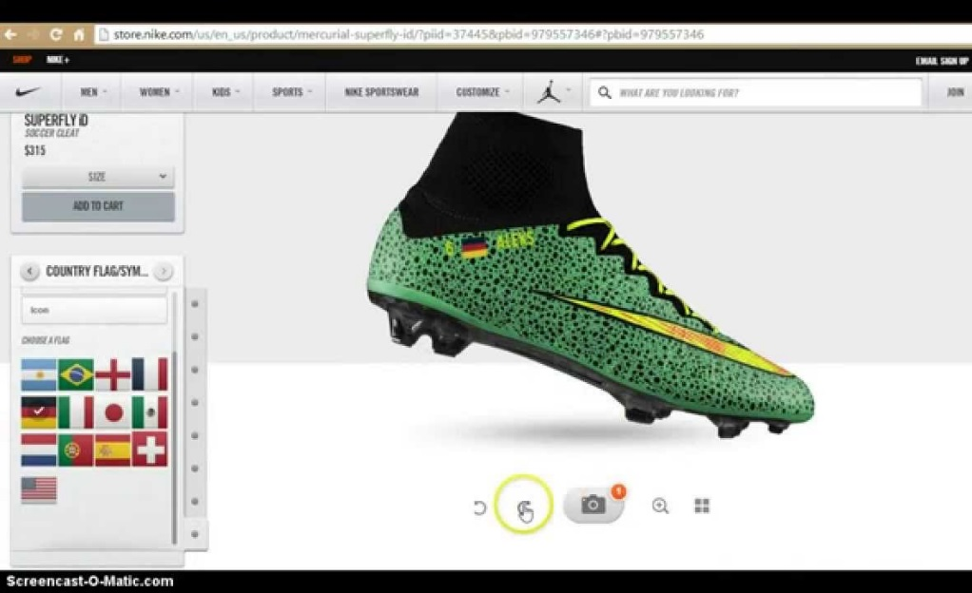
T5: Increasing Asymmetry
Customization of Sporting Goods
Nowadays customer are able to personalize commodities. For example, they can choose between different football shoes and then they can tailor them using different color and details, so no one will have shoes like their.
They can also customize the shirt of their team with their own name and number.
In other words, Nike allows buyers to make exactly the shoes, or other goods, that they want.

Slide 7
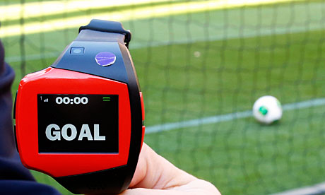
T6: Increasing Transparency
Goal Line Technology
The goal line technology is used in football to help referee, indeed this technology must provide if the ball has fully crossed the line and a goal has been scored or not.
The GLT main is to collaborate with the official and to assist him in decision-making and not to substitute him.

Slide 8
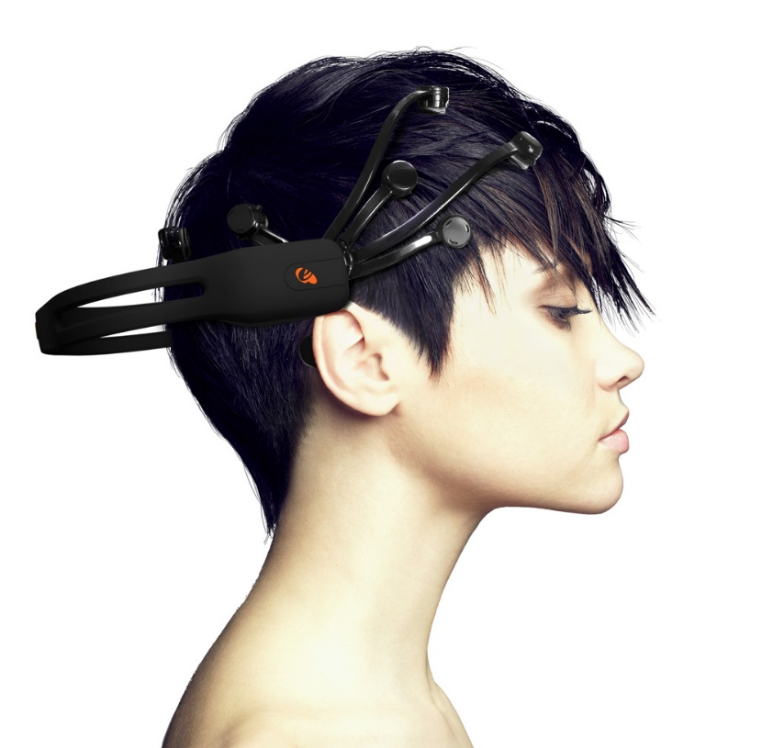
T7: Trimming/Reducing Complexity
Brain Computer Interface in Video Games
Brain computer interface will be a new way to play at video games.
It will be like a headband and players won’t need television, console or joysticks.
It will works to use neurofeedback device and brainwave frequencies. Moreover the game will learn the player so it will be more personalized than the typical game.

Slide 9
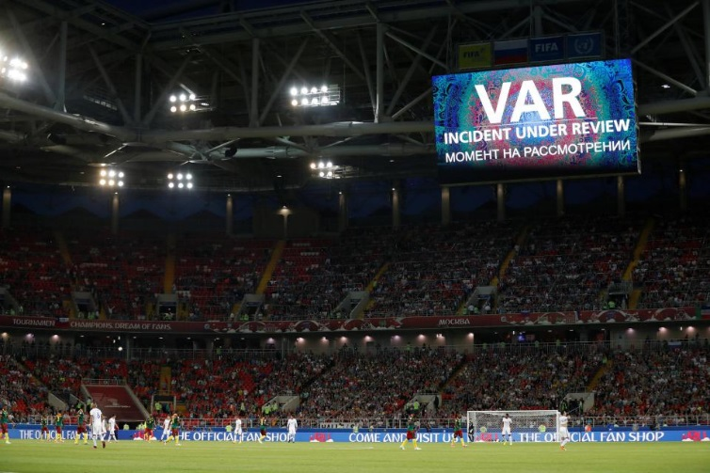
T8: Decrease Human Involvement
VAR in Serie A, Bundesliga, MLS
The Video Assistan Referee (VAR) tries to get referees less involved.
It is a highly-trained match official who is watching the match in a room somewhere in the stadium.
The VAR starts to work when the referee asks for help: it can’t just review whatever they want , though if they spot something they think they ought to review they can ask the referee t ask them to review it.
Once committed, the referee draws the outline of a TV screen in the air so everybody knows what is going on and then waits to be told what to do.
Sometimes, the referee can go to review a decision himself on an off-pitch monitor.

Slide 10
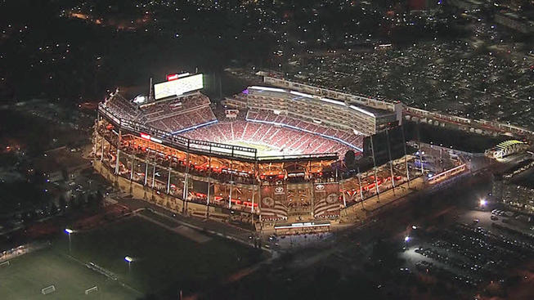
T9: Customer Expectation
Smart Stadium at Levi’s Stadium
A survey has revealed 70% of fans use their mobile phone at the stadium so in Levi’s Stadium you can access to some services by your phone.
Through the application of the San Francisco 49ers the fans can use a phone as a virtual guide to their seat, watching replays during the live game, ordering a food delivered to their seat and a guide to the closest bathroom with the shortest lines.

Slide 11
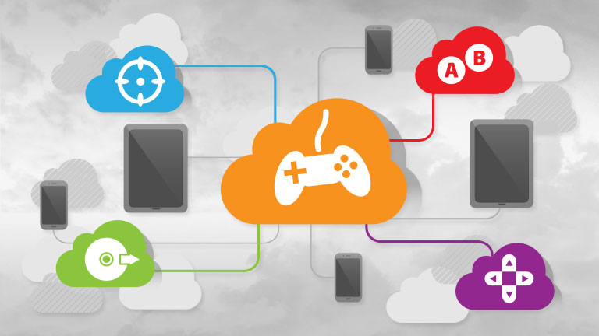
T10: Rhythm Coordination
Cloud Gaming
Currently there are two main types of cloud gaming:
cloud gaming based on video streaming and cloud
gaming based on file streaming. Cloud gaming
aims to provide end users frictionless and direct
play-ability of games across various devices.
Game content is not stored on the user's hard
drive and game code execution occurs primarily at
the server cluster, so the subscriber can use a less
powerful computer to play the game than the game would normally require, since the server does all
performance-intensive operations usually done by
the end user's computer.
One example of such platform is STEAM, where
people can play online games.

Slide 12
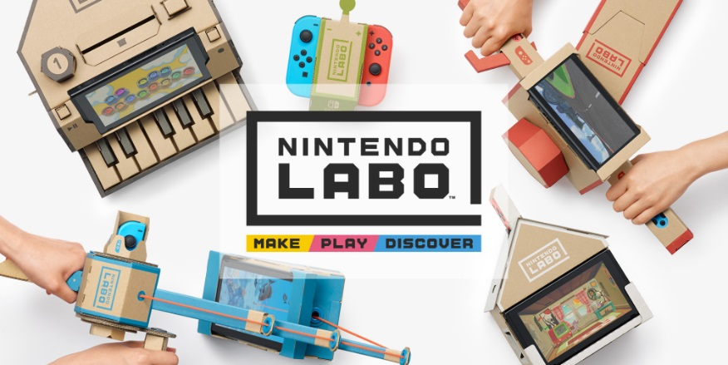
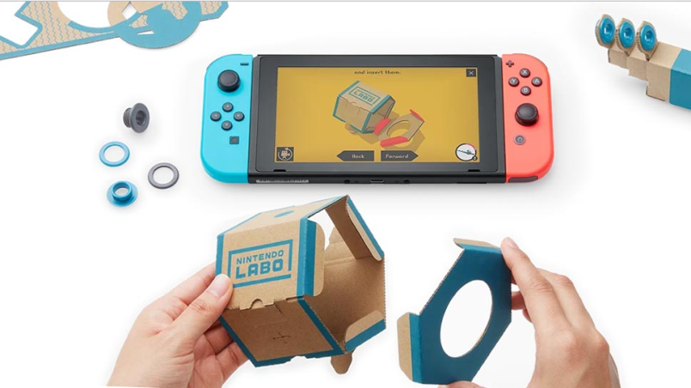
T11: Segmentation
Nintendo Labo
Nintendo Labo is a gaming and a construction toy platform developed by Nintendo and used as an extension for the Nintendo Switch video game console, which was released in April 2018.
The platform uses kits that include cardboard cut-outs and other materials that are to be assembled in combination with the Nintendo Switch console display and Joy-Con controllers to create “Toy-Cons” that can interact with game software and vice versa.

Slide 13
T12: Increasing Uses Of Senses
Hardlight Suit
Hardlight suit is a video game gadget that increase the of touch during a game experience.
It’s a technological gilet that the player put on during a game and he can feel what the main character is living in the game. Morgan Sinko, president of Hardlight, had this idea because the motion-controlled wasn’t enough for him.

Slide 14
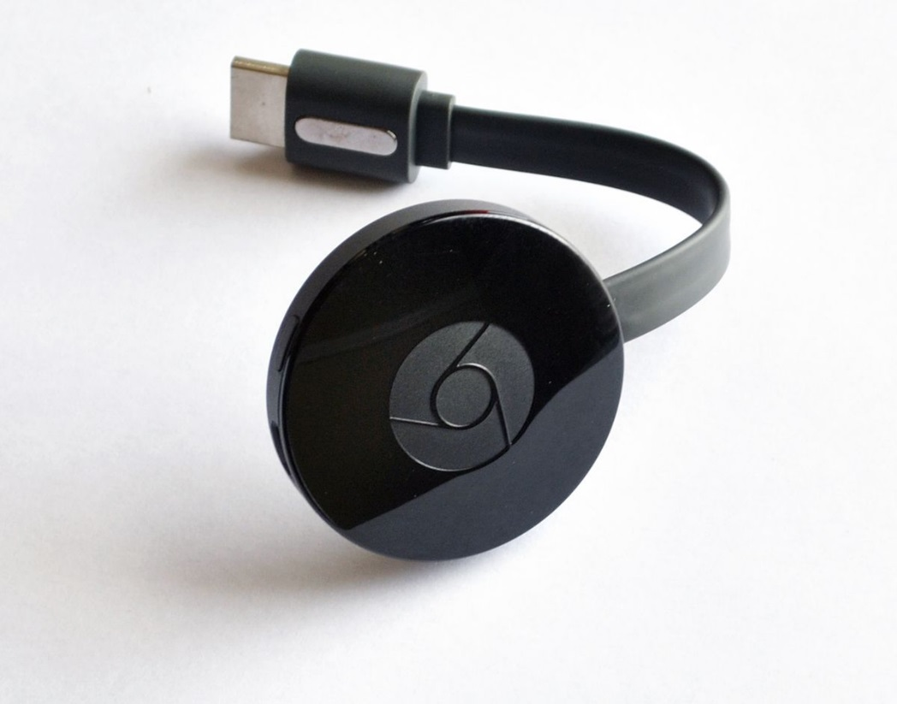
T13: Action Coordination
Google Chromecast
Chromecast is a line of digital media players developed by Google.
The devices, designed as small dongles, enable users with a mobile device or personal computer to initiate and control payback of Internet-streamed audio-visual content on a high definition television or home audio system through mobile and web apps what support the Google Cast technology.

Slide 15
T14: Mono-Bi-Poly (Various)
3 Reyes Stickers Album
The key point of this trend is to offer an increasing number of products or services, which have a different value proposition, but typically reinforce the value of the initial offering.
- This is based on the freemium model
Recently in Perù, 3 Reyes launched a sticker album for the 2018 World Cup, which enables augmented reality.
Certain stickers with a silver line provide the augmented reality characteristics.
When using a mobile phone, you can watch on your screen saves, goals or skills of the player that you are framing.

Slide 16
T15: Mono-Bi-Poly (Similar)
Portsmuth FC Matchday Program
This other trend is similar to the previous one, but the difference is that the products or services essentially deliver the same functionality, while they may offer different convenience levels.
The soccer team Portsmuth FC, thanks to a partnership with Navigate Digitale and Blippar, has entertained its fans with the interactive matchday programs with augmented reality.
The fans are albe to view video content straight from their matchday programs using their mobile devices that are triggered from the team’s logo on the page.
The idea was probably borrowed from the Sunday Times that augmented their Sports Newspaper Supplement some time before.

Slide 17
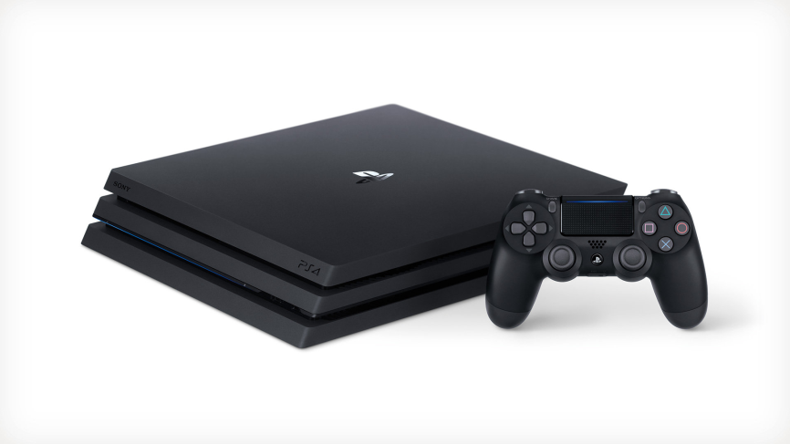
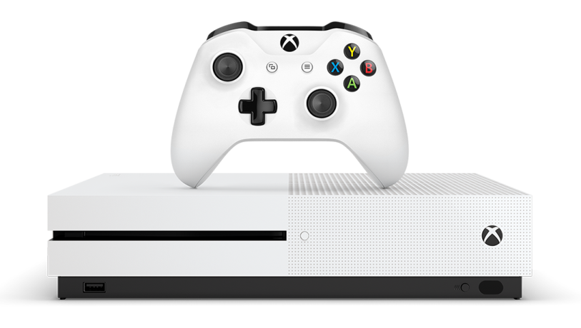
T16: Mono-Bi-Poly (Increasing Differences)
Sony, Microsoft Consoles
Consoles such as PlayStation 4 and X-Box One are state of the art and now can perform function that their earlier versions were not offering.
Consoles can be used to watch movies, play music, connect to the internet and browse, watch TV and can access online store and shop.

Slide 18
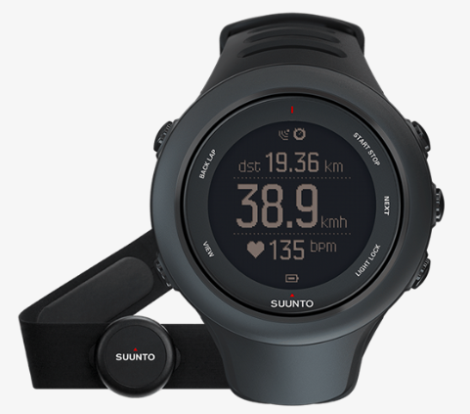
T17: Design Point
Suunto Ambit 3 Sport
A GPS sport watch is an electronic watch built with two key purpose.
Providing athletes accurate performance information while training and collection, analysing relevant information about the workout.
The Suunto Ambit 3 Sport can track your running performance and analyse your sleep recovery.

Slide 19
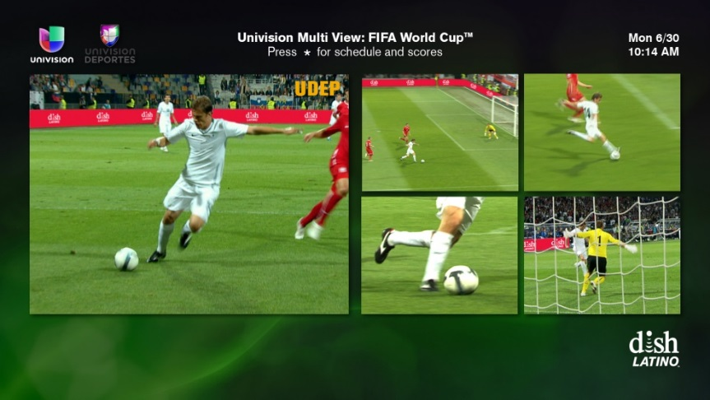
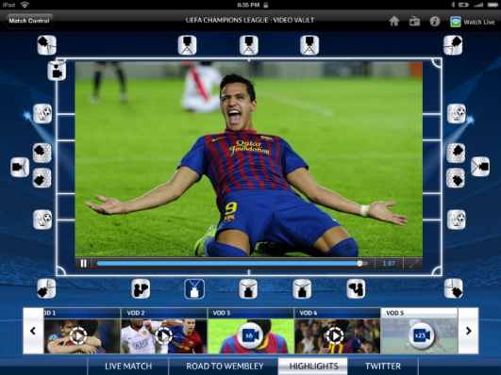
T18: Degrees Of Freedom
Following The Players
If you have a favorite player and
the regular director’s cut rarely
shows him or her on the screen, you can select to follow that player
throughout the sports event and
can have him or her on your screen.
This is not limited to just one sport,
this ability to control what you see at home on your screen is being
offered now for almost all sporting
events.

Slide 20
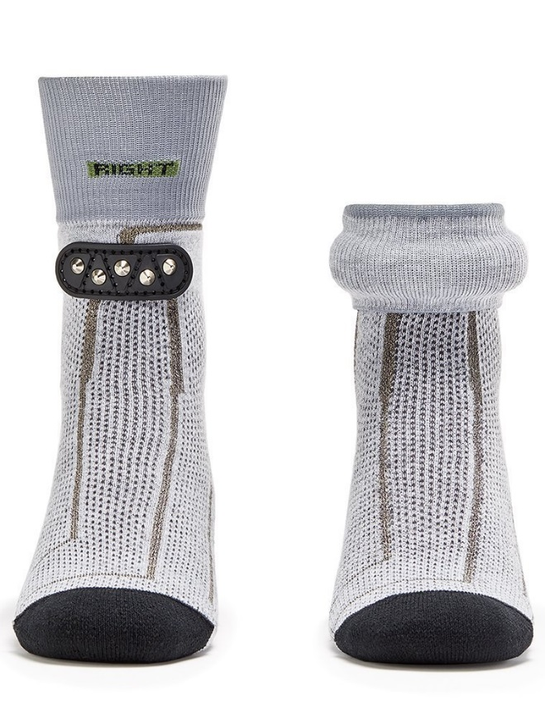
T19: Nesting Up
Sensoria Socks
Smart clothes offer the possibility to have many different devices in one integrated device, integrating sensors.
Sensoria’s Socks 2.0 monitors your sports performance, running metrics and now it also tells you how well you’ve run.
They record pace, distance, speed and time as well as track routes via GPS. They also pick up cadence data alongside foot landing and impact forces. This data can be streamed to the Sensoria 2.0 iOS app in real time.
An AI-powered coach called Mara will provide actionable advice on how to run farther, faster and healthier.

Slide 21
T20: Listening/Communication
Game
At the beginning they launched the Game rewards app, which enabled customers to collect
loyalty points in-store using their smartphones rather than the firm’s legacy game loyalty cards.
Game developed the loyalty app by building in gamification through achievements similar to
those give when playing the video games themselves.
A scanning capability was introduced to allow consumers to scan any game in any store using
the Game app, watch trailers based on the title, learn about the game and get a price comparison. It also offered a personalized price based on the consumer’s loyalty position with the Game brand.
Augmented reality was then built into the app for use in stores, enabling customers to interact
with digital signage to watch adverts, download content, watch or play game demos and take
pictures for use on social media. All the while, Game collects customer data through all
interactions with the retailer, including store purchases, web interactions and interactions through
the Game app.
All data collected can go towards personalizing each customer’s experience with the brand across all channels. By making adaptations to the customer journey and experience, and collecting
more data along the way, Game found that even loyal customers were reducing their store visits,
despite the fact that the games industry continues to grow.

Slide 22
Thank You!

