Slide 1
Current trends and innovations in the music industry
Ludovica Brugnoli
Louise Jornet
Pauline Streichenberger
Florine Tissier
Pierre Vasseur

Slide 2
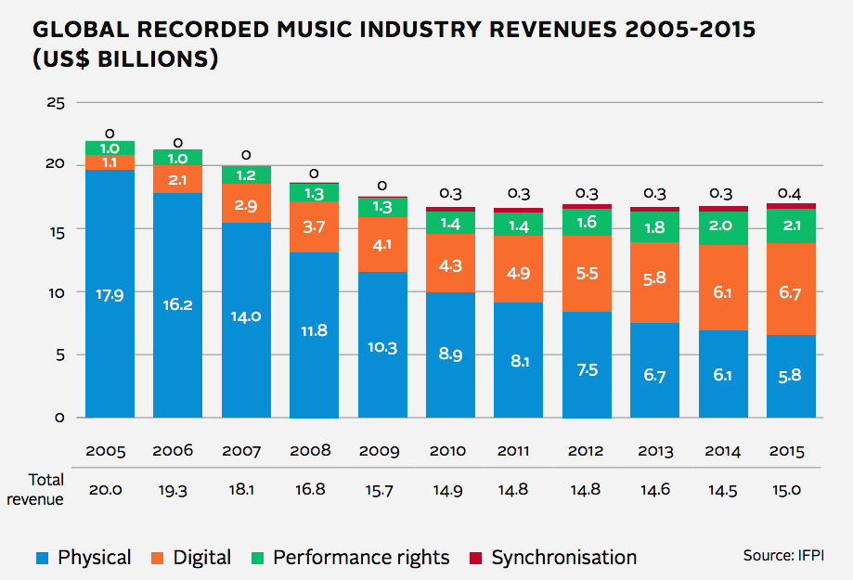
The music industry

Slide 3
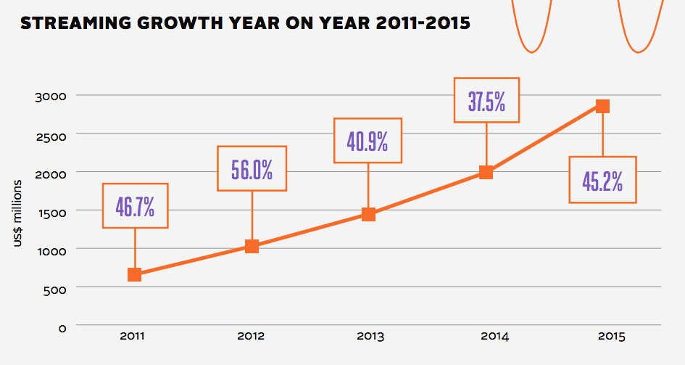
Thank you streaming
Source : IFPI Global music report 2016

Slide 4
Problems ?
CDs and downloads sales declined
Music is illegally download
Friction between label, artists and fans
Artists receive low payments
Music quality format issues
Live concert problems
Notes:
Artists don’t trust anymore traditional records labels (cash cow, risk avoidance)
Streaming give low paymets to artists
Live concert problems : high prices, security concern since Bataclan attacks)
MP3 is a lossy music format

Slide 5
Opportunities ?
Democratization of the music distribution and promotion
Provide unique services by using the technology
Find alternative ways for the artists to get paid
Use technology to improve audio quality

Slide 6
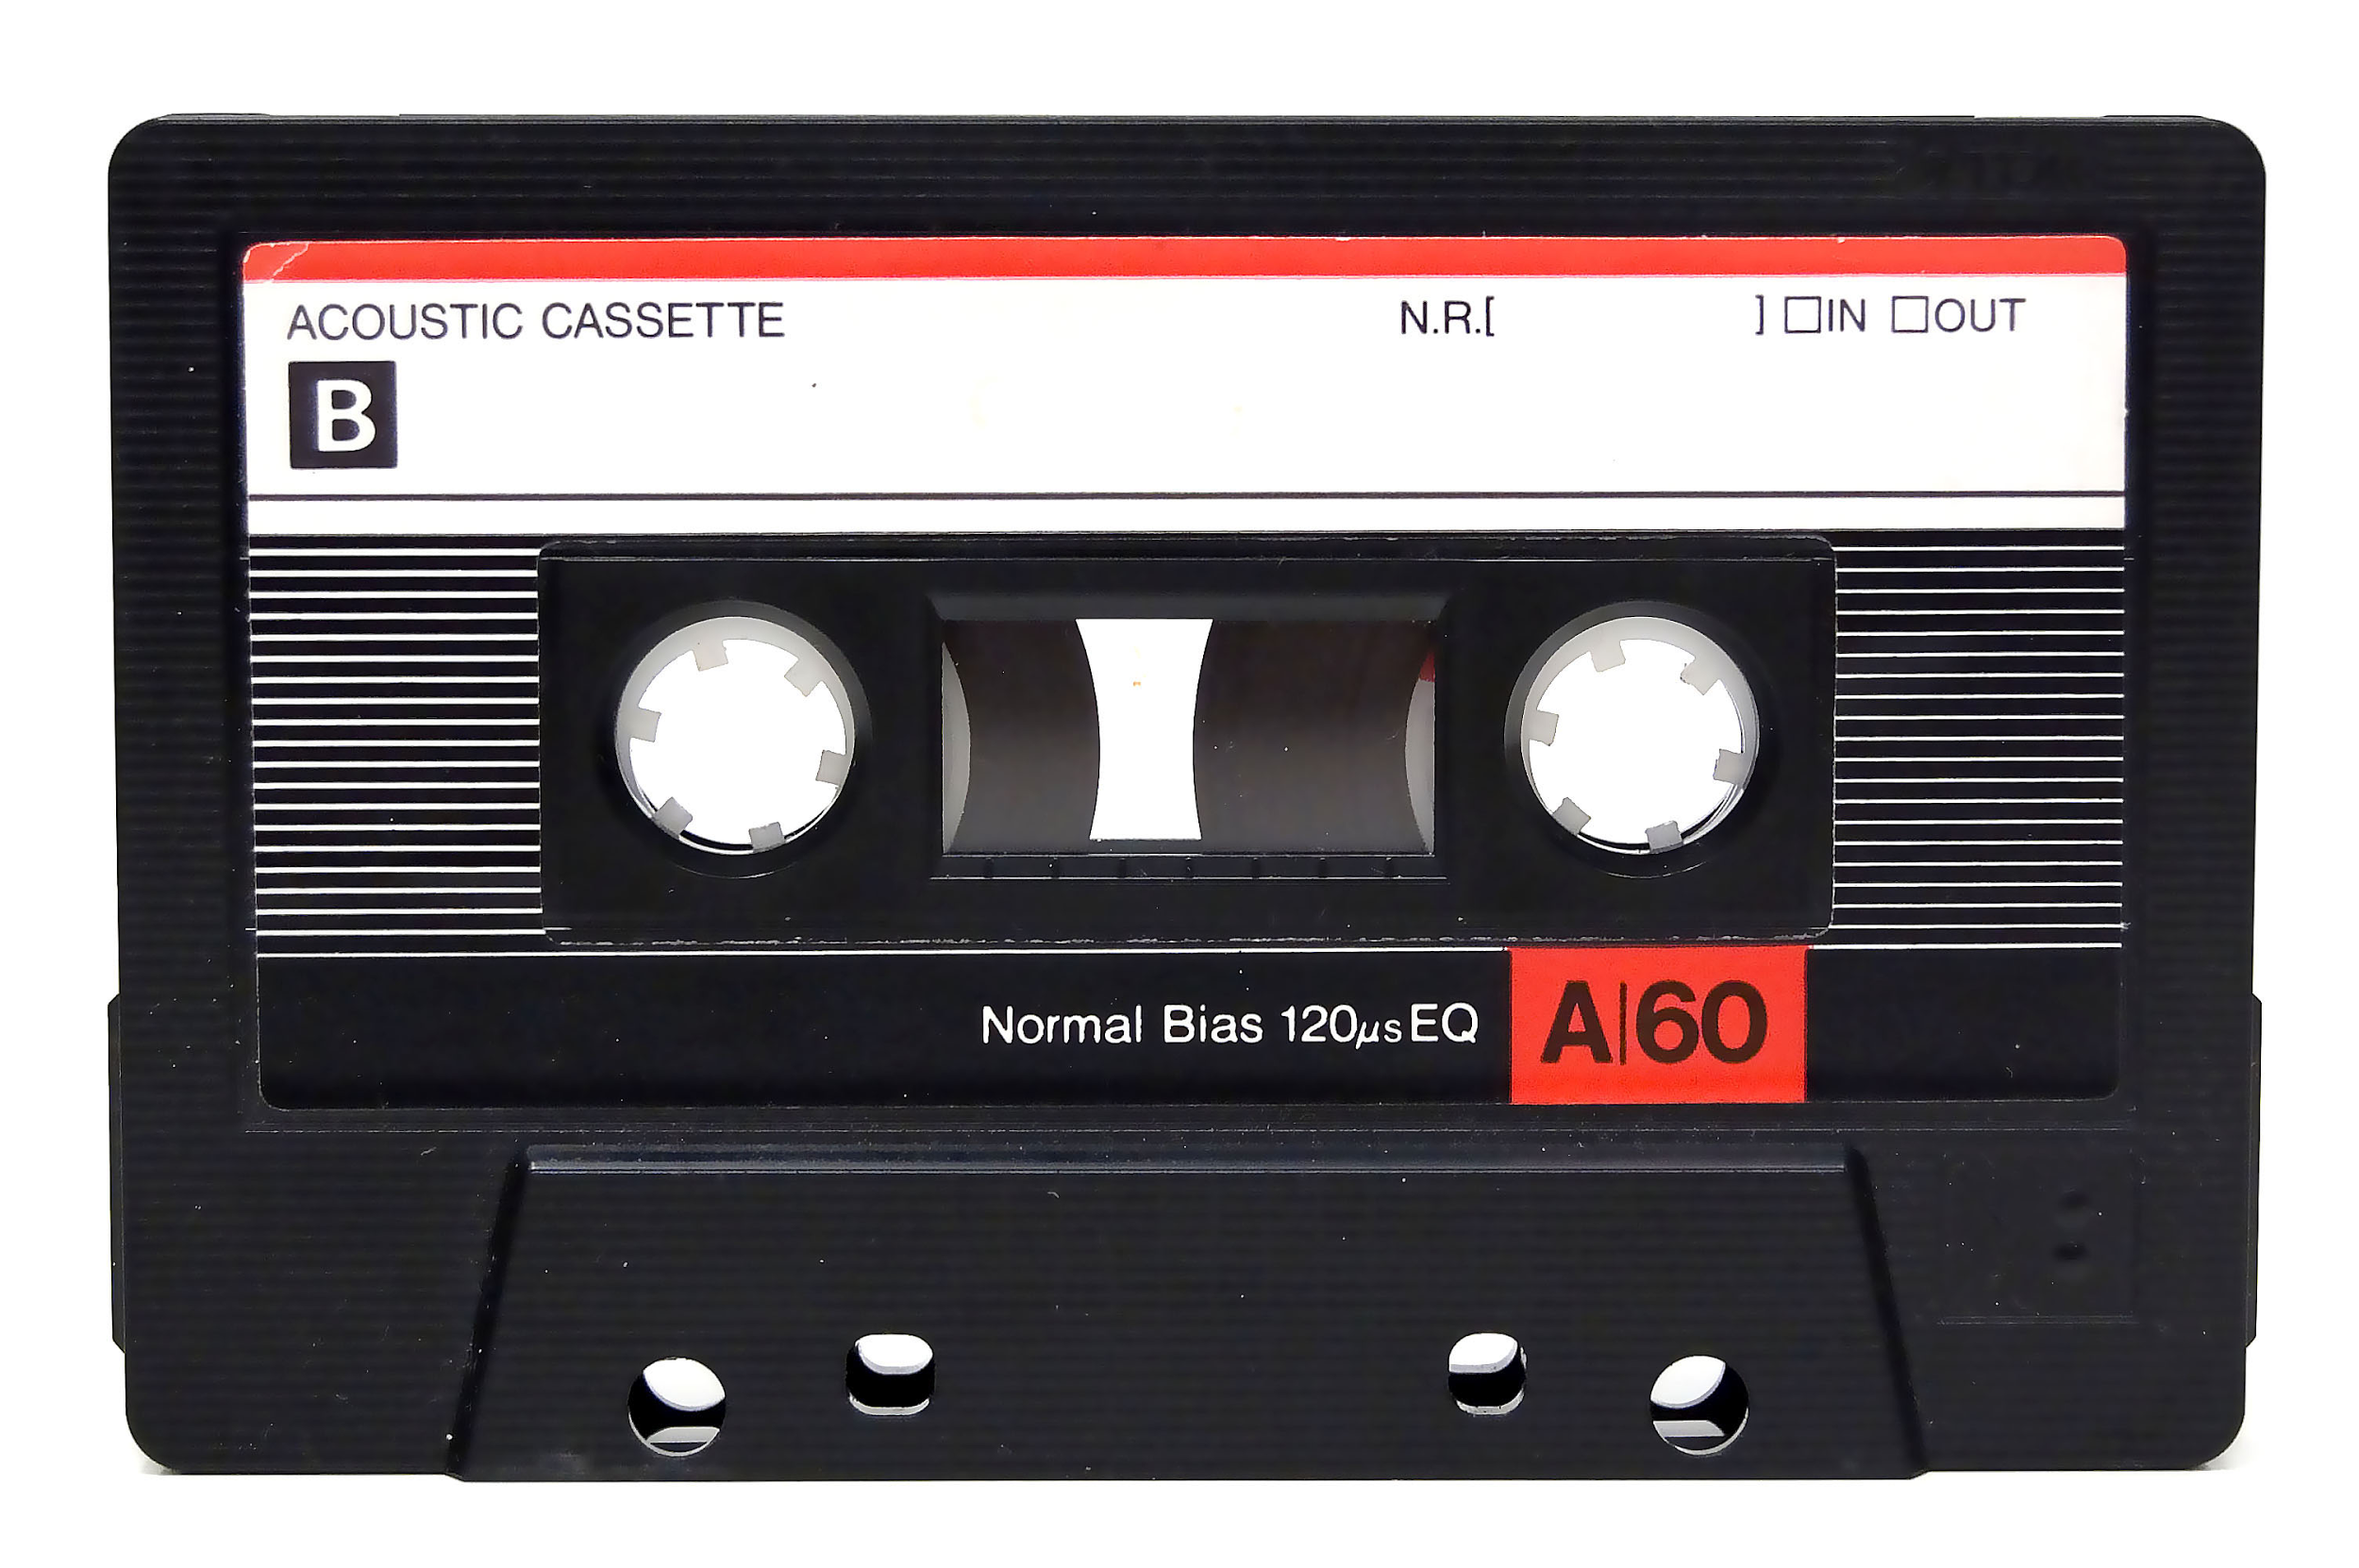
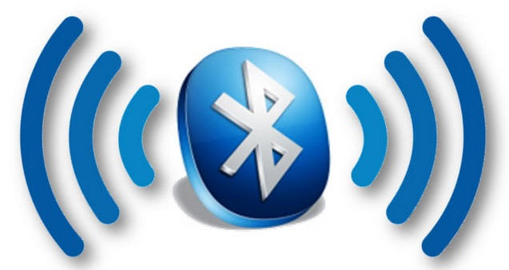
Improvement of format and quality
Increase the mobility of music use

Slide 7
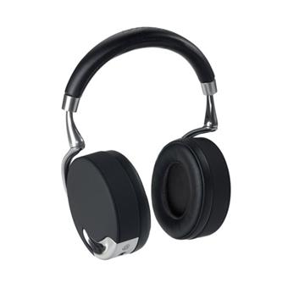
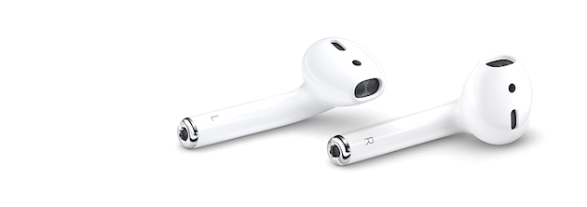
Bluetooth technology in the music industry
Elimination of the physical link → reduce the complexity
Improve the sound’s quality → For a better experience
Allow multi-tasking

Slide 8
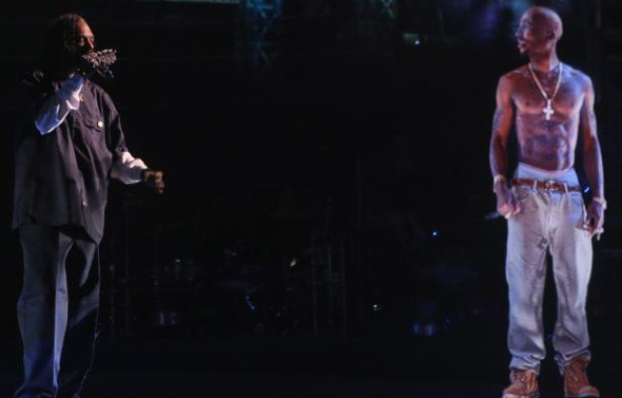
Virtual Reality Augmented Reality
devices that creates a virtual world
Increase dimensionality
Add value to customer experience :
From Audio to walk through music videos
Adding virtual elements to the reality
https://www.youtube.com/watch?v=JxVVNm35rJE

Slide 9
Drumpants 2.0 : video
Video

Slide 10
Drumpants 2.0
Music instrument wearable => play music from your body
Open source
Works with accessories: 2 elongated drum pads and 2 foot pedals and a box where the music comes out
Easy way to access to all kind of instruments
TRENDS
⇒ reduce complexity
⇒ mono-bi-poly (similar)

Slide 11
Jamshake : video

Slide 12
Jamshake
Social network
Collaborative as every user can contribute to the part of a song and download it on the platform
TRENDS:
⇒ boundary breakdown
⇒ increasing transparency
⇒ increasing use of senses

Slide 13
?
?
?
Publisher
Rights owner
Songwriter
Artists
?
?

Slide 14
Rebuilding music industry on the Blockchain
Artists own and control their creative content and they are paid directly. No middlemen.
Very low costs
Imogen Heap released Tiny Human on the Ethereum blockchain.

Slide 15
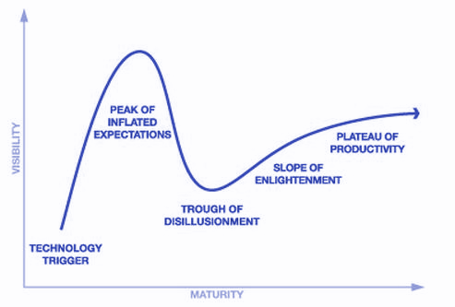
On the Gartner Hype cycle

Slide 16
UJO TRIZ
Break boundaries : no major company needed, the artist manage the music contracts
Increasing transparency : datas are not lost, royalties and contract are completely transparent
Peer to peer : Self organised system, no hierarchy, no responsible for it

Slide 17
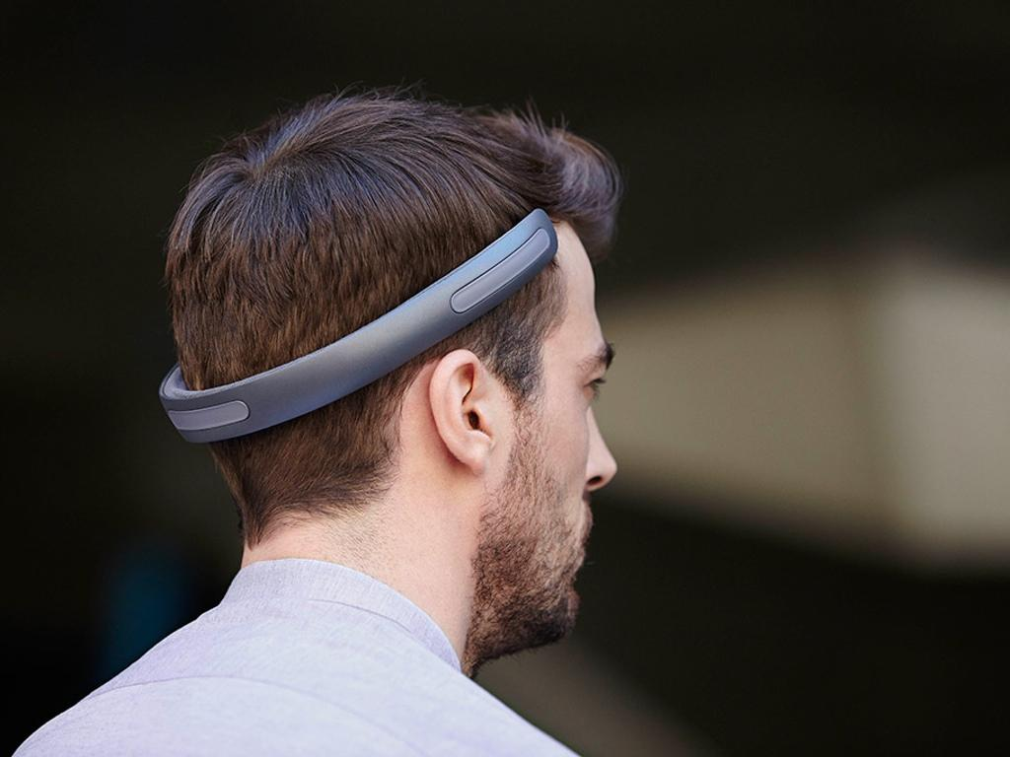
BATBAND
piece of sound technology that permit you to listen to your private music
high fidelity acoustic experience via an innovative bone conduction system

Slide 18
CHARACTERISTICS
It works via bone conduction → it creates vibrations directly on your head
It sends sounds directly into your inner ear
It leaves your ear free
Trends
→ increasing use of sense
→ customer expectation

Slide 19
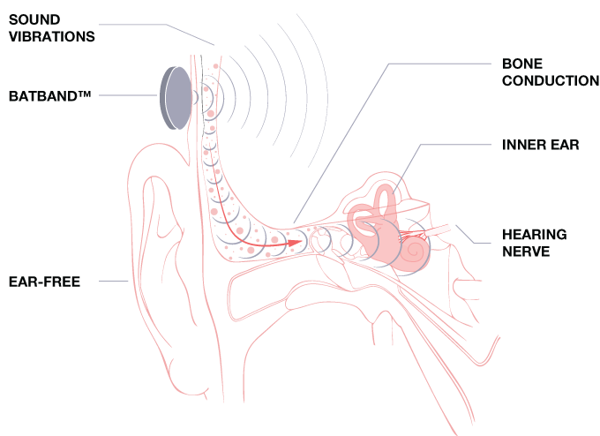
CHARACTERISTICS
There are three emitting sound waves incorporated in the product
the sounds that you feel can’t be listened from the other people

Slide 20
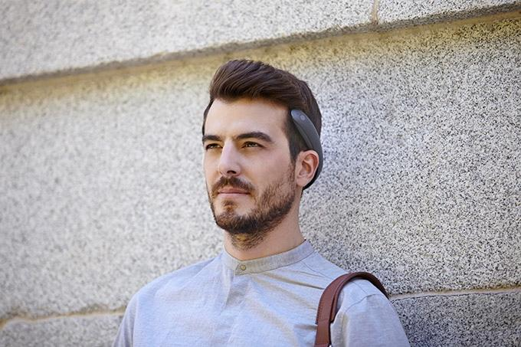
HOW CAN YOU USE IT
place it around the back of your head
associate it to a mobile dispositive with bluetooth
you have to control the touch sensors

Slide 21
WHEN WOULD I USE BATBAND

Slide 22
TECHNICAL SPECIFICATIONS
Batband was created by Studio Banana Things
Powered by a Lithium-ion battery
six hours of music
eight hours of talk-time

Slide 23
AudioOrb
We can consider AudioOrb as a way to let your troubles and the everyone’s voices away

Slide 24
CHARACTERISTICS
A clear plexiglass sphere
inside it there are eighteen internal speakers
there are pillows for the body
we can consider it as your mini-pod
the name of the sphere is Cacoon 1
Trend
→ customer expectation

Slide 25
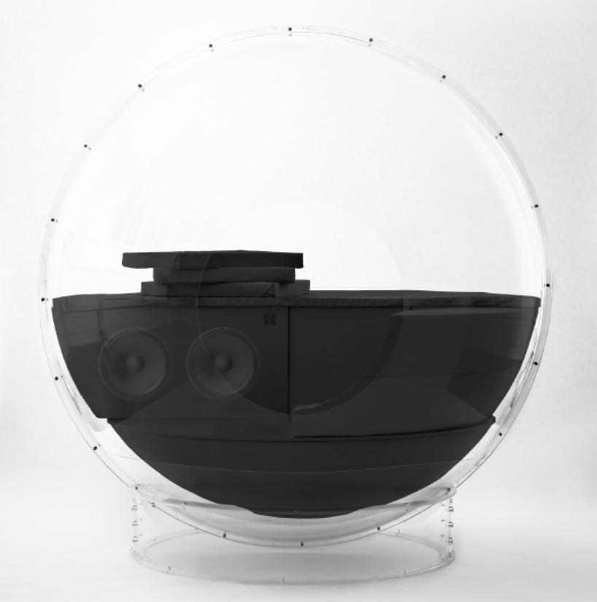
HOW CAN USE IT
You can use it in a simple way:
enter in the sphere
speakers are covered by pillows permitting a better comfort place

Slide 26
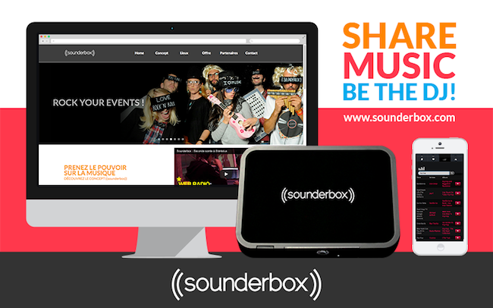
Sounderbox
web application
autonomous and collaborative system of playlist
add social dimension to streaming
everyone can contribute from any device
>60K tracks
moderation by system of votes

Slide 27
Problems
Lack of interaction between people in public spaces
Music that doesn’t match with the general mood
Solution
Chose your own music in any place and share with people about music thanks to the app.

Slide 28
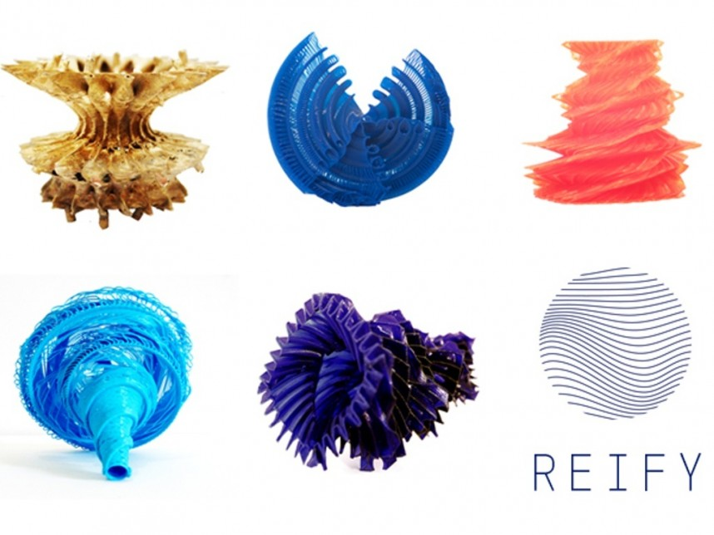
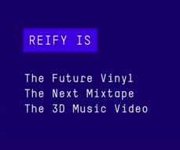
REIFY
A brand new way to experience music.

Slide 29
Characteristics
combines digital + physical music technology
custom totems : captures sound waves of the song → makes it physical → refine it to capture emotions of the song
3D printed, unique features
Technology used: FFT data → algorithm that takes time and frenquency of an audio file
2:10

Slide 30
Problem
We lost the physical aspect of music (tapes, radios)
Solution
Bring back the physical aspect of music combinated with digital. Experience music through senses via the structure: hear, see and touch music

Slide 31
Thank you for your attention !
Any questions ?

Slide 32
References
Global music industry 2016 - IFPI http://www.ifpi.org/downloads/GMR2016.pdf
UJO Music, http://ujomusic.com/
Drumpants, http://www.drumpants.com/
Jamshake, https://www.jamshake.com/
Sounderbox, http://www.frenchweb.fr/la-startup-du-jour-sounderbox-creation-de-playlists-collaboratives-pour-vos-soirees/139858
Reify, http://observer.com/2015/07/new-augmented-reality-totemapp-combo-makes-music-an-experience-to-hear-see-and-feel/

