Slide 1
Trends in Digital Innovations
Ng Ka Hei
Pei Jinya
Djamen Kouaya Leisly Kevine
Hypermarket

Slide 2
The game-changer of the hypermarket industry
Challenges of retailers
Spending patterns change:
personalised experience
Keen competition from digital &
new retail formats
Weak consumer sentiment
High labor costs
Requirements on data sharing efficiency

Slide 3
The game-changer of the hypermarket industry
Challenges of consumers
Long queuing time
Demand for
personalised experience
Payment security
Convenience
Product availability

Slide 4
Latest innovation trends

Slide 5
4D space scanner
Current problems:
Out of stock items cost retailers nearly US$500 bn
High labor costs for staff to regularly do the inventory check and staff cannot concentrate on customer service
Data collected has time lag and inaccuracy
4D Space Genius is a robot developed by 4D Retail Technology Corp. in Canada, able to:
Image an avg 43,000 sq. ft. store in less than an hour to efficiently and accurately collect timely data
Ensure every product on every shelf in every aisle is always stocked, tagged and correctly priced
Provide actual spatial data, a real view of the store
Integrate with sales data of the store to provide analysis and advice, such as the optimal location of a product and in-store compliance
TRIZ trends: increasing dimensionality
Notes:
Inventory issues are a huge financial drain on retail stores. Out of stock items cost retailers nearly $500 billion a year, according to one study by the IHL Group. If a customer can not find the product they are looking for, they might choose a competing brand, or go to a different store.

Slide 6
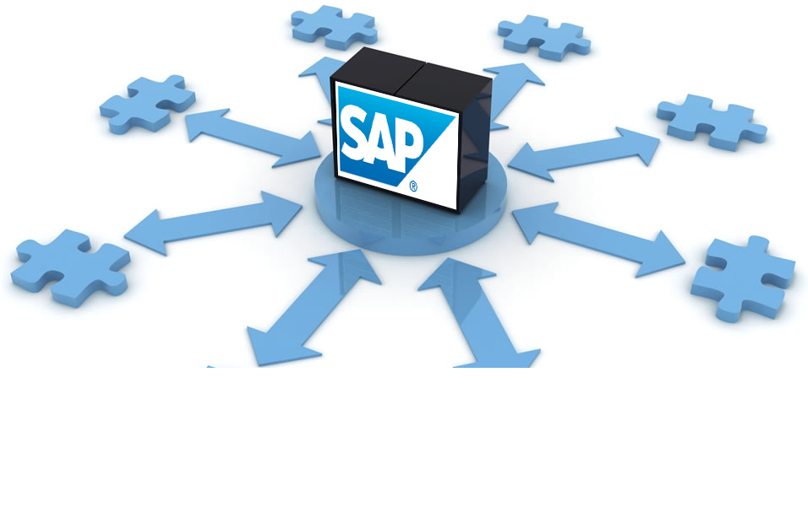
SAP implementation
Current problems:
Disconnected and old-fashioned information sharing among various systems and departments
Difficult to devise multi-channel strategies
Managerment’s lost visibility on sales and profit performance
Australian supermarket Woolworths recently launched its SAP system to integrate several systems on customer relationship management, performance reporting, buying, promotions management and store-ordering processes.
Streamline the movement of goods through supply chain through collaborations with suppliers
Precise management of product availability and performance data for decision making
Increase the IT assets of the company and enhance employee’s technological capabilities
Builds foundation of long-term growth by increased efficiency and transparency
However, Woolworths has faced challenges in the implementation, such as a 6-year implementation time, hundreds of millions of implementation costs and tense relationship with suppliers.
TRIZ trends: boundary breakdown

Slide 7
iBeacon networks
Current problems:
Department stores suffer from low customer flow due to the strong competition from e-commerce
Stores are too similar to one another
Customers require more tailored services nowadays
Barneys New York is the first luxury department store to implement iBeacon networks to personalize shopping experience.
Share rich multimedia contents such as videos, look books and designer interviews to entertain customers
Offer tailored fashion recommendations
Mine core customers’ online data to match with their offline behavior and preferences for improving sales performance
TRIZ trends: increasing asymmetry and customer experience hierarchy

Slide 8
iBeacon networks
Chinese department store Parkson Retail even launched its beacon network with the country’s largest tripadvisor-like product and service review platform Dianping.
Pushes relevant promotions and product review info according to customers’ locations
Channel customer flow to department stores from its F&B and entertainment partners, and vice versa, to provide comprehensive customer experience
Package customer loyalty activities into its location-sensitive application
Collect big data
Taiwanese department store Living Mall uses iBeacon to launch interactive marketing games for customers.
Similar to Pokemon-Go, customers go to specific points to collect scores, which can be used to exchange for coupons and gifts
TRIZ trends: increasing asymmetry and customer experience hierarchy

Slide 9
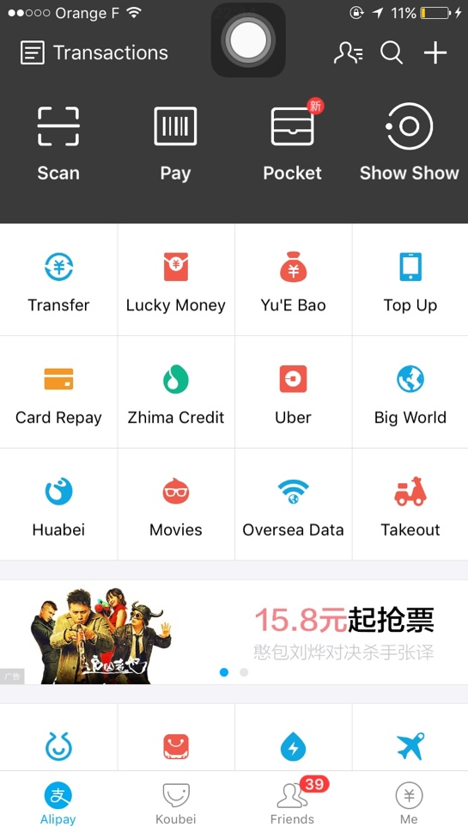
Third-party payment platform - Alipay
Current problems:
China’s weak consumer protection law
Consumers lack confidence in C2C or B2C quality control
Reliance on escrow service – the money will not be released before customers’ verification in 2 weeks after delivery
TRIZ trends: reducing complexity, customer expectation evolution,
Mono-Bi-Poly (various)
Notes:
Inventory issues are a huge financial drain on retail stores. Out of stock items cost retailers nearly $500 billion a year, according to one study by the IHL Group. If a customer can not find the product they are looking for, they might choose a competing brand, or go to a different store.

Slide 10
Third-party payment platform - Alipay
Unique alipay code in different devices
A mode of payment
Print secret codes or verify by fingerprint
Transfer money
using “ show-show to find nearby merchants and special offers
Transfering money to Yu’e bao to gain interest
Booking tickets
Food delivery
…
TRIZ trends: reducing complexity, customer expectation evolution,
Mono-Bi-Poly (various)
Notes:
Inventory issues are a huge financial drain on retail stores. Out of stock items cost retailers nearly $500 billion a year, according to one study by the IHL Group. If a customer can not find the product they are looking for, they might choose a competing brand, or go to a different store.

Slide 11
Footprint tracking for big data mining
Current problems:
How to expend their business?
How to improve online services’ quality?
BIG DATA
local services
CONSUMERS’ INFORMATION
ONLINE TRANSACTION
core commerce
Affiliate businesses in digital media& entertainment
TRIZ trends: increasing asymmetry, boundary breakdown
Notes:
Inventory issues are a huge financial drain on retail stores. Out of stock items cost retailers nearly $500 billion a year, according to one study by the IHL Group. If a customer can not find the product they are looking for, they might choose a competing brand, or go to a different store.

Slide 12
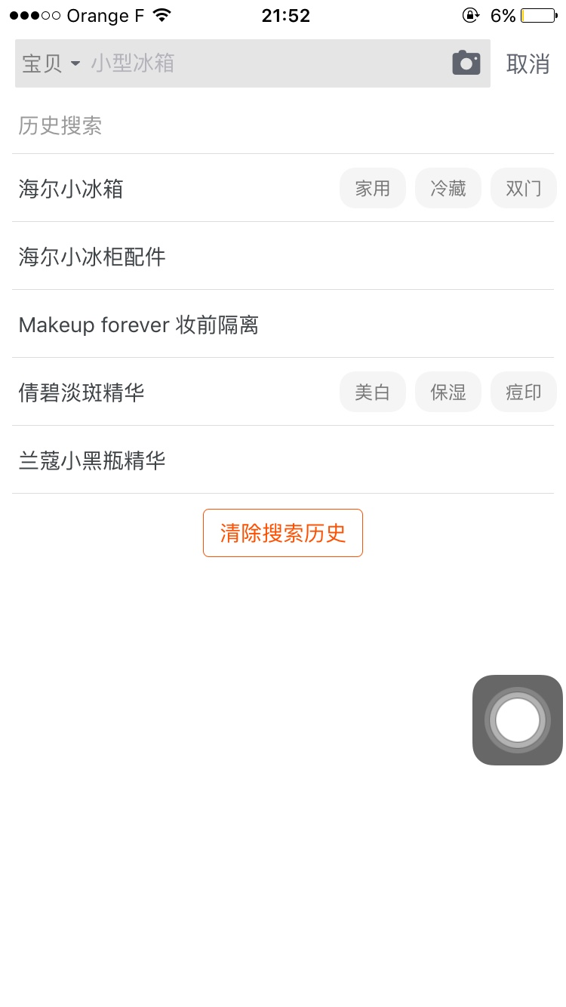
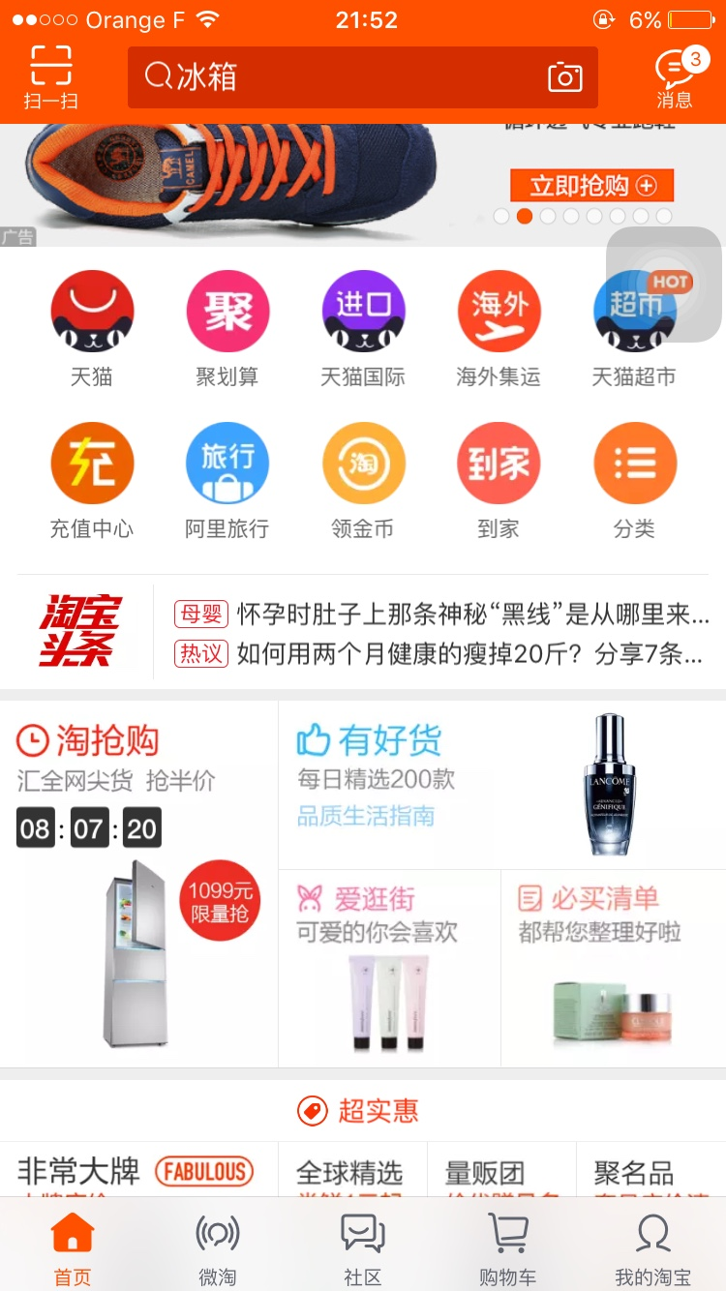
Footprint tracking for big data mining
Helping advertisers to track other consumers’ footprints
Helping different merchants and business partners grow their businesses
Pictures of freezer and cosmetics are in the home page---today
Search ice freezers and cosmetics in TAOBAO mall ---yesterday
TRIZ trends: increasing asymmetry, boundary breakdown
Notes:
Inventory issues are a huge financial drain on retail stores. Out of stock items cost retailers nearly $500 billion a year, according to one study by the IHL Group. If a customer can not find the product they are looking for, they might choose a competing brand, or go to a different store.

Slide 13
Anti-crowd application
Current problems:
Retailers
Difficulty in satisfying the customers demand on time
Difficulty in managing crowded stores with not enough of staff
Consumers
Time spent on queues
Store time restriction
Inconvenience
Avoid The Crowds is an mobile application which collect data from multiple social media platforms to estimate customer flow in stores.
Inform customers whether stores are crowded or not
Help retailers to manage human resources in store
TRIZ trends: customer buying hierarchy and customer expectation

Slide 14
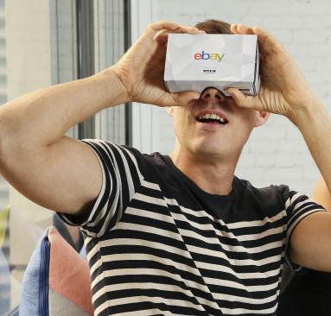
Virtual reality department store
Current problems:
Consumers
Daily commuting problems
Time spent on queue and store time restriction
Ease of payment
Product availability
Retailers
Keen competition
eBay and Myer jointly launched virtual reality department store to offer a 24-H online store for customers.
Shoppers can browse more than 12,500 products before adding to cart
The 24-H store is custom built around customers’ needs
Speed up shopping processes
Shoppers enjoy promotions and product information
TRIZ trends: customer buying hierarchy, customer expectation, increasing dimensionality, increase use of senses

Slide 15
Thank you

