Slide 1
Hotels & Restaurants
GRANT MOSES
ERICA CROTTI
FAITHFUL ADIA

Slide 2
OPERA – Hotel Management System
Trend 1 – Boundary Breakdown, Trend 3 – Dynamization
Opera provides core property management capabilities that extend to meet the operational needs of hotels.
Operational functions such as front office admin, sales and planning, reporting, marketing, customer communication and much more. Sharing information in one big network across all operational levels.
OPERA is used in all operations ranging from a small hotel with single location to international hotel chains with multiple locations.
Experienced support teams are available 24 hours a day, 7 days so that your operations will never be interrupted.

Slide 3
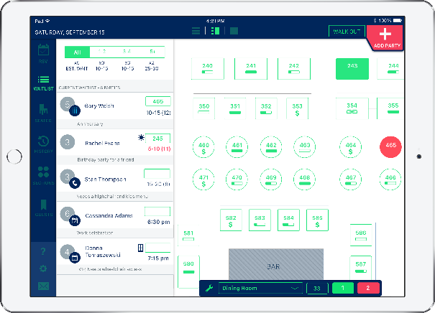
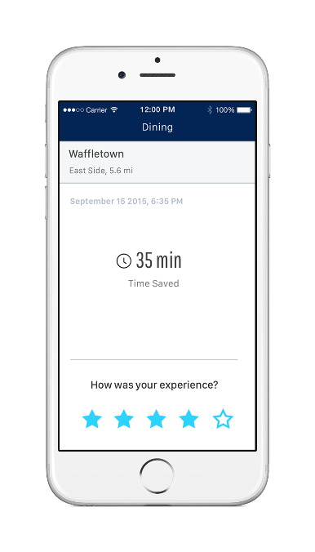
Waitlist Application - Nowait
Trend 2 – Customer Buying Hierarchy,
Trend 19 – Nesting up
Nowait app allows customers get on a waiting list before they walk into the door of the restaurant.
Increased reliability and convenience for the customer.
Reduces wait times, makes reservation, write reviews
They allow guests to get on a waiting list through the mobile phones, receive SMS updates on their wait time, and manage the entire waitlist process.

Slide 4
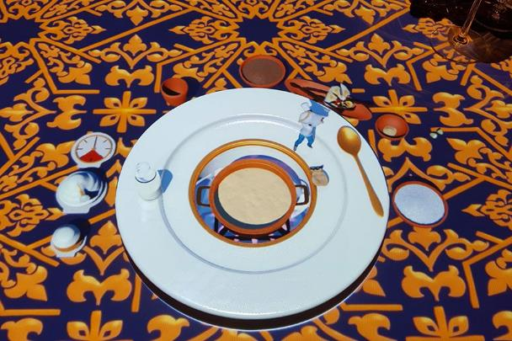
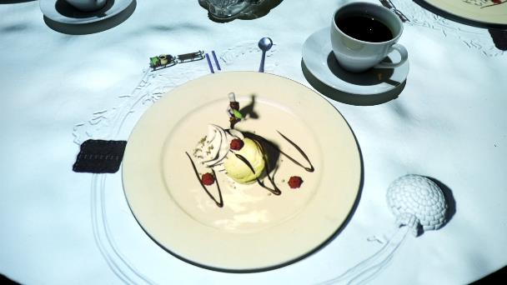
Le petit Chef
Trend 4 – Increasing Dimensionality, Trend 9 – Customer Expectation
“Le petit chef – in the footstep of Marco Polo” brings visual mapping to the restaurant table, using 3D projection to bring food to life.
It’s a two-hour dining show that tells the story of the world’s smallest chef who followed the rout of Marco Polo.
It brings the 3D dimension on the table of the restaurant with the augmented reality, involving customers during their waiting for the dishes
It’s a culinary journey across the regions, a unique gastronomic experience full of fun and surprises.
Click to watch

Slide 5
Le petit Chef

Slide 6
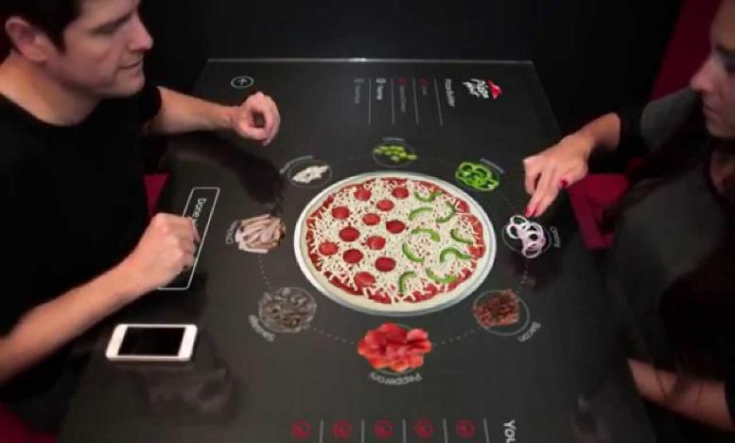
Pizza Hut – Interactive table
Trend 5 – Increasing Asymmetry
Traditional pizzas such as a pepperoni pizza, Hawaii or even meat lovers, to a more customized way. Smart table shift the notion of symmetrical to asymmetrical.
Real time, as able to create their custom pizza which various exciting features. E.g. size, sauces, half or full toppings.

Slide 7
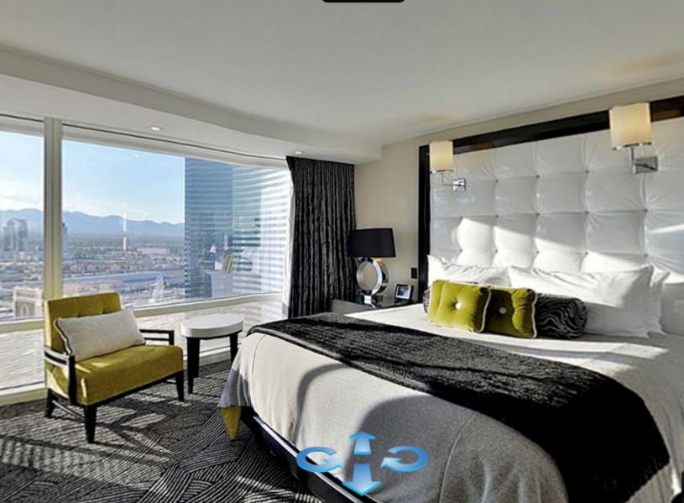
Hotel Aria – Virtual Tour
Trend 6 – Increasing Transparency
More transparency for the customers on how the products and services of the hotel look like.
From the simple photos to the Virtual Tour at 360°.

Slide 8
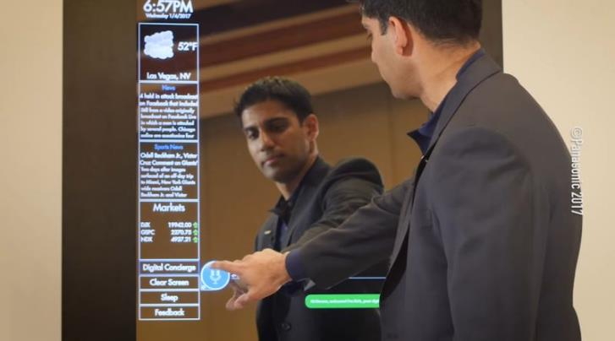
The Marriott –Smart Mirrors
Trend 7 – Trimming/Reducing Complexity, Trend 16 – Mono-Bi Poly (increasing difference)
The Electric Mirror gives access to all the room’s functions such as lighting, temperature, room-service and more on one platform.
Apart from being mirrors to reflect ourselves, they give the customer access to the weather forecast, latest news, sport scores.
Saves time and reduces complexity on performing different hotel functions. Improves guest experience and efficiency.
Also possible to pair it via Bluetooth to connect the phone and see Twitter feed and other alerts.

Slide 9
Introducing Henn na Hotel

Slide 10
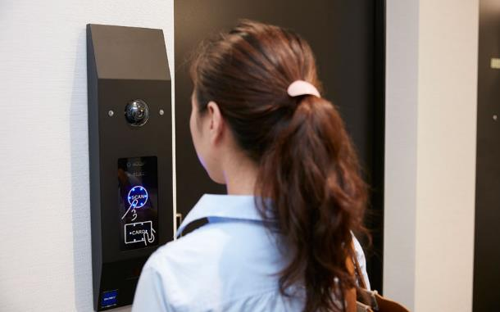
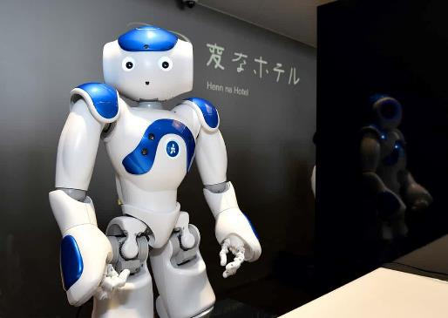
Henn na Hotel
Trend 8 – Decreasing Human Involvement, Trend 10 – Rhythm Coordination, Trend 14 – Mono-Bi-Poly (Various)
Henn-na Hotel allows guests to access their rooms using facial recognition software. Henn-na Hotel is the world-first hotel staffed by robots.
Guests can also control light settings using a tablet device, while motion sensors automatically switch off the lights when the room is vacant.
They use electromagnetic waves to either restrict or encourage a person’s body heat based on the ambient temperature of the room.

Slide 11
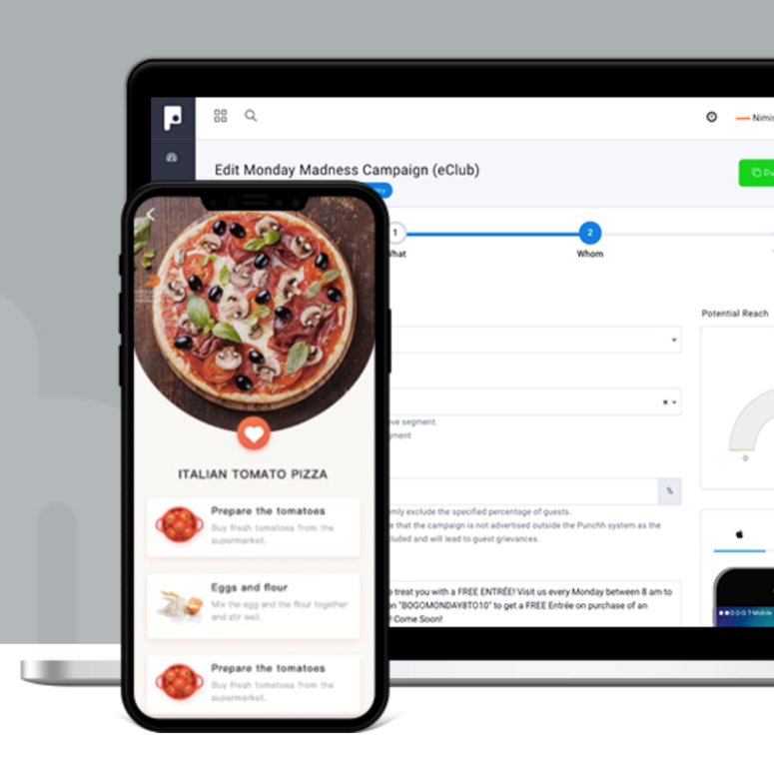
Customer Segmentation Tool
Trend 11 – Segmentation
Punchh is a CRM platform for the brick-and-mortar business world. It provides apps for restaurants that engage people in games and rewards systems that are all hooked into point of sale (POS) systems.
The company has a customer segmentation tool that allows a restaurant to explore customer sales information down to a granular level. This allows a restaurant owner to segment customers that like tequila, for instance, and send them a discount on their next margarita.

Slide 12
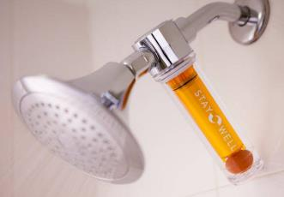
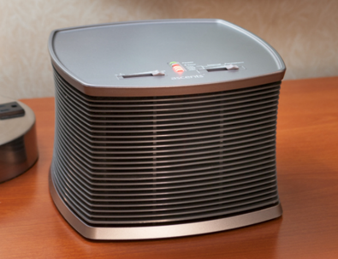
Marriott - Stay Well Room
Trend 12 – Increasing the uses of senses
The Tampa Marriott Waterside Hotel and Marina launched the new Stay Well rooms.
Experience increased with senses, these rooms are used as the “sensual note” of the hospitality:
Touch: Mattress with memory foam
Smell: Aromatherapy
Smell: Air purification system
Hearing: Dawn Simulator
Impressions: Vitamin C-infused shower system
Intuition: Circadian mood lighting

Slide 13
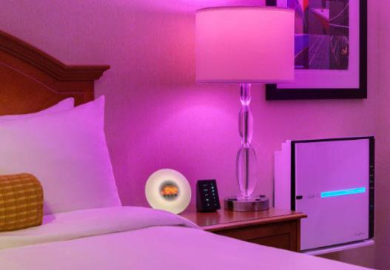
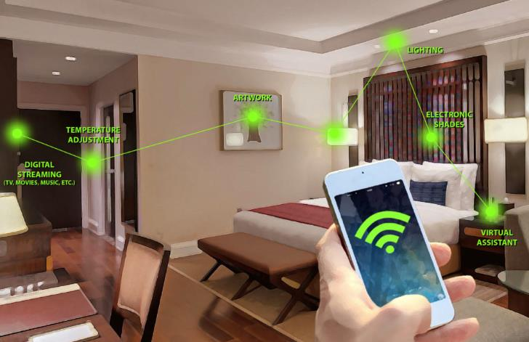
Marriott - Stay Well Room
Trend 18 – Degrees of Freedom
Traditional hotels were more linear with very little freedom of choice, now users can choose elements of how their room will be.
Equipped with smart lighting, smart mirrors, tablets, imaginary projection walls which the tenant have freedom to choose style.

Slide 14
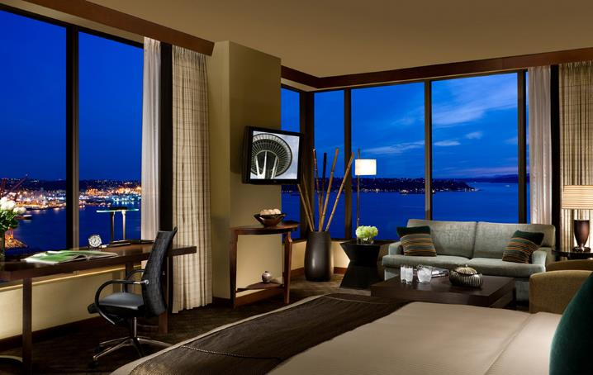
Hotel 1000, Seattle - Sensor
Trend 13 – Action Coordination
This is a fully networked technological lodge. Highlights include a silent infrared doorbell with sensors that detect body heat to inform housekeeping if the room is occupied, smart climate control settings, a digital do-not-disturb button and a 40-inch LCD HDTV that doubles as a digital art gallery, displaying works that you can personally select.
There's video-on-demand, surround sound, satellite radio, high-speed Wi-Fi (included with room). What's more, an intelligent mini-bar notifies the front desk when it needs stocking, Cisco video phones float around the hotel and a virtual reality Golf Club is swing-ready with more than 50 courses from around the world.

Slide 15
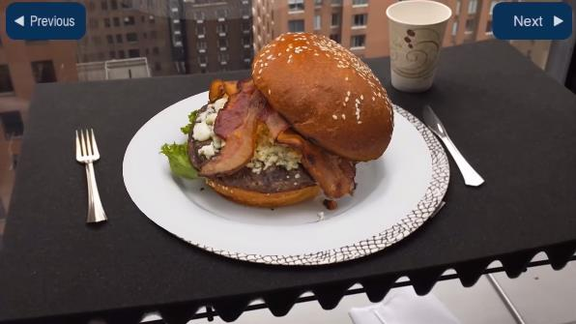
KabaQ – 3D Menu
Trend 15 – Mono-Bi Poly (Similar)
From Mono-system with the simple paper menu to a Bi-system with the paper menu combined with a tablet.
It shows the customers how the dishes look like at 360°.
Increased convenience and customer engagement

Slide 16
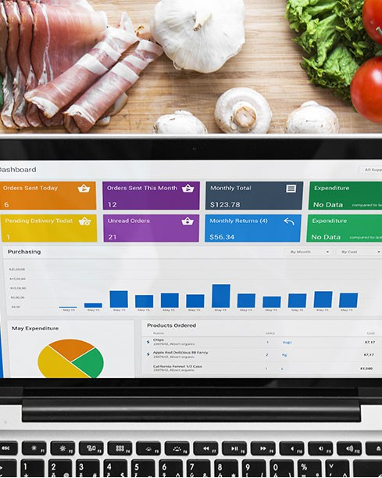
SimpleOrder – Restaurant Inventory Management System
Trend 17 – Design Point
SimpleOrder is an easy-to-use restaurant inventory management software, designed to optimize and streamline Back-of-House restaurant operations.
The cloud-based platform and apps feature online purchasing, automatic inventory, menu costing, central kitchen operations, POS integration and more.

Slide 17
TripAdvisor
Trend 20 – Listening/Communication
Moving from an ignoring behaviour to an empathetic listening
Restaurants and Hotels nowadays listen to their customers and also reply to them on TripAdvisor.
They can, in this way, easily see what to improve and tailor the customer experience accordingly
With the result of a win-win situation

Slide 18
Thank you!

