Slide 1
TRENDS IN DIGITAL
HEALTH

Slide 2
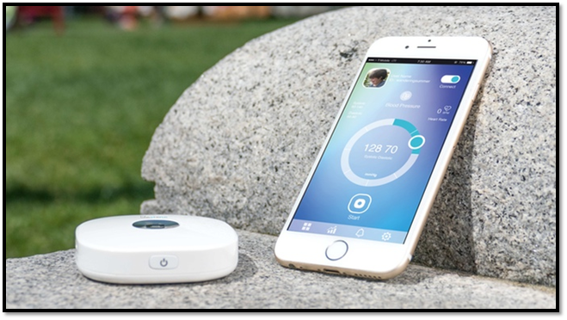
the most intelligent health tracker
Developed in the United States by « Lifestone health care » company.
What does the tracker do?
- Calculate your blood pressure
- Calculate the body temperature
- Measure your blood oxygen level
- Track your heart rate
- Record the number of breaths taken
- Evaluate your stress level
- Acoustic device for auscultation

Slide 3
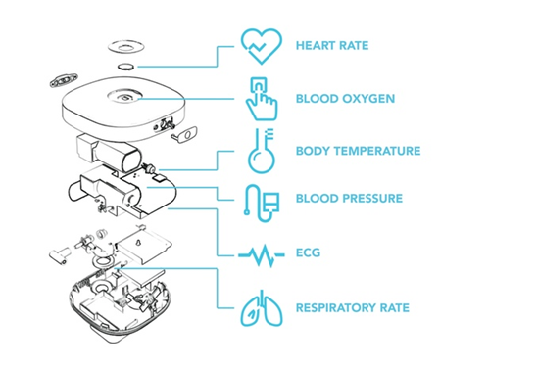
Life stone: the most intelligent health tracker
How does it work?
Lifestone uses an innovative detachable cuff with a micro-air pump.
> provides real measurement
TRIZ:
Boundary breaken
Dynamization
Reducing complexity
Mono-bi-poly
Nesting UP

Slide 4
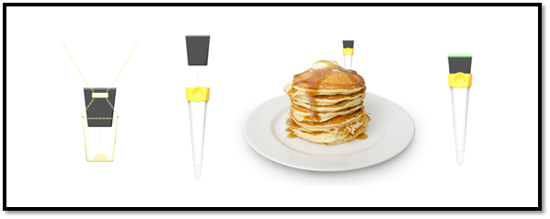
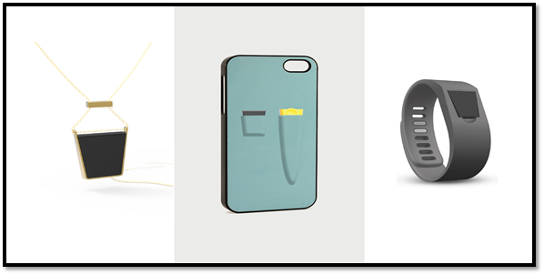
Allergy amulet
>> Detect ingredients in meals.
Ideas come from: Abigail Barnes and Joseph Belbruno. In 2018.
Key advantages : Restaurants and meals at work are very complicated when you have some allergies! This amulet can detect all the presence of allergens.
How it works?
Users insert the disposable test strip into their food and within seconds,
> the reader alerts users to the presence of target allergens.
TRIZ: customer buying hierarchy / Increasing transparency / customer expectation evolve

Slide 5
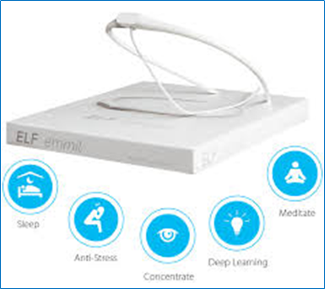
ELF Emmit
Connected headband relies on your brain
How does it work?
Contains a wearable case which you can put at the back of your head. It will send electromagnetics waves into your brain.
TRIZ
Boundary breakdown
Increasing dimensionality
Customer expectation evolves
Mono-bi-poly
Degrees of freedom
Created by Urban Butinar,
United States.

Slide 6
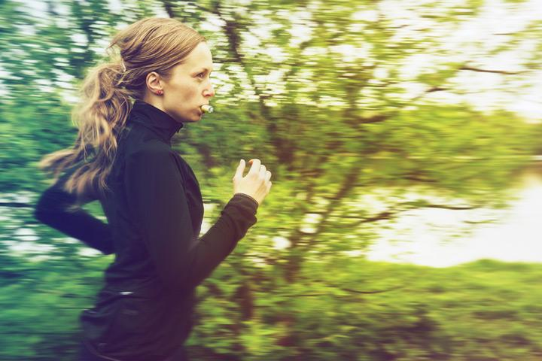
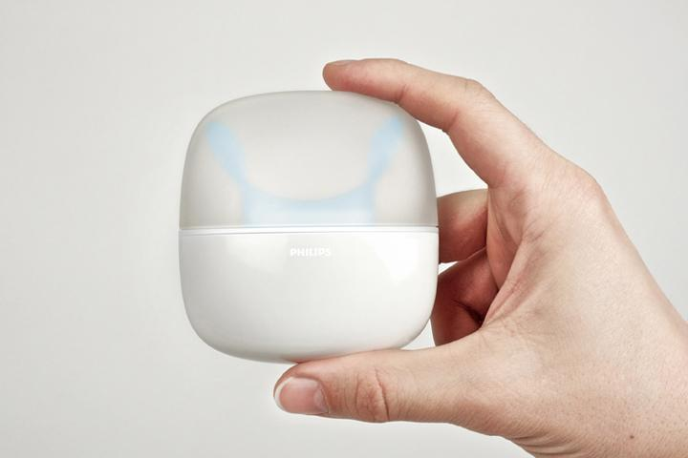
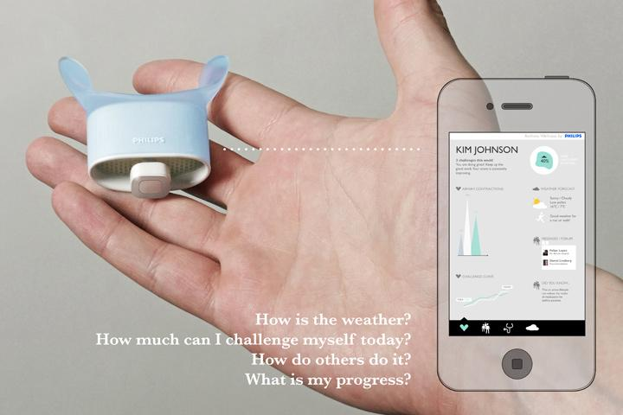
The Asthma Wellness Kit
A concept showing how holistic thinking and wellness can be incorporated into asthma care today.

Slide 7
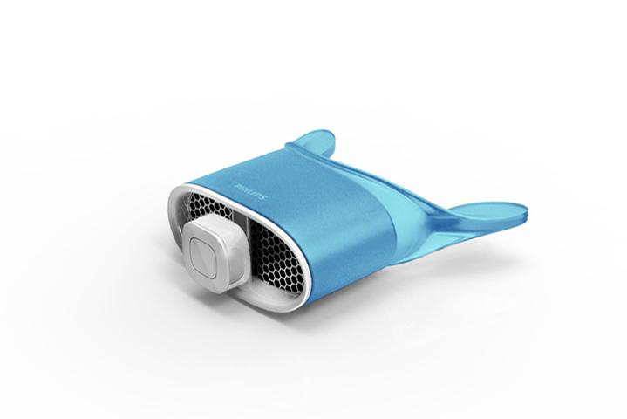
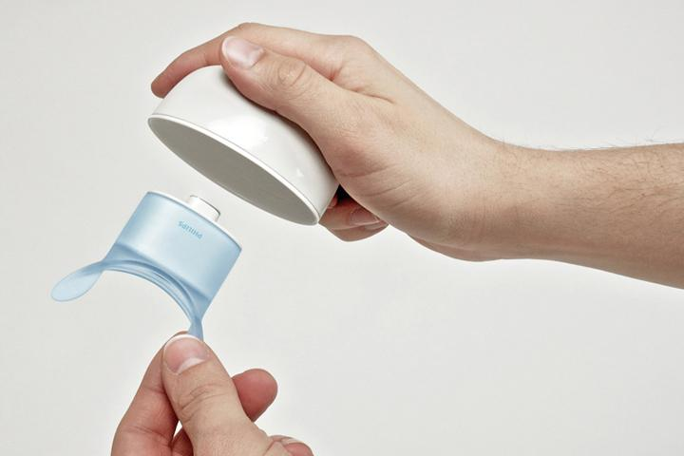
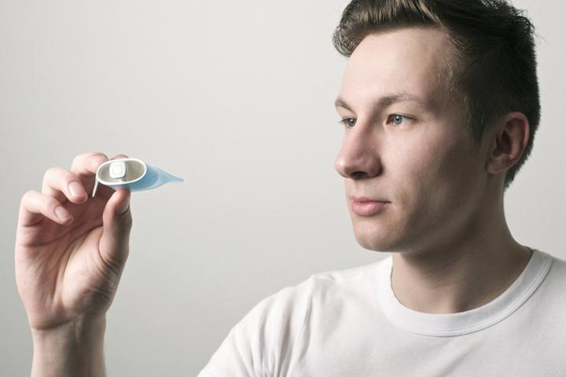
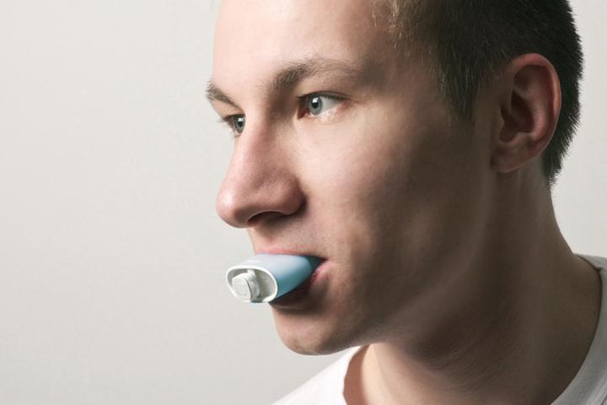
The Asthma Wellness Kit
Makes exercising easier for Asthmatics
Built-in heat exchanger
Peak-flow meter

Slide 8
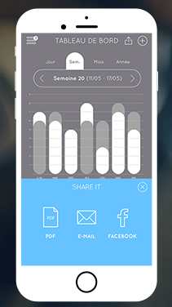
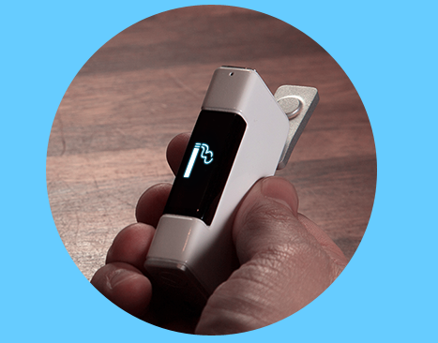
JICC LIGHTER
The first smart lighter
-Keep a record
-Lock down
-Notice
TRIZ
-Customer expectation
-Mono-Bi-Poly
-Nesting

Slide 9
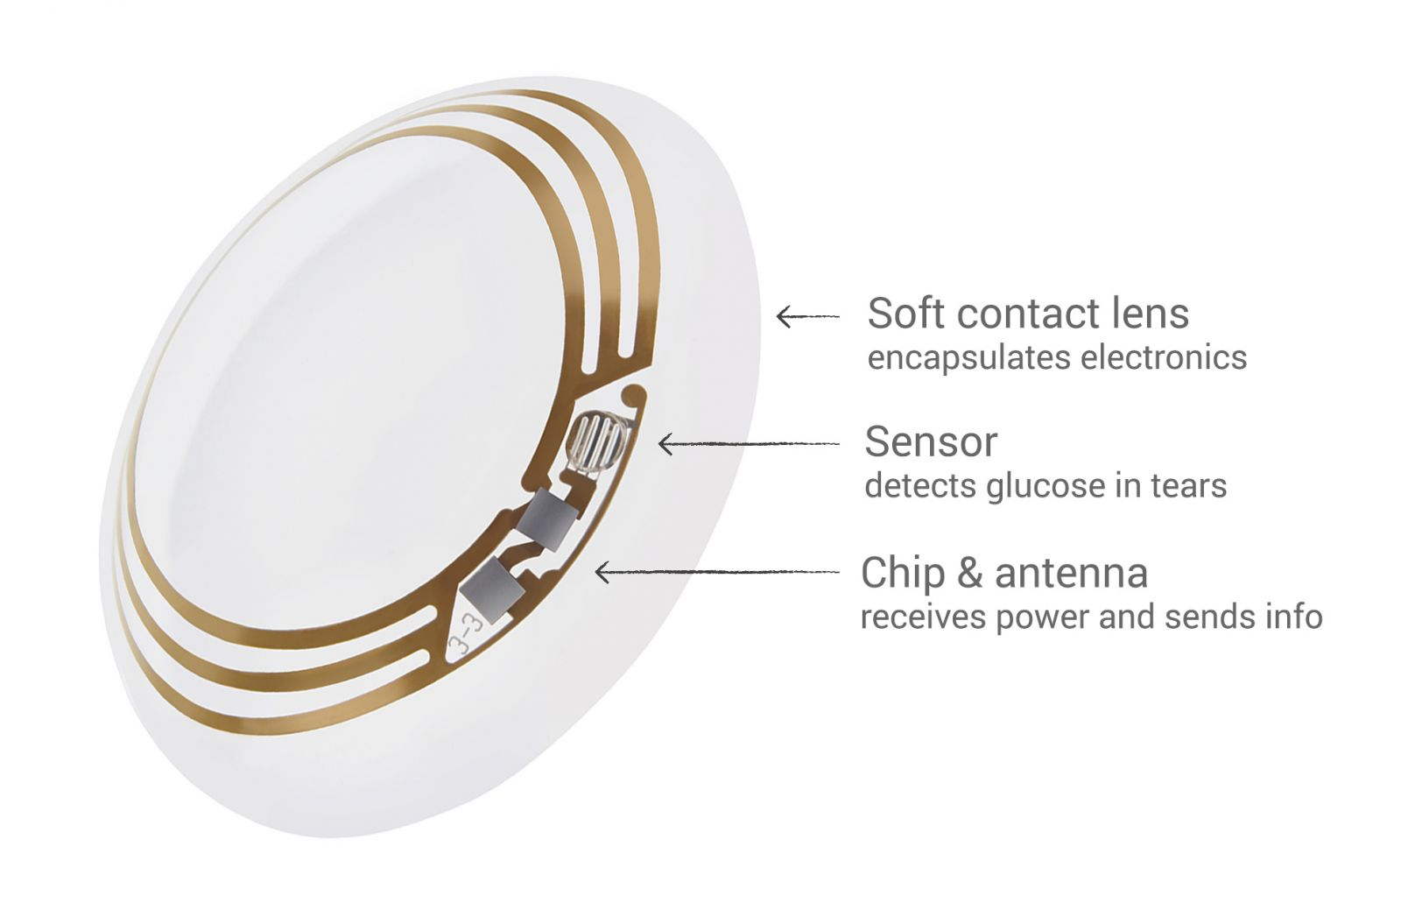
CONTACT LENSES
By Detecting glucose in tears, diabetics do not need to do blood test anymore.

Slide 10
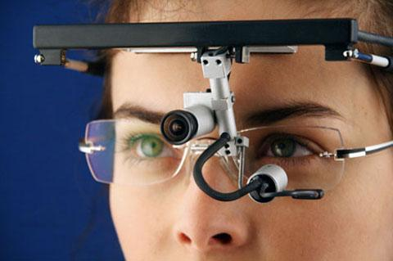
Eye Tracking
-Used for doctors & patients
-Training
-Diagnosing
TRIZ
-Boundary breakdown
-Trimming/Reducing complexity

Slide 11
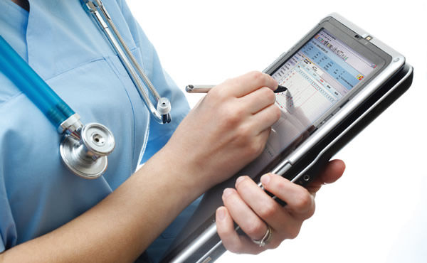
Electronic Medical Records
-Automation of clinical operations
-Big data analytics & machine learning
-Coordination, Analysis & Prevention
TRIZ
-Dynamization
-Increasing transparency
-Decreasing human involvement
-Mono-Bi-Poly
-Nesting (UP)
-Listening/Communication

Slide 12
In Hospitals

Slide 13
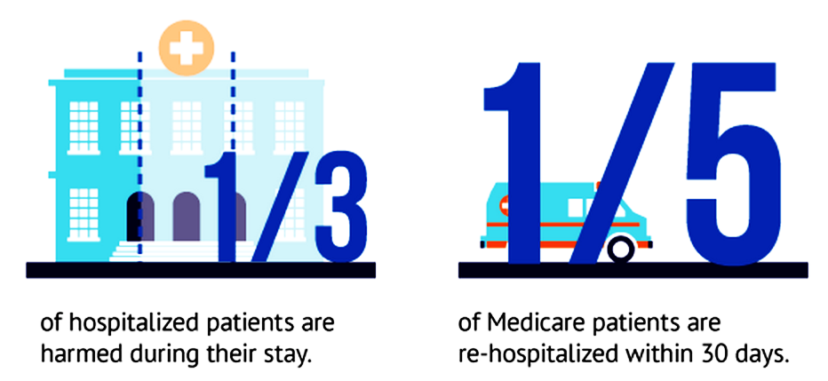
Issues
>400,000 deaths/year from preventable harm in hospitals
1 in 25 HCAI, which costs $35.7 to $45 billion due to Hand Hygiene
Medical errors are :
the 3rd leading cause of death in the US
1/6 of all deaths in the US

Slide 14
Technologies
Company/School
TRIZ
}
Depth Sensor
RFID
VisioSafe SA
Stanford University
Machine Learning / Artificial Intelligence
Increasing dimensions
Segmentation
Mono-Bi-Poly (Various)

Slide 15
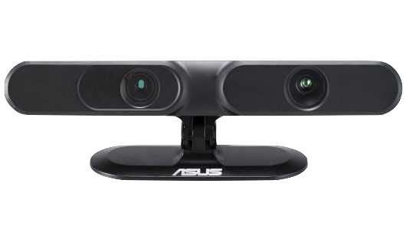
Depth Sensor

Slide 16
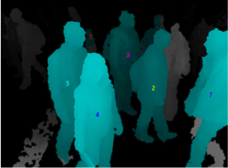
Privacy

Slide 17
Process Monitoring

Slide 18
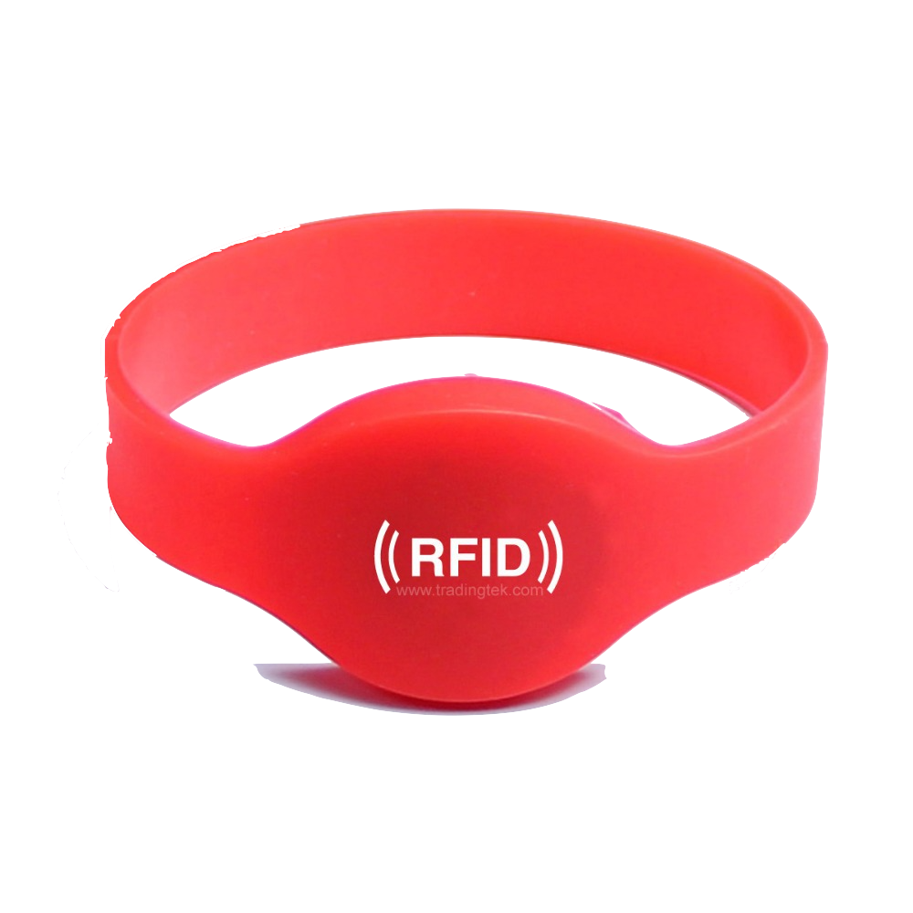
RFID

Slide 19
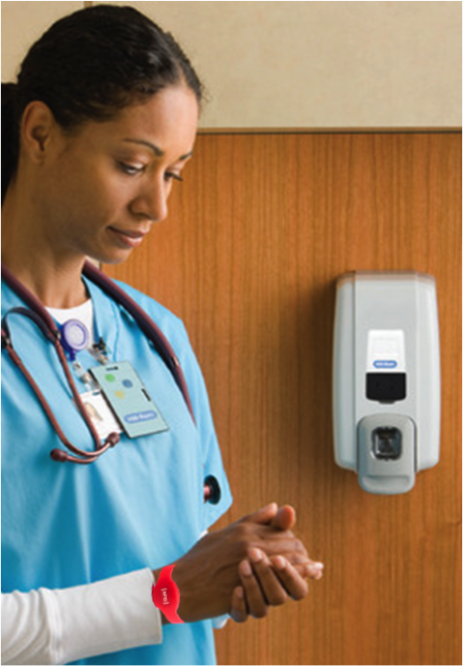
Hand Hygiene

Slide 20
In Closing
-New solutions in Healthcare provide both positives and negatives
-Does Health outweigh Privacy & Security?

