Slide 1
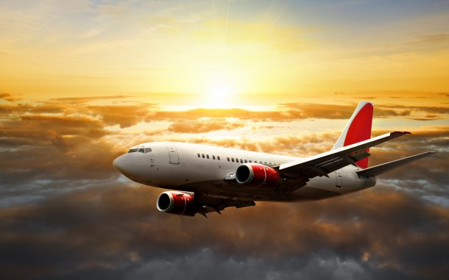
AIRLINES INDUSTRY
DIGITAL INNOVATIONS

Slide 2
SPENCER PROJECT ROBOTICS AND COGNITIVE SYSTEM
“Social situation-aware perception and action for cognitive robots”
Functions:
Scans passenger’s boarding passes
Guides them to their departure gates.
Objective:
Perform simple, time-consuming tasks
KLM completed testing phases in Amsterdam Airport Schilphol
Trends:
Decrease human involvement
Customer expectation

Slide 3
SPENCER PROJECT

Slide 4
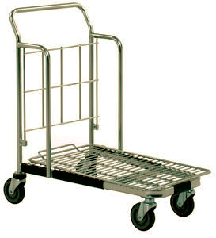
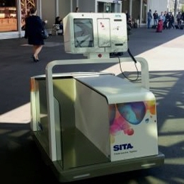
LEO SITA THE BAGGAGE ROBOT
Geneva’s airport
Objective :
Limit the number of bags in the airport
Enable passengers to gain time
Makes the airport navigation easier
Functions :
Check in, prints tags, transports suitcases
Load onto the correct flight
Has an obstacle avoidance capability
Trends :
Decrease of human involvement
Timing/Reducing complexity

Slide 5
LEO SITA

Slide 6
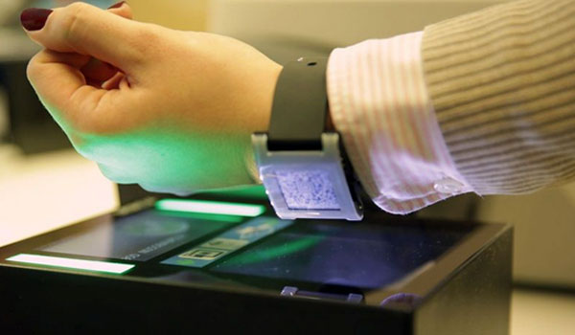
SMARTWATCH-BASED BOARDING PASS
First launched by Sony for Vueling and followed by Pebble for Airberlin and Samsung for Iberia
Functions :
Store boarding pass on smartwatch and present it at airport checkpoints.
Wearable technology
Near Field Communication
Objectives :
Simplify the airport experience for passengers.
Airberlin x Pebble
Iberia x Samsung
Trends :
Mono-Bi-Poly (Various):
Customer Expectation

Slide 7
SMARTWATCH-BASED BOARDING PASS

Slide 8
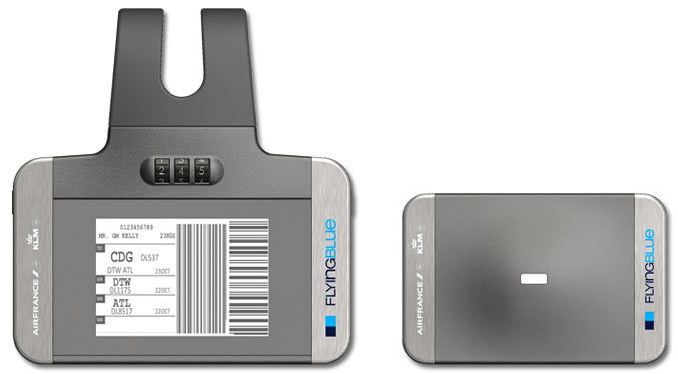
ETAG AND ETRACK
By Air France and KLM
Objective :
Tracking purpose
Functions :
Uses RFID technology
Electronic baggage label
Drop off luggage without having to re label
Traces luggages everywhere in the world
Use of GSM, GPS and bluetooth
Trends :
Customer Buying Hierarchy
Customer expectation

Slide 9
ETAG AND ETRACK

Slide 10
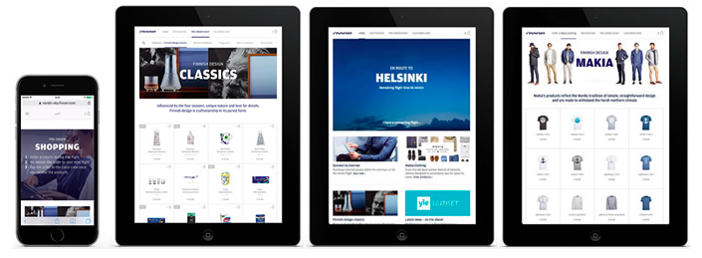
FINNAIR- IN FLIGHT ENTERTAINMENT REVIVING DUTY FREE SALES
WiFi portal into an E-commerce : « Nordic Sky »
Going from : tired trolley product push -→ online platform for duty free
Trends :
Mono-bi-poly : offer more and more things but different value proposition
Customer expectation : New experience

Slide 11
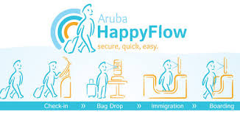
ARUBA HAPPY FLOW FACIAL RECOGNITION TECHNOLOGY
Functions :
Biometrics to identify at all checkpoints.
No need to show passeport or boarding pass.
Objective :
Secure and streamline passengers’ journeys through the airport
Easier, Faster & Safer
Trends :
Boundary breakdown : between employees and customers
Trimming and reducing complexity : short cut

Slide 12
ARUBA HAPPY FLOW

Slide 13
PREDIX GE’S PREDICTIVITY SOFTWARE
GE’s recovery solution:
Functions:
Uniting analytics and physics with software solutions
Objective:
Identify potential disruptions
Provide decision support to quickly recover the schedule, the crew
Minimize the impact on the airline’s customers.
Trends:
Action co-ordination
Design point
Using data and analytics to identify ways to reduce operating costs, increase aircraft utilization and improve the way we fly
Investing in "big data" technology

Slide 14
PREDIX

Slide 15
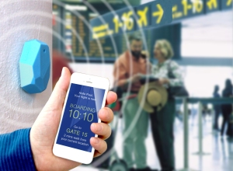
iBEACONS WAY FINDING
Technology Apple
Using Bluetooth and geofencing
Trigger the display of location-relevant information on devices at the right time and in the right situation
Functions:
Wayfinding
Flight information
Baggage collection
Measuring the distance to the gate
Offering loyalty programs
Coveying duty-free promotions
Find places close (restaurants, ATM...)
Objectives :
Create enhanced experiences at airports, through passengers smartphones
Social help → In San Francisco for blind people
Trends :
Increasing asymmetry

Slide 16
iBEACONS

Slide 17
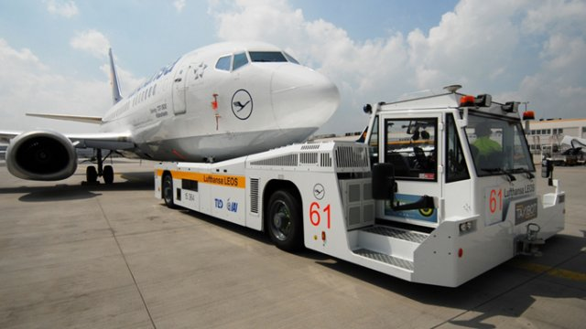
TAXIBOT
Objectives :
Fuel costs savings
Reduce noise and air pollution without affecting airport safety and efficiency
Trends :
Decrease human involvement
Functions :
Semi-autonomous vehicle
Provides pilot steering capability, using the airplane’s existing controls in the cockpit.

