Slide 1
Trends in Digital Innovations for Agriculture
Maria Eduarda
Sridhar Karunakaran
Rajeshwari Chandrasekaran

Slide 3
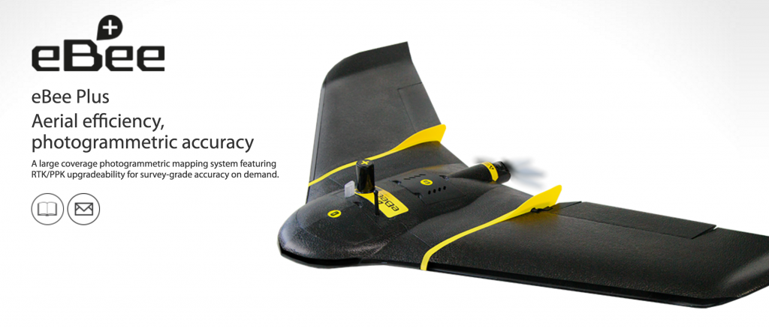
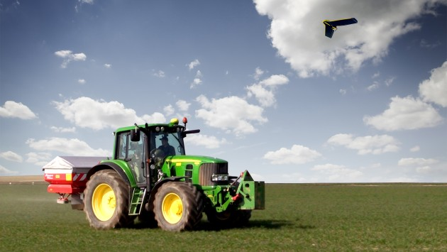
Ebee
Is a complete precision agriculture solution. It includes:
Drone with infra-red camera
Flight planning software (emotion)
Image processing/ index calculation software post flight (Post fight terra 3D)
Compatible with self-driving tractors software
Keeps data confidential (no cloud)

Slide 4
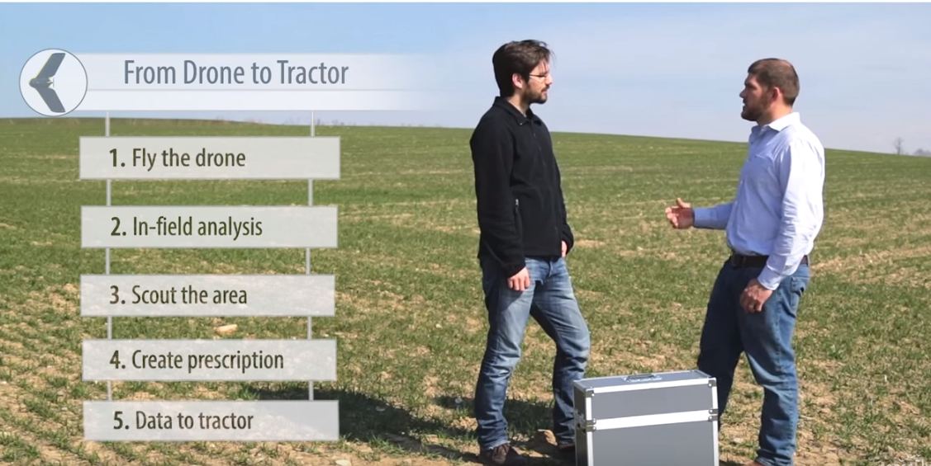
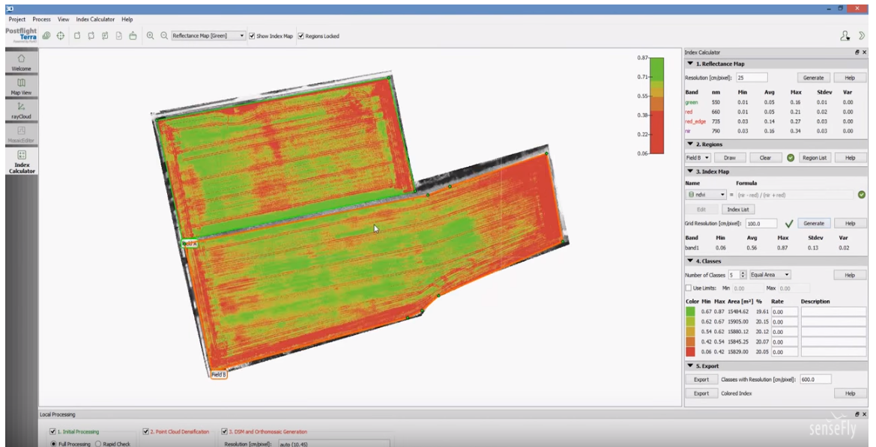
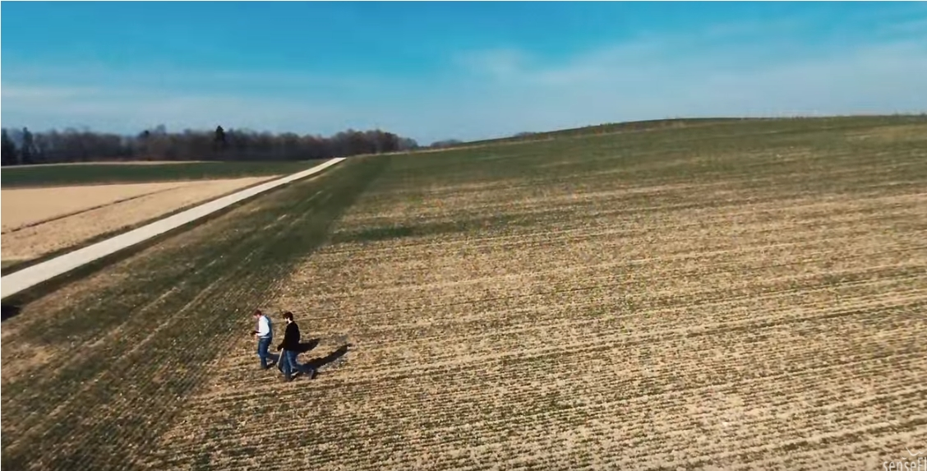
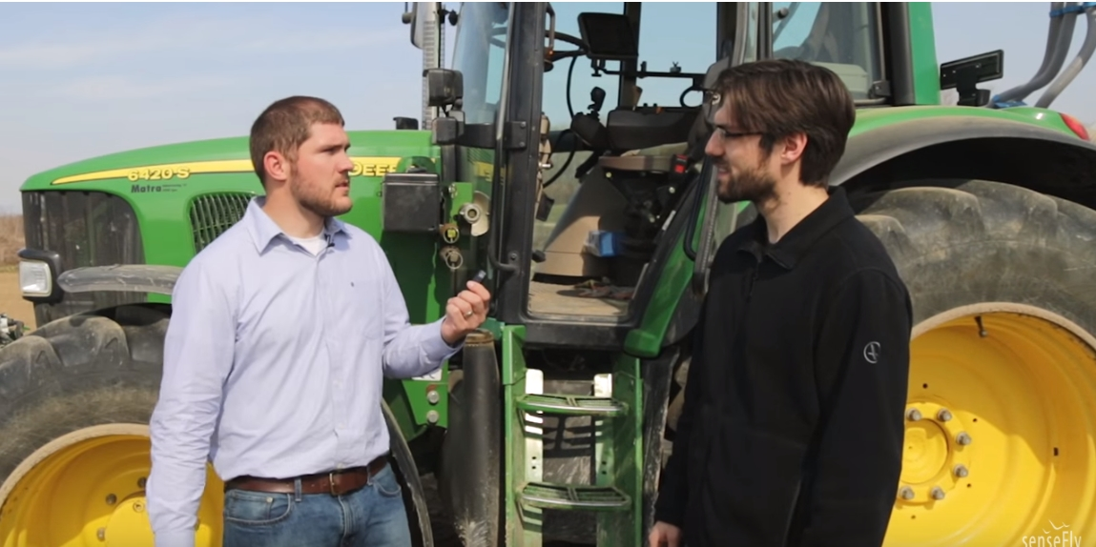
Ebee Explaining this technology

Slide 5
Which trends match with Ebee technology?
Trend 3: dynamization
aerial photography of lands are sent to a software where they are analyzed and processed.
Trend 4: Increasing Dimensionality:
Panoramic view of landscape
Trend 7: Trimming/reducing complexity
Automation of the process, time efficiency.

Slide 6
Trend 8: Decrease human involvement
Less human interference
Trend 12: Increasing use of senses
Panoramic views and infra-red imagens
Trend 17: Design point
Adapting different parts of the soil to different needs
Trend 18: Degrees of freedom
Working with only pieces of land in your property that are important.
Trend 19: Nesting (UP)
Completely integrated into higher level system

Slide 7
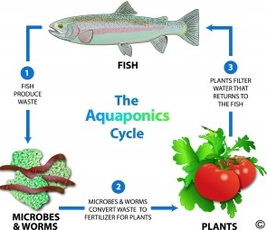
Aquaponics
“is the combination of aquaculture (raising fish) and hydroponics (the soil-less growing of plants) that grows fish and plants together in one integrated system.
The fish waste provides an organic food source for the plants, and the plants naturally filter the water for the fish.”

Slide 8
Which trends match with Aquaponics technology?
Trend 13: Action Coordination
Increase system efficiency
Improve response to external changes
Trend 16: Mono-bi-poly (Increasing differences)
Fish and plants within the same system.

Slide 9
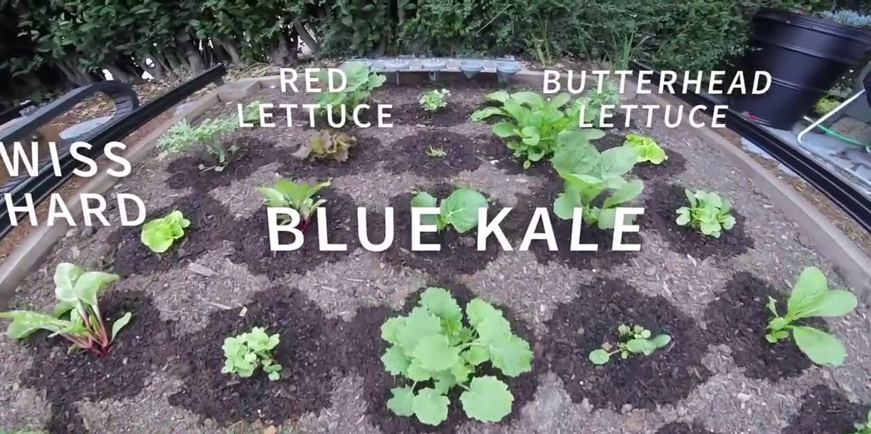
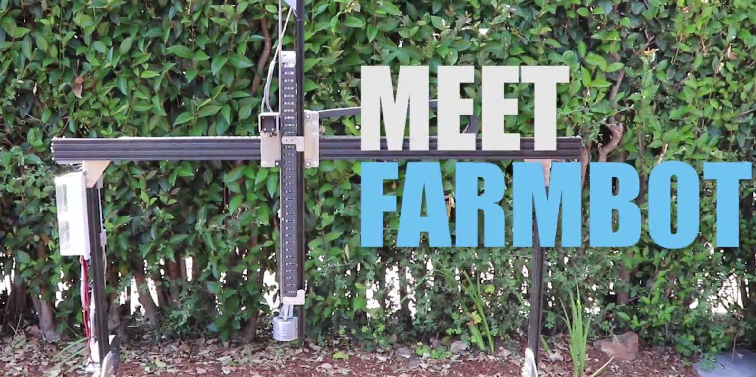
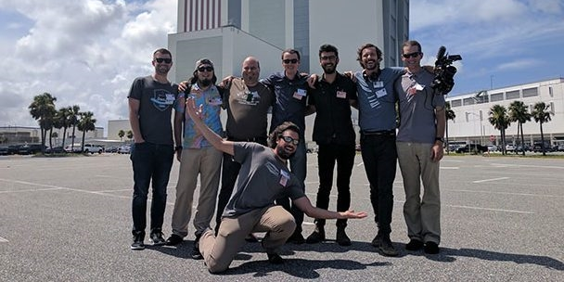
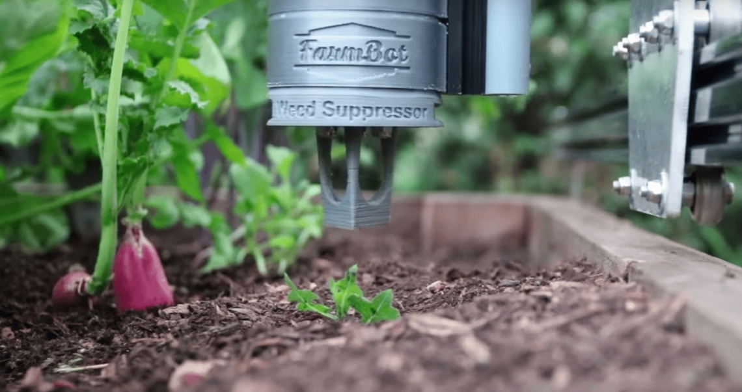
FARMBOT GENESIS XL
Open source precision agriculture CNC farming project
Cartesian coordinate robot farming machine
Operates outdoors, indoors, and covered areas
STEM and NASA
Motto: “Grow your food from anywhere”
E-mail alert when ready for harvest

Slide 10
TRENDS RELATED TO FARMBOT
Trend 1 : Boundary Breakdown
Trend 2 : Customer buying hierarchy
Trend 4 : Increasing Dimensionality
Trend 8 : Decreasing human involvement
Trend 6 : Increasing transparency
Trend 7 : Trimming/reducing complexity
Trend 9 : Customer expectation
Trend 11 : Segmentation
Trend 14 : Mono-Bi-Poly
Trend 15 : Mono-Bi-Poly (Similar)
Trend 18 : Degree of freedom

Slide 11
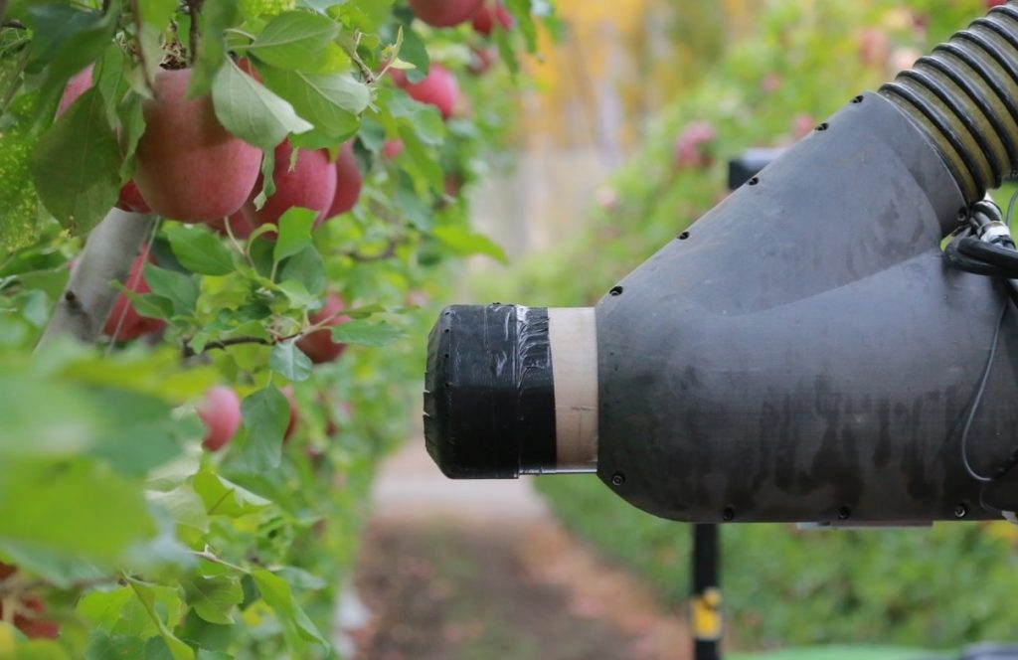
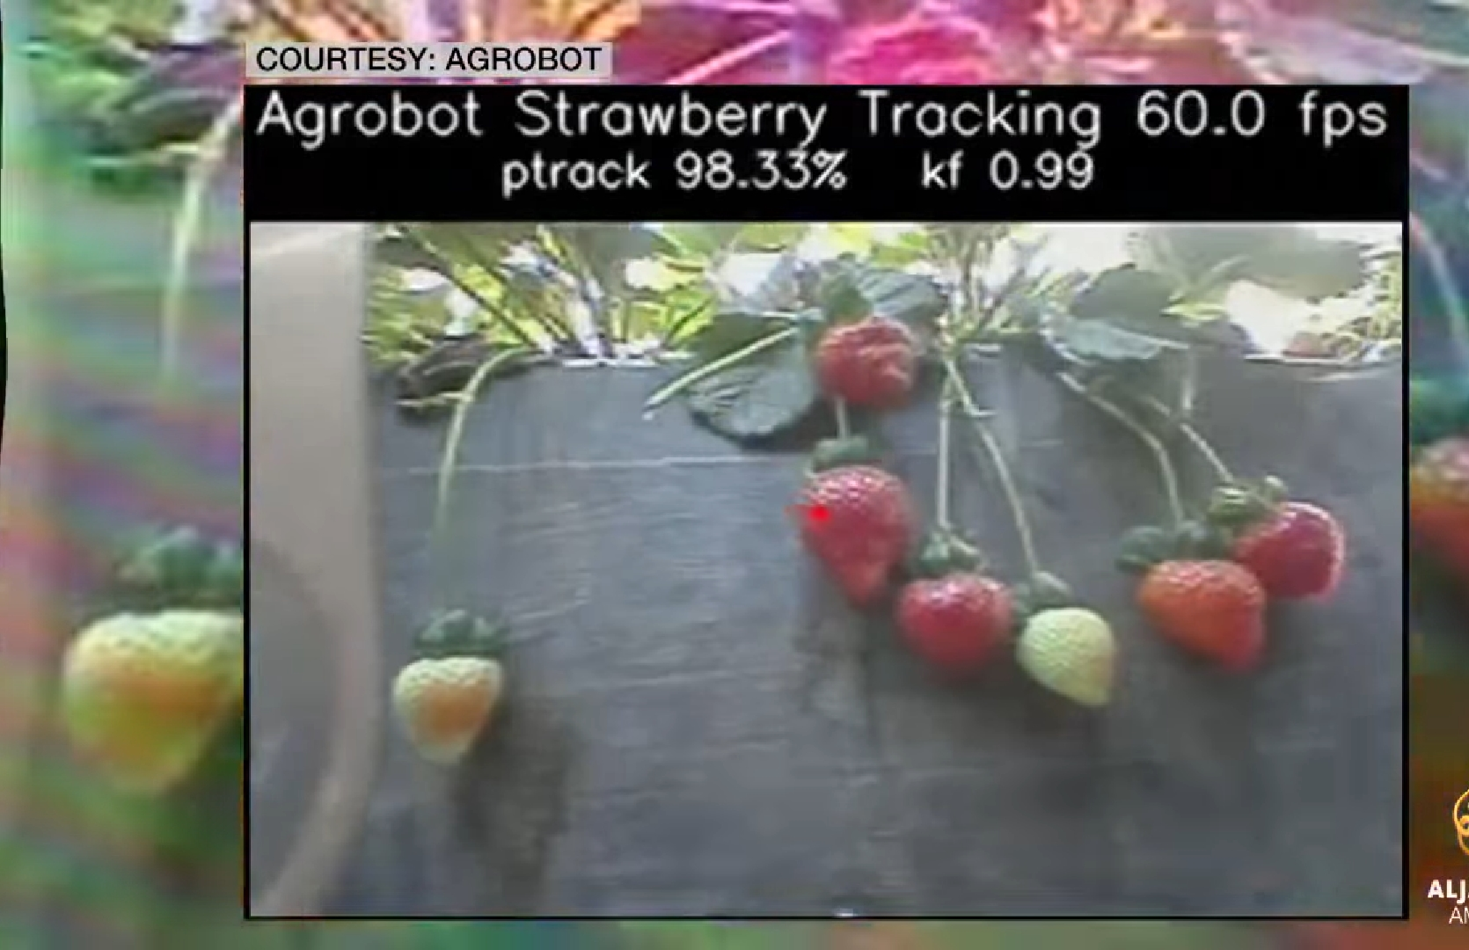
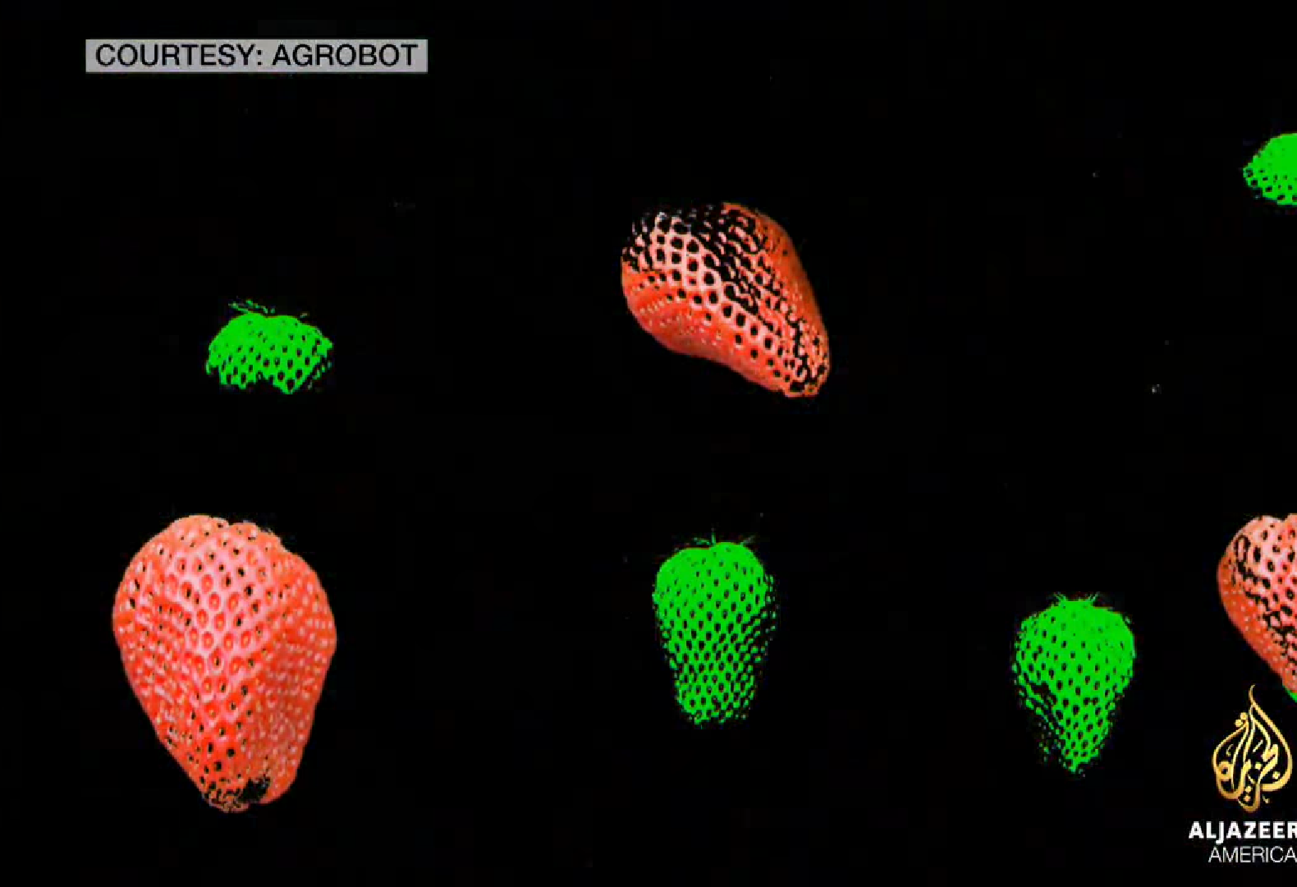
AGROBOT
Robotic Harvesters
Strawberry and apple picking by Real-time AI, 3D sensing, 24/7, and LiDAR-based autonomous navigation
Harvester does not contact fruit. The robotic arms grip and cut the stem and then place into field container for later packing in consumer container.
Adaptable Configuration : 24 robotic arms working wirelessly as a team

Slide 12
TRENDS RELATED TO AGROBOT
Trend 4 : Increasing Dimensionality
Trend 5 : Increasing Asymmetry
Trend 7 : Trimming/Reducing complexity
Trend 9 : Customer Expectation
Trend 10 : Rhythm co-ordination
Trend 12 : Increasing use of senses
Trend 17 : Design point
Trend 20 : Listening/Communication

Slide 13
https://www.theaquaponicsource.com/what-is-aquaponics/
http://agrobot.com/
http://octinion.com/products/harvesting-series/strawberry-picking-robot
https://farm.bot/2017/12/01/farmbot-genesis-xl/
https://www.youtube.com/watch?v=du7wJX6hEP4

